Slide 1


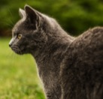
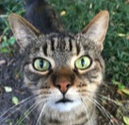

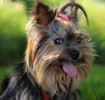
Adopt,
Don't Buy!
KING
British Shorthair
More About Me >>
Cathy
British Shorthair
More About Me >>
Happy
Yorkshire Terrier
More About Me >>
Myra
Yorkshire Terrier
More About Me >>
copyright©2016
Tel: (886-2) 2771-2171

