Slide 1
Multimedia Database System
Practical assignment
Alexander Eble
Fuad Shirinli

Slide 2
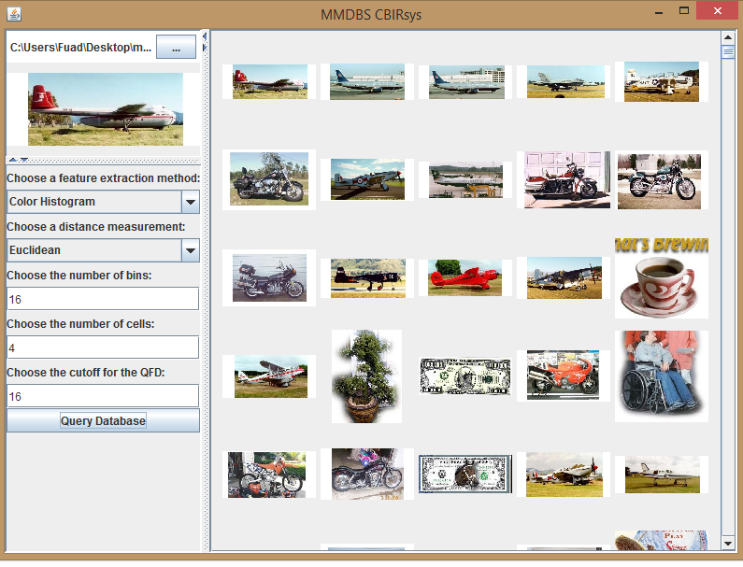
User interface of our application

Slide 3
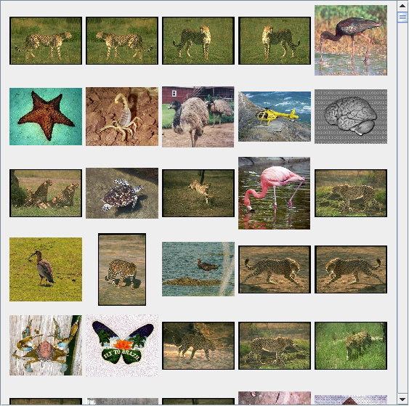
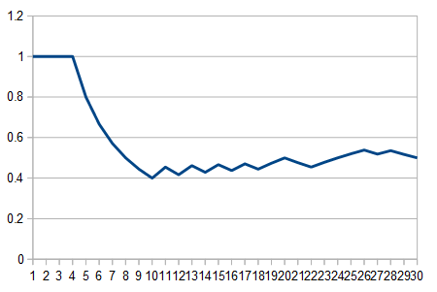
Finding
We ran a global edge query over the dataset with Leopards/image_0030.jpg as query thinking that the body structure would help.

Slide 4
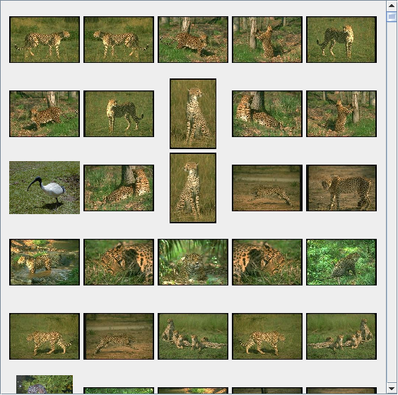
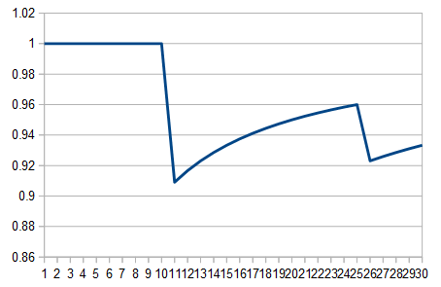
Finding
Going back to simply using the color histogram (16 bins, 4^2 = 16 cells) and Euclidean distance however brings that savanna-feel to the front page:

Slide 5
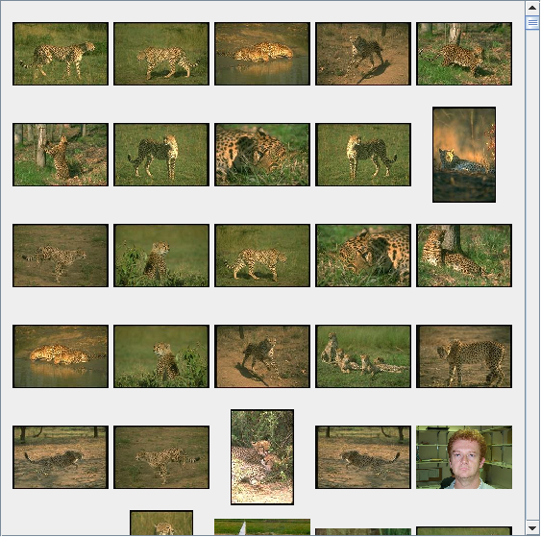
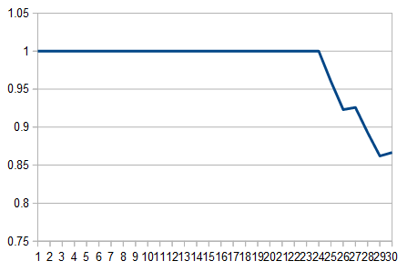
Finding
Further Improvement using the Quadratic Form Distance

Slide 6
Conclusion
⦁ Different types of images need different feature extraction methods.
⦁ Tweaking both the number of bins and the number of cells in the color histogram feature extraction needs to be done carefully and overshooting the optimal value is easy.
⦁ Quadratic form distance is generally more accurate than Euclidean distance (at least for the examples tested here). This is due to it describing the way humans perceive color more exactly than the Euclidean distance.
⦁ The Global Edge Histogram is only useful if one wants to find the shape of an object and here most of the shapes weren't defined well enough for it to be actually useful.

Slide 7
Thank You !!!

Slide 9
Finding
Going back to simply using the color histogram (16 bins, 4^2 = 16 cells) and Euclidean distance however brings that savanna-feel to the front page:
blue line= Quadratic Form Distance
orange = Euclidean Distance

