Slide 1

FlexiPath —
switch before the link fails
Keep a drone's control link, voice and video alive
when it moves between Wi-Fi, 5G, satellite and wired
networks. Switch before the signal fails.
TEAM TAROT CLUB
Fuad Ahamed
system architecture and software developer
Al Ain University
Mohameden Sidi ahmed
EDGE GROUP CHALLENGE
networks and protocols research,
QoS/QoE guidelines
Advanced Technology
Pioneers 2026
Reema Awad
experiments and data analysis
▶ TRY THE LIVE PROTOTYPE
flexipath.vercel.app
guided demo, simulator and the 2-minute video
LIVE PROTOTYPE
Nazer Alzaabi
flexipath.vercel.app
product, demo and presentation
All members: Al Ain University

Slide 2






Executive summary
FlexiPath keeps critical connections alive with little extra power
In our model, a legacy stack leaves one network before it joins the next. A moving
user loses the connection. When the control link (C2) of a drone is silent
for more than 300 ms, the drone must stop and hover (our piloted-flight rule).
PROBLEM
FlexiPath finds a fading signal seconds early. It wakes the next network and tests it. For 0.4 s, it sends only the critical commands on both networks. Then it switches with no gap. An anchor relay keeps each connection open.
Spare modems sleep at all other times to save power.
MECHANISM
We run 160 paired simulated flights (8 scenarios, 5 seeds, 4 speeds) with a legacy stack and two existing methods. Reactive multipath (MPTCP/ATSSS) switches after failure. Always duplicate (PDCP duplication) sends twice.
With our 300 ms rule and 60 vs 250 ms outage detection, FlexiPath keeps C2 on 100 % of flights. A legacy stack keeps it on 0 %. Reactive multipath fails in three scenarios. Always duplicate uses 2.1–2.6× the power.
EVIDENCE
4–7 points more reliability per extra watt for FlexiPath
versus 0.3–0.9 for always duplicate.
DELIVERED
A working prototype (interactive 3D digital twin with a guided demo),
a deterministic simulation with a headless benchmark, and a documented model. We check its parameters against published data.
All results are from simulation; we claim no live-network measurements.

Slide 3



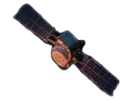




The problem and why it matters
In our model, every network change costs a legacy stack 3.8 s of silence.
Dropped calls. Frozen streams.
300 ms of silence makes a drone hover.
Emergency response, industrial automation, connected transport and defence cannot wait.
Two drones, one route: Wi-Fi → 5G → satellite.
Why drones: we model a hover after 300 ms without C2 (our piloted-flight rule).
1. DOCK (WIRED)
2. WI-FI 6
3. 5G SA
4. LEO SATELLITE
Stable baseline mission prep
Local coverage on the move
Wide-area coverage at speed
Global reach
beyond line of sight
CONTROL LINK (C2)
PUSH-TO-TALK VOICE (REAL-TIME)
CAMERA UPLOADS (BULK)
Command and control
Clear, low-latency communications
High-throughput data transfer

Slide 4






Existing mechanisms we analysed (criterion 01)
REACTIVE MULTIPATH
ALWAYS DUPLICATE
COMMON SHORTCOMINGS
MPTCP backup subflow (RFC 8684) and 3GPP ATSSS active-standby.
MPTCP redundant scheduler
and PDCP duplication.
Neither looks ahead.
Ignores the fading signal.
Keeps a backup network on standby. It moves only after it confirms losses and the spare modem wakes up.
Sends every important packet on two networks, all the time.
Ignores the known route.
99–100 %
2.65–3.39 W
Neither adds protection only at the moment a link fades.
0.35 s
1.20 W
critical delivery
(most reliable)
high power consumption
and copies 49–100 % of protected bytes
gap, more than our
300 ms C2 budget
low power
consumption
Still fails when both paths fail together
(a shared radio shadow).
WHAT WE ADAPT
Keep the anchored session (from multipath).
Keep the duplication (from PDCP), but use it only in a 400 ms burst around a predicted failure.
New in combination: prediction, route knowledge and traffic classes.
References: RFC 8684, Multipath TCP v1 (IETF, 2020) · 3GPP TS 23.501 §5.32, ATSSS · 3GPP TS 38.323, PDCP duplication · 3GPP TS 22.125 §7.2, UAV C2 KPIs · Related products: Elsight Halo, Peplink SpeedFusion, uAvionix muLTElink

Slide 5
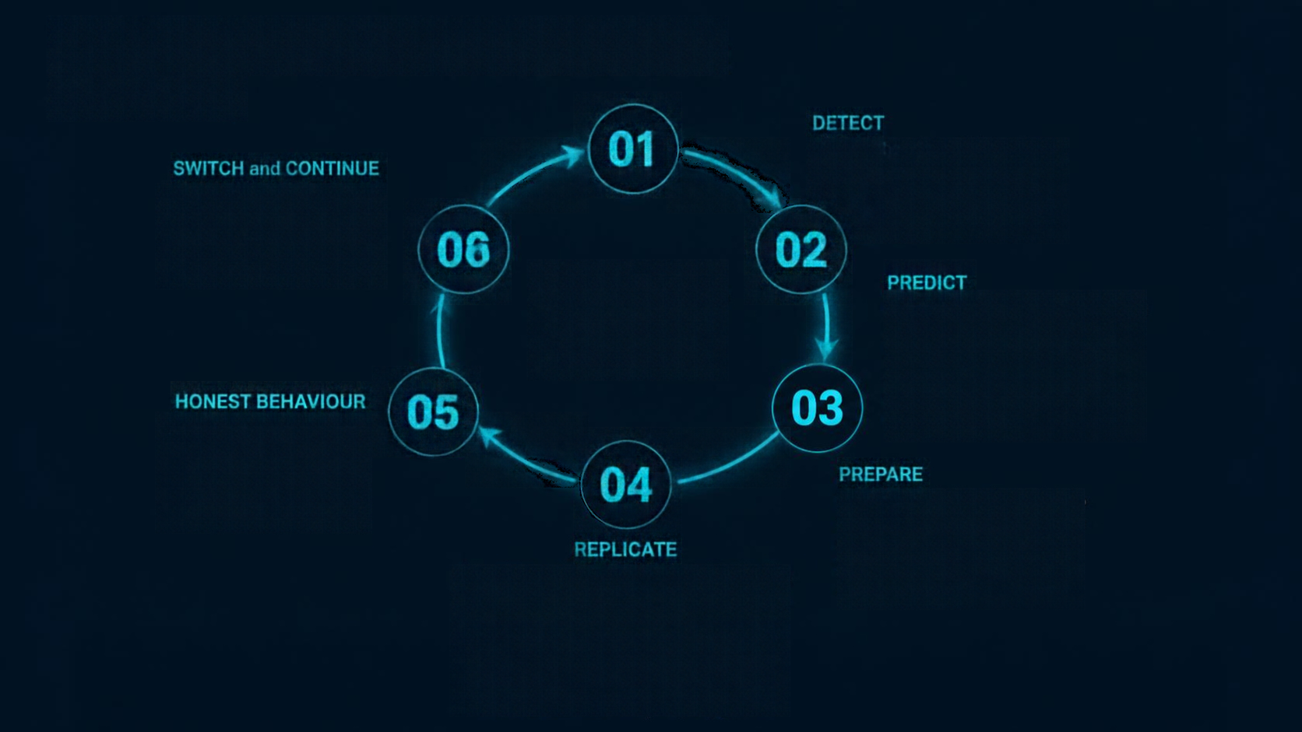











The FlexiPath mechanism
(criterion 02)
01
Measure the primary link ten times a second.
Spare modems sleep in DRX at
1.2 W and report signal once
per cycle.
Make the tested network the main one with a 0 ms gap. Put the old radio back to sleep.
Connections stay open in a tunnel to the anchor relay.
02
Continuous, zero-gap resilience
Extend the signal trend to find where packet loss reaches 15 %.
Watch from 8 s to failure; act under 3 s.
The coverage map warns 8 s before a known shadow.
05
A reversed trend cancels the prediction at no cost.
If an outage comes with no warning, use a fast failover (160 ms in our model).
04
Wake the best spare modem (1.8 W) and test it with small 64-byte heartbeats.
Check its delay and loss before it carries anything.
For a 400 ms burst (3.4 W), send critical traffic on both paths. Add real-time traffic if its loss is over budget.
The receiver keeps the first copy of each sequence number and discards the late duplicate, so head-of-line delay is 0 ms.
Never copy bulk traffic; only pace it.

Slide 6



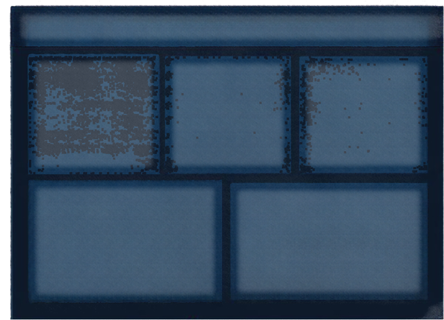

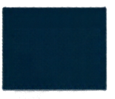







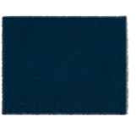
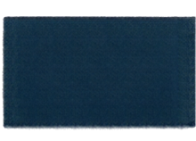






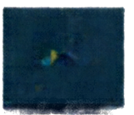







System design
One engine. Multiple radios. Continuous sessions.
RADIOS
APPLICATIONS
FLEXIPATH ENGINE ON VEHICLE
wired dock
port
link model:
signal, loss, RTT, jitter, capacity
C2 link
(critical)
ANCHOR RELAY
link monitor
and predictor
traffic manager
replication, pacing, reordering buffer
path scorer
a fixed address
in the operator's network
link model:
signal, loss, RTT, jitter, capacity
Wi-Fi 6
push-to-talk voice
(real-time)
the vehicle's
tunnel rebinds
across radios
radio power manager
DRX / warm probe /
burst
link model:
signal, loss, RTT, jitter, capacity
coverage map
5G SA
camera and survey
uploads (bulk)
the remote side
never changes
LEO
satellite
link model:
signal, loss, RTT, jitter, capacity
EXPLAINABILITY AND DASHBOARD
it records each decision with the values at that tick:
current path
trend
time-to-failure
alternate score
radio tier
action
reason
DESIGNED TO SIT UNDER ANY COMMAND-AND-CONTROL APPLICATION
it needs no change to the application

Slide 7

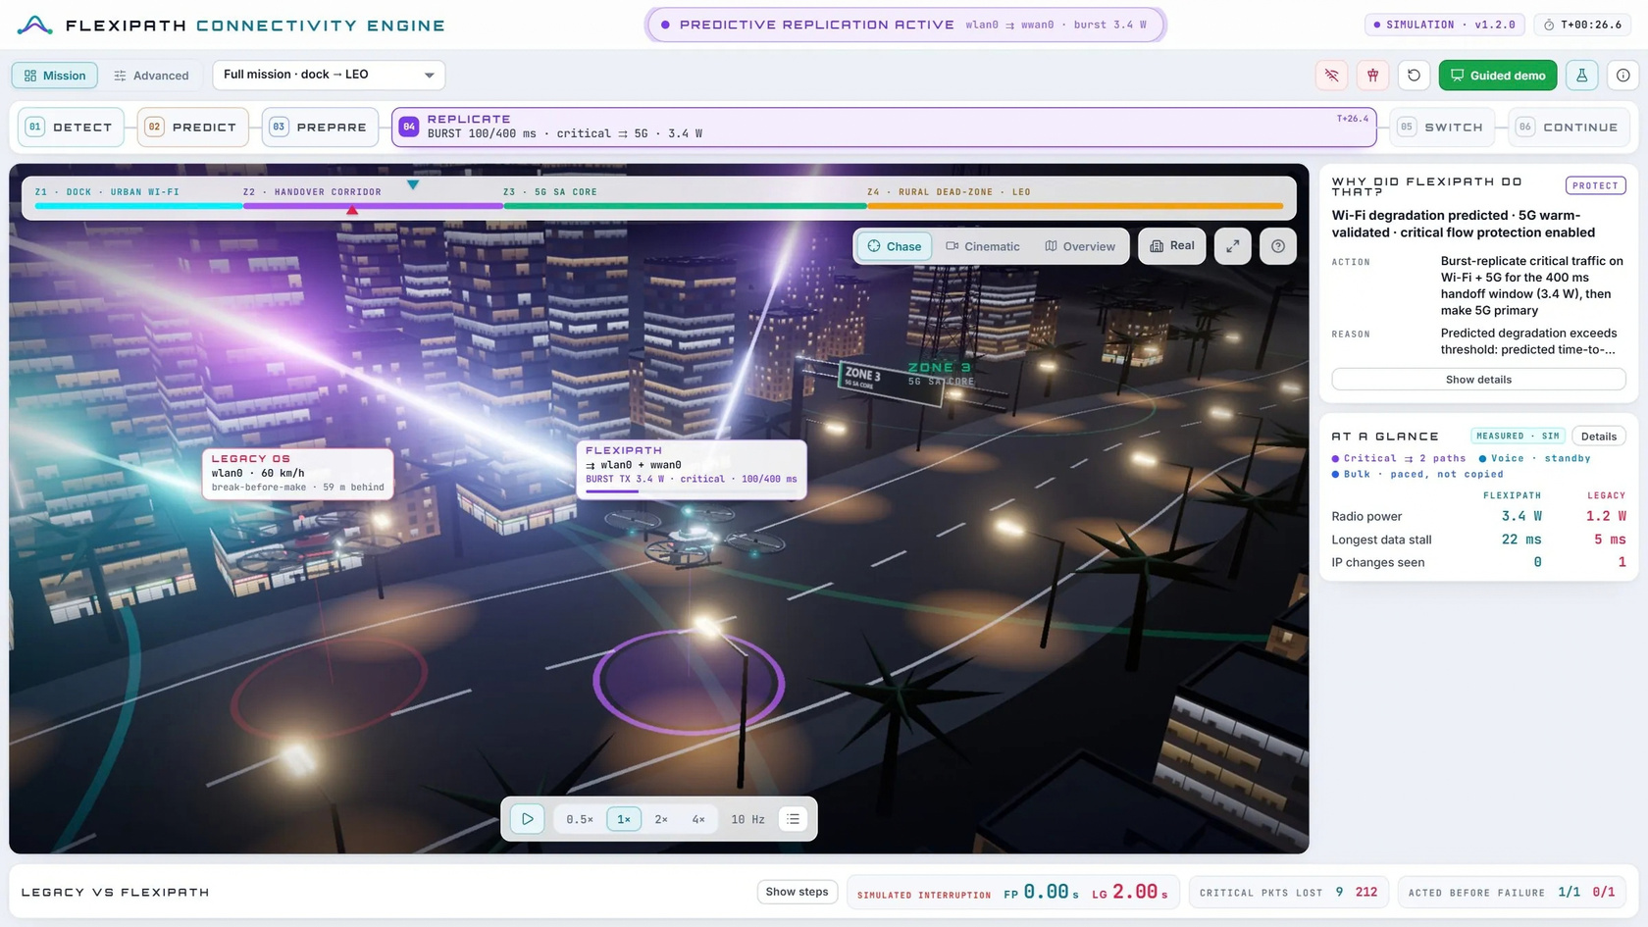
Prototype, simulation and model (criterion 03)
flexipath.vercel.app
interactive 3D digital twin with mission and advanced views
guided demo
pauses at each real decision, explains what happened and which panel shows it
deterministic 10 Hz engine
seeded random streams with fading, capacity, loss, RTT, jitter, TCP and radio models
headless benchmark
scenarios A–H × 5 seeds × 4 speeds = 160 paired runs per stack, plus baselines and ablations; CSV output with 95 % CIs
published model
Mission view of the live prototype. The FlexiPath drone (cyan) and the legacy-stack drone (crimson) fly with the same seed and radio conditions. The decision loop, decision card and scoreboard are around the twin.
we check parameters against published measurements and test the 100 ms modem wake at 260 ms as a sensitivity run
▶ Try it yourself: flexipath.vercel.app · the guided demo, the simulator and the 2-minute video

Slide 8

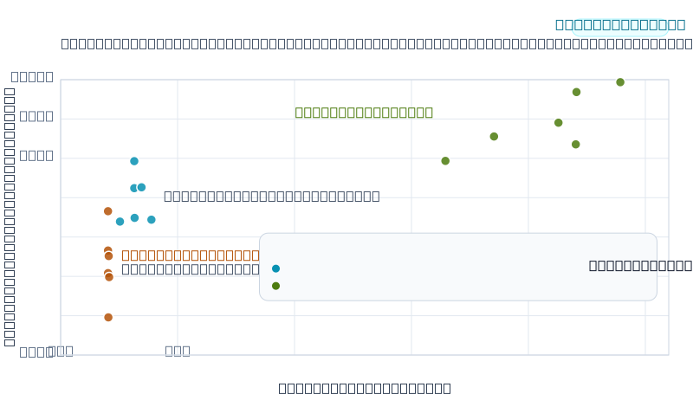
Results against the existing mechanisms (criterion 04)
Paired means over 20 runs per scenario, same seeds for every stack.
100%
of flights where FlexiPath keeps C2 (flight count) under our piloted
300 ms rule
1.2–4.6 s
FlexiPath acts before the path fails, versus 0.1–0.5 s after for reactive multipath
fewer critical packets lost vs
reactive multipath (CI 30–39 %);
held-out; ~20 % with equal detection
35%
Reliability per extra watt versus
reactive multipath
(16.9–24.5 in D)
4.0-7.1 pp/W
Reliability against radio power, scenarios A–D, G and H (paired means). FlexiPath is between the two existing designs. It gives 0.6–1.2 points more critical delivery than reactive multipath for 0.05–0.18 W more. It uses 2.1–2.6× less power than always duplicate.
FlexiPath's extra watts give 4.5–21× more reliability than always duplicate's
0.3–0.9 pp/W
4.5-21×
Flights that keep C2 under the piloted 300 ms rule (Legacy · Reactive multipath · Always duplicate · FlexiPath): A, B, C 0 · 100 · 100 · 100 — D 0 · 0 · 100 · 100 — G, shared radio shadow 0 · 0 · 40 · 100 — H, map out of date 0 · 0 · 100 · 100.
Robustness: the ablations show trend prediction gives the gain; in our model, the burst adds no measurable reliability. The results hold on held-out seeds. Under the 1 s waypoint rule, every multipath stack keeps C2. So the piloted-rule advantage needs a spare modem that resumes fast.

Slide 9










Guidelines for QoS and QoE
across heterogeneous networks (criterion 05)
01
Anchor the session, not the interface — a fixed anchor relay prevents every reset.
02
Act on the trend, not on the failure — a 3 s signal trend gives seconds of warning.
03
Prepare the next path just in time, and only then — test it at 1.8 W; do not keep radios on.
04
Duplicate only what needs it, only around the handover — a 400 ms burst costs ≈ 1 % of protected bytes.
05
Deliver the first copy; never make real-time traffic wait in order.
06
Detect a failed path faster than the application allows — within the 300 ms C2 budget.
07
Hold still unless a move clearly helps — a reversed trend cancels the prediction at no cost.
08
Measure what users feel, on matched pairs: interruption, delivery, voice MOS, power, same seeds.
09
Use what you know about the route — a coverage map is better than reaction if two radios fail together.

Slide 10

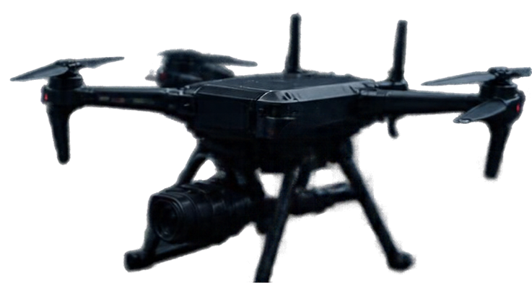

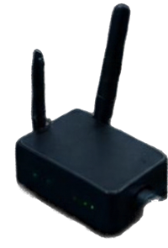

Plan for real-life use, limits, and declaration
▶ TRY THE LIVE PROTOTYPE
flexipath.vercel.app
guided demo, simulator and the 2-minute video
Deployment path, known limits, and our AI-use declaration
DEPLOYMENT
A userspace agent on the vehicle's companion computer (Linux) controls modems through standard interfaces.
The anchor relay is at the operator's ground station or cloud edge.
It runs under current C2 and video applications; they need no change.
LIMITS
All results are simulated.
We evaluate the radio model at ground level.
Piloted rule needs a spare modem that resumes in ~100 ms
(5G RRC_INACTIVE or connected-mode DRX).
At 260 ms, an unexpected outage still forces a hover.
REAL-LIFE USE
Phase 1 (bench): laptop with Wi-Fi and a 5G dongle runs the included handover probe to measure one real network change. Phase 2 (field): test drone with Wi-Fi, 5G and a LEO terminal on a surveyed corridor; first survey flights build the coverage map. Phase 3 (pilot): one operator, one corridor, the paired-comparison method of this study applied to real flights.
AI-USE DECLARATION
AI tools (Anthropic Claude) helped with code, analysis drafts,
this deck and the video. An AI voice (Kokoro) reads the narration.
The design decisions, the experiments and their interpretation are
the team’s own, and every member can explain their part in their own words.

