Slide 1




Advanced Front-End Development RADFE-203
Babayev Fuad

Slide 2


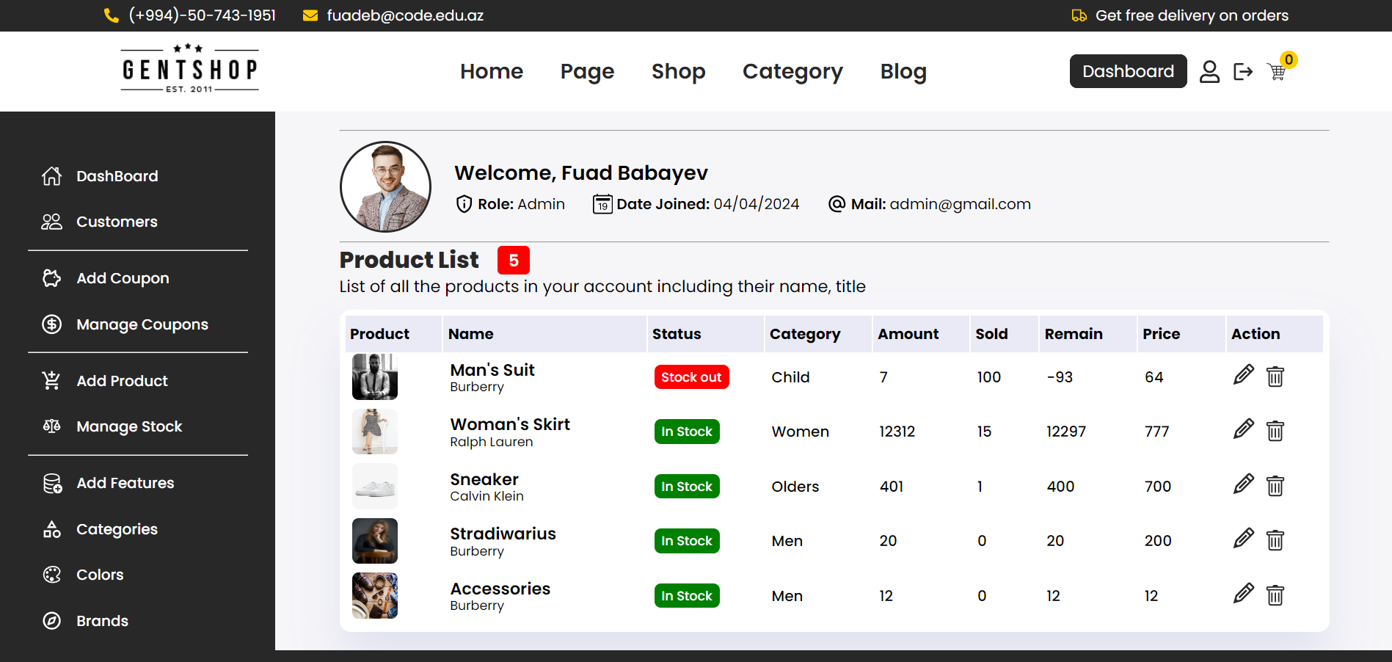
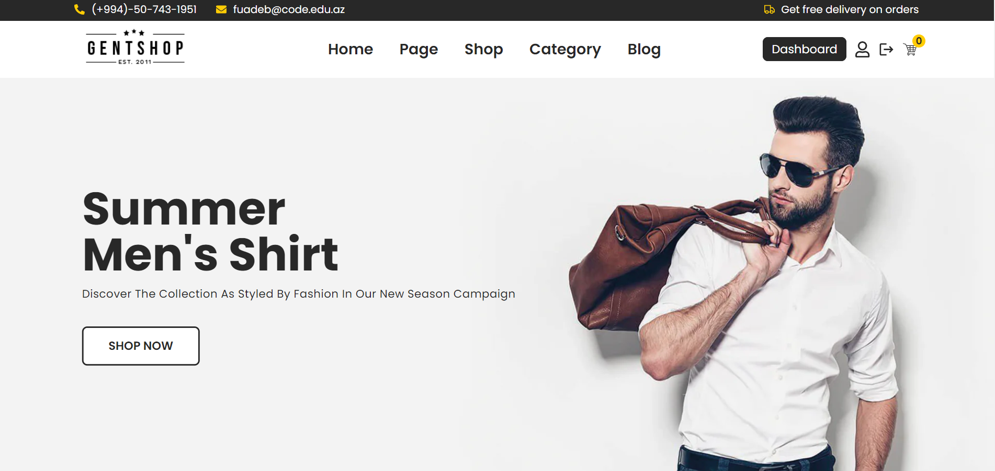

Mern stack Ecommerce Project

Slide 3












Technologies used in Server Side
Written in MVC Design Pattern

Slide 4












Technologies used in CLIENT Side
REACT + VITE

Slide 5
APPLICATION FEATURES
Authentication, Authorization
Stock, Category Management (CRUD product)
Coupon System
Product Filtering
Order Placement Process
Payment Integration / Webhook

Slide 6
thanks for your attention

