Slide 1




PL/SQL PROJECT REPORT: ROW-LEVEL SECURITY (RLS)
Presented by Eng.Fuad Maher & Eng.Momen Mohanna
under supervision of Eng. Sameh Salem

Slide 2
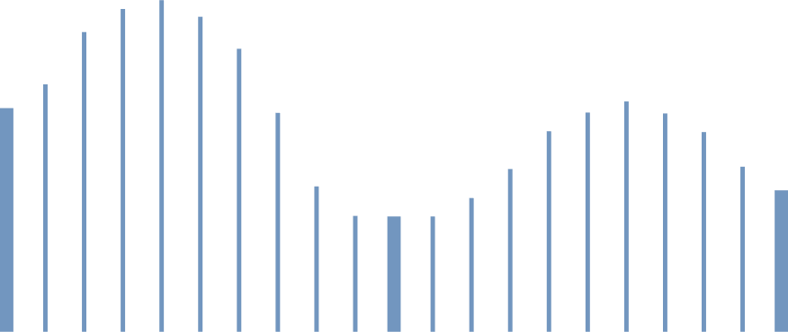

Our Team
م.فؤاد السرساوي
م.مؤمن مهنا

Slide 3
Cover Page
Project Title: Protecting Sensitive Data using Row-Level Security in an
Oracle Environment.
Student Name: Fuad Maher & Momen Mohanna
Programming Language : PL/SQL Programming.
Supervised by: Eng. Sameh Samlem

Slide 4



Introduction
Databases are the backbone of any information system. Protection is not limited to preventing unauthorized access but extends to controlling what each user can see within the tables. Row-Level Security (RLS), also known as Virtual Private Database (VPD), is a powerful Oracle feature that ensures users view only authorized data by transparently appending a "hidden condition" to every SQL query.

Slide 5
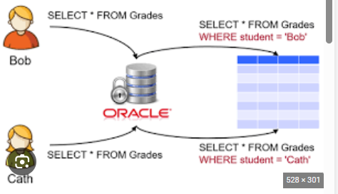

Slide 6
Project Idea
The project implements an HR Management System containing sensitive salary data. Instead of creating separate tables for each department, we use a single global table. Based on the User Identity logged into the database, the PL/SQL engine dynamically modifies queries to display only the rows relevant to that user's department.

Slide 7




Objectives
Implement the Principle of Least Privilege.
Manage data access dynamically without changing application code.
Utilize PL/SQL to build flexible security policies.
Protect sensitive information (like salaries) from internal unauthorized access.

Slide 8
DataBase Design
The system relies on a central table and specific user roles:
Table EMPLOYEES_DATA: Contains EMP_ID, EMP_NAME, DEPT_NAME, and SALARY.
Users for Testing:
HR_MANAGER: Authorized to view all records.
SALES_USER: Authorized to view Sales department records only.
TECH_USER: Authorized to view Technology department records only.

Slide 9


Proposed Solutions
The solution is implemented through three PL/SQL layers:
Policy Function: A function that returns a dynamic WHERE clause (predicate).
DBMS_RLS Package: A system package used to bind the function to the table.
Policy Enforcement: Automatically activating the filter during SELECT operations.

Slide 10
Coding :
We have uplopded a file on Classroom that contain coding

Slide 11


Testing and Results
When executing SELECT * FROM employees_data;,
the results vary by user:
HR_MANAGER: Sees 4 rows.
SALES_USER: Sees 2 rows (Sara, Khalid).
TECH_USER: Sees 1 row (Laila).

Slide 12
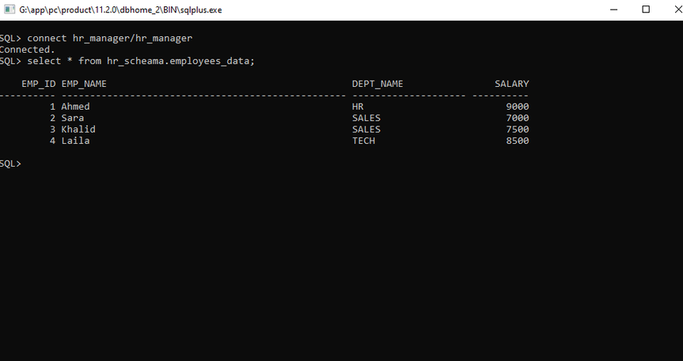
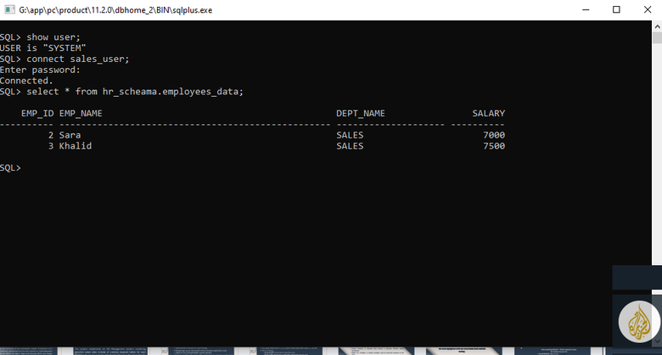
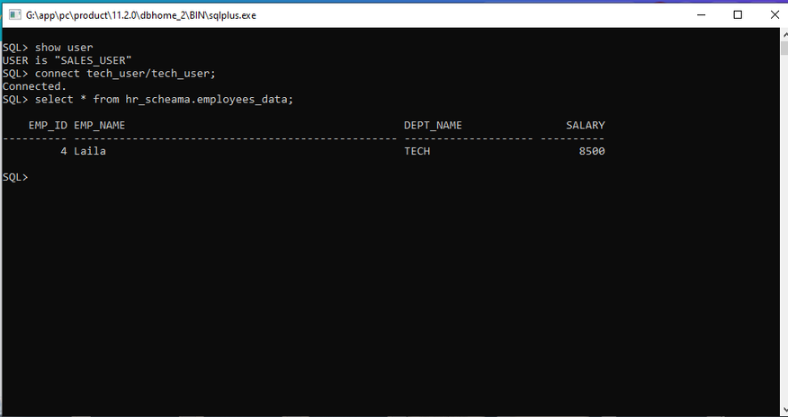
Testing And Results :

Slide 13
challenges :
Understand the "Hidden" Logic: Grasping how Oracle dynamically applies policies in the background.
Managing User Roles: Ensuring the PL/SQL function correctly identifies different users (like HR_MANAGER vs. TECH_USER)
Using System Packages: Learning the exact syntax needed to link our function to the table using the DBMS_RLS package

Slide 14
CONCLUSION:
The RLS project demonstrates that true data security starts within the database layer. By using PL/SQL and VPD, we built a "transparent" security layer that ensures privacy without requiring any changes to the application's front-end code.

Slide 15
Resources :
Oracle Documentation

