Slide 1

General Programming
Math Review 2026
Fadime Stemmer
07/13/2026

Slide 2

About me
4th year in MC&G
Saito Lab (come find me in Watson 117!)
Research:
(Metallo-)proteomics, Metaproteomics
Enzymatic POM digestion and metalloprotease characterization
E-Mail: fstemmer@mit.edu
Github: Fuchan2004
And you?
Rounds of introduction! Name, Year, Where you are from, who you work with,
… and most importantly: favorite ice cream flavor!

Slide 3
What is programming?
 | Compiling Languages | Scripting Languages
Explanation | Human readable code (source codE) turned into non-human readable set of instructions to be carried out by a computer. | Processed with an interpreter rather than compiled. Require a program to run
Example | Example: C, C++ | Example: Python, R, bash, MATLAB
Advantage | specific to computer, reusable as many times as needed | Modifiable, no need for compiling
Disadvantage | Sometimes slower and less optimized | Sometimes slower and less optimized

Slide 4
The CLI, Shell, bash
The Command Line Interface (CLI) allows users to interact with a computer by reading and writing text. It excels at making repetitive tasks automatic and fast.
Shell is a program that takes commands you type and gets the operating system to run them.
Bash is one specific implementation of a shell. One program that does that job, with its own particular syntax and features.
There are several other shells that do the same basic job differently:
zsh = macOS's current default, bash-like but with extra features (better autocomplete, plugins)
PowerShell = Windows's native shell, works very differently (objects instead of text)
Learn how to use command line: https://swcarpentry.github.io/shell-novice/01-intro.html

Slide 5
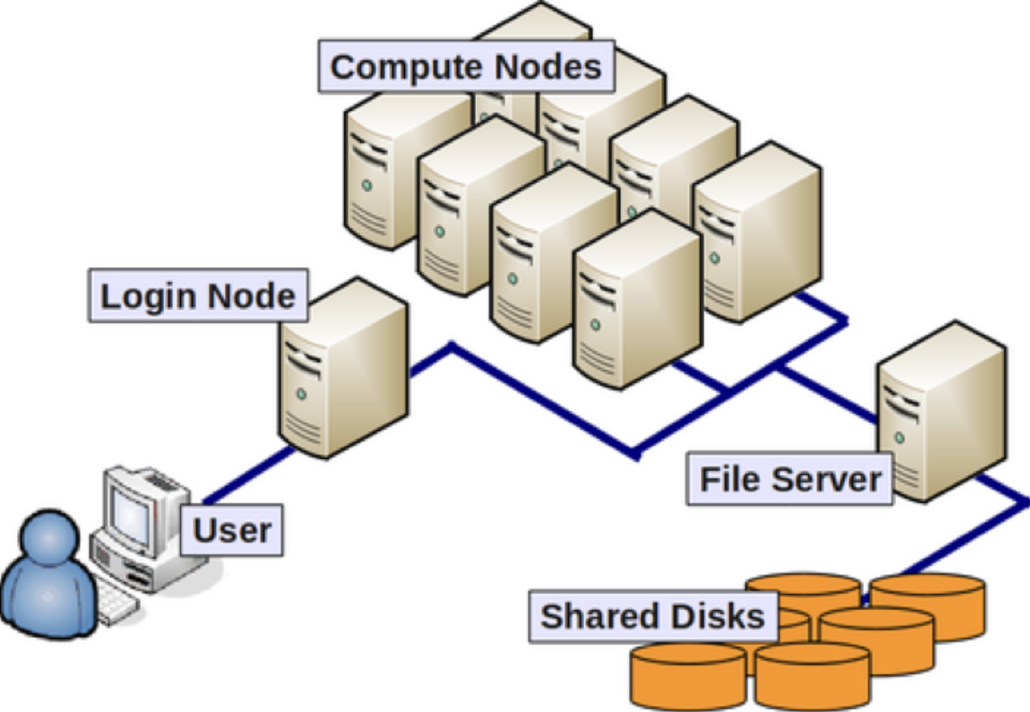
High Performance Computer (HPC)
Software designed to work with the resources on an HPC environment and is unusable on a personal computer
Data is big --> HPC allows you to avoid issues with memory and to get the analysis done faster with better processing capacity
Frees up your local computer (less storage requirement, less effort, etc.)
Easier to parallelize your workflows

Slide 6
HPC Rules
Login Node = entering the HPC computing environment from your local computer
Login node is only for navigating on the HPC
Never do computing on Login Node!
Compute Nodes = Nodes with allocated memory and cores for running large computing

Slide 7
Github
= software that helps you version control your code. GitHub is a platform that integrates with git and helps you collaborate with others. Be aware:
Git is not an archival service
Git is not a good place to store data or data products (checkout Zenodo or OSF.io instead)

Slide 8
More Resources
Environmental Bioinformatics (taught next in Fall 2027, Harriett Alexander, Maria Pachiadaki, Carolyn Tepolt)
Software Carpentries tutorials: https://swcarpentry.github.io/shell-novice/index.html
MIT-PraCTES IAP workshop: https://github.com/PraCTES/MIT-PraCTES
Tmux cheat sheet: https://tmuxcheatsheet.com/
Lets get programming!

