Slide 1
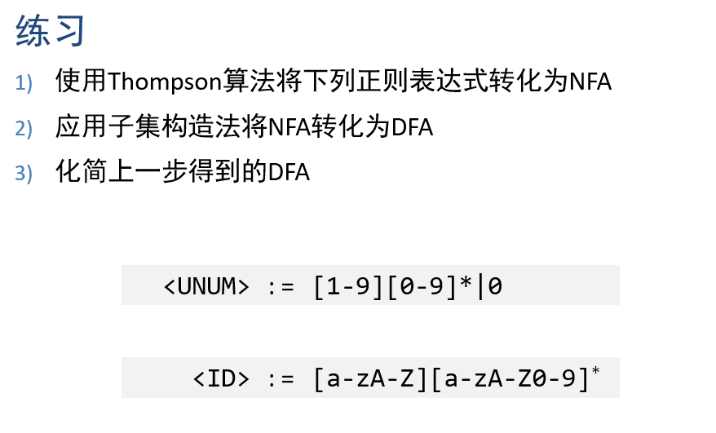

Slide 2



























（1）
$$S_{2}$$
$$0$$
$$S_{3}$$
$$ε$$
$$ε$$
$$S_{t}$$
UNMU
$$S_{1}$$
$$ε$$
$$ε$$
$$ε$$
$$[1−9]$$
$$ε$$
$$[0−9]$$
$$ε$$
$$ε$$
$$S_{4}$$
$$S_{5}$$
$$S_{6}$$
$$S_{7}$$
$$S_{8}$$
$$S_{0}$$
$$ε$$
$$ε$$
$$ε$$
$$[a−zA−Z]$$
$$ε$$
$$ε$$
$$[a−zA−Z0−9]$$
$$ε$$
$$S_{13}$$
$$S_{9}$$
$$S_{10}$$
$$S_{11}$$
$$S_{12}$$
$$S_{t}$$
ID
$$ε$$

Slide 3
（2）
DFA | NFA | 0 | 1-9 | a-zA-Z
d_0 | s_0,s_1,s_2,s_4,s_9 | s_3,NUM | s_5,s_6,s_8,NUM | s_{10},s_{11},s_{13},ID
d_1 | s_3,NUM | - | - | -
d_2 | s_5,s_6,s_8,NUM | s_6,s_7,s_8,NUM | s_6,s_7,s_8,NUM | -
d_3 | s_{10},s_{11},s_{13},ID | s_{11},s_{12},s_{13},ID | s_{11},s_{12},s_{13},ID | s_{11},s_{12},s_{13},ID
d_4 | s_6,s_7,s_8,NUM | d_4 | d_4 | -
d_5 | s_{11},s_{12},s_{13},ID | d_5 | d_5 | d_5

Slide 4













（2）
$$d_{1}$$
UNMU
$$0$$
$$[0−9]$$
$$[1−9]$$
$$[0−9]$$
$$d_{2}$$
$$d_{4}$$
UNMU
$$d_{0}$$
$$[a−zA−Z0−9]$$
$$[a−zA−Z0−9]$$
$$[a−zA−Z]$$
$$d_{3}$$
$$d_{5}$$
ID

Slide 5









（3）
$$d_{1}$$
UNMU
$$0$$
$$[0−9]$$
$$[1−9]$$
$$d_{2}$$
UNMU
$$d_{0}$$
$$[a−zA−Z]$$
$$[a−zA−Z0−9]$$
$$d_{3}$$
ID

