Slide 1
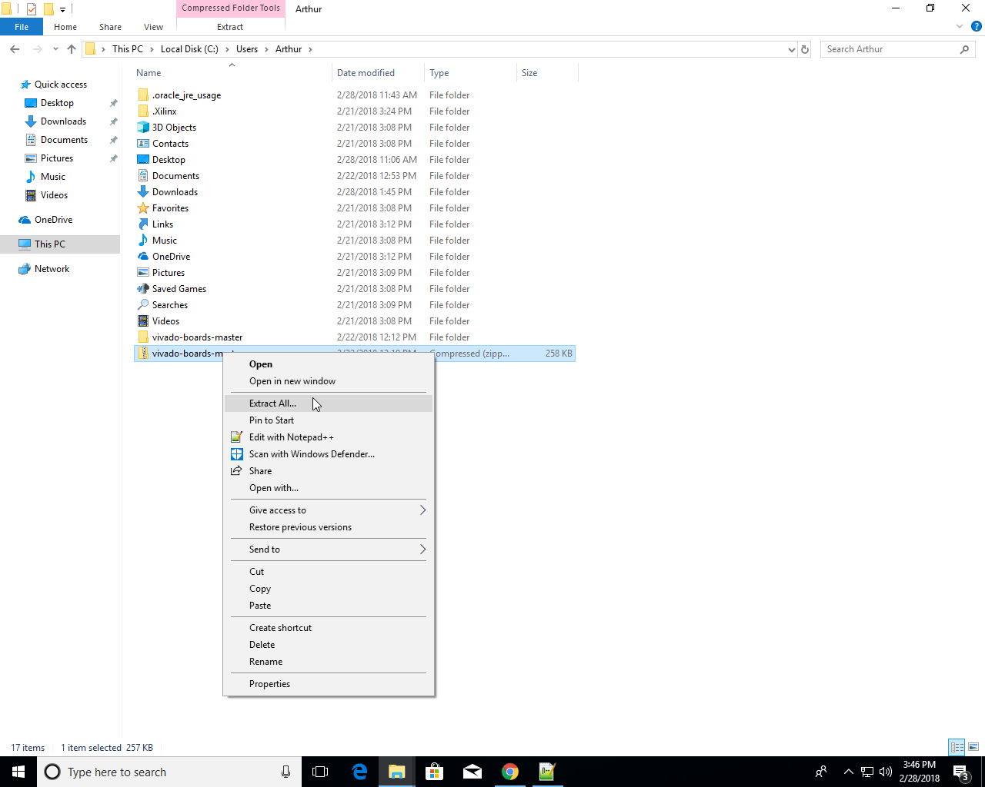
Install Board File
教程:
https://digilent.com/reference/programmable-logic/guides/installing-vivado-and-vitis#install_digilent_s_board_files
zip archive:
https://github.com/Digilent/vivado-boards/archive/master.zip?_ga=2.217466262.1460531839.1712926097-1066417410.1712238826
step1: 下载zip存档并解压

Slide 2
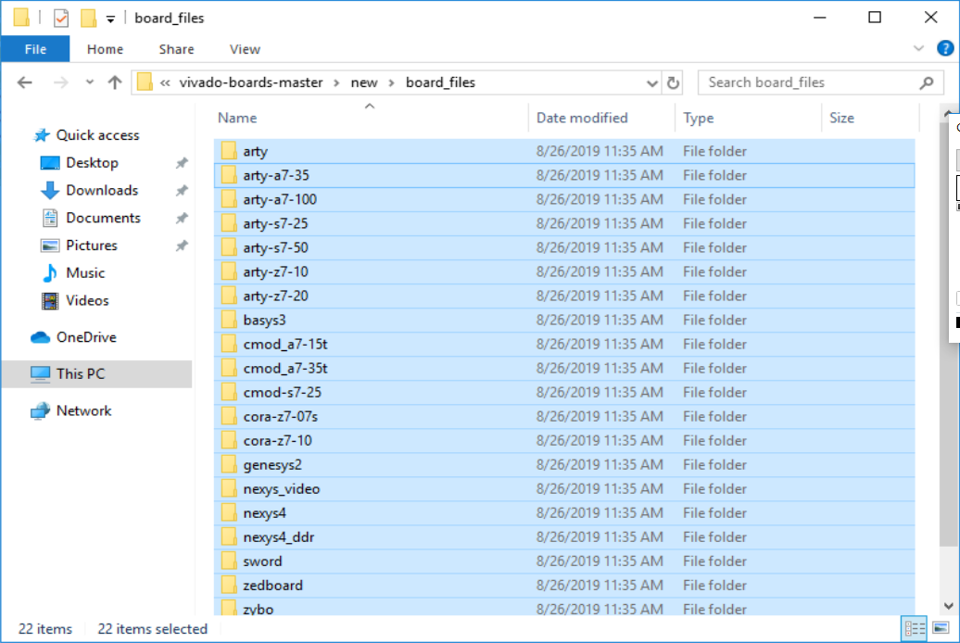
安装Board File
教程:
https://digilent.com/reference/programmable-logic/guides/installing-vivado-and-vitis#install_digilent_s_board_files
zip archive:
https://github.com/Digilent/vivado-boards/archive/master.zip?_ga=2.217466262.1460531839.1712926097-1066417410.1712238826
step2:打开从存档中提取的文件夹并导航到其文件夹。复制new\board_files目录下的所有子文件夹

Slide 3
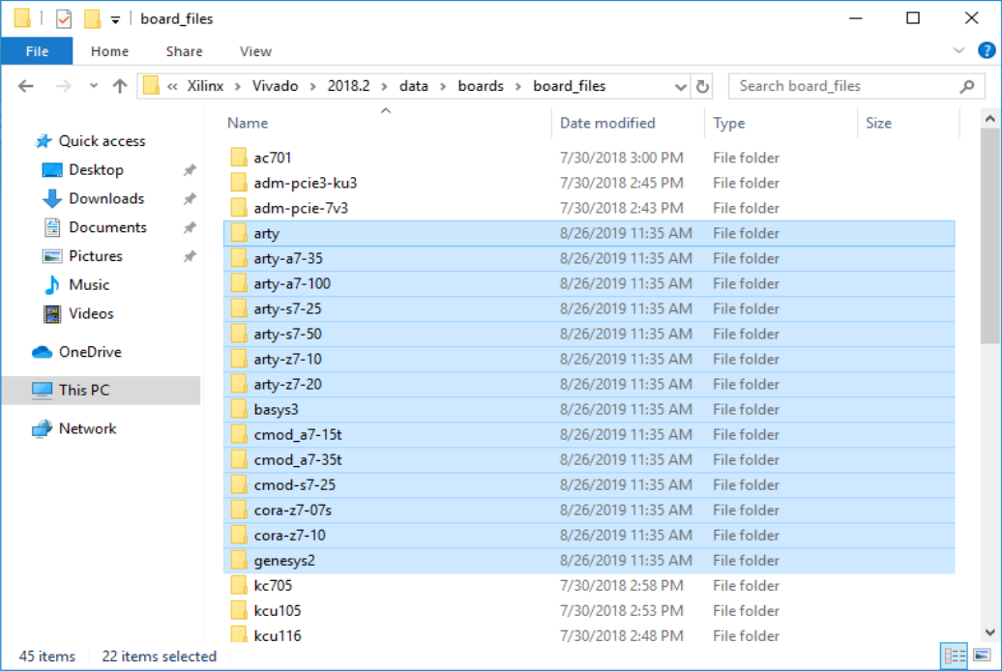
安装Board File
教程:
https://digilent.com/reference/programmable-logic/guides/installing-vivado-and-vitis#install_digilent_s_board_files
zip archive:
https://github.com/Digilent/vivado-boards/archive/master.zip?_ga=2.217466262.1460531839.1712926097-1066417410.1712238826
step3:将step2中复制的文件夹粘贴到C:/Xilinx/Vivado/2018.2/data/boards/board_files目录下, (2018.2应替换为相应的Vivado版本号)

Slide 4
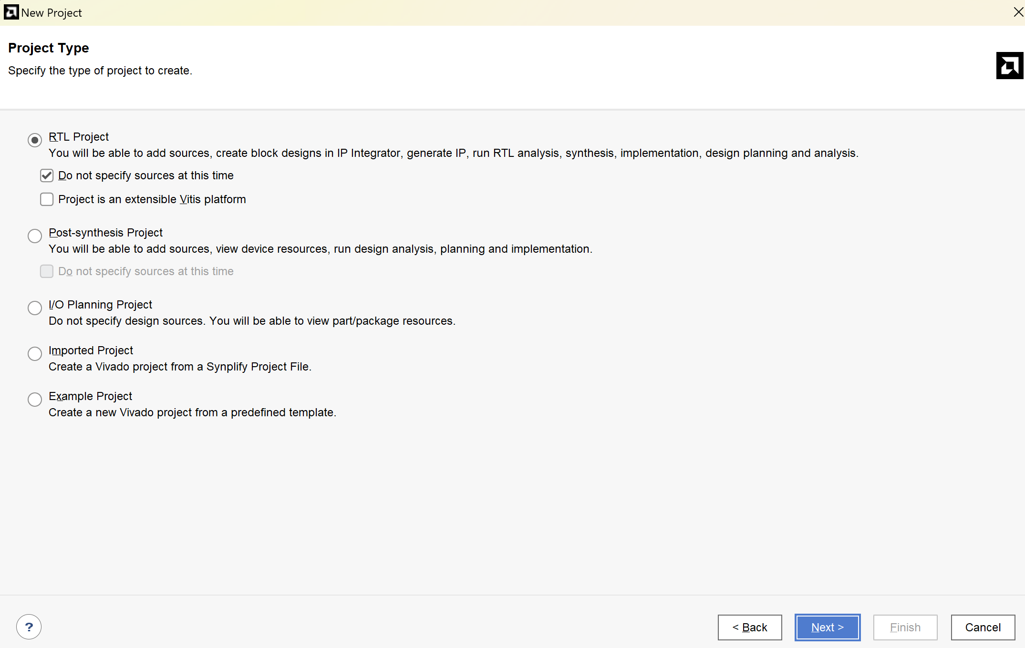
创建Vivado Project
设置Project Type为RTL
勾选”Do not specify source at this time”

Slide 5
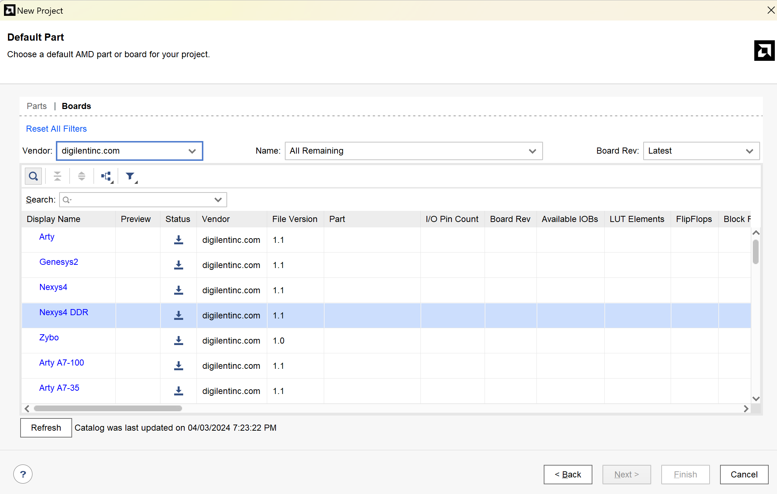
创建Vivado Project
设置Default Part: Boards
Vendor选择digilentinc.com
下载Nexys4 DDR
Next => Finish
若未出现Nexys4 DDR选项, 尝试Refresh:)

Slide 6
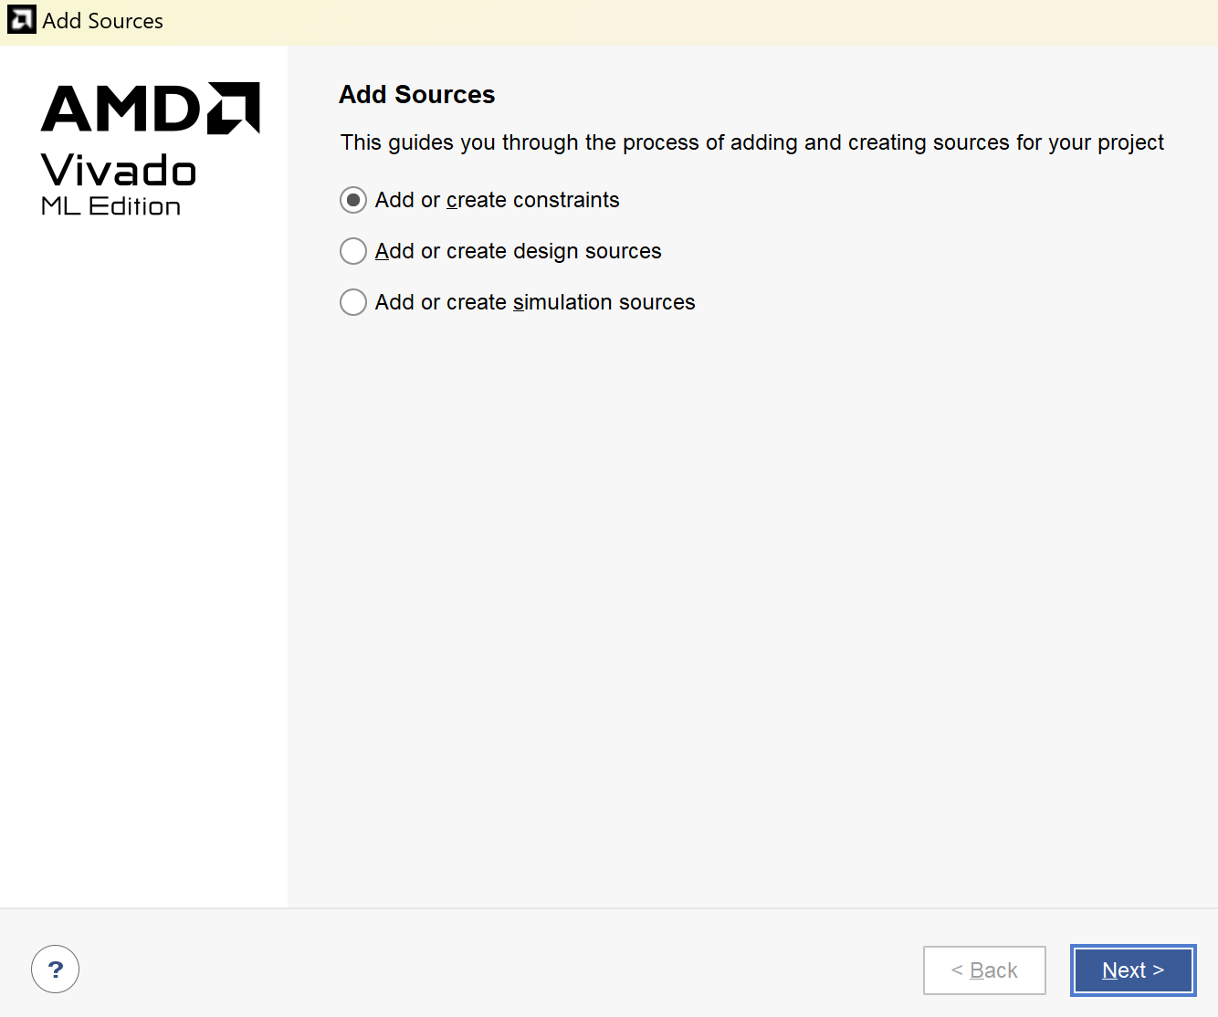
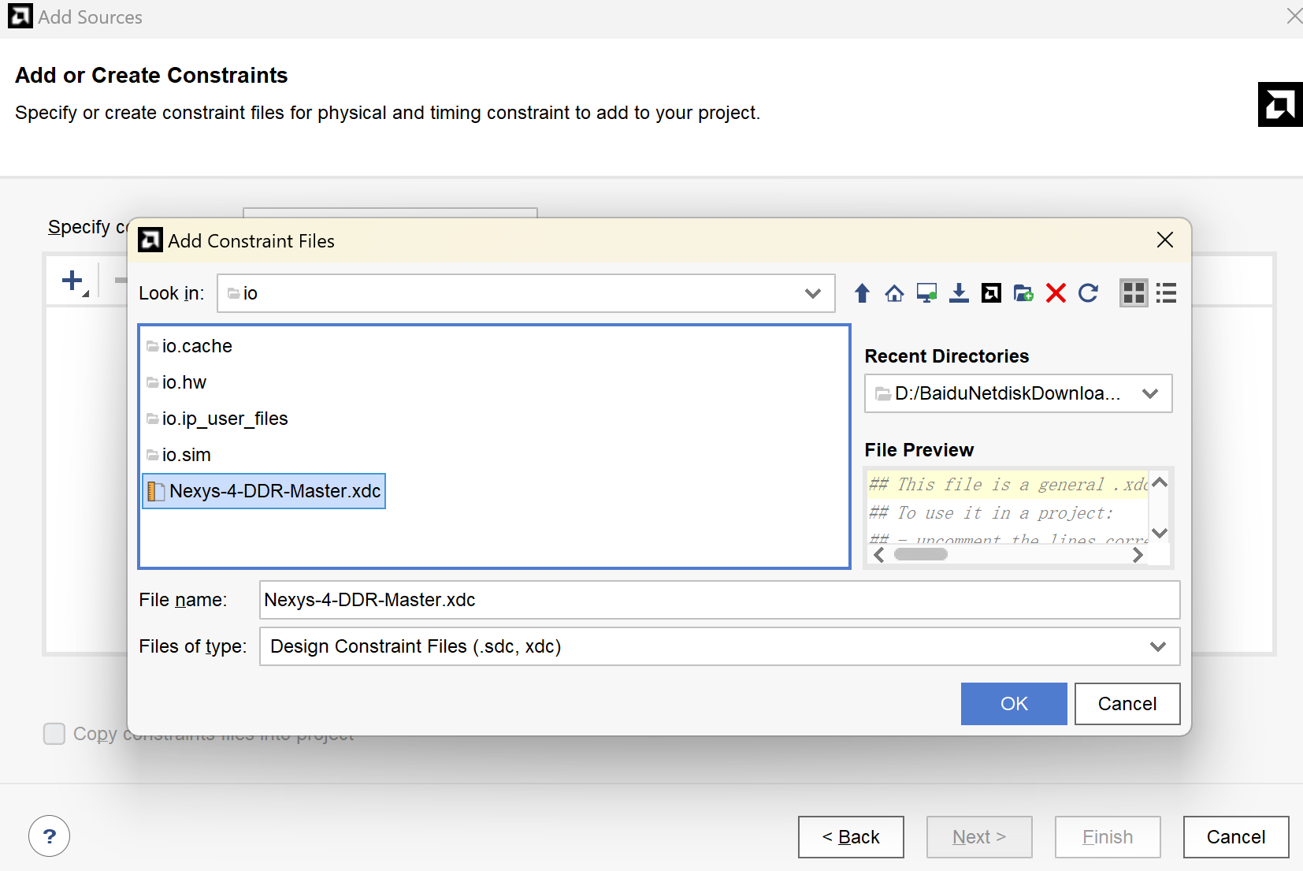
添加约束文件
教程:
Vivado 纯硬件设计入门 - Digilent 参考
zip archive(你需要下载然后添加其中的Nexys-4-DDR-Master.xdc到项目中):
https://github.com/Digilent/digilent-xdc/archive/master.zip?_ga=2.210609173.1460531839.1712926097-1066417410.1712238826

Slide 7
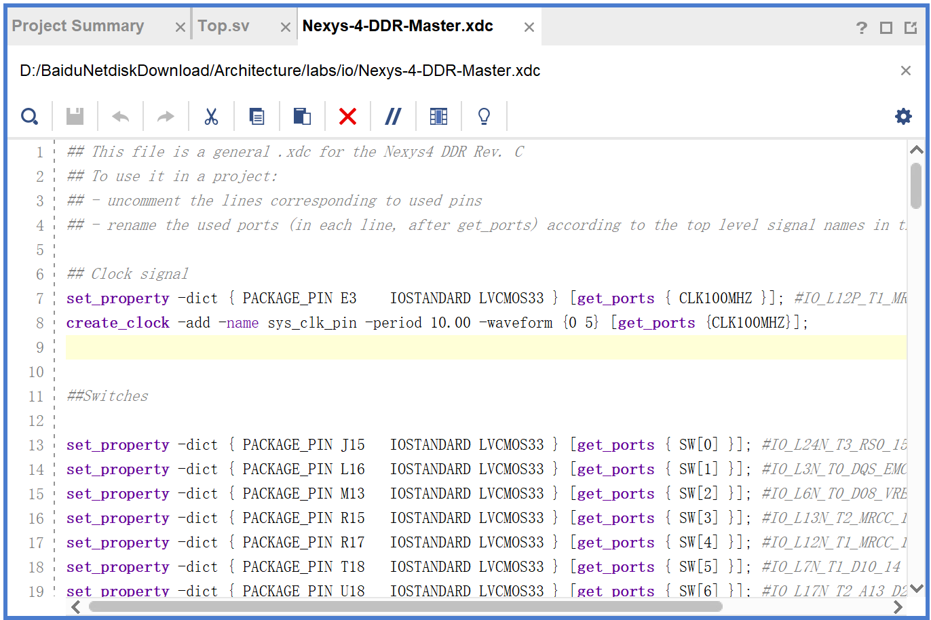
添加约束文件
教程:
Vivado 纯硬件设计入门 - Digilent 参考
zip archive(你需要下载然后添加其中的Nexys-4-DDR-Master.xdc到项目中):
https://github.com/Digilent/digilent-xdc/archive/master.zip?_ga=2.210609173.1460531839.1712926097-1066417410.1712238826
要让约束文件生效:
取消实验中用到端口前的注释;
根据顶层模块中端口的名称重命名.xdc文件中的标识符

Slide 8
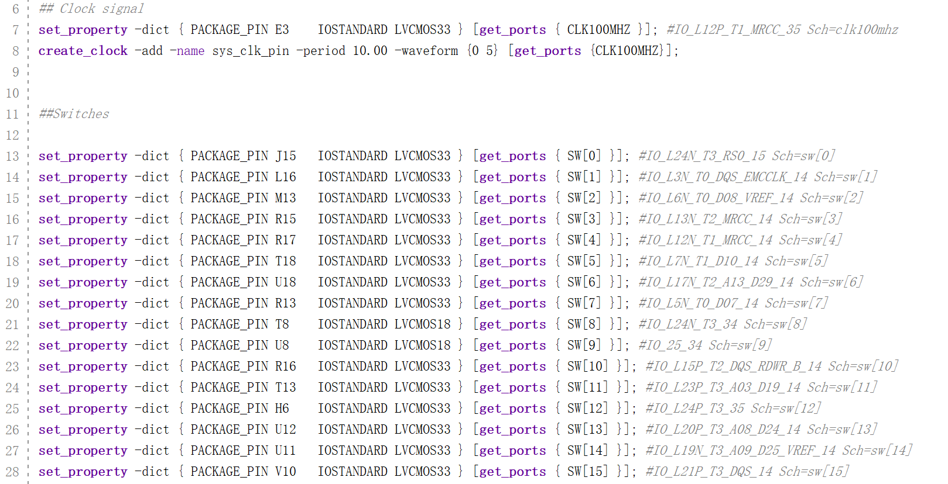
添加约束文件
实验会用到的端口:
CLK100MHZ,
SW[15:0]

Slide 9
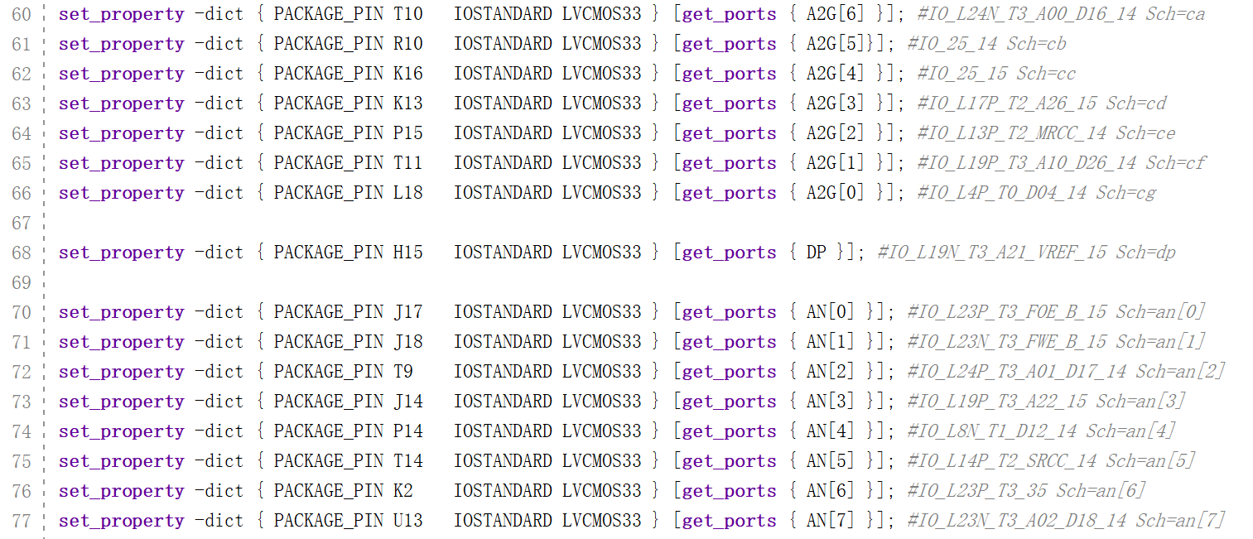
添加约束文件
实验会用到的端口:
A2G[6:0],
AN[7:0]

Slide 10
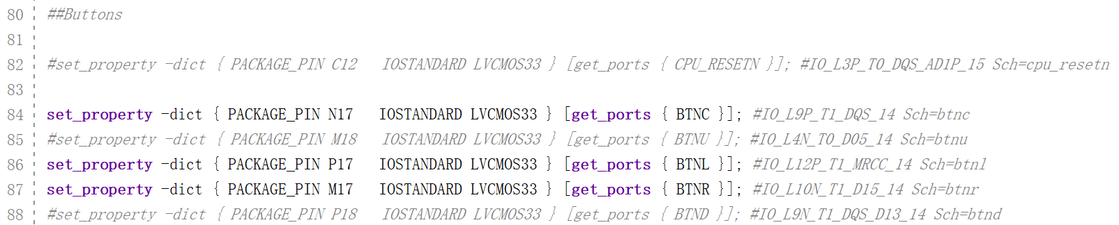
添加约束文件
实验会用到的端口:
BTNC,
BTNL,
BTNR

Slide 11
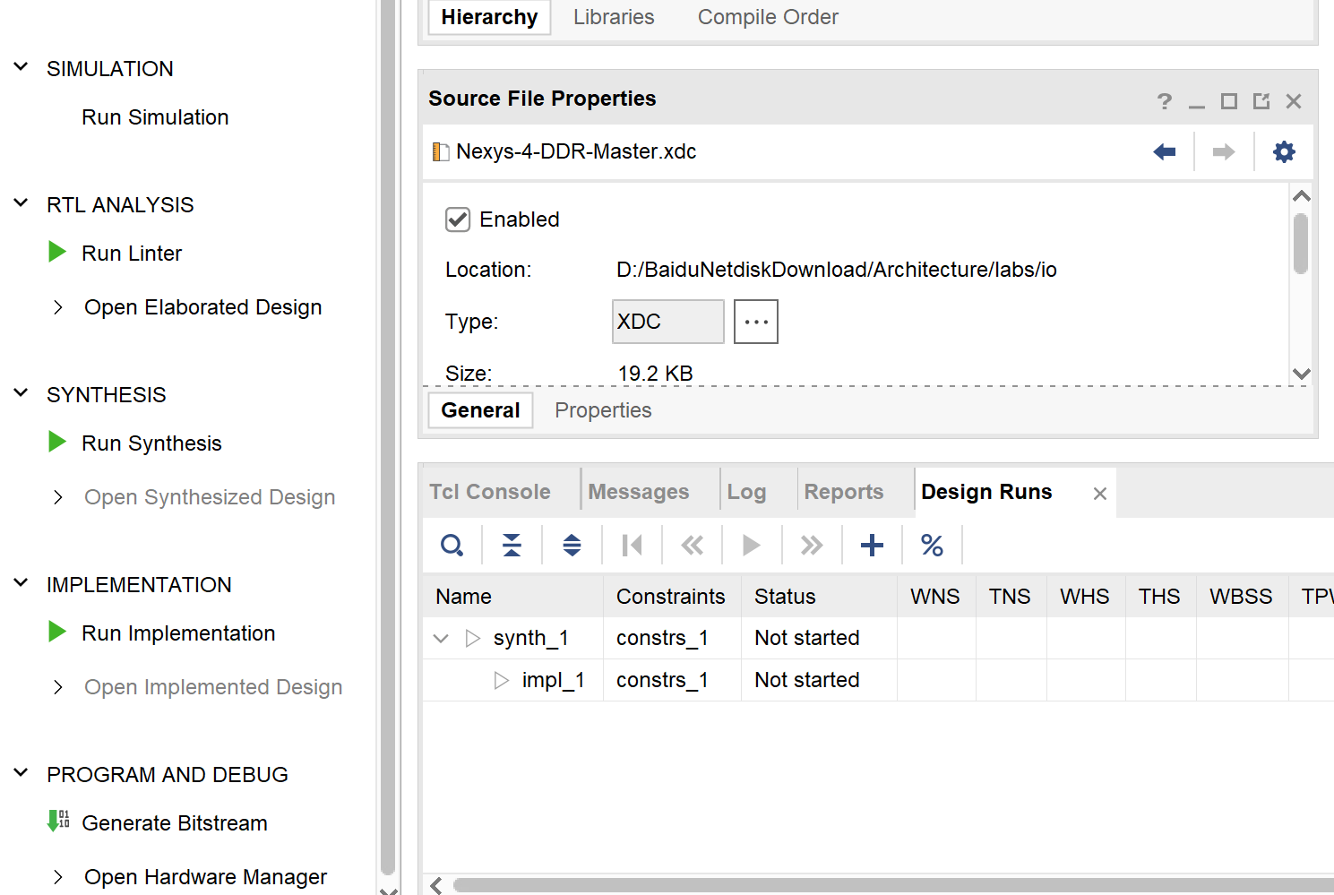
生成bitstream
将.sv文件以及memfile.dat添加到项目中
依次运行:
Run Synthesis
Run Implementation
Generate Bitstream
Open Hardware Manager

Slide 12
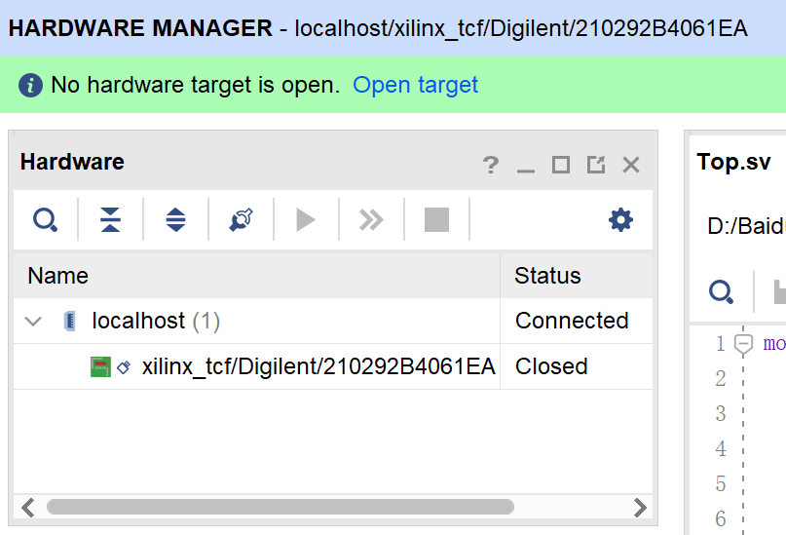
编程DDR板
Open target:
选择auto connect

Slide 13
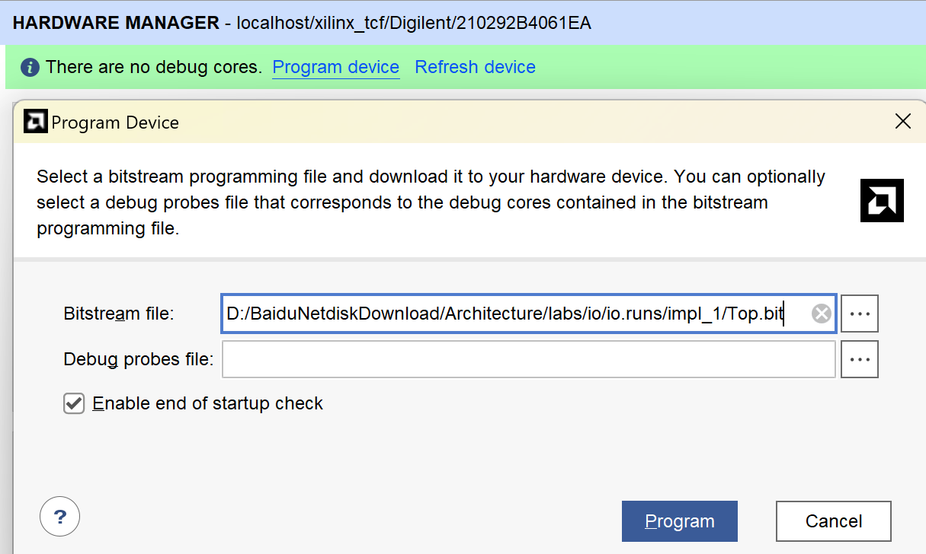
编程DDR板
用上一步生成的bitstream编程DDR板

