Slide 1
PYSPARK
Data Engineering Bootcamp
Data management and archiving in the research environment
By Niklas Büchner, Christian Singer, Ahmad Al-Taie, Mike Sickmüller

Slide 2

Content
Introduction & Presentation ETL Process
Actions & Basic Transformations
Advanced Transformations
Databricks

Slide 3

Introduction &Presentation ETL Process

Slide 4

Goal of the learning sections
Create a basic understanding for Data Engineering
Understand how an ETL workflow is structured
The Role of Spark in such a contex

Slide 5
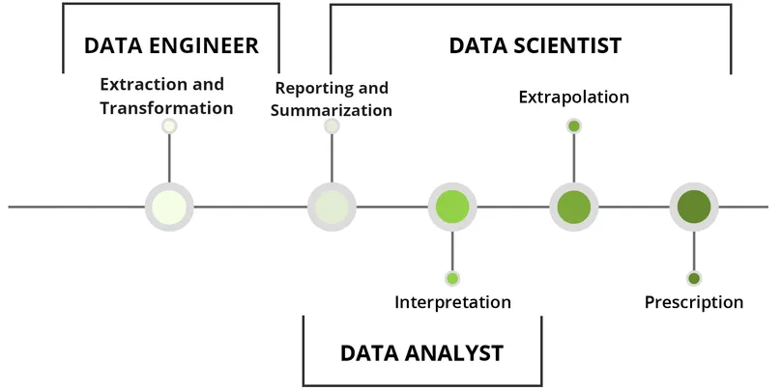
What is Data Engineering ?
Developing and building systems for collecting, storing and analyzing data
Provide data for evaluation and optimization performance of enterprises
Data engineers manage data resources
Data analysts use data to gain insights

Slide 6
What is ETL ?
Extraction
Raw data is copied or exported from a variety of data sources
These can be structured or unstructured
Transformation
Collected raw data is consolidated for the intended use case
During transformation, data is deduplicated, translated or summarized
Adapt data to the Data Warehouse schema
Loading
Load transformed data into the Target-Data-Warehouse

Slide 7
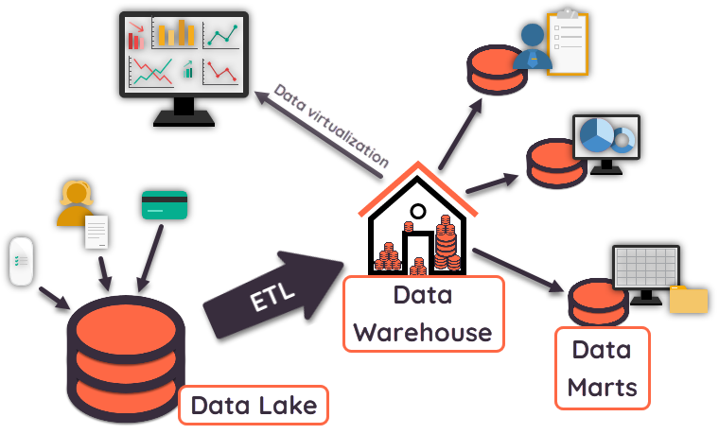
What is ETL ?

Slide 8
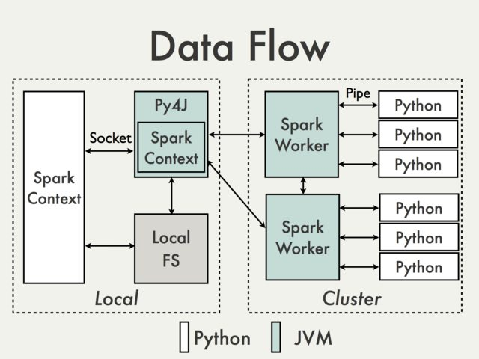
What is Spark ?
Apache Spark/PySpark
Multilingual engine for data engineering execution
Outsourcing of the data development workflow to a number of servers
Processing Big Data through parallelization
Spark is written in Scala
Python functions are available via Python-based wrapper PySpark

Slide 9
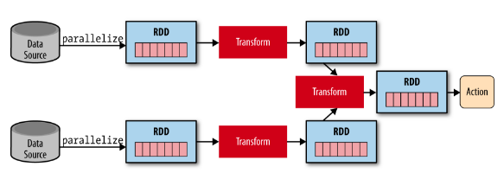
SparkSQL
Basic Data Structure Resilient Distributed Dataset (RDD)
Tutorial focus on SparkSQL model, DataFrame
DataFrame has great advantages over RDD
powerful optimization engine
Data Science module working with DataFrames

Slide 10
Advanced Transformations

Slide 11
Goal of the learning sections

Slide 12
Spark functions

Slide 13
Save results to database

