Slide 1

DataVault
Data Engineering Bootcamp

Slide 2
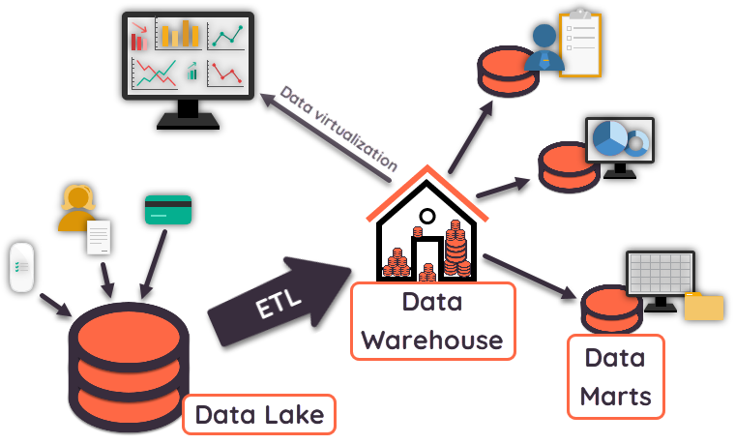
What is ETL ?

Slide 3
Revenue by Country
Today
Country | Revenue (%)
Germany | 50%
France | 10%
Tomorrow
Country | Revenue (%)
Germany | 0%
France | 60%
Customer moves to France

Slide 4
Forecast Water Consumption
Today
Plant | Water consumption until grown
Tomato | 50L
Tomorrow
New tomato type arrvies
which needs 12L to grow per day
Plant | Water consumption until grown
Tomato | 60L

Slide 5
HOW DO WE TRACK CHANGES of our source datA Over time?

Slide 6
DataVault
Data Engineering Bootcamp

Slide 7
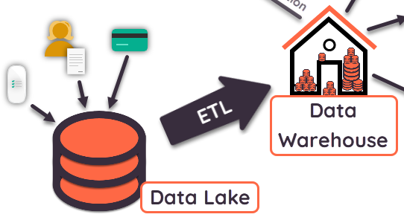
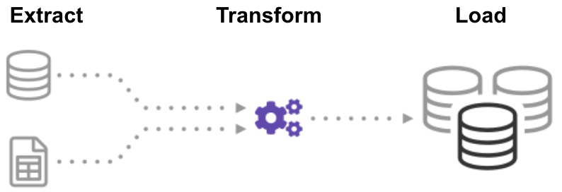
What is A Datavault ?
Image: https://panoply.io/uploads/etl-1.png

Slide 8
Model
crops:
+------+----------+-------------------+
| id | crop | water_consumption |
+------+----------+-------------------+
| C-1 | tomato | 10 |
+------+----------+-------------------+
| C-2 | cucumber | 15 |
+------+----------+-------------------+
fields:
+------+-------+----------+
| id | field | crop_id |
+------+-------+----------+
| F-5 | small | 2 |
+------+-------+----------+
| F-6 | big | 1 |
+------+-------+----------+
Tomatos now have a water consumption of 12 liters/day.
How can we communicate our stakeholders that yesterdays analysis contained a different value?

Slide 9
Satelite
crops satelite:
+---------------+----------+-------------------+------------+----------+---------------+-----------+
| crop_hash_key | crop | water_consumption | load_date | end_date | record_source | hash_diff |
+---------------+----------+-------------------+------------+----------+---------------+-----------+
| b519e | tomate | 10 | 2022-05-01 | NULL | ERP | 8a3f0 |
+---------------+----------+-------------------+------------+----------+---------------+-----------+
| 5f763 | cucumber | 15 | 2022-05-01 | NULL | ERP | c345a |
+---------------+----------+-------------------+------------+----------+---------------+-----------+
crops:
+------+----------+-------------------+
| id | crop | water_consumption |
+------+----------+-------------------+
...
+------+----------+-------------------+

Slide 10
Alter data
crops satelite:
+---------------+----------+-------------------+------------+------------+---------------+-----------+
| crop_hash_key | crop | water_consumption | load_date | end_date | record_source | hash_diff |
+---------------+----------+-------------------+------------+------------+---------------+-----------+
| b519e | tomate | 10 | 2022-05-01 | 2022-05-02 | ERP | 8a3f0 |
+---------------+----------+-------------------+------------+------------+---------------+-----------+
...
+---------------+----------+-------------------+------------+------------+---------------+-----------+
| b519e | tomate | 12 | 2022-05-02 | NULL | ERP | 8a3f0 |
+---------------+----------+-------------------+------------+------------+---------------+-----------+
✅ Tracking data changes
✅ Only import differences

Slide 11
Add Column
crops height satelite:
+-----------------+-------------+------------+----------+---------------+-----------+
| height_hash_key | crop_height | load_date | end_date | record_source | hash_diff |
+-----------------+-------------+------------+----------+---------------+-----------+
| 74f10 | 30 | 2022-05-03 | NULL | ERP | a8c94 |
+-----------------+-------------+------------+----------+---------------+-----------+
| d9570 | 15 | 2022-05-03 | NULL | ERP | ef3a9 |
+-----------------+-------------+------------+----------+---------------+-----------+
crops - crops height link:
+---------------------------+---------------+----------------------+------------+---------------+
| crop_crop_height_hash_key | crop_hash_key | crop_height_hash_key | load_date | record_source |
+---------------------------+---------------+----------------------+------------+---------------+
| 05610 | b519e | 74f10 | 2022-05-03 | ERP |
+---------------------------+---------------+----------------------+------------+---------------+
| 2c61c | 5f763 | d9570 | 2022-05-03 | ERP |
+---------------------------+---------------+----------------------+------------+---------------+
✅ Tracking schema changes
✅ Downstream ETL processes do not need to be adjusted if they don't need the new information

Slide 12
Remove A Column
All Columns need to be nullable
Therefore no further changes are needed.

Slide 13
Pros & cons of a DataVault
Pros:
Long-term storage of data
Tracking data changes
Fast import of data
Changes in data schemas do not necessarily required downstream ETL and analysis processes to be adjusted
Cons:
Not easy to query
Large overhead

Slide 14
HOW DO WE TRACK CHANGES of our source data over time?

Slide 15
Thank You For your Attention

