Slide 1
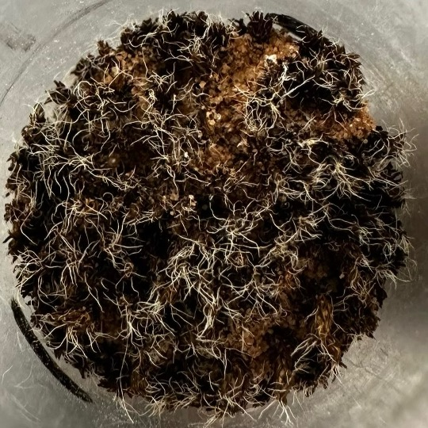
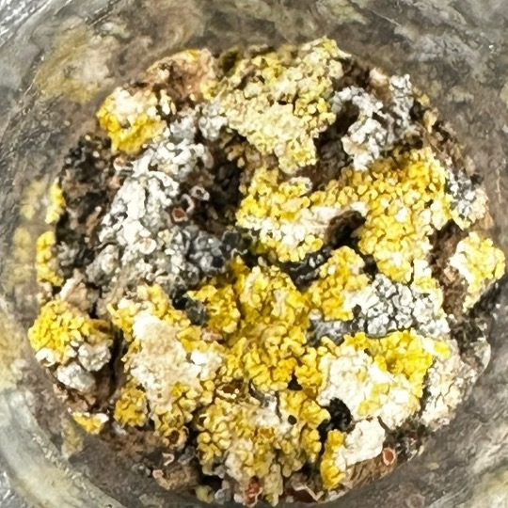
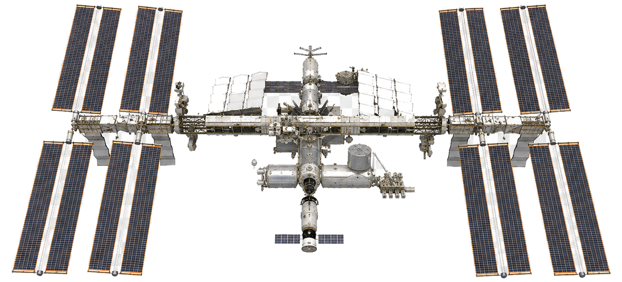
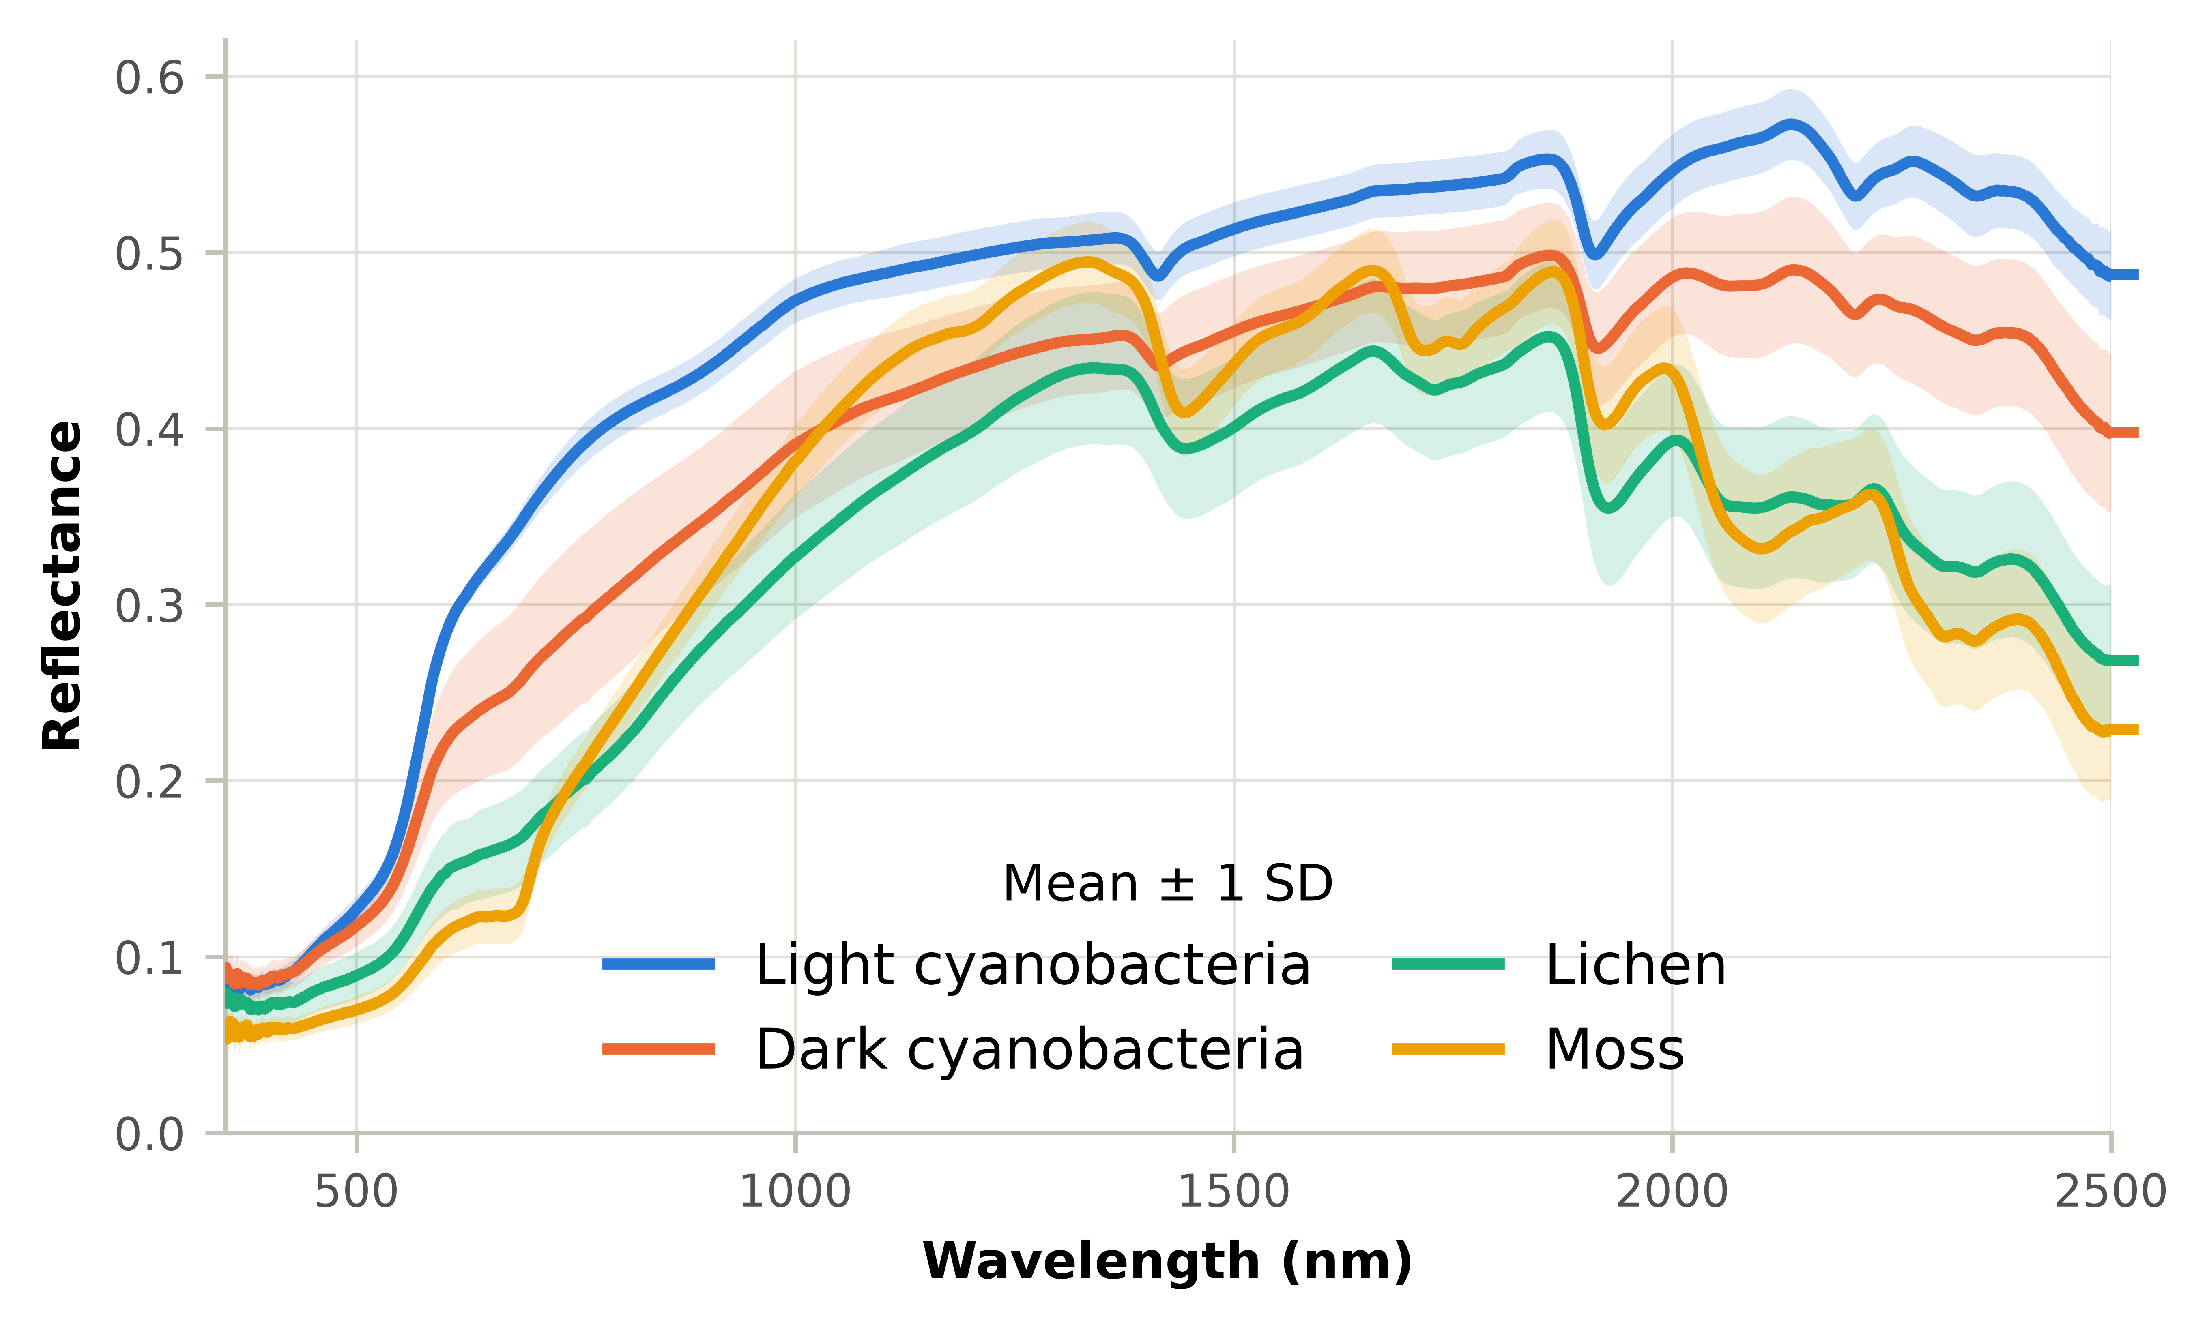

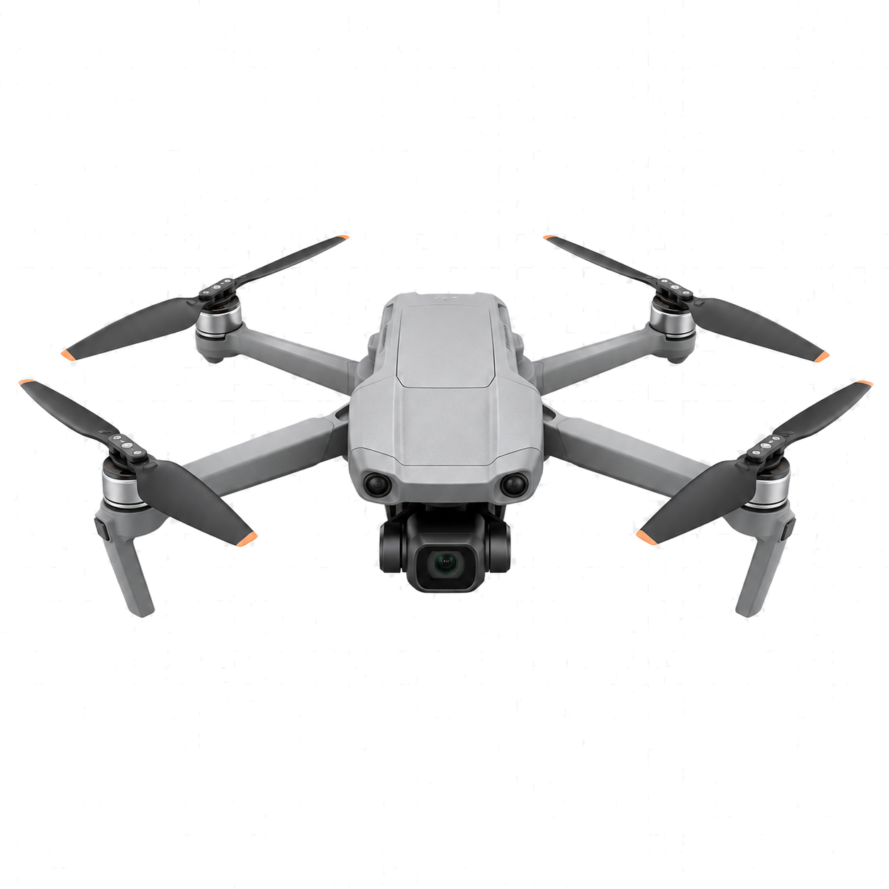
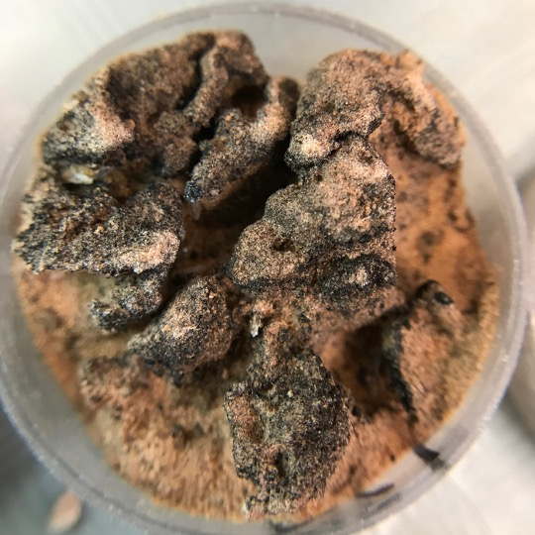
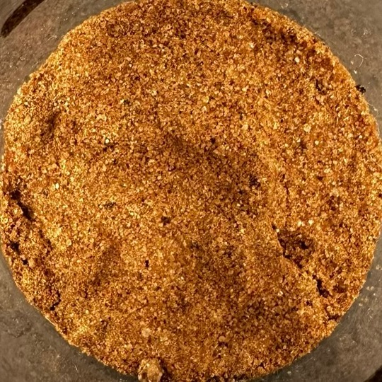
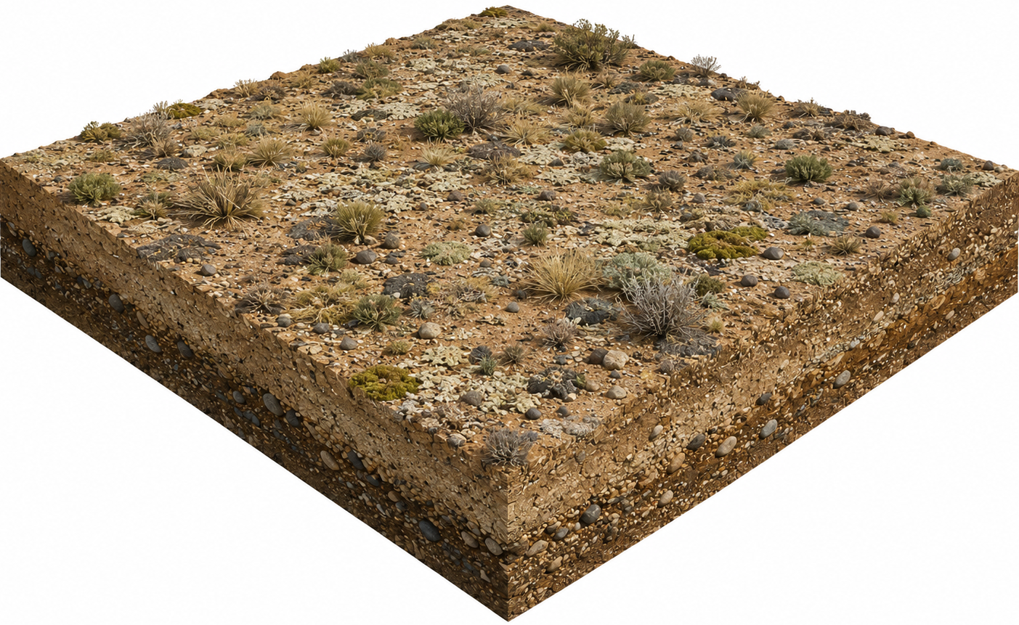
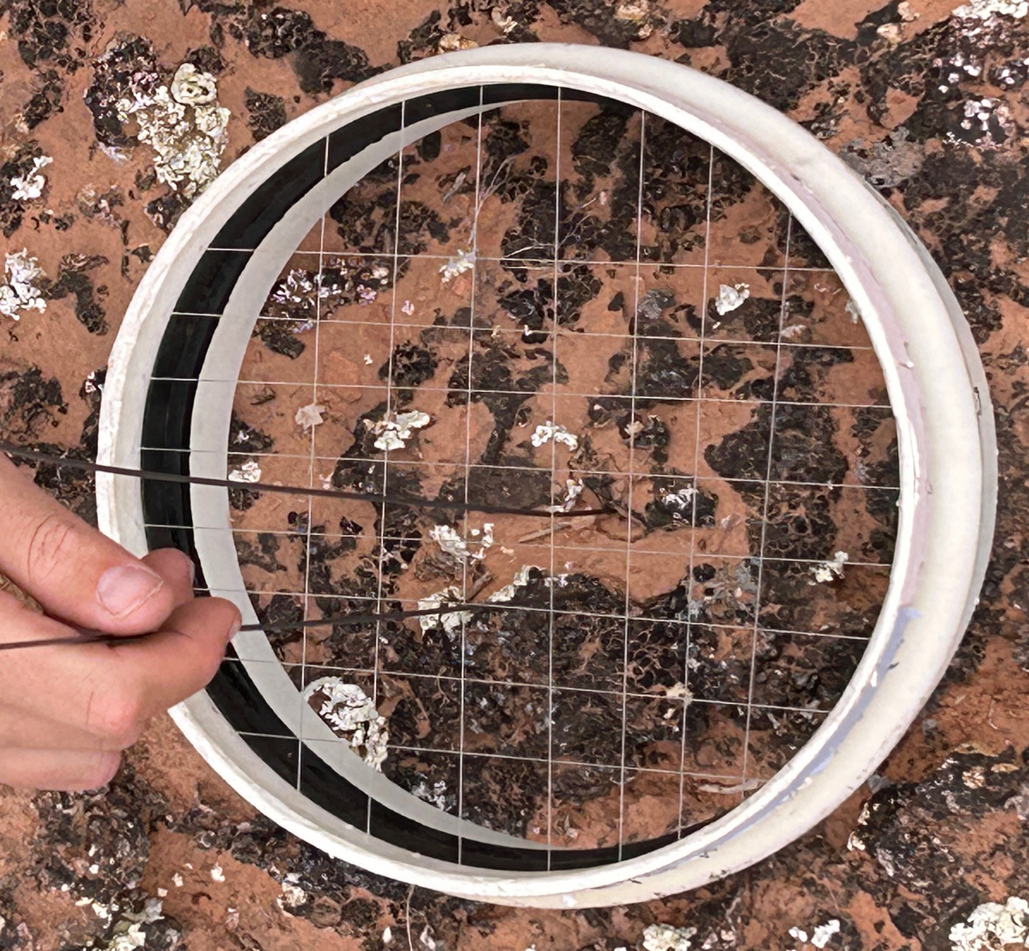
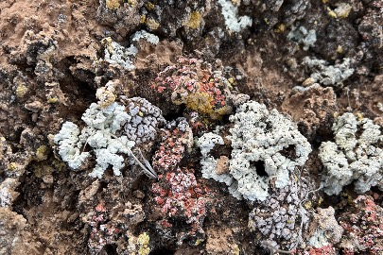
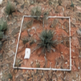
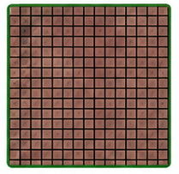
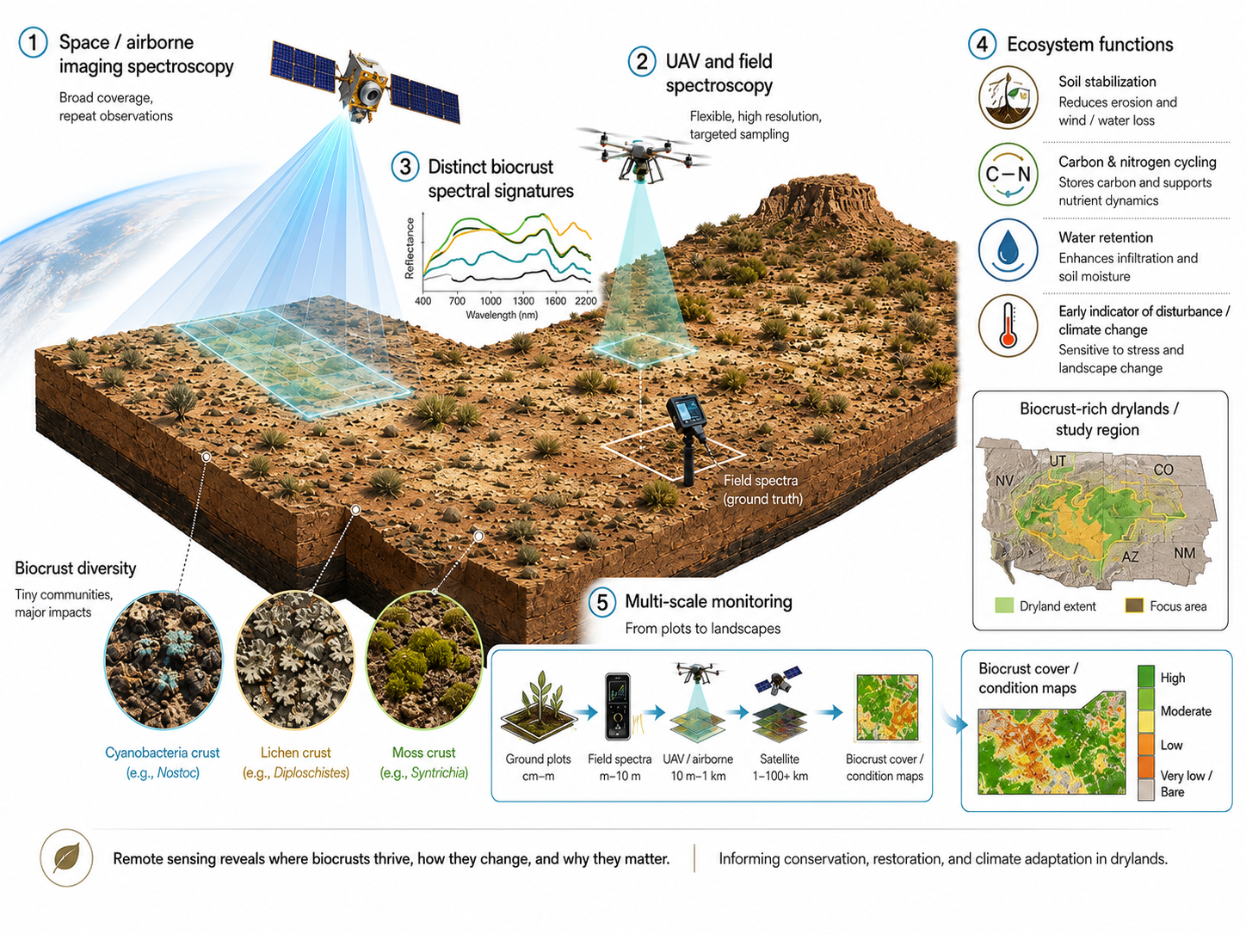
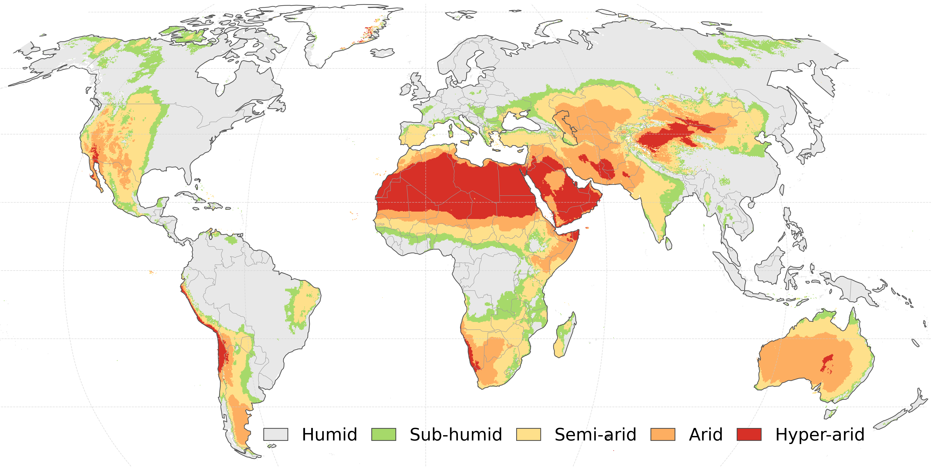



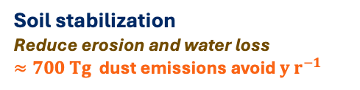
Biocrust types
Multi-platform Imaging spectroscopy
Biocrust spectral signals
1
3
4
Spaceborne
Airborne
Bryophyte (moss)
Lichen
UAS
5
Multi-scale monitoring
From plots to landscapes – Data fusion $∙$ Deep learning
Darkly pigmented cyanobacteria
Lightly pigmented cyanobacteria
Field reference measurements
Composition $∙$ Cover $∙$ Reflectance
2
Inform functional assessment
Plot
cm
1–10m
60m
6
Ecosystem functions
Hyperspectral remote sensing reveals where biocrusts thrive, how they change, and why they matter, informing conservation, restoration and climate adaptation in drylands.
Soil stabilization
Reduce erosion and water loss
$≈700 Tg$ dust emissions avoid ${y r}^{−1}$
Water retention
Modifies infiltration and soil moisture
Carbon & nitrogen cycling
Stores carbon and supports nutrient dynamics
$≈18\%$ of natural terrestrial biological nitrogen fixation
Early indicator of
disturbance / climate change
Sensitive to stress and landscape change

