Slide 1
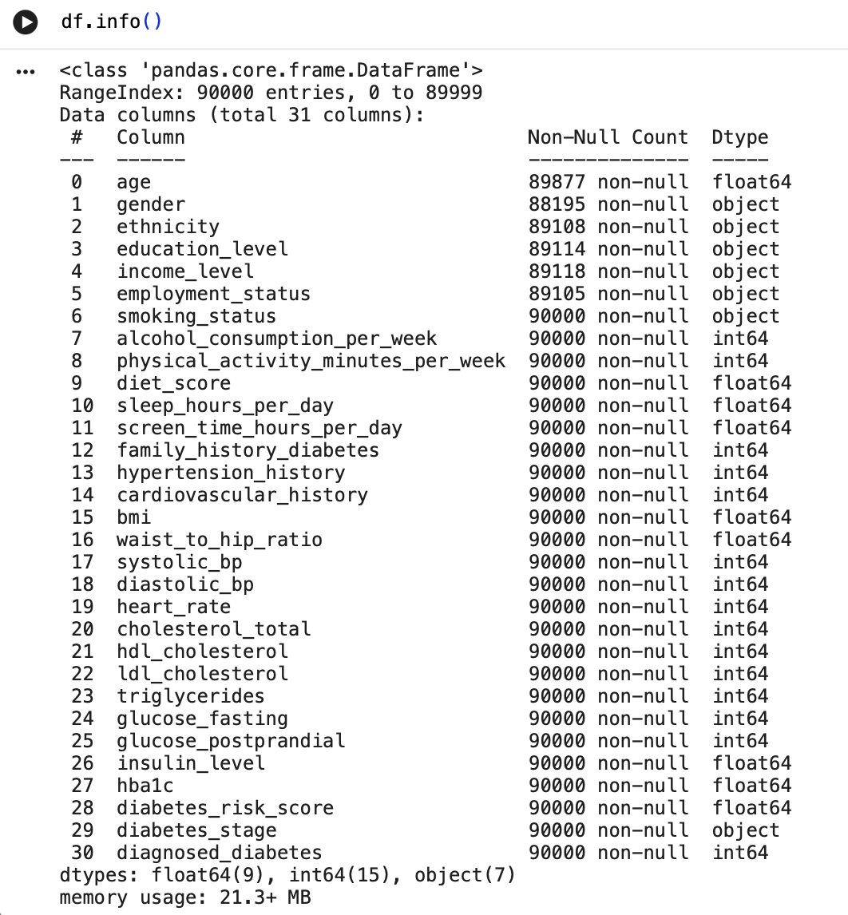
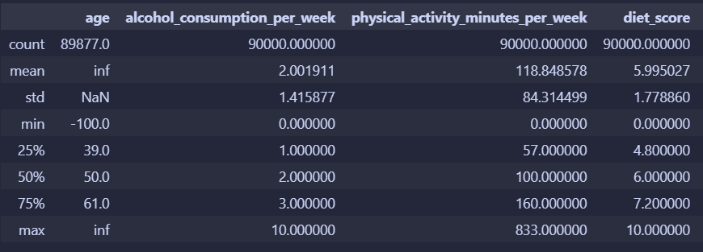
Dataset Overview

Slide 2
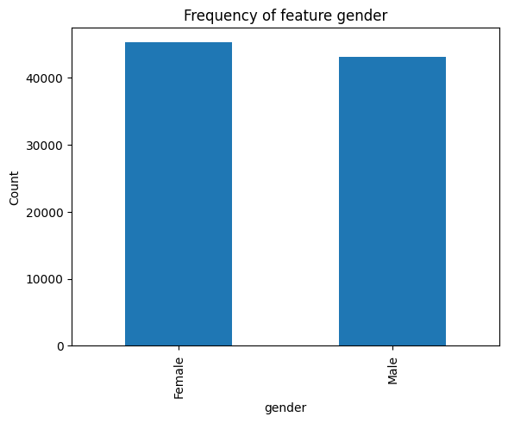
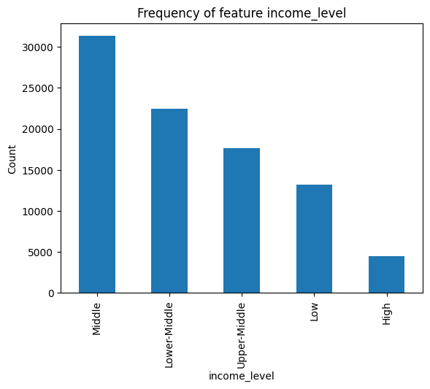
Data Visualization
No class imbalance
Class imbalance

Slide 3
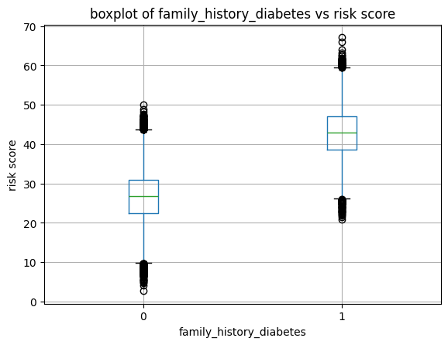
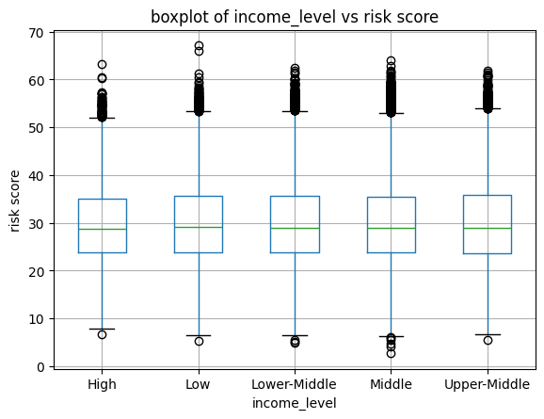
Data visualization/Correlation Analysis
Median and IQR differs across groups, important feature
Median and IQR is similar across groups, feature is not important (most categorical features are unimportant)

Slide 4
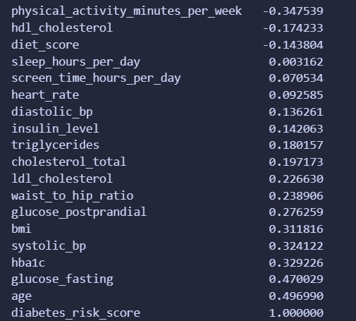
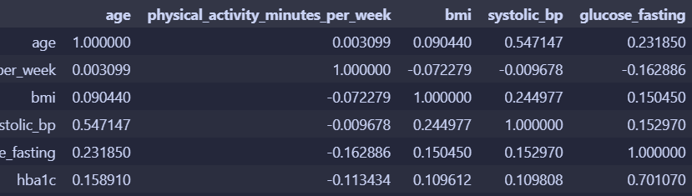
Correlation Analysis
Features with abs. correlation greater than 0.30:
Physical_activity, bmi, systolic_bp, hba1c, glucose_fasting, age
Features bp and age, as well as hba1c and glucose show multicollinearity, so we will drop the feature with the lowest correlation with the target (hb1c, bp)

Slide 5
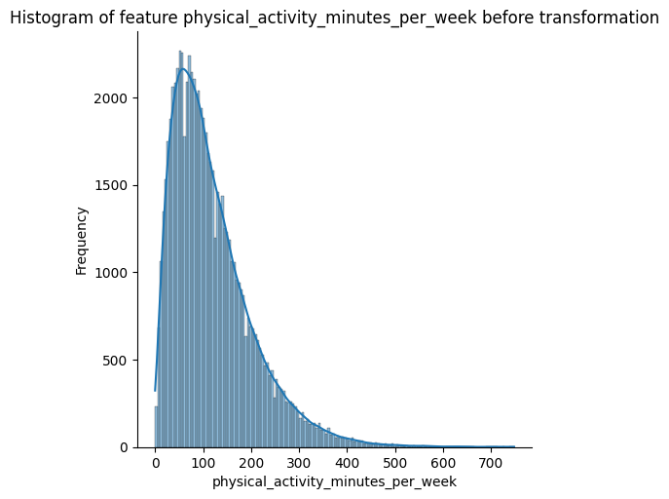
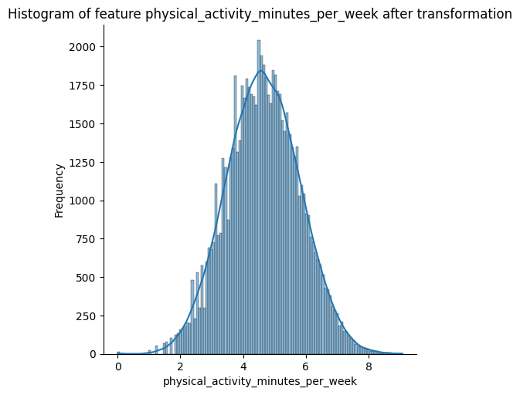
Data splitting and imputation
Data transformation
Data scaling
Split the data into 80% training, 10% validation and 10% testing
Impute any missing or outlier data using SimpleImputer
Use cube root transformation to change the distribution of physical_activity_minutes
Scaled the data using a StandardScaler since most of our data has a normal distribution

Slide 6
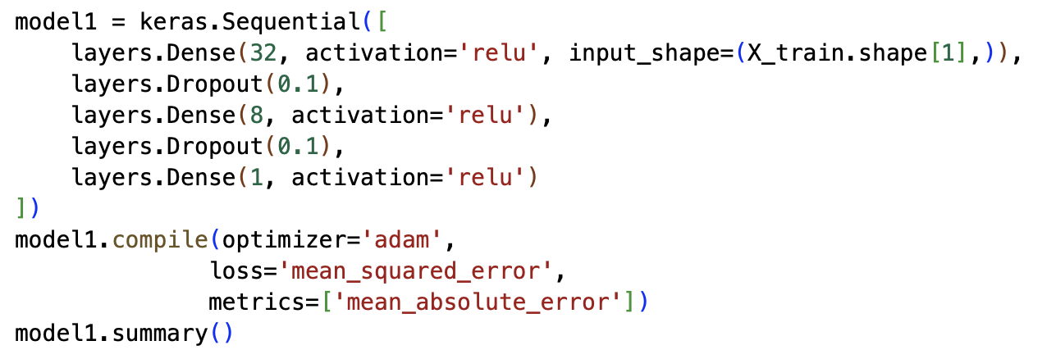
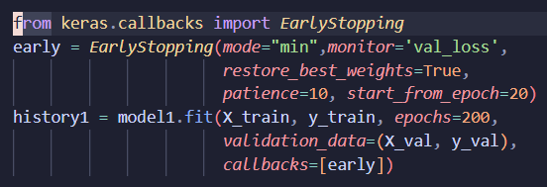
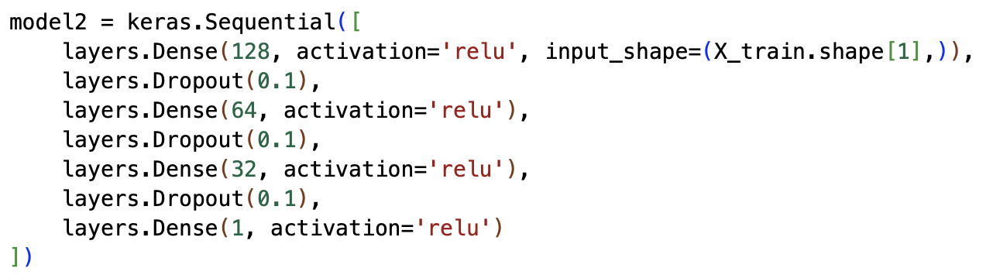

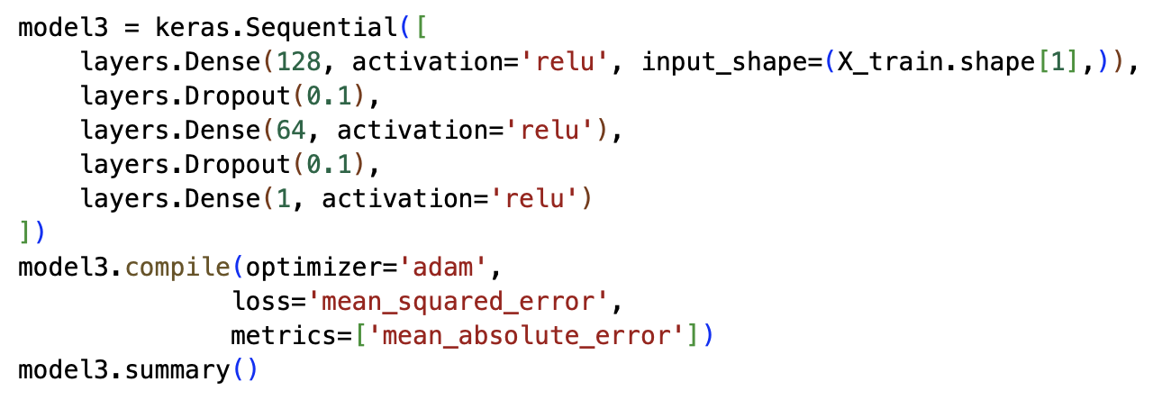
Model Selection

Slide 7
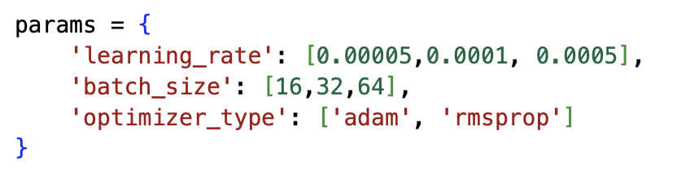
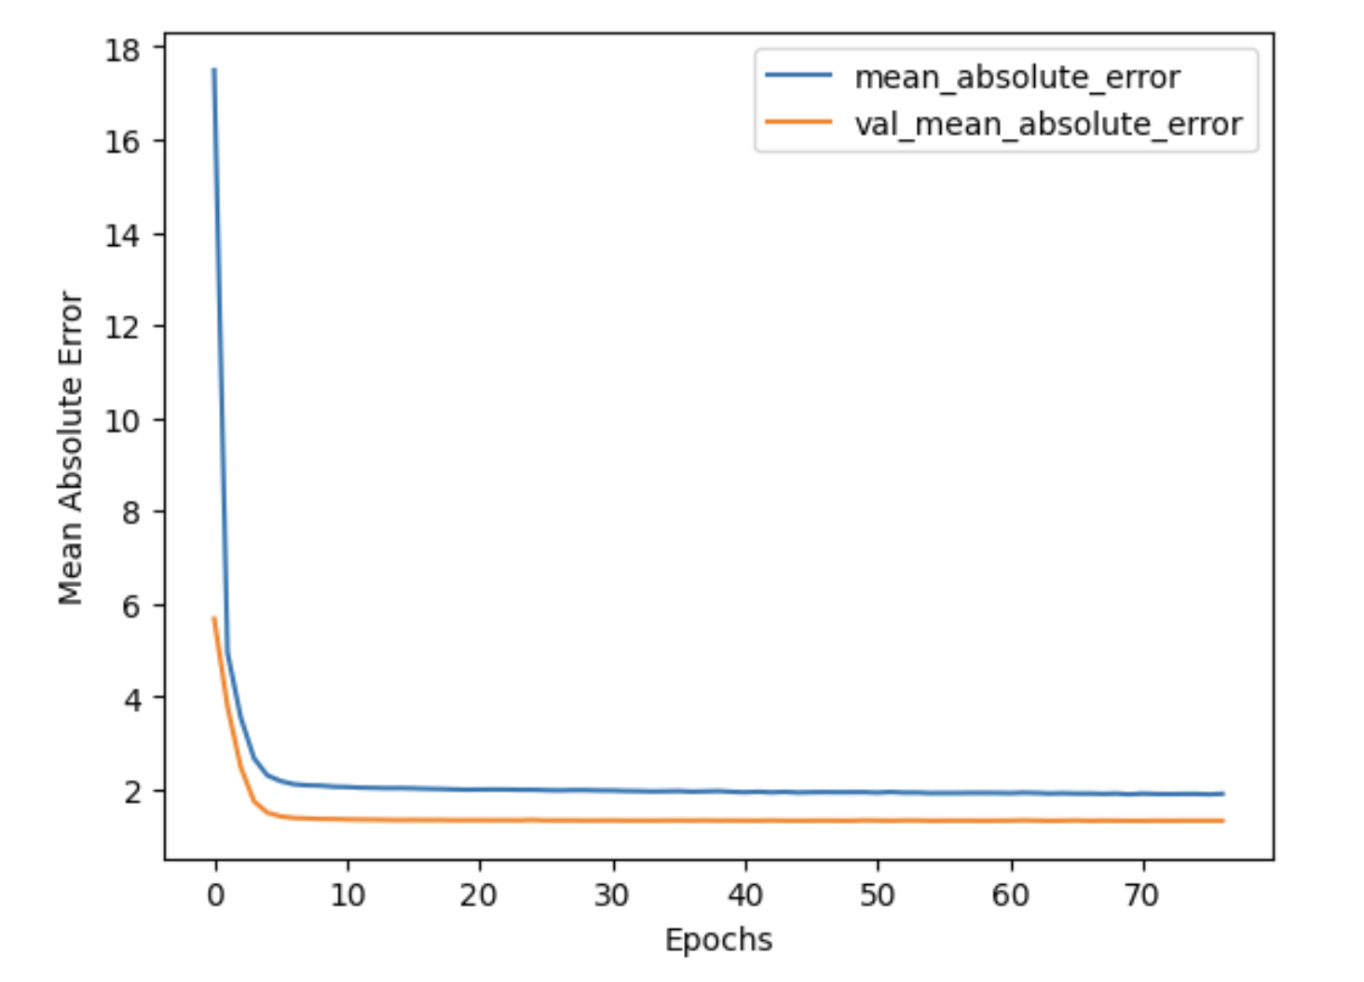

Hyperparameter Tuning and Final Test results
For each choice of hyperparameters, we fit the model and see which model gave the best results

