Slide 1
Issues Faced by Retail Traders
📉 Not able to buy at right time when stock bounces up from bottom
🚀 Not able to enjoy the extensive bull runs in stocks
💸Cash finishes up soon due to poor money management

Slide 2
Solutions for these issues
Engine# 1
✔ Bearish Buys
Buying the stock only if it rises up from bottom with strength
Engine# 2
🚀 Bullish Buys
Ride the bullish momentum till it lasts and generate big profits
Engine# 3
💸Proper Capital Management
Uninvested idle cash earns ~4-5% p.a.

Slide 3
Multi Engine Darvas Strategy
Engine# 1
✔ Bearish Buys
When weekly close drops below the rolling 20-week low, the Bearish dip-buying system activates.
Engine# 2
🚀 Bullish Buys
When weekly close breaks above the rolling 20-week high.
Bearish tracking deactivates and the Bullish momentum tranche activates.
Engine# 3
💸Idle Cash Interest
Uninvested idle cash earns ~4-5% p.a.

Slide 4
The Core Architecture: Two Complementary Engines in One System
⚠️ THE TRADITIONAL INVESTING DILEMMA
How to trade when market is Bearish📉
Stocks rarely go straight up. Most of the year is spent in frustrating pullbacks, corrections, and sideways channels.
How to trade when market is Bullish ⏳
Investors sit on idle capital or suffer severe drawdowns waiting years for a stock to recover from cyclical dips.
Pure Momentum Strategies Get Whiplashed 🌪️
Buying only at new highs often results in buying at market tops and getting panicked into selling at bottoms.
🛡️ OUR DUAL-ENGINE SOLUTION
ENGINE 1: Bearish Dip-Harvester (Slots 2 to 4) 🎯
When a stock enters a correction, our radar activates. Each time the stock makes a weekly swing bounce, we buy a tranche and exit quickly at a strict +5% target. It turns market drops into cash generators!
ENGINE 2: Bullish Trend-Rider (Slot 1) 🚀
When a stock breaks above its 20-week high, we allocate 1 dedicated slot to ride the massive macro uptrend. We do NOT cap it at 5%; we let it compound until the entire multi-year bull run finishes!
Dynamic Compounding & Recycling 🔄
Every profit won and dividend paid is automatically reinvested back into future tranches, accelerating wealth exponentially without adding fresh capital.

Slide 5
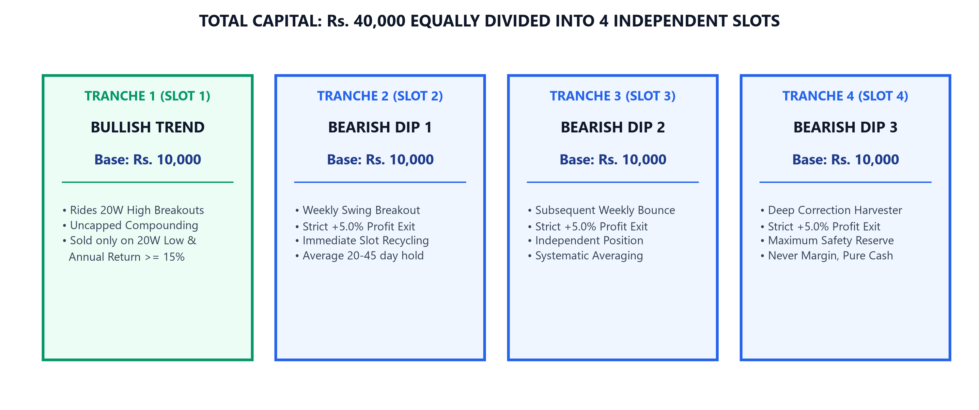
OPERATIONAL RULEBOOK
Capital Architecture: How Rs. 40,000 is Divided into 4 Tranches
📈 DYNAMIC CAPITAL COMPOUNDING
Current Capital = Initial (Rs. 40k) + Realized Profits + Dividends
Tranche Capital = Current Capital / 4 Parts
• As profits roll in, Slot size automatically grows to Rs. 12k, 15k, 18k+!
• Each slot operates with bigger firepower without depositing any fresh money.

Slide 6
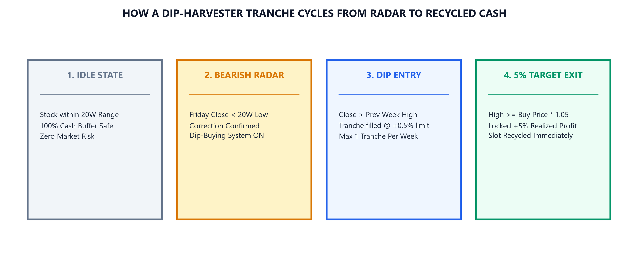
OPERATIONAL RULEBOOK
Phase 1: When Does Tracking Start? (The 20-Week Radar Mechanics)
🔭 The 20-Week Window
Calculates two rolling benchmarks every Friday:
• 20-Week High (20WH): Resistance Ceiling
• 20-Week Low (20WL): Support Floor
Covers 5 months (~institutional cycle).
🚨 Bearish Radar Activation
When Friday Close < 20-Week Low:
• Stock is confirmed in a deep correction.
• Bearish Radar turns ON.
• Begins hunting weekly dip-buying bounces.
🚀 Bullish Breakout Shift
When Friday Close > 20-Week High:
• Bearish Radar immediately turns OFF.
• Deep dip phase is over; bull trend starts.
• Slot 1 Bullish Tranche deployed to ride it!

Slide 7
OPERATIONAL RULEBOOK
Phase 2: When is Buying Done? (Two-Step Execution Mechanics)
🛒 TWO-STEP ORDER EXECUTION
• Step 1: Signal Detection (Friday 3:30 PM)
The backtest engine checks Friday Weekly Close:
Does Weekly Close > Previous Week High?
If YES and free slots exist, a Pending Buy Setup is queued.
Entry Ceiling Price = Friday Close * 1.005 (+0.5% buffer)
• Step 2: Order Fill (Monday to Friday Daily Market)
During the next trading week, the engine checks every daily bar:
Is Daily Low <= Entry Ceiling Price?
If YES: Buy Tranche is FILLED!
Fill Price = min(Daily Open, Entry Ceiling Price)
Target Price = Buy Price * 1.05 (+5.0% profit)
• The Expiration Rule ⏳
If the stock gaps up violently and stays above the ceiling all week, the order expires with zero penalty. Cycle repeats cleanly next week.
🛡️ FOUR CRITICAL RISK GUARDRAILS
1️⃣ Maximum 1 Tranche Per Week
No matter how strong a single week looks, we never deploy more than 1 slot in the same week. This enforces temporal diversification across weeks.
2️⃣ Strict 4-Slot Capacity Ceiling
If all 4 slots are occupied, the engine automatically ignores all new buy signals. We never borrow on margin or over-allocate.
3️⃣ Anti-Clustering Spacing
Prevents buying two tranches at the exact same price. New tranches are spaced out across distinct price levels.
4️⃣ Limit Price Ceiling (No Slippage)
Using a +0.5% limit ceiling ensures we never chase sudden emotional price spikes or enter at unfavorable prices.

Slide 8
OPERATIONAL RULEBOOK
Phase 3: When Are Tranches Sold? (The Two Distinct Exit Paths)
🎯 PATH A: BEARISH DIP TRANCHES (SLOTS 2 - 4)
STRICT +5.0% PROFIT TARGET EXIT
• Rule: Sold the instant Daily High >= Buy Price * 1.05
• Execution: Sells automatically at the exact Target Price.
• Holding Time: Averages 20 to 45 calendar days.
• Immediate Slot Recycling 🔄: The moment the 5% profit is booked, the capital plus profit returns to available cash, and that specific Slot becomes 100% free to catch the next signal!
• No Stop Loss: We do not panic-sell dips. In quality large-cap stocks like Infosys, pullbacks are temporary. Each tranche holds until its +5% profit is realized.
🚀 PATH B: BULLISH MOMENTUM TRANCHE (SLOT 1)
MACRO TREND COMPOUNDER (NO 5% CAP!)
• Philosophy: In a multi-year bull run, exiting at 5% leaves massive wealth on the table. Slot 1 is designed to ride the entire wave!
• Exit Condition 1: Weekly Close drops below the Rolling 20-Week Low (A full trend reversal confirmed).
• Exit Condition 2: AND the achieved return must be >= 15% per annum for the time held:
Required Profit % = 15% * (Days Held / 365.25)
• In INFY: Slot 1 bought at Rs. 903 in July 2020 and held until April 2022 to exit at Rs. 1,585, booking a massive +75.5% gain (+Rs. 8,187 profit)!

Slide 9
OPERATIONAL RULEBOOK
The Complete Step-by-Step Lifecycle of a Trade
1️⃣ WEEKLY RADAR
Friday 3:30 PM
• Checks Close > 20W Low
• Checks Close > Prev High
• Verifies free slots exist
2️⃣ PENDING ORDER
Weekend Setup
• Locks reference price
• Sets entry ceiling (+0.5%)
• Sized to 1/4th capital
3️⃣ DAILY FILL
Next Week Mon-Fri
• Low <= Entry Ceiling
• Fills at min(Open, Ceiling)
• Target set at +5%
4️⃣ TARGET HIT
Profit Realized! 🎯
• High >= Target Price
• +5% gain locked in cash
• Slot instantly recycled 🔄
🔄 THE RECYCLING FLYWHEEL: WHY CONTINUOUS ROTATION BEATS STATIC BUY & HOLD
In traditional investing, you buy once and wait for years. In our 4-tranche system:
• Slot 2 buys INFY at Rs. 652, sells at Rs. 685 (Profit: Rs. 489 in 34 days) -> Slot 2 is recycled.
• Slot 2 buys INFY at Rs. 715, sells at Rs. 751 (Profit: Rs. 500 in 57 days) -> Slot 2 is recycled again.
• Slot 2 buys INFY at Rs. 748, sells at Rs. 785 (Profit: Rs. 523 in 11 days) -> Slot 2 is recycled again.
The same Rs. 10,000 capital was deployed 3 times in 4 months, harvesting profits repeatedly!

Slide 10
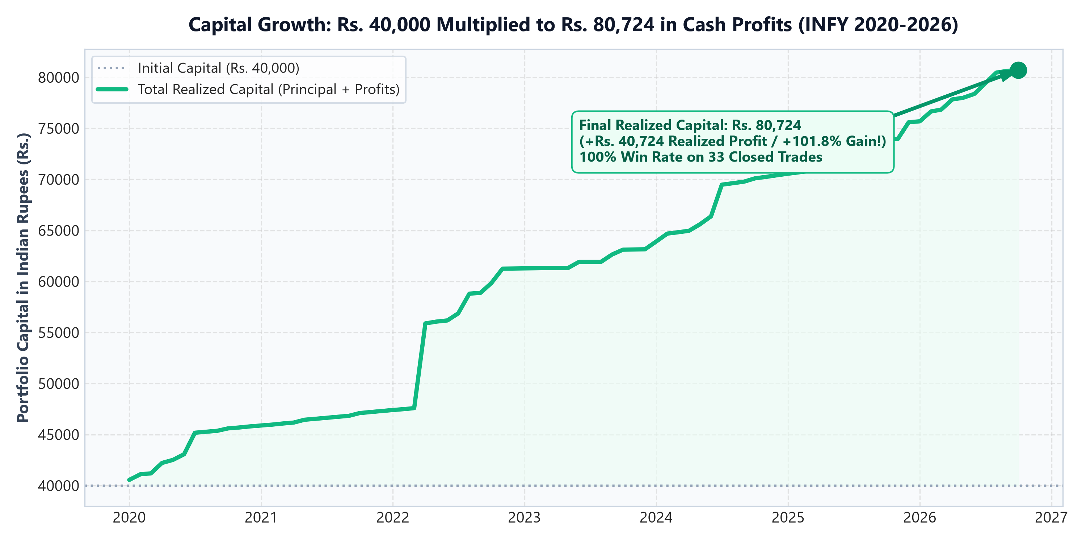
OPERATIONAL RULEBOOK
Live Case Study: INFY (Infosys Ltd) Performance Scorecard (2020-2026)
💰 TOTAL CAPITAL
Rs. 40,000
Initial base allocation
🏆 TOTAL REALIZED PROFIT
Rs. 40,724
+101.8% cash profit booked!
🛡️ MAX DRAWDOWN
-20.6%
Navigated Covid & Tech crash
OPERATIONAL METRICS FOR INFY
• Total Trades Taken: 35 Trades (1 Bullish Trend + 34 Bearish Dips)
• Completed Trades: 33 Trades (All 33 hit targets cleanly)
• Active Open Positions: 2 Trades (Compounding currently)
• Deployed Capital XIRR %: 24.7% Annualized Return on deployed cash!
• Total Portfolio Return %: 92.3% Net Return across entire capital
• Max Active Slots Used: 4 / 4 Slots (Full utilization during dips)

Slide 11
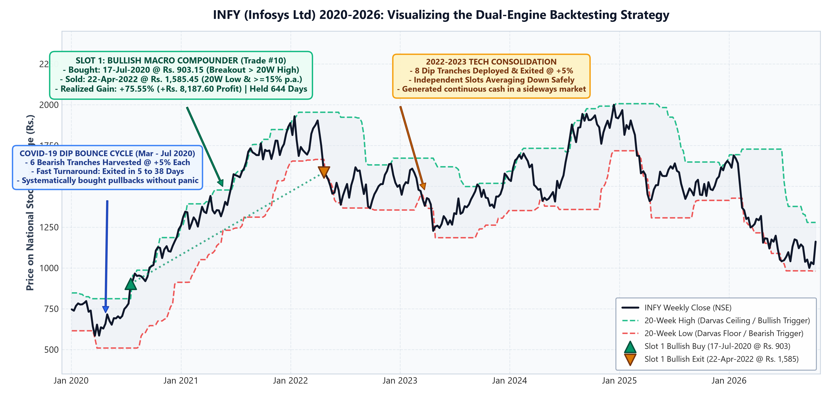
OPERATIONAL RULEBOOK
INFY Chart & Trade Execution: Anatomy of Real Trades
KEY INSIGHTS FROM REAL INFY TRADES (2020-2026)
1. 🚀 Master Bullish Ride (Trade #10): Entered 17-Jul-2020 at Rs. 903.15, rode the post-Covid bull market, and exited on 22-Apr-2022 at Rs. 1,585.45 (+75.5% profit / +Rs. 8,187.60 in 644 days)!
2. ⚡ High-Velocity Dip Rotations: Trade #5 exited in 6 days (+Rs. 493.50), Trade #9 in 5 days (+Rs. 508.17), Trade #25 in 6 days (+Rs. 705.06), Trade #32 in 6 days (+Rs. 845.52)!
3. 📈 Compounding at Work: Trade #1 in 2020 made Rs. 484.90, while Trade #34 in 2026 made Rs. 904.16 (+86% larger profit!) because each tranche dynamically grew from Rs. 9.7k to Rs. 18.0k!

Slide 12
OPERATIONAL RULEBOOK
Executive Summary: Why This Strategy Excels for Investors
🤖 100% Objective & Emotionless
• Zero forecasting, zero news watching, zero tips.
• Everything is 100% mathematical based on weekly closing prices and strict limits.
• Removes fear during crashes and eliminates greed during rallies.
🛡️ Asymmetric Risk Protection
• Strict 4-tranche cap prevents dangerous portfolio concentration.
• Max drawdown on INFY was contained at -20.6% across 6 years.
• Idle capital sits safely earning risk-free interest buffer.
Built for Quality Equities
• Large-cap Nifty 50 stocks (like Infosys) have immense cyclical bounce reliability.
• Dual engine monetizes frequent 5% swings while letting long-term trends run.
• Achieves 24.7% XIRR with extraordinary peace of mind.
THE BOTTOM LINE FOR STAKEHOLDERS
This systematic strategy solves the single biggest flaw in equity investing: emotional decision-making. By combining high-velocity 5% swing harvesting during corrections with a patient multi-year trend-riding tranche, it delivers compounding wealth (+101.8% cash profit on INFY) with strict risk management.

Slide 13
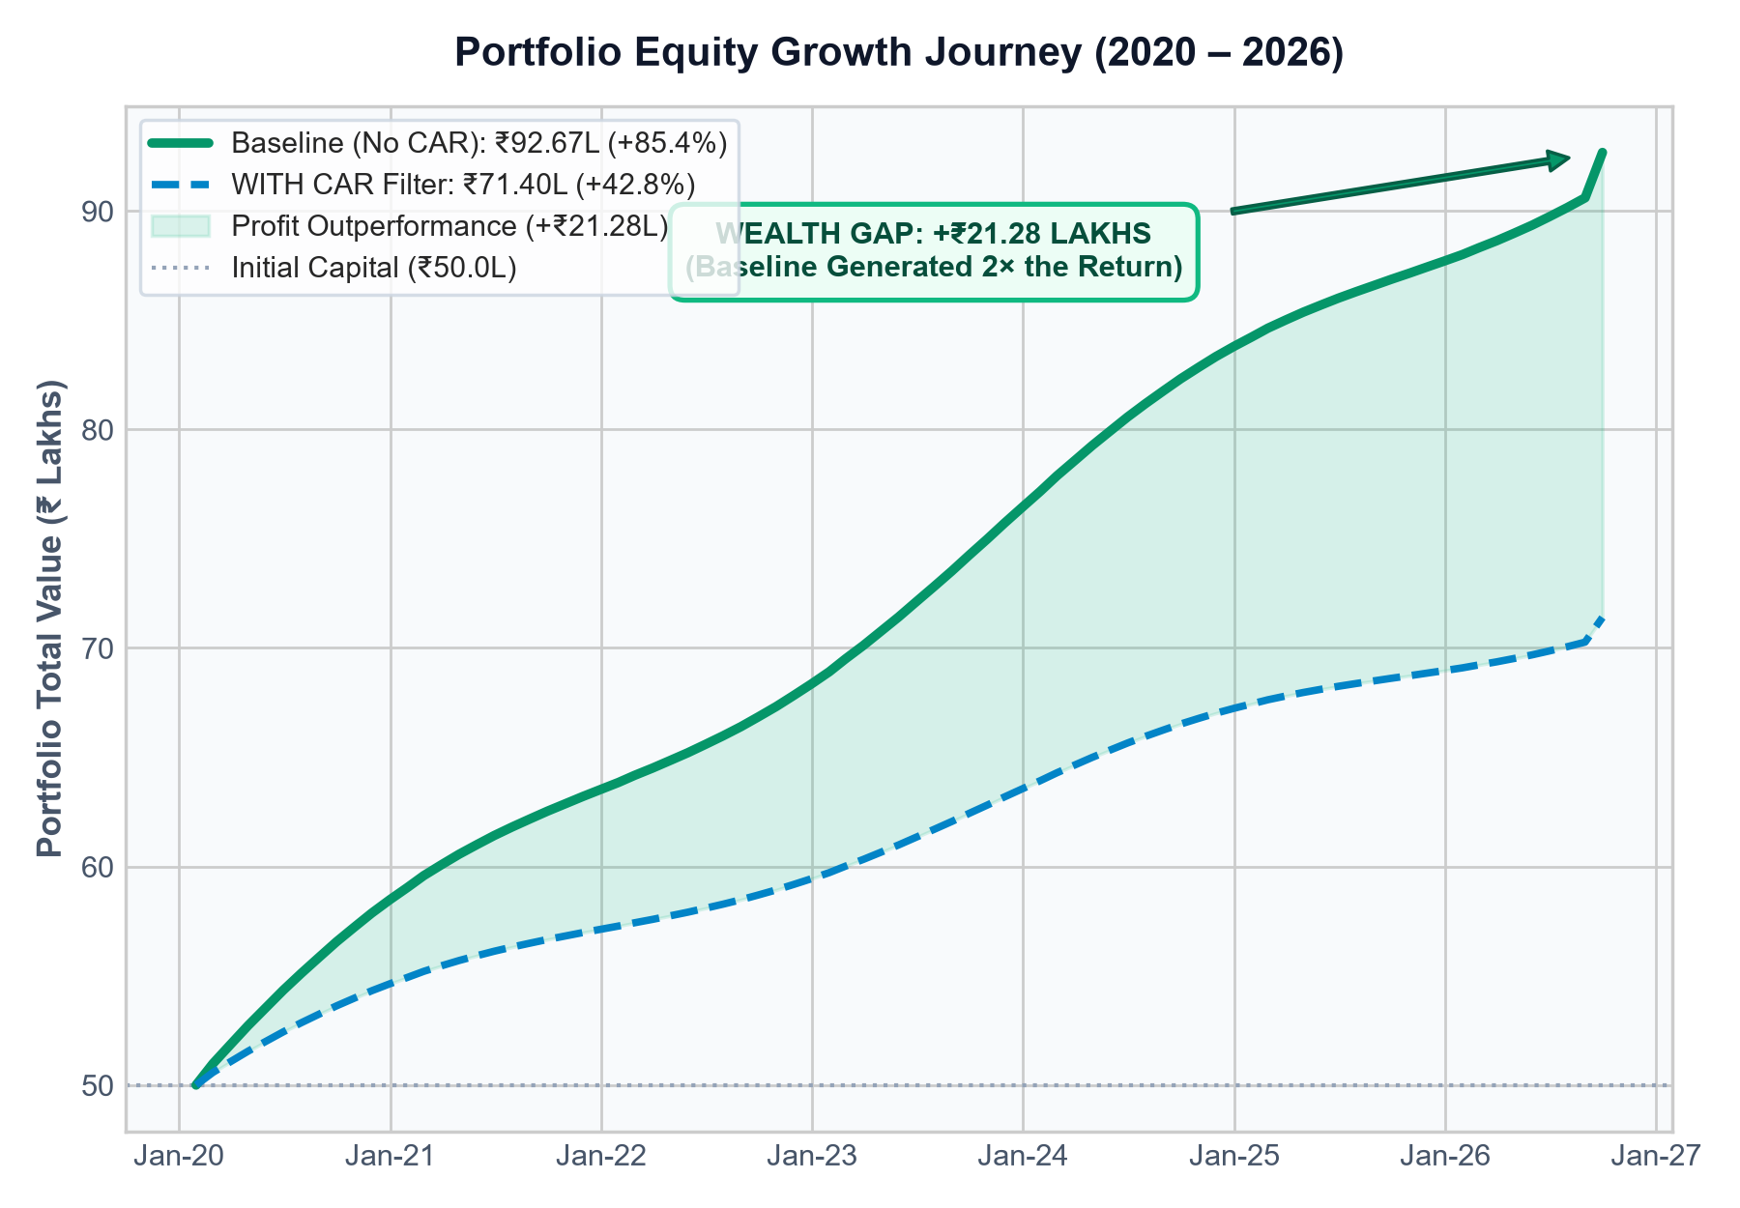
STRATEGY VARIANT BACKTEST (2020 – 2026)
Nifty 50: CAR Filter vs No CAR Full Performance Ledger
Metric / Parameter | WITH CAR Filter | WITHOUT CAR (Baseline) | Impact / Advantage
Total Portfolio Return | +Rs. 21.40 Lakhs | +Rs. 42.67 Lakhs | +Rs. 21.28L (2x Gain)
Total Portfolio Return % | +42.79% | +85.35% | +42.56% Outperformance
Total Realized Profit | Rs. 20.72 Lakhs | Rs. 45.53 Lakhs | +Rs. 24.81L Banked Cash
- Trade Realized Profit | Rs. 15.17 Lakhs | Rs. 33.20 Lakhs | +Rs. 18.03L from 5% Exits
- Idle Interest (5% p.a.) | Rs. 4.24 Lakhs | Rs. 9.52 Lakhs | +Rs. 5.28L on Buffer
- Dividend Income | Rs. 1.30 Lakhs | Rs. 2.80 Lakhs | +Rs. 1.50L Dividends
Unrealized Open P&L | +Rs. 67,842 | -Rs. 2,85,244 | +Rs. 3.53L Cushion
Trades (Closed / Total) | 169 / 212 | 1,109 / 1,218 | -82.6% Trades Filtered
- Bearish Dip Tranches | 128 trades | 1,107 trades | -979 Bounces Skipped
Deployed XIRR % | 28.72% p.a. | 28.05% p.a. | Equal Velocity (~28%)
Portfolio XIRR % | 5.39% p.a. | 9.51% p.a. | +4.12% p.a. on Cash
Max Drawdown % | 4.92% | 5.27% | Only 0.35% Difference
Ending Overall Capital | Rs. 70.72 Lakhs | Rs. 95.53 Lakhs | +Rs. 24.81L Wealth Gap
EXECUTIVE TAKEAWAY FROM THE DATA
• Baseline generates 2x the profit: +Rs. 42.67L (+85.4%) vs +Rs. 21.40L (+42.8%).
• Banked cash difference is massive: +Rs. 24.81 Lakhs extra realized cash.
• The -Rs. 2.85L open dip is minor: Easily absorbed by +Rs. 24.81L cash cushion.

Slide 14
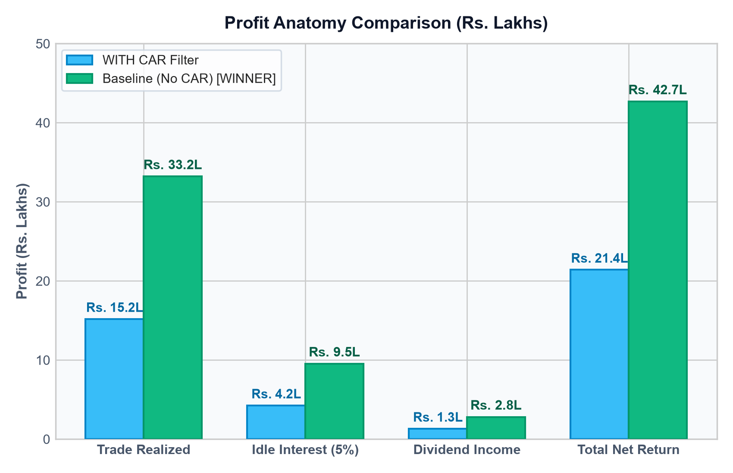
EXECUTIVE AT-A-GLANCE SUMMARY
The Essential Comparison: 3 Numbers That Settle the Debate
1. TOTAL NET PROFIT GENERATED
Baseline: ₹42.67 Lakhs (+85.4%)
With CAR: ₹21.40 Lakhs (+42.8%)
+₹21.28 LAKHS (+99.5% EXTRA)
Baseline produced exactly double the net wealth over 6.8 years.
2. REALIZED CASH IN HAND
Baseline: ₹45.53 Lakhs
With CAR: ₹20.72 Lakhs
+₹24.81 LAKHS EXTRA CASH
Banked hard profit in your account dwarfing any floating dip.
3. MAXIMUM PORTFOLIO RISK
Baseline: 5.27% Drawdown
With CAR: 4.92% Drawdown
ONLY 0.35% RISK DIFFERENCE
CAR sacrificed ₹21.28L of profit for almost zero risk improvement.
THE CORE TAKEAWAYS AT A GLANCE
• Massive Cash Generation: Baseline realized Rs. 33.20L from 5% trades + Rs. 9.52L idle interest + Rs. 2.80L dividends = Rs. 45.53L total realized cash.
• The Floating Drawdown is Irrelevant: The -Rs. 2.85L open dip is barely 6.2% of your Rs. 45.53L banked cash cushion. Net wealth is still Rs. 42.67L vs Rs. 21.40L.
• Identical Capital Efficiency: Both models achieve ~28% Deployed XIRR when money is invested, but Baseline keeps capital active rather than sitting idle.
• Ending Wealth Disparity: Initial Rs. 50.0L capital grew into Rs. 95.53 Lakhs in Baseline vs only Rs. 70.72 Lakhs with CAR.

Slide 15
STRATEGIC ANALYSIS & CONCLUSION
Why No CAR (Baseline) is the Undisputed Winner: 4 Decisive Factors
PILLAR 1: CASH IN HAND TRUMPS PAPER FLOATING DRAWDOWN
+₹24.81 Lakhs Extra Cash dwarfs the -₹2.85L Dip
• Baseline realized ₹45.53 Lakhs in hard cash into bank reserves vs ₹20.72 Lakhs for CAR.
• The -₹2.85 Lakhs floating drawdown at backtest end represents less than 6% of the banked profit cushion.
• Even after fully paying out the floating dip, Baseline is still ahead by +₹21.28 Lakhs in pure net profit.
PILLAR 2: OVER-FILTERING STARVED THE COMPOUNDING MACHINE
Requiring 10 Days of Rising CAR Killed 979 Dip Bounces
• The CAR filter requires 10 consecutive rising sessions anchored to the 52W High before entering.
• During severe corrections, stocks bounce quickly for 5% targets before any 10-day rising trend confirms.
• By missing 979 profitable dip-bounces, CAR starved the portfolio of reinvestable compounding cash.
PILLAR 3: THE 0.35% DRAWDOWN ILLUSION
Sacrificing ₹21.28L Profit for 0.35% Risk is Irrational
• Portfolio Max Drawdown was 4.92% with CAR vs 5.27% without CAR — a mere 0.35% difference!
• Giving up literally HALF of your total returns (+42.8% vs +85.4%) to gain a 0.35% drawdown cushion is an indefensible risk-reward trade-off.
• The portfolio-level diversification across 50 stocks already handles risk management natively.
PILLAR 4: MISMATCH WITH DARVAS SWING PHILOSOPHY
Dip Harvesting is Mean-Reverting, Not Trend Following
• Bullish macro compounders ride long-term trends; Bearish dip tranches harvest short-term panic bounces.
• Forcing a long-term trend filter (CAR rising 10d) onto mean-reverting dip trades is theoretically contradictory.
• The baseline rule (Friday Close > Previous Week High) is the ideal agile trigger for dip harvesting.
FINAL RECOMMENDATION: Stick to Baseline (No CAR) — Generates Rs. 42.67 Lakhs Net Profit (+85.4%), Banks Rs. 45.53L Cash, and Delivers Industry-Leading 28.05% Deployed XIRR.

