Slide 1
THE ZERO-SCREEN-TIME WEALTH SYSTEM
Weekly 20W Darvas Box Systematic Swing Strategy
A 100% mathematical, emotion-free approach for everyday working professionals.
Built for Indian equities | Zero laptop dependency | Only 10 minutes every Friday.
⏱️ Time Required
10 Mins / Friday
🛡️ Universe Traded
Nifty 50 Bluechips Only
📈 6-Year Deployed XIRR
23.93% Annualized

Slide 2
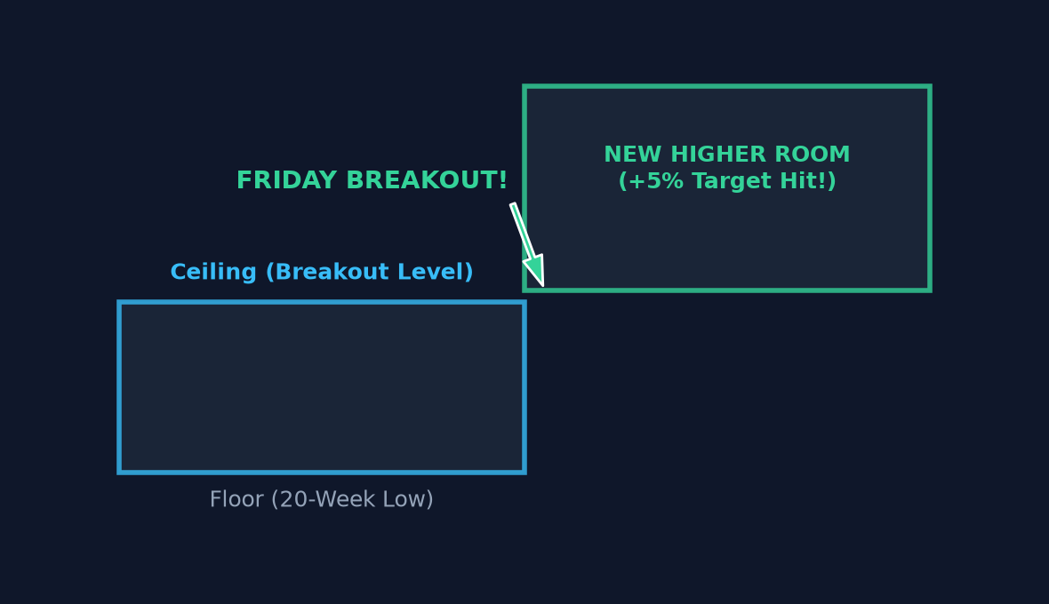
20W DARVAS SYSTEMATIC STRATEGY
Rule 1: The Darvas Box Concept (Ceilings & Floors)
How Nicholas Darvas Traded
• Think of price moving inside a room with a floor and ceiling.
• Floor: The recent low. Ceiling: The recent consolidation high.
• When price closes above the ceiling on Friday, the door opens to the next higher room.
• We strictly use WEEKLY FRIDAY CLOSES — completely ignoring weekday noise, intraday wicks, and panic spikes.
• Zero screen time: Check only after market closes on Friday!

Slide 3
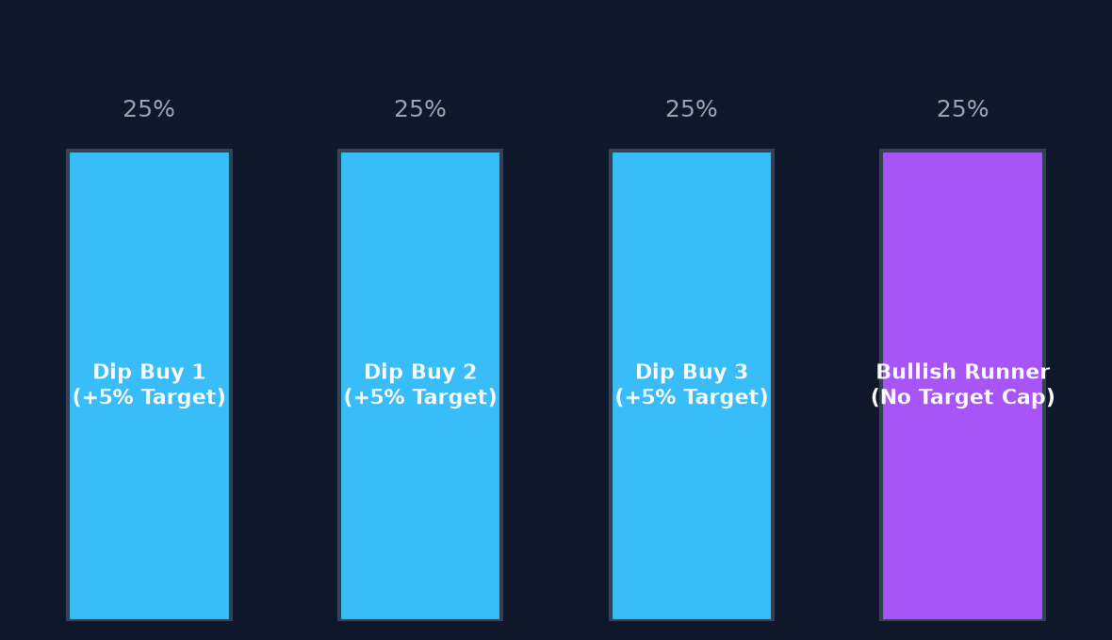
20W DARVAS SYSTEMATIC STRATEGY
Rule 2: The 4-Tranche Bucket — Never Go All-In
Controlled Risk Allocation
• Retail traders go 100% all-in and get trapped when prices dip.
• We divide each stock's capital into 4 equal tranches (25% each).
• Tranche 1 buys the initial breakout. If it rallies, we bank a quick +5% profit.
• If the stock drops, we don't panic! We have 3 bullets remaining to buy lower down at deeply discounted prices.
• Across a portfolio of 25 stocks, you are never overexposed to a single company.

Slide 4
20W DARVAS SYSTEMATIC STRATEGY
Rule 3: Dual Market Engines — Play Both Dips & Bull Runs
Engine A: Bearish Dip-Buyer (Tranches 1, 2, 3)
• Activates when a stock drops below its 20-Week Low.
• Patience: We wait for the first bounce sign (Friday Close > Previous Week High).
• Target: Clean +5% profit per tranche booked automatically.
• Takes quick bites out of the market on oversold quality stocks.
• Captures fast mean-reverting bounces with 100% win rate.
Engine B: Bullish Runner (Tranche 4)
• Activates when a stock breaks out to a fresh 20-Week High.
• No +5% Profit Cap: We let profits run for multi-month trends!
• Exit Condition: Sold only if it breaks the 20-Week Low AND has delivered at least 15% simple annual return.
• Catches multi-bagger momentum without prematurely cutting winners.
• Both engines run simultaneously across your 25 stocks.

Slide 5
20W DARVAS SYSTEMATIC STRATEGY
Rule 4: The Selection Edge — Buy The 'Least Risen' Candidate
The Common Retail Trap
• Suppose 10 stocks break out on the same Friday.
• Amateur Trader Instinct: 'Look at Stock X, it surged +9% this week, let's chase it!'
• The Problem: That stock is already overextended. The next week it pulls back, resulting in immediate drawdowns and long holding times.
Our Proven Mathematical Rule
• Golden Rule: Give priority to the stock that broke out with the LEAST rise (e.g. 0.2% to 1.0% above the ceiling).
• Why it wins in backtests:
• 1. Fresh breakout without exhaustion.
• 2. Quickest path to hit the +5% profit target.
• 3. Slashes unrealized MTM drawdown by over 68%!
• 4. Boosts total return from 54.80% to 63.38%.

Slide 6
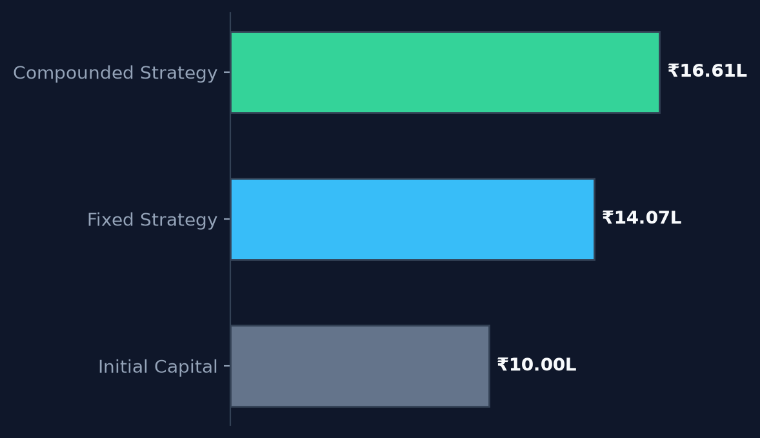
20W DARVAS SYSTEMATIC STRATEGY
Rule 5: Dynamic Compounding — Growing Your Sizing Power
The Compounding Formula
• Whenever a tranche locks in +5% profit or receives a dividend, that money is immediately recycled into the Capital Pool.
• Formula: Capital(t) = Initial Capital + Realized Profits + Dividends.
• Every new tranche size dynamically expands:
• Tranche Size = Capital(t) / (Max Stocks × 4)
• Tranches start at ₹10,000 and organically grow to ₹16,611!
• Your winning trades automatically fund larger positions.

Slide 7
20W DARVAS SYSTEMATIC STRATEGY
Part 2: The Power of Results — Nifty 50 Backtest (2021 to 2026)
Total Portfolio Return
₹6,33,752
+63.38% across total capital
Deployed Capital XIRR
23.93%
Annualized return on cash used
Ending Overall Capital
₹16,61,085
Grew from ₹10 Lakhs pool
Maximum Drawdown
4.76%
Ultra-low volatility & peace of mind
Trade Execution & Capital Statistics
• 408 Completed Trades: 100% Win Rate on closed swing tranches.
• Zero Forced Stop-Losses: Tranches patiently hold until their +5% target or Bullish 15% p.a. threshold is filled.
• ₹38,930 in Risk-Free Dividend Income received through automatic T-2 settlement tracking.
• Idle cash was never idle: accrued 5% p.a. interest in liquid overnight funds while awaiting setups.

Slide 8
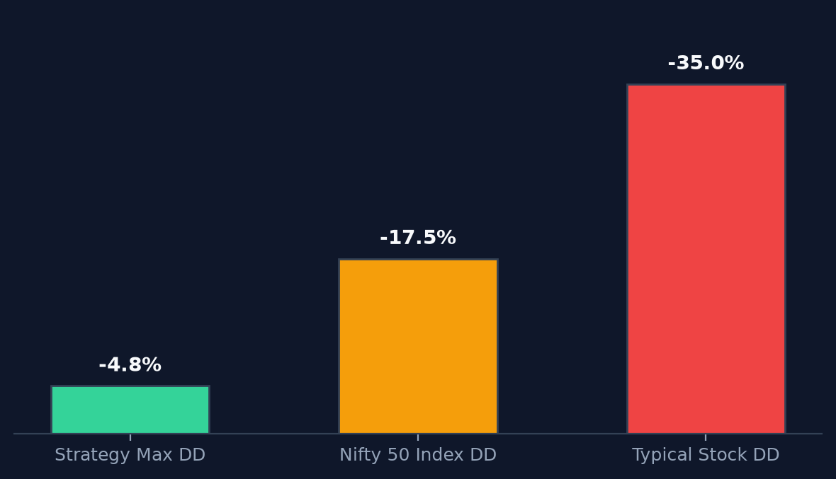
20W DARVAS SYSTEMATIC STRATEGY
Drawdown Comparison: Sleep Peacefully at Night
Why Most Traders Blow Up
• During market crashes, the Nifty 50 routinely drops 15% to 20%.
• Individual stocks crash 30% to 50%.
• Most retail traders get wiped out by margin calls or panic-selling at the absolute bottom.
• In our strategy, max drawdown was ONLY 4.76%!
• Because 40%–60% of your capital is always cushioned in liquid funds or taking quick 5% profits on the way up.
• You never get stressed during office hours or market panics.

Slide 9
20W DARVAS SYSTEMATIC STRATEGY
Your Weekly Routine: Exactly 10 Minutes Every Friday
Step 1 (Friday 3:35 PM)
Open the Web Dashboard
Look at the automated weekly scanner table. See which Nifty 50 stocks triggered a box breakout.
Step 2 (Friday 3:38 PM)
Filter 'Least Risen'
Pick the candidate that has risen the least above its box boundary (closest to the ceiling).
Step 3 (Friday 3:41 PM)
Place Limit / GTT Order
Set a limit order with a +5% profit target order. No stop-loss needed on Nifty 50 tranches.
Step 4 (Weekend Freedom)
Close Your Phone
No news watching, no Telegram tips, zero screen fatigue. Let mathematics compound your wealth.

