Slide 1
Geometric approaches to Nielsen equivalence
David Sheard
UCL/KCL Junior Geometry Seminar
4th February 2021

Slide 2
Outline
Group generators and free groups
Nielsen equivalence
Groups as complexes
Stallings’ folds
Grushko’s Theorem
Applications of Nielsen equivalence

Slide 3
Some combinatorial group theory
Don’t worry…it will be over soon

Slide 4
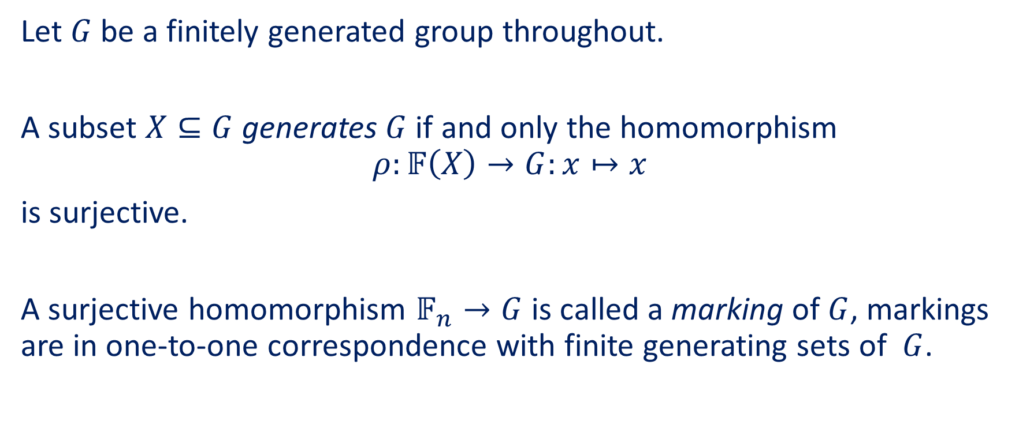
Group generators and free groups
Let $G$ be a finitely generated group throughout.
A subset $X⊆G$ generates $G$ if and only the homomorphism
$$ρ:𝔽\left(X\right)→G:x↦x$$
is surjective.
A surjective homomorphism $𝔽_{n}→G$ is called a marking of $G$, markings are in one-to-one correspondence with finite generating sets of $G$.

Slide 5
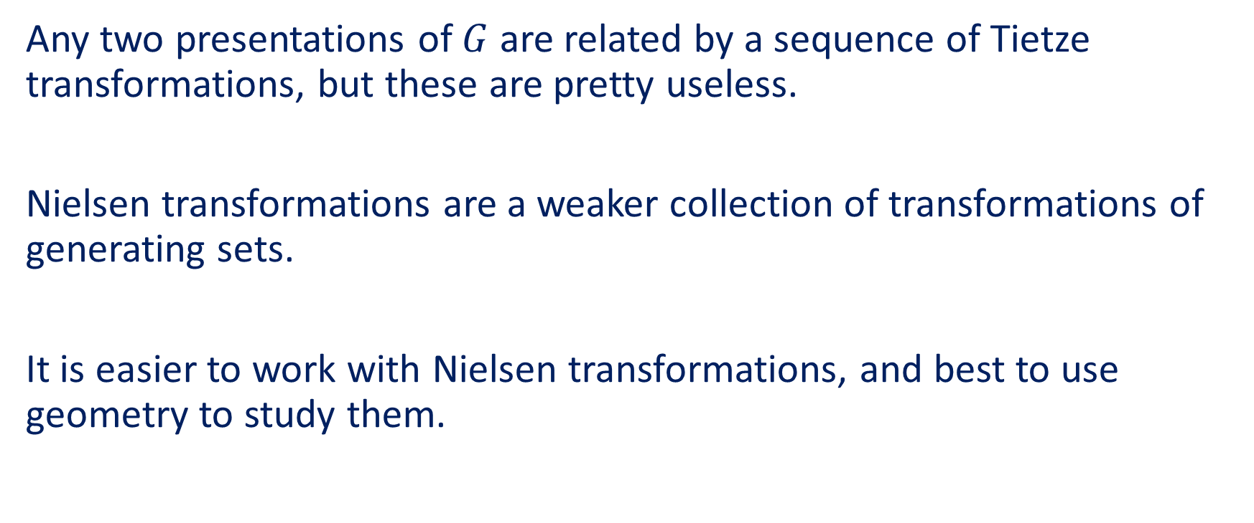
Nielsen transformations
Any two presentations of $G$ are related by a sequence of Tietze transformations, but these are pretty useless.
Nielsen transformations are a weaker collection of transformations of generating sets.
It is easier to work with Nielsen transformations, and best to use geometry to study them.

Slide 6
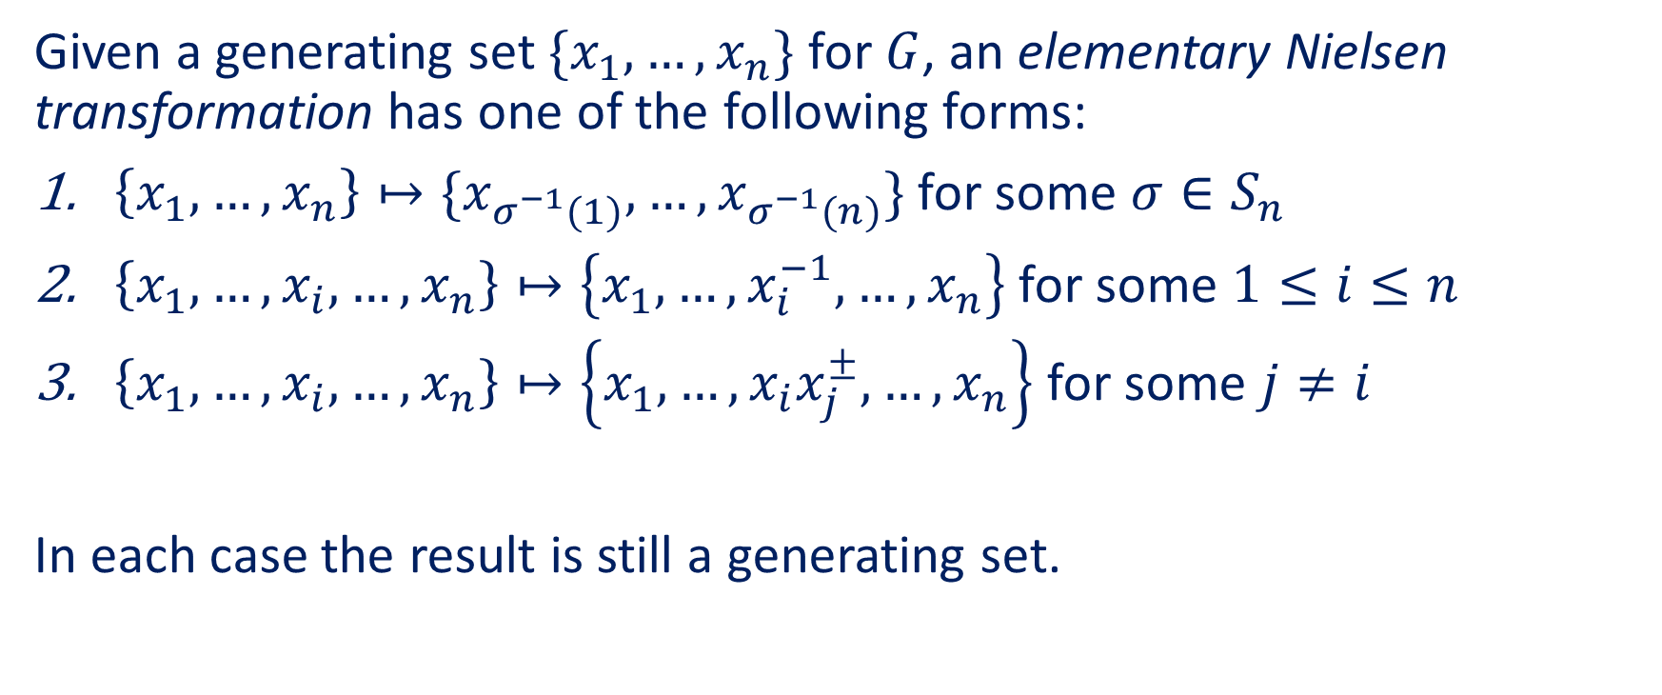
Nielsen transformations
Given a generating set $\{x_{1},…,x_{n}\}$ for $G$, an elementary Nielsen transformation has one of the following forms:
$\left\{x_{1},…,x_{n}\right\}↦\{x_{σ^{−1}(1)},…,x_{σ^{−1}(n)}\}$ for some $σ∈S_{n}$
$\left\{x_{1},…,x_{i},…,x_{n}\right\}↦\left\{x_{1},…,x_{i}^{−1},…,x_{n}\right\}$ for some $1≤i≤n$
$\left\{x_{1},…,x_{i},…,x_{n}\right\}↦\left\{x_{1},…,x_{i}x_{j}^{±},…,x_{n}\right\}$ for some $j≠i$
In each case the result is still a generating set.

Slide 7
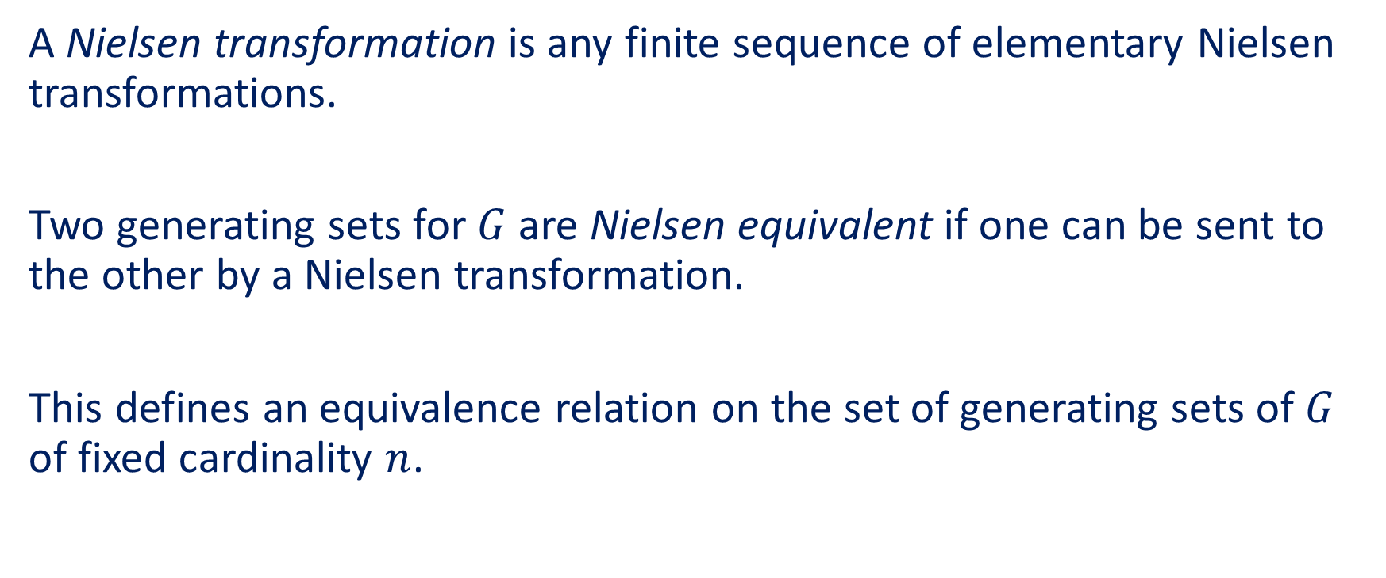
Nielsen equivalence
A Nielsen transformation is any finite sequence of elementary Nielsen transformations.
Two generating sets for $G$ are Nielsen equivalent if one can be sent to the other by a Nielsen transformation.
This defines an equivalence relation on the set of generating sets of $G$ of fixed cardinality $n$.

Slide 8
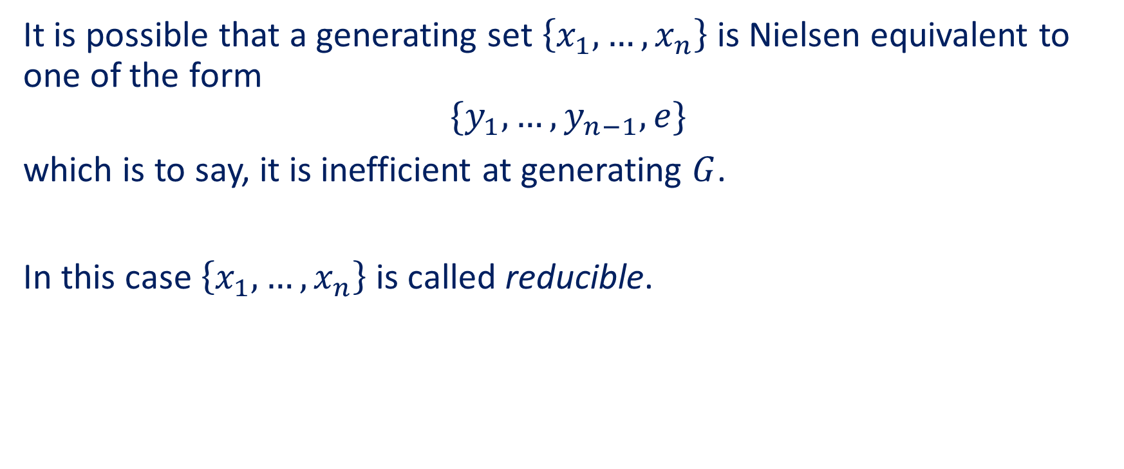
Reducibility
It is possible that a generating set $\left\{x_{1},…,x_{n}\right\}$ is Nielsen equivalent to one of the form
$$\{y_{1},…,y_{n−1},e\}$$
which is to say, it is inefficient at generating $G$.
In this case $\left\{x_{1},…,x_{n}\right\}$ is called reducible.

Slide 9
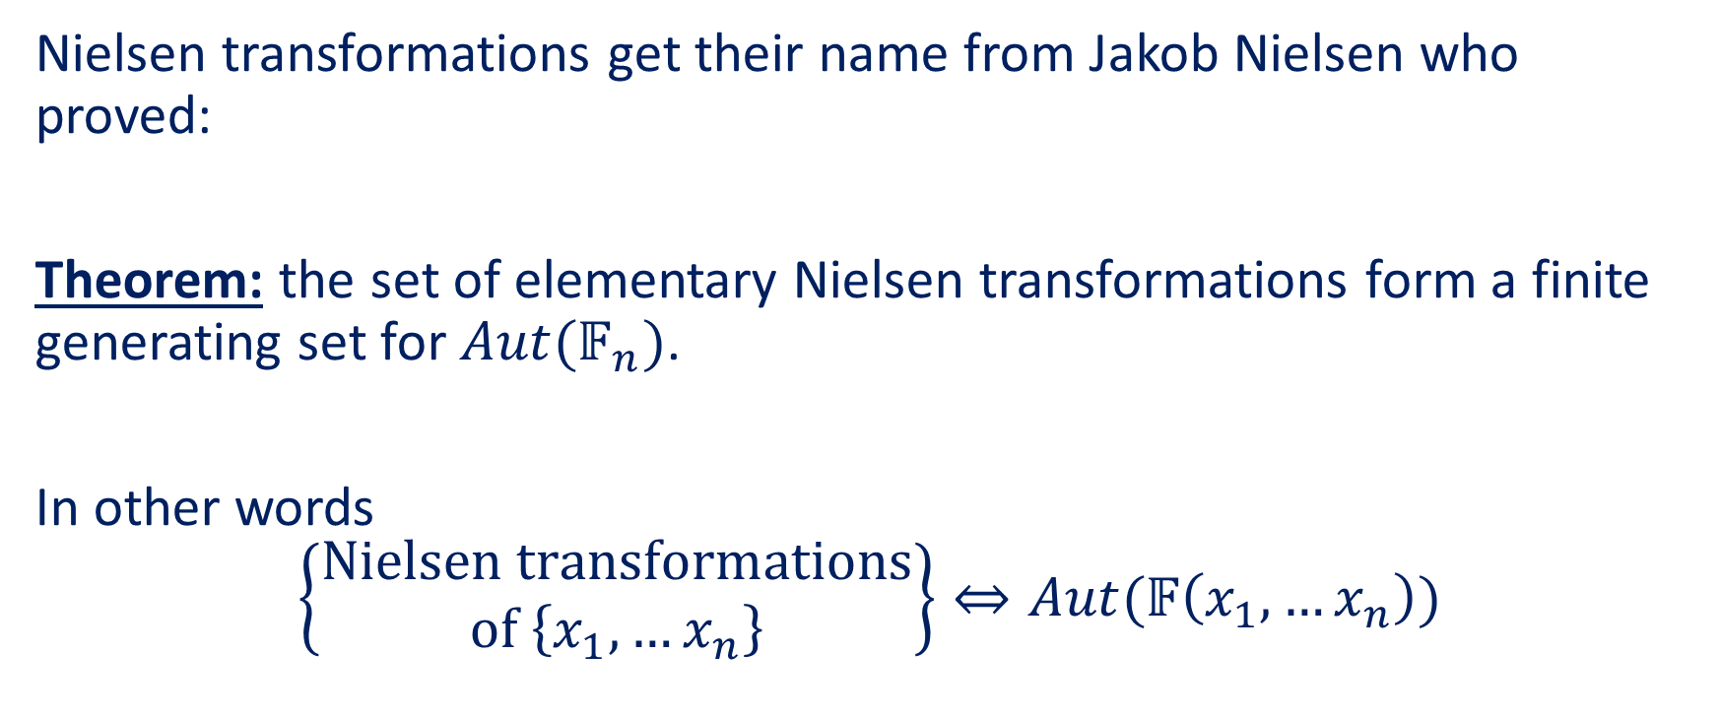
Nielsen’s Theorem
Nielsen transformations get their name from Jakob Nielsen who proved:
Theorem: the set of elementary Nielsen transformations form a finite generating set for $Aut(𝔽_{n})$.
In other words
$$\left\{\begin{matrix}\text{Nielsen} \text{transformations} \\ \text{of} \left\{x_{1},…x_{n}\right\}\end{matrix}\right\}⇔Aut(𝔽\left(x_{1},…x_{n}\right))$$

Slide 10











Equivalence of markings
We can use Nielsen’s Theorem to reinterpret Nielsen transformations in the language of markings:
$$𝔽_{n}$$
automorphism
$$𝔽_{n}$$
$$⊂$$
$$⊂$$
$$\left\{x_{1},…,x_{n}\right\}$$
$$\left\{y_{1},…,y_{n}\right\}$$
Nielsen transformation
Nielsen transformation
$$\left\{x_{1},…,x_{n}\right\}$$
$$\left\{y_{1},…,y_{n}\right\}$$
$$⊂$$
$$⊂$$
$$G$$

Slide 11


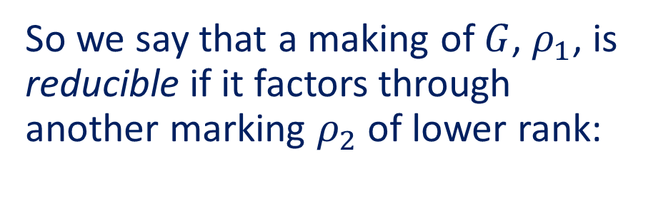


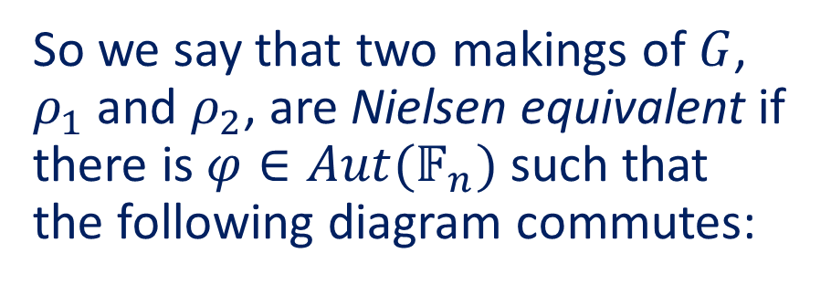









Equivalence of markings
So we say that two makings of $G$, $ρ_{1}$ and $ρ_{2}$, are Nielsen equivalent if there is $φ∈Aut(𝔽_{n})$ such that the following diagram commutes:
So we say that a making of $G$, $ρ_{1}$, is reducible if it factors through another marking $ρ_{2}$ of lower rank:
$$φ$$
$$𝔽_{n}$$
$$𝔽_{n}$$
$$𝔽_{n}$$
$$𝔽_{m} m<n$$
bijection
surjection
$$ρ_{1}$$
$$↻$$
$$ρ_{2}$$
$$ρ_{1}$$
$$↻$$
$$ρ_{2}$$
$$G$$
$$G$$

Slide 12
A few examples

Slide 13
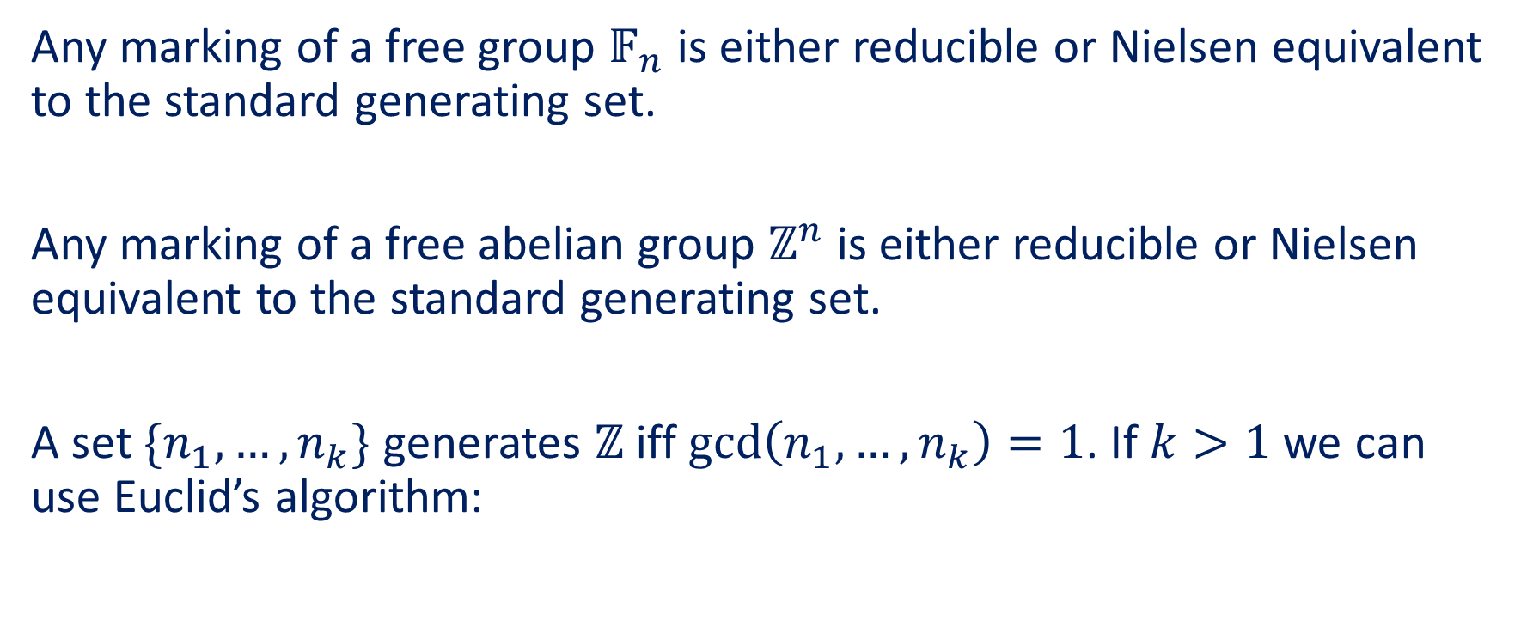
Examples
Any marking of a free group $𝔽_{n}$ is either reducible or Nielsen equivalent to the standard generating set.
Any marking of a free abelian group $ℤ^{n}$ is either reducible or Nielsen equivalent to the standard generating set.
A set $\{n_{1},…,n_{k}\}$ generates $ℤ$ iff $\gcd\left(n_{1},…,n_{k}\right)=1$. If $k>1$ we can use Euclid’s algorithm:

Slide 14
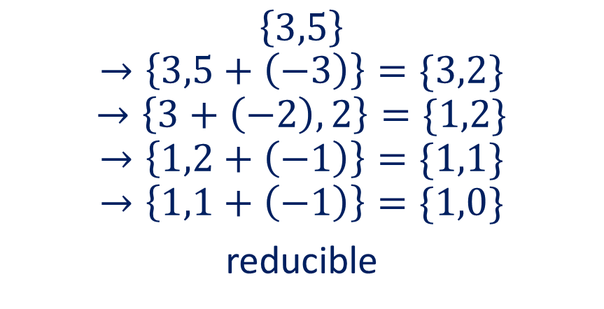
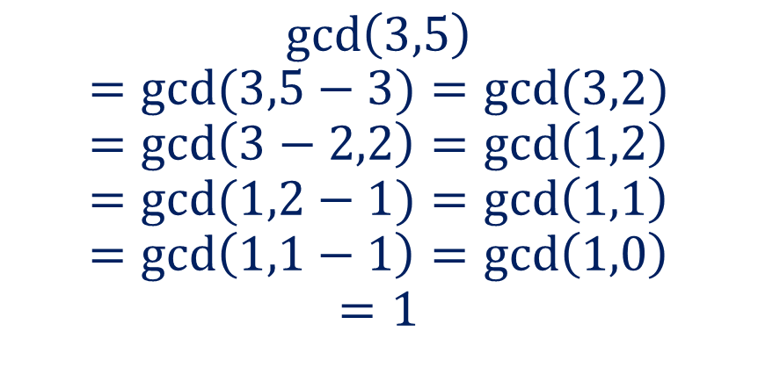
Euclid's algorithm
$$\gcd\left(3,5\right)$$
$$=gcd⁡(3,5−3)=gcd⁡(3,2)$$
$$=\gcd\left(3−2,2\right)=\gcd\left(1,2\right)$$
$$=gcd⁡(1,2−1)=\gcd\left(1,1\right)$$
$$=\gcd\left(1,1−1\right)=\gcd\left(1,0\right)$$
$$=1$$
$$\left\{3,5\right\}$$
$$→\left\{3,5+\left(−3\right)\right\}=\{3,2\}$$
$$→\left\{3+\left(−2\right),2\right\}=\{1,2\}$$
$$→\left\{1,2+\left(−1\right)\right\}=\{1,1\}$$
$$→\left\{1,1+\left(−1\right)\right\}=\{1,0\}$$
reducible

Slide 15
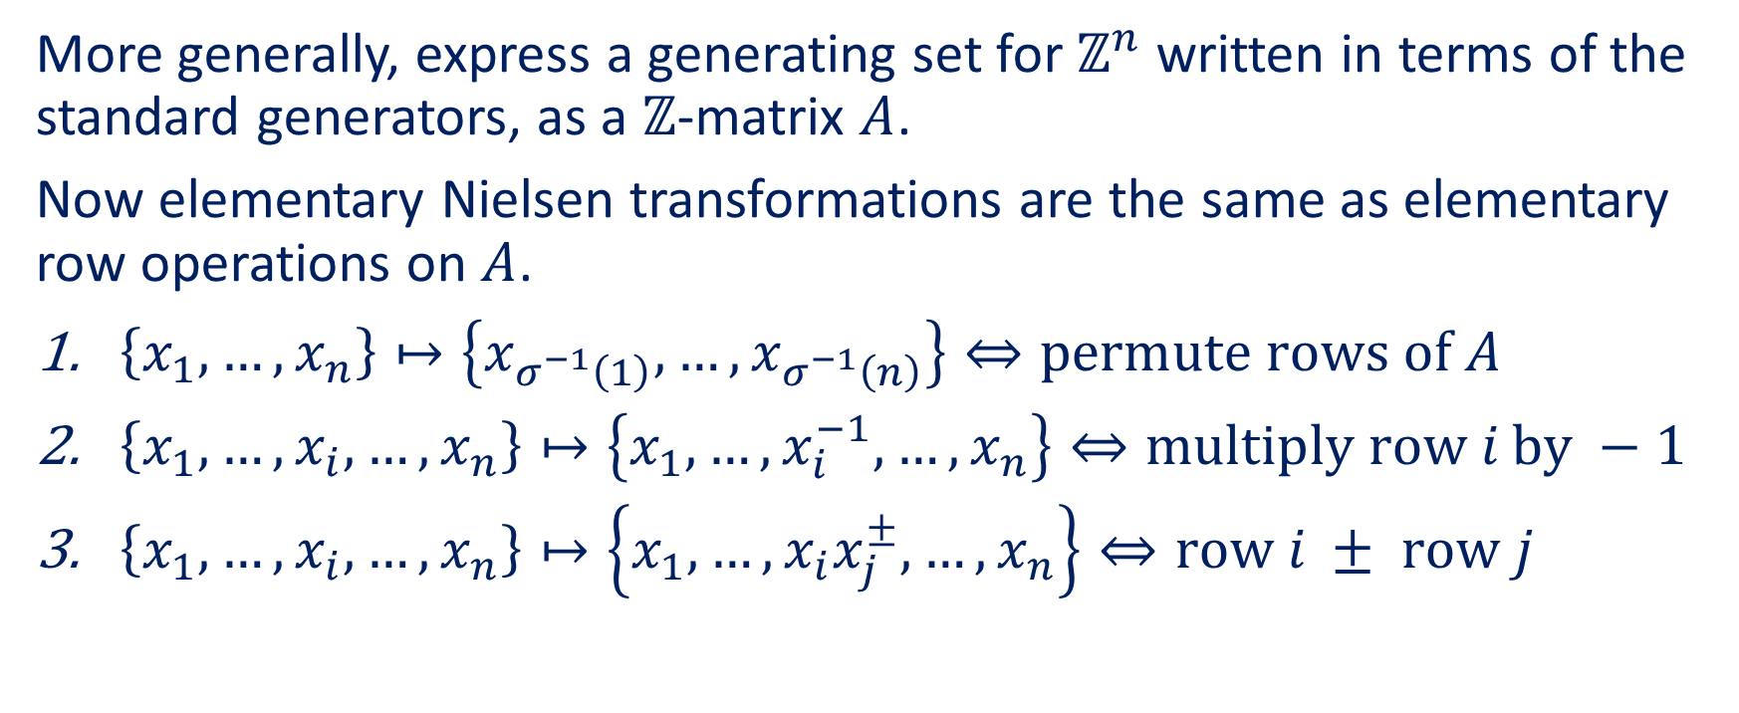
Elementary row operations
More generally, express a generating set for $ℤ^{n}$ written in terms of the standard generators, as a $ℤ$-matrix $A$.
Now elementary Nielsen transformations are the same as elementary row operations on $A$.
$\left\{x_{1},…,x_{n}\right\}↦\left\{x_{σ^{−1}\left(1\right)},…,x_{σ^{−1}\left(n\right)}\right\}⇔\text{permute} \text{rows} \text{of} A$
$\left\{x_{1},…,x_{i},…,x_{n}\right\}↦\left\{x_{1},…,x_{i}^{−1},…,x_{n}\right\}⇔\text{multiply} \text{row} i \text{by} −1$
$\left\{x_{1},…,x_{i},…,x_{n}\right\}↦\left\{x_{1},…,x_{i}x_{j}^{±},…,x_{n}\right\}⇔\text{row} i ± \text{row} j$

Slide 16
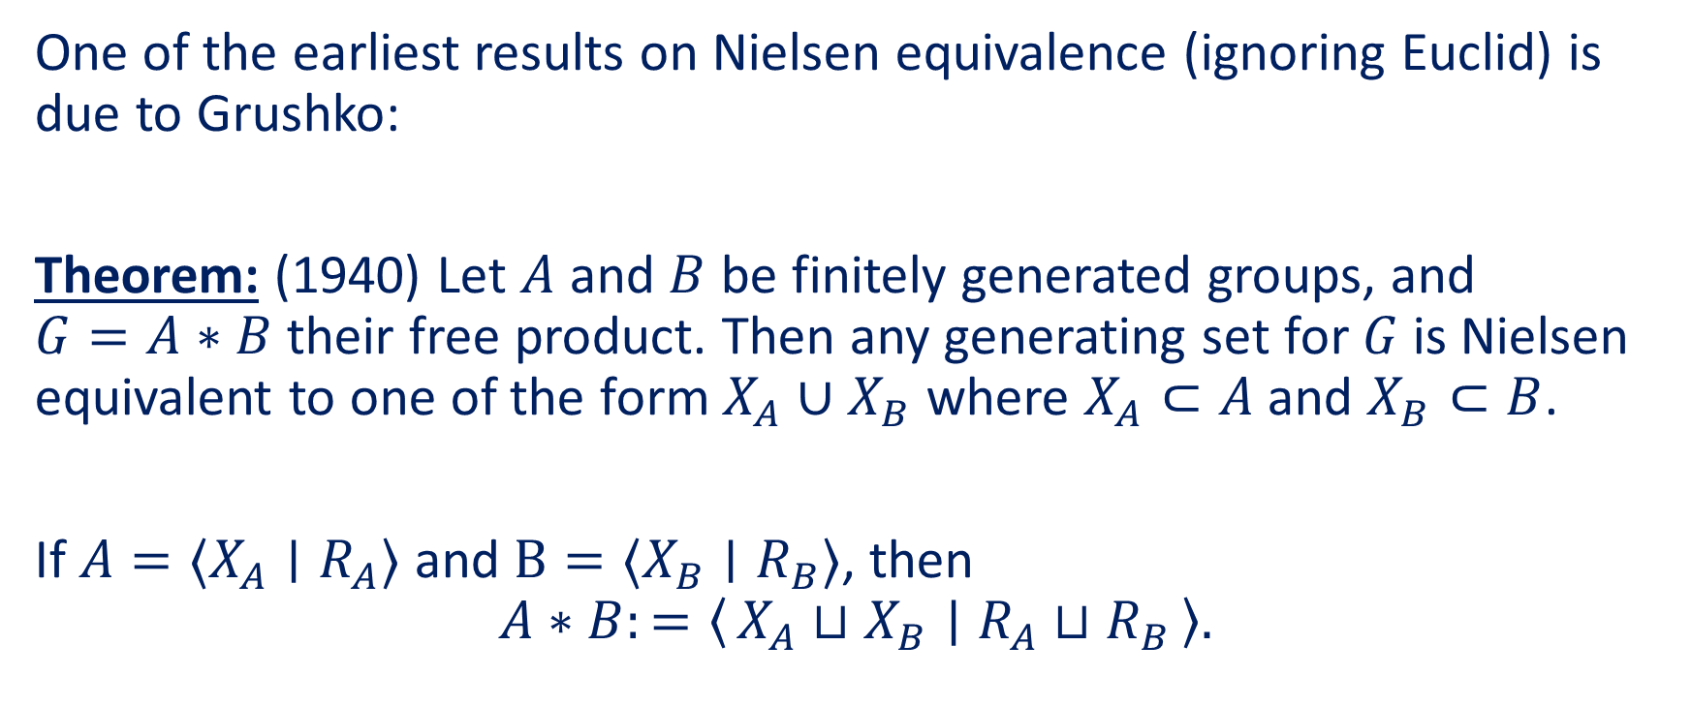
Grushko’s Theorem
One of the earliest results on Nielsen equivalence (ignoring Euclid) is due to Grushko:
Theorem: (1940) Let $A$ and $B$ be finitely generated groups, and $G=A∗B$ their free product. Then any generating set for $G$ is Nielsen equivalent to one of the form $X_{A}∪X_{B}$ where $X_{A}⊂A$ and $X_{B}⊂B$.
If $A=⟨X_{A}∣R_{A}⟩$ and $B=⟨X_{B}∣R_{B}⟩$, then
$$A∗B:=\left\langle X_{A}⊔X_{B} ∣ R_{A}⊔R_{B}\right\rangle .$$

Slide 17

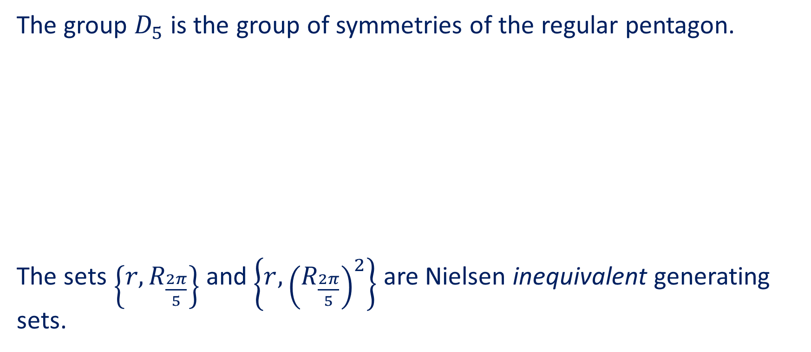


Dihedral groups
The group $D_{5}$ is the group of symmetries of the regular pentagon.
The sets $\left\{r,R_{\frac{2π}{5}}\right\}$ and $\left\{r,{\left(R_{\frac{2π}{5}}\right)}^{2}\right\}$ are Nielsen inequivalent generating sets.
$$r$$
$$R_{\frac{2π}{5}}$$
$${\left(R_{\frac{2π}{5}}\right)}^{2}$$

Slide 18
From groups to complexes

Slide 19
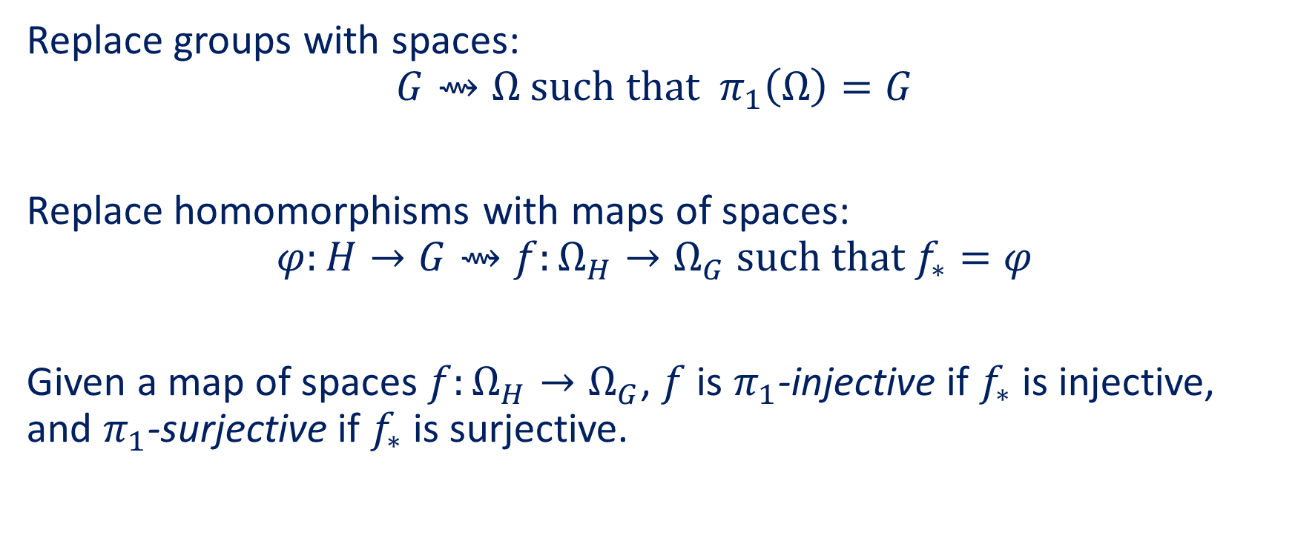
Geometric group theory
Replace groups with spaces:
$$G⇝Ω \text{such} \text{that} π_{1}\left(Ω\right)=G$$
Replace homomorphisms with maps of spaces:
$$φ:H→G⇝f:Ω_{H}→Ω_{G} \text{such} \text{that} f_{∗}=φ$$
Given a map of spaces $f:Ω_{H}→Ω_{G}$, $f$ is $π_{1}$-injective if $f_{∗}$ is injective, and $π_{1}$-surjective if $f_{∗}$ is surjective.

Slide 20










Nielsen equivalence for spaces
We can translate the definition of a Nielsen transformation into the language of spaces:
$$φ$$
$$f$$
$$𝔽_{n}$$
$$𝔽_{m}$$
$$Γ$$
$$Γ^{′}$$
bijective
$π_{1}$-isomorphism
surjective
$π_{1}$-surjective
$$ρ_{1}$$
$$↻$$
$$ρ_{2}$$
$$p_{1}$$
$$↻$$
$$p_{2}$$
$$G$$
$$Ω_{G}$$

Slide 21





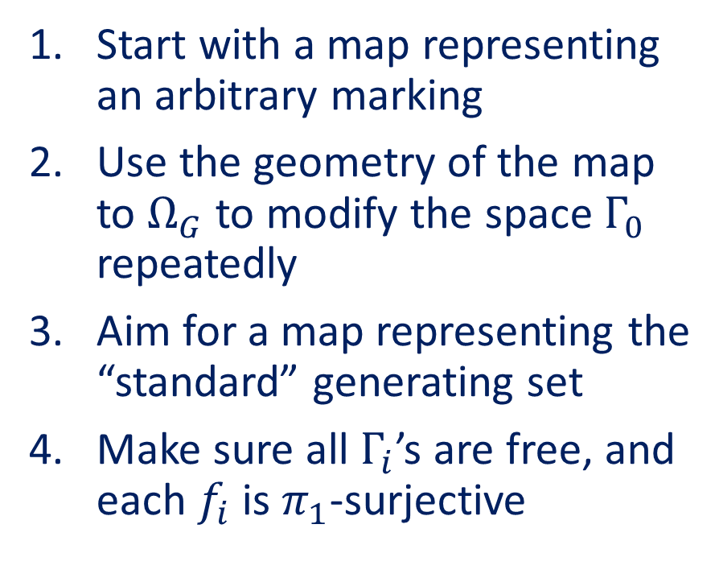
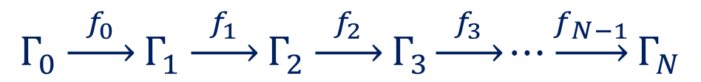





Strategy to study Nielsen equivalence
Start with a map representing an arbitrary marking
Use the geometry of the map to $Ω_{G}$ to modify the space $Γ_{0}$ repeatedly
Aim for a map representing the “standard” generating set
Make sure all $Γ_{i}$’s are free, and each $f_{i}$ is $π_{1}$-surjective
$$Γ_{0}\underset{→}{{ f}_{0} }Γ_{1}\underset{→}{{ f}_{1} }Γ_{2}\underset{→}{{ f}_{2} }Γ_{3}\underset{→}{ f_{3} }⋯\underset{→}{f_{N−1}}Γ_{N}$$
$$↻$$
$$↻$$
$$↻$$
$$p_{1}$$
$$p_{2}$$
$$⋯$$
$$p_{0}$$
$$p_{3}$$
$$p_{N}$$
$$Ω_{G}$$

Slide 22
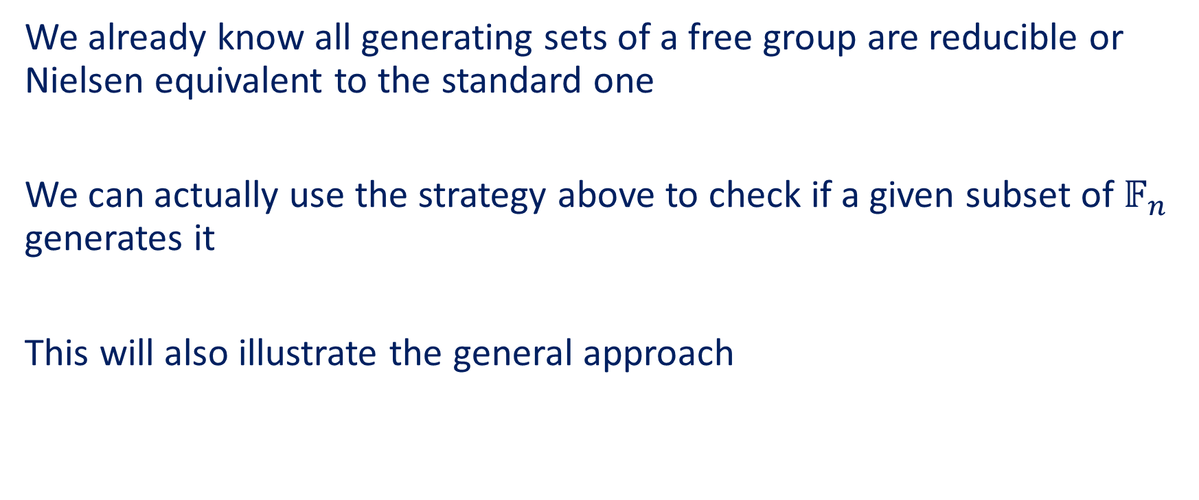
Example: free groups and Stallings’ folds
We already know all generating sets of a free group are reducible or Nielsen equivalent to the standard one
We can actually use the strategy above to check if a given subset of $𝔽_{n}$ generates it
This will also illustrate the general approach

Slide 23
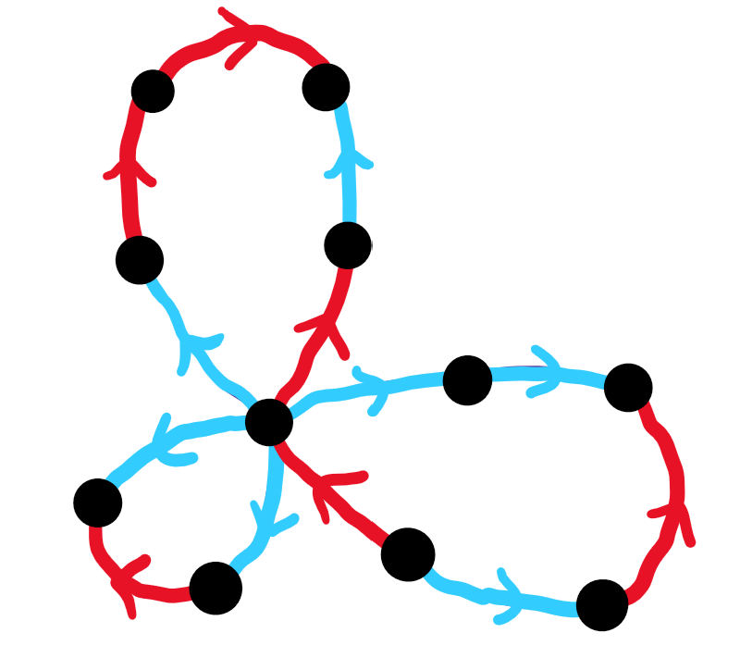




Example: free groups and Stallings’ folds
Does $\{abba^{−1}b^{−1},aab^{−1}a^{−1}b,aba^{−1}\}$ generate $𝔽_{2}=⟨a,b⟩$?
$$p_{1}$$
Stallings’ fold:
$π_{1}$-isomorphism
$$⇝$$

Slide 24
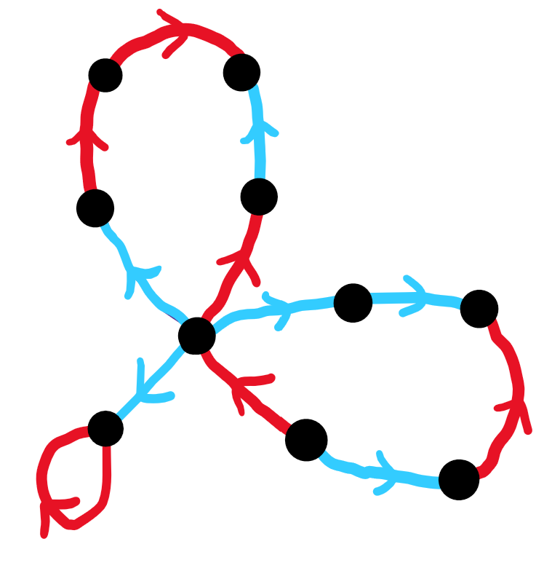

Example: free groups and Stallings’ folds
Does $\{abba^{−1}b^{−1},aab^{−1}a^{−1}b,aba^{−1}\}$ generate $𝔽_{2}=⟨a,b⟩$?
$$p_{2}$$
Stallings’ fold:
$π_{1}$-isomorphism
$$⇝$$

Slide 25
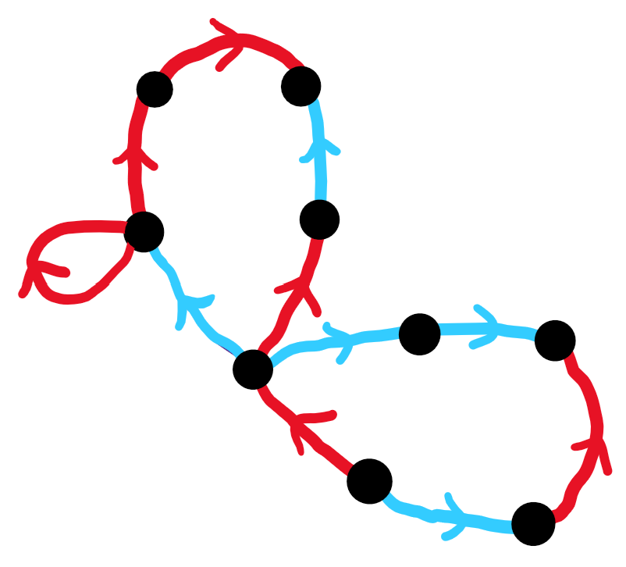


Example: free groups and Stallings’ folds
Does $\{abba^{−1}b^{−1},aab^{−1}a^{−1}b,aba^{−1}\}$ generate $𝔽_{2}=⟨a,b⟩$?
$$p_{3}$$
Stallings’ fold:
$π_{1}$-isomorphism
$$⇝$$
$$⇝$$

Slide 26
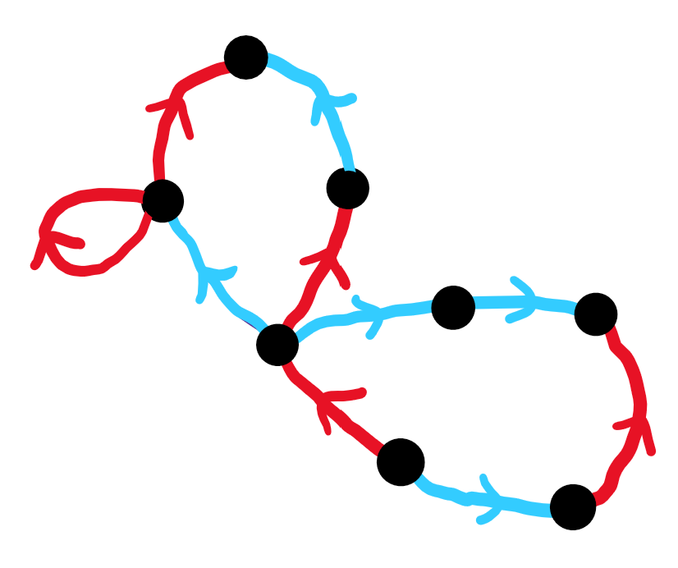

Example: free groups and Stallings’ folds
Does $\{abba^{−1}b^{−1},aab^{−1}a^{−1}b,aba^{−1}\}$ generate $𝔽_{2}=⟨a,b⟩$?
$$p_{4}$$
Stallings’ fold:
$π_{1}$-isomorphism
$$⇝$$
$$⇝$$

Slide 27
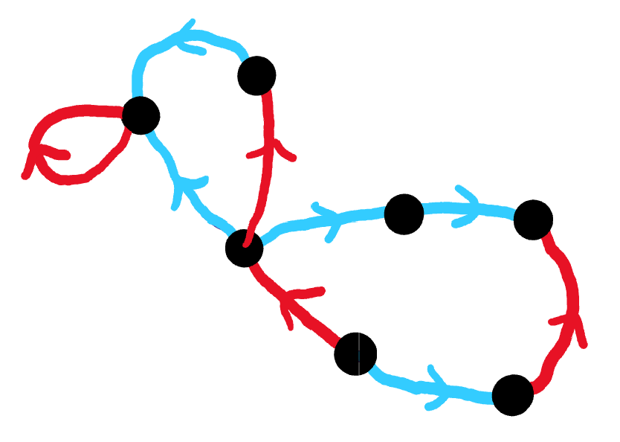

Example: free groups and Stallings’ folds
Does $\{abba^{−1}b^{−1},aab^{−1}a^{−1}b,aba^{−1}\}$ generate $𝔽_{2}=⟨a,b⟩$?
$$p_{5}$$
Stallings’ fold:
$π_{1}$-isomorphism
$$⇝$$
$$⇝$$

Slide 28
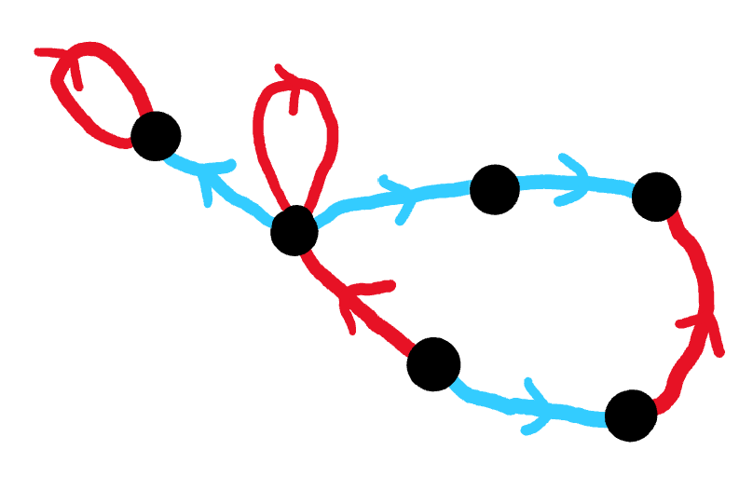

Example: free groups and Stallings’ folds
Does $\{abba^{−1}b^{−1},aab^{−1}a^{−1}b,aba^{−1}\}$ generate $𝔽_{2}=⟨a,b⟩$?
$$p_{6}$$
Stallings’ fold:
$π_{1}$-isomorphism
$$⇝$$
$$⇝$$

Slide 29
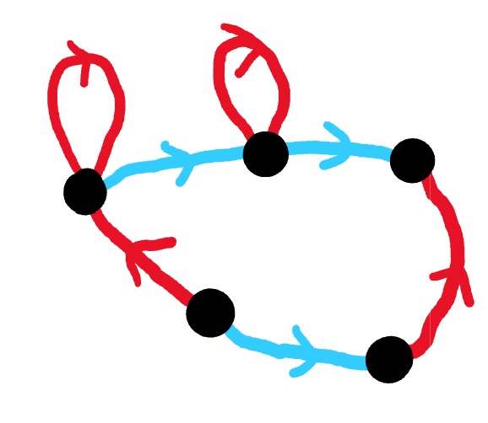

Example: free groups and Stallings’ folds
Does $\{abba^{−1}b^{−1},aab^{−1}a^{−1}b,aba^{−1}\}$ generate $𝔽_{2}=⟨a,b⟩$?
$$p_{7}$$
Stallings’ fold:
$π_{1}$-isomorphism
$$⇝$$
$$⇝$$

Slide 30
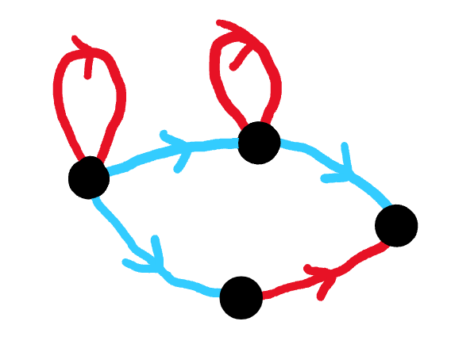

Example: free groups and Stallings’ folds
Does $\{abba^{−1}b^{−1},aab^{−1}a^{−1}b,aba^{−1}\}$ generate $𝔽_{2}=⟨a,b⟩$?
$$p_{8}$$
Stallings’ fold:
$π_{1}$-isomorphism
$$⇝$$
$$⇝$$

Slide 31
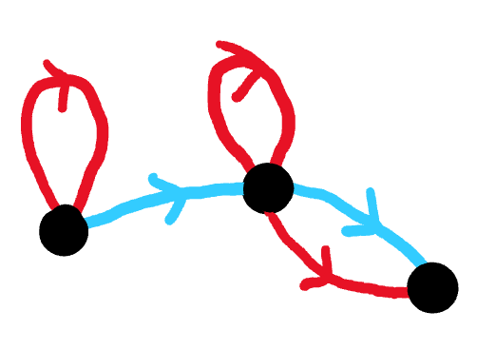

Example: free groups and Stallings’ folds
Does $\{abba^{−1}b^{−1},aab^{−1}a^{−1}b,aba^{−1}\}$ generate $𝔽_{2}=⟨a,b⟩$?
$$p_{9}$$
Stallings’ fold:
$π_{1}$-isomorphism
$$⇝$$
$$⇝$$

Slide 32
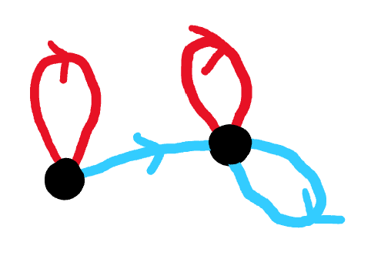

Example: free groups and Stallings’ folds
Does $\{abba^{−1}b^{−1},aab^{−1}a^{−1}b,aba^{−1}\}$ generate $𝔽_{2}=⟨a,b⟩$?
$$p_{10}$$
Stallings’ fold:
$π_{1}$-isomorphism
$$⇝$$
$$⇝$$

Slide 33




Example: free groups and Stallings’ folds
Does $\{abba^{−1}b^{−1},aab^{−1}a^{−1}b,aba^{−1}\}$ generate $𝔽_{2}=⟨a,b⟩$?
$$p_{11}$$
Stallings’ fold:
$π_{1}$-surjection
$$⇝$$
$$⇝$$

Slide 34


Example: free groups and Stallings’ folds
Does $\{abba^{−1}b^{−1},aab^{−1}a^{−1}b,aba^{−1}\}$ generate $𝔽_{2}=⟨a,b⟩$?
$$p_{12}$$
Stallings’ fold:
$π_{1}$-surjection
$$⇝$$
$$⇝$$

Slide 35
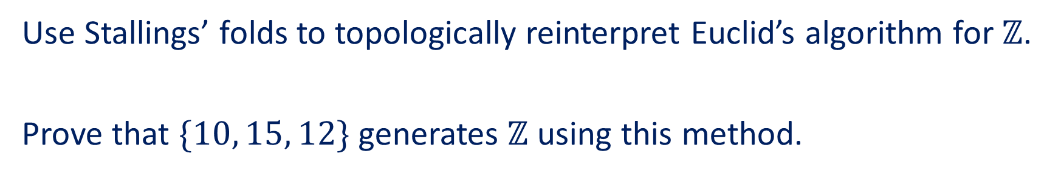
Fun and easy exercise
Use Stallings’ folds to topologically reinterpret Euclid’s algorithm for $ℤ$.
Prove that $\{10, 15, 12\}$ generates $ℤ$ using this method.

Slide 36
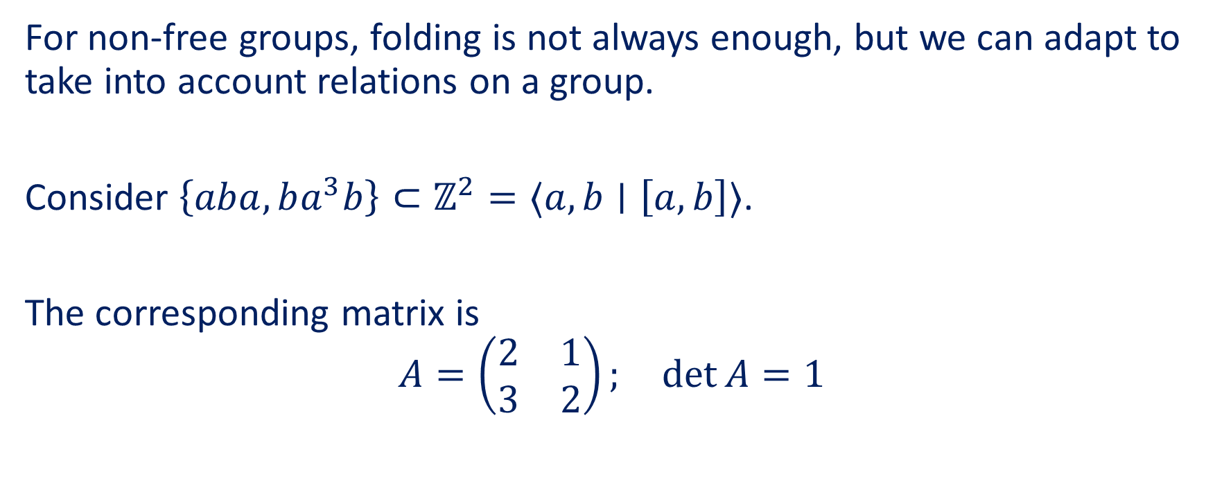

Example: squaring up to $ℤ^{2}$
For non-free groups, folding is not always enough, but we can adapt to take into account relations on a group.
Consider $\left\{aba,ba^{3}b\right\}⊂ℤ^{2}=⟨a,b∣\left[a,b\right]⟩$.
The corresponding matrix is
$$A=\left(\begin{matrix}2 & 1 \\ 3 & 2\end{matrix}\right); \det{A}=1$$

Slide 37
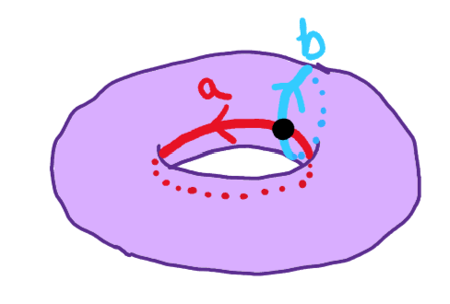
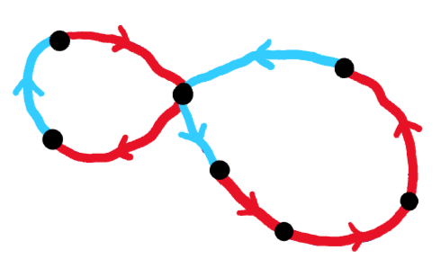

Example: squaring up to $ℤ^{2}$
Is $\left\{aba,ba^{3}b\right\}$ Nielsen equivalent to $\left\{a,b\right\}$ in $ℤ^{2}$?
$$p_{1}$$
No folds possible

Slide 38
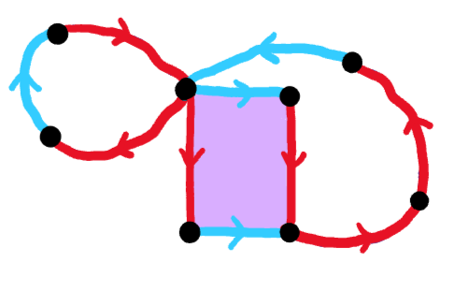

Example: squaring up to $ℤ^{2}$
Is $\left\{aba,ba^{3}b\right\}$ Nielsen equivalent to $\left\{a,b\right\}$ in $ℤ^{2}$?
$$p_{2}$$
Now a fold is possible

Slide 39
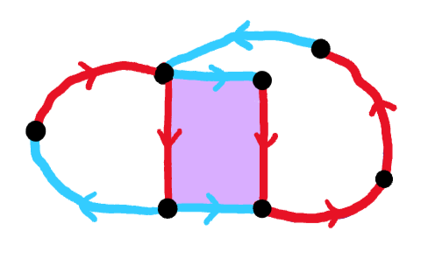

Example: squaring up to $ℤ^{2}$
Is $\left\{aba,ba^{3}b\right\}$ Nielsen equivalent to $\left\{a,b\right\}$ in $ℤ^{2}$?
$$p_{3}$$

Slide 40
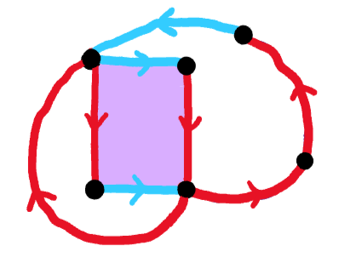

Example: squaring up to $ℤ^{2}$
Is $\left\{aba,ba^{3}b\right\}$ Nielsen equivalent to $\left\{a,b\right\}$ in $ℤ^{2}$?
$$p_{4}$$

Slide 41
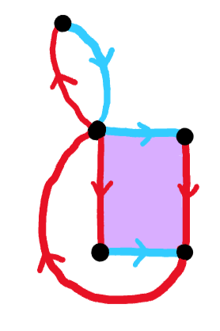

Example: squaring up to $ℤ^{2}$
Is $\left\{aba,ba^{3}b\right\}$ Nielsen equivalent to $\left\{a,b\right\}$ in $ℤ^{2}$?
$$p_{5}$$

Slide 42
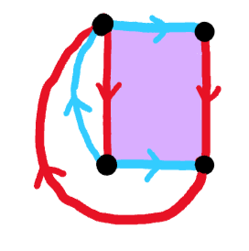

Example: squaring up to $ℤ^{2}$
Is $\left\{aba,ba^{3}b\right\}$ Nielsen equivalent to $\left\{a,b\right\}$ in $ℤ^{2}$?
$$p_{6}$$

Slide 43
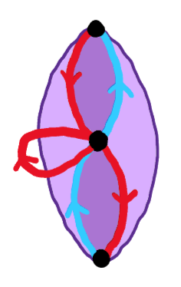

Example: squaring up to $ℤ^{2}$
Is $\left\{aba,ba^{3}b\right\}$ Nielsen equivalent to $\left\{a,b\right\}$ in $ℤ^{2}$?
$$p_{7}$$

Slide 44
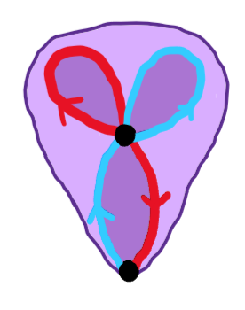

Example: squaring up to $ℤ^{2}$
Is $\left\{aba,ba^{3}b\right\}$ Nielsen equivalent to $\left\{a,b\right\}$ in $ℤ^{2}$?
$$p_{8}$$

Slide 45
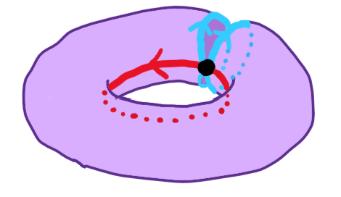
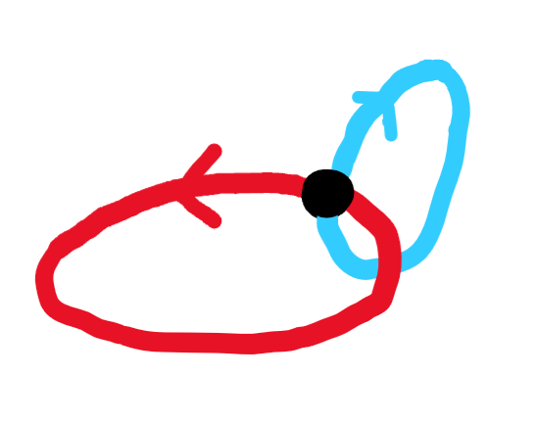

Example: squaring up to $ℤ^{2}$
Is $\left\{aba,ba^{3}b\right\}$ Nielsen equivalent to $\left\{a,b\right\}$ in $ℤ^{2}$?
$$p_{9}$$
deformation retraction
inclusion

Slide 46
Grushko’s Theorem

Slide 47
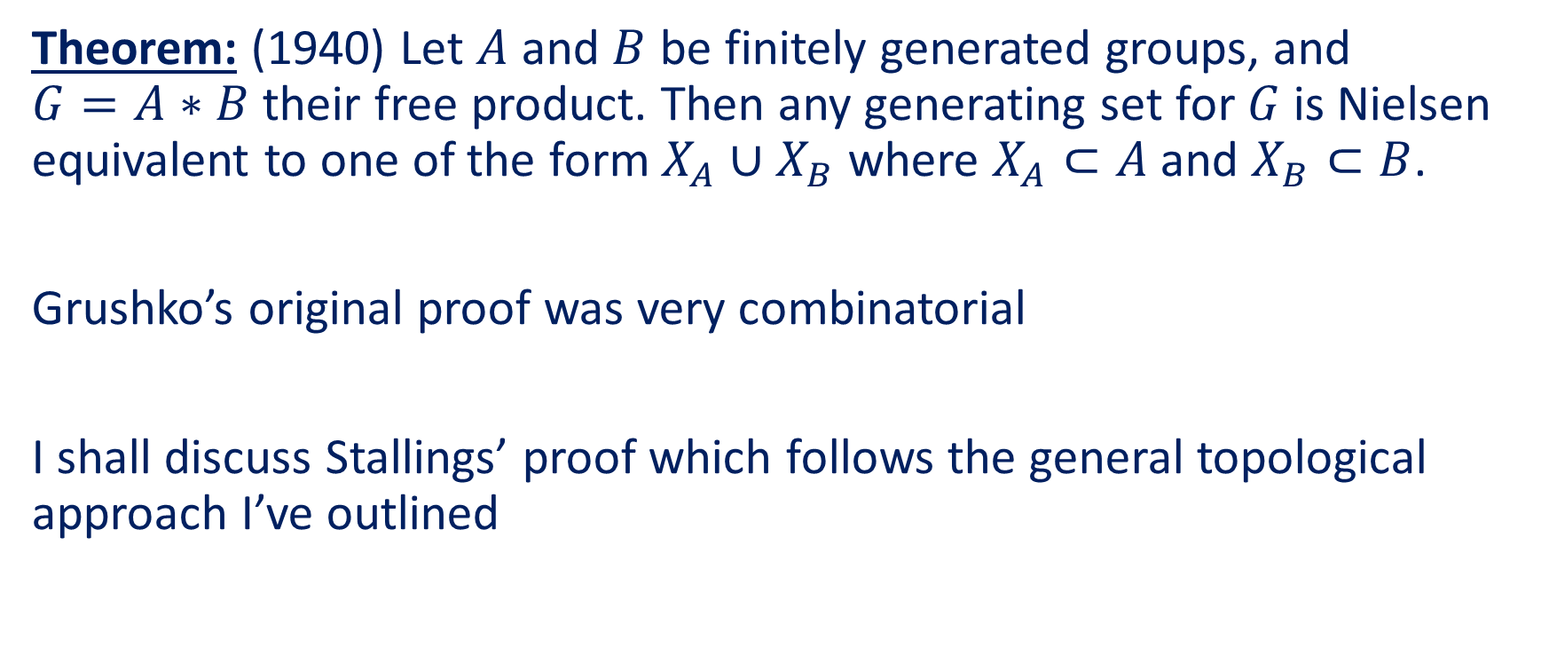
Grushko’s Theorem
Theorem: (1940) Let $A$ and $B$ be finitely generated groups, and $G=A∗B$ their free product. Then any generating set for $G$ is Nielsen equivalent to one of the form $X_{A}∪X_{B}$ where $X_{A}⊂A$ and $X_{B}⊂B$.
Grushko’s original proof was very combinatorial
I shall discuss Stallings’ proof which follows the general topological approach I’ve outlined

Slide 48
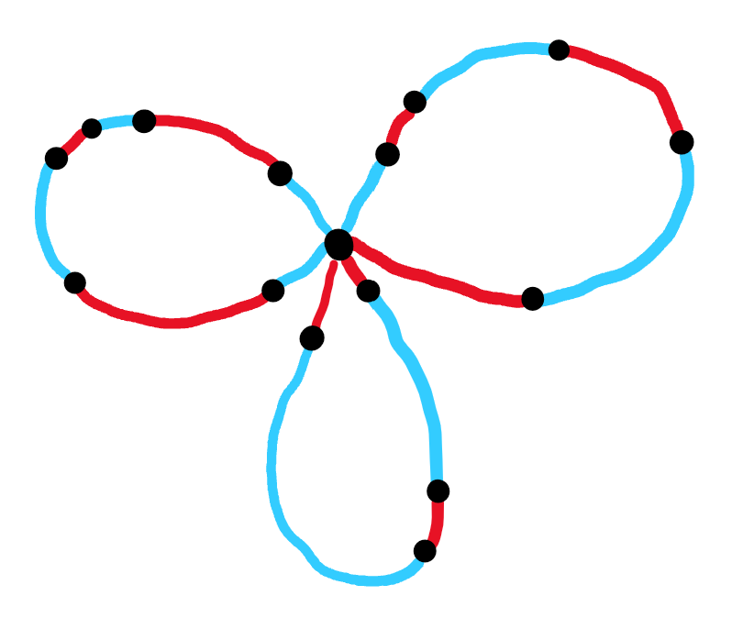
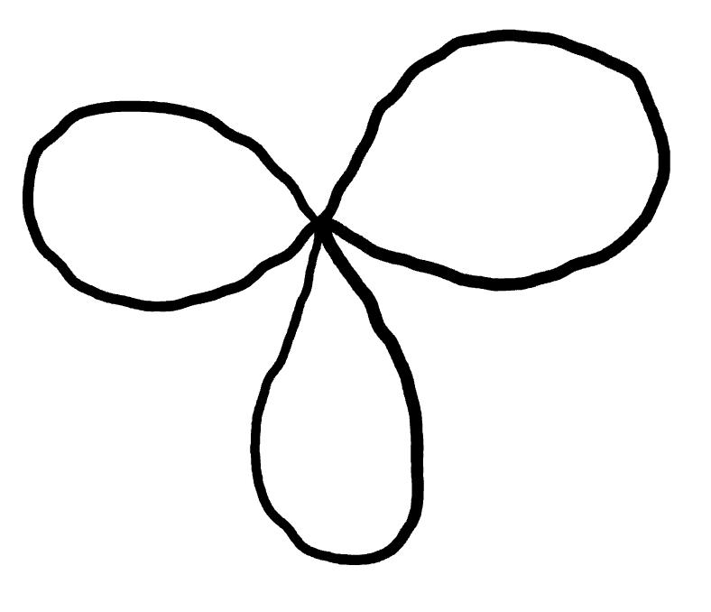
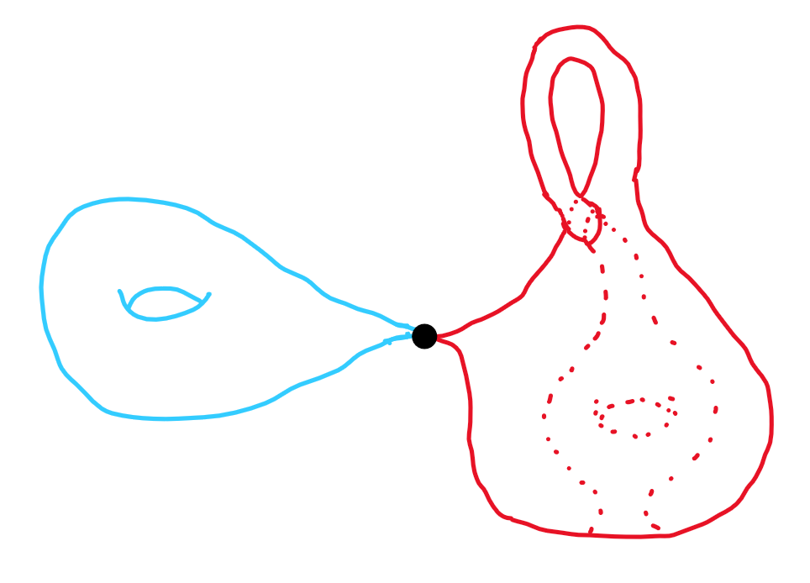





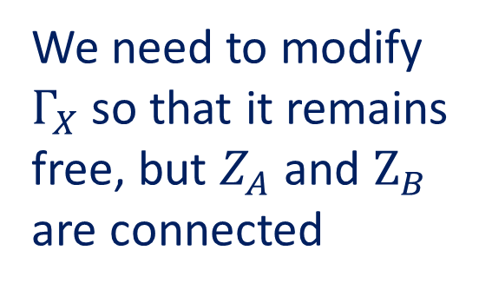
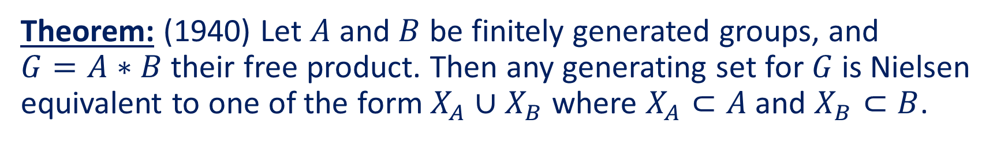


Grushko’s Theorem
Theorem: (1940) Let $A$ and $B$ be finitely generated groups, and $G=A∗B$ their free product. Then any generating set for $G$ is Nielsen equivalent to one of the form $X_{A}∪X_{B}$ where $X_{A}⊂A$ and $X_{B}⊂B$.
$$Z_{A}$$
$$Ω_{G}=Ω_{A}∧Ω_{B}$$
$$Z_{B}$$
$$p_{1}$$
We need to modify $Γ_{X}$ so that it remains free, but $Z_{A}$ and $Z_{B}$ are connected
$$Γ_{X}$$
$$Ω_{A}$$
$$Ω_{B}$$
this is a cartoon

Slide 49
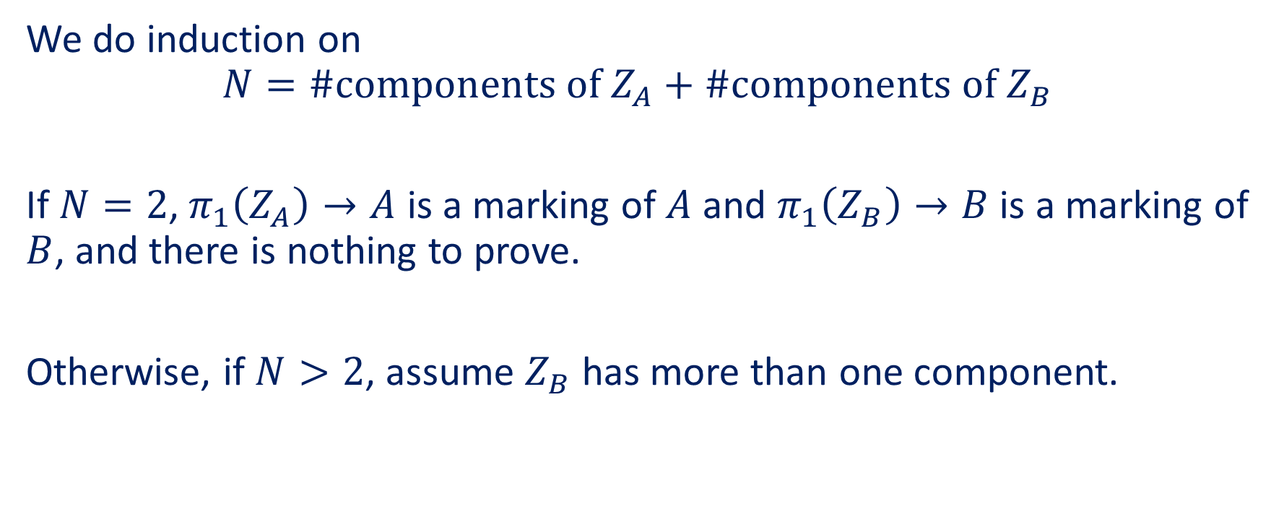
Proof of Grushko’s Theorem
We do induction on
$$N=\#\text{components} \text{of} Z_{A}+\#\text{components} \text{of} Z_{B}$$
If $N=2$, $π_{1}\left(Z_{A}\right)→A$ is a marking of $A$ and $π_{1}\left(Z_{B}\right)→B$ is a marking of $B$, and there is nothing to prove.
Otherwise, if $N>2$, assume $Z_{B}$ has more than one component.

Slide 50






Tying things together
$γ:\left[0,1\right]→Γ_{X}$ connects different components of $Z_{A}∩Z_{B}$. $p\left(γ\right)⊂Ω_{G}$ is a loop.
Let $γ^{′}⊂Γ_{X}$ be a loop based at $γ(1)$ s.t. $p\left(γ^{′}\right)=p{\left(γ\right)}^{−1}$
$$γ$$
$$p\left(γ′\right)$$
$$p$$
$$p\left(γ\right)$$
$$Γ_{X}$$
$$γ′$$
$$Ω_{A}$$
$$Ω_{B}$$
this is a cartoon

Slide 51

Tying things together
Consider the path $γ∗γ^{′}=:γ_{1}∗⋯∗γ_{k}$ where the $γ_{i}$’s alternate blue or red.
$p(γ∗γ^{′})$ is a loop representing $e$ in G; each $p(γ_{i})$ is a loop in $Ω_{A}$ or $Ω_{B}$.
$$γ$$
$$p\left(γ′\right)$$
$$p$$
$$p\left(γ\right)$$
$$Γ_{X}$$
$$γ′$$
$$Ω_{A}$$
$$Ω_{B}$$
this is a cartoon

Slide 52



Tying things together
$e=p\left(γ_{1}\right)⋯p\left(γ_{k}\right)$ implies $p\left(γ_{i}\right)=e$ for some $i$.
$γ_{i}$ ties together two components of $Z_{B}$ and is null homotopic in $Ω_{A}$.
$$γ$$
$$p\left(γ_{i}\right)$$
$$p\left(γ′\right)$$
$$p$$
$$p\left(γ\right)$$
$$Γ_{X}$$
$$γ′$$
$$Ω_{A}$$
$$γ_{i}$$
$$Ω_{B}$$
this is a cartoon

Slide 53



Tying things together
Glue a disc $D$ to $Γ_{X}$ along $γ_{i}$ and extend $p$ over $D$:
The number of components of $Z_{B}$ is now decreased by 1.
$$p\left(D\right)$$
$$p\left(γ_{i}\right)$$
$$p$$
$$Γ_{X}$$
$$Ω_{A}$$
$$γ_{i}$$
$$Ω_{B}$$
this is a cartoon

Slide 54
Beyond Nielsen equivalence

Slide 55
What is Nielsen equivalence useful for?
Natural way to classify generating sets of a group
Generating random elements of finite groups
Understanding the isomorphism problem

Slide 56

Applications of Grushko’s Theorem
Immediately implies
$$\text{rank}\left(A∗B\right)=\text{rank}\left(A\right)+\text{rank}(B)$$
The starting point for the theory of:
Accessibility of groups
JSJ-decompositions for abstract groups

Slide 57


Applications of Stallings’ folds
They are the way to study subgroups of $𝔽_{n}$
Given $X⊂𝔽_{n}$ represent $G=\left\langle X\right\rangle ↪𝔽_{n}$ by a map of graphs
Fold as much as possible to get a canonical immersion of graphs representing $G↪𝔽_{n}$
Easily read off properties of $G$ from this map of graphs, e.g.
Is $G<𝔽_{n}$ finite index?
What is $[𝔽_{n}:G]$ if so?
Is $G⊲𝔽_{n}$?
Is $x∈𝔽_{n}$ in $G$?
$$p$$

Slide 58

Applications of Stallings’ folds
These techniques generalise to many non-free groups, including
$π_{1}(Y)$ where $Y$ is non-positively curved cube complex
Right-angled Coxeter groups
Folding techniques are used to study Nielsen equivalence in:
Surface groups
Right-angled Coxeter groups
Fuchsian groups

Slide 59
Thank you

