Slide 1
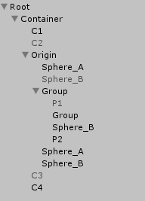
BeforeSelf
Child/Children
Parent/Ancestors
AfterSelf
Descendants

Slide 2
BeforeSelf
Parent/Ancestors
Child/Children
LINQ to GameObject
AfterSelf
LINQ to GameObject
Descendants
origin.Descendants()
.Where(x => x.tag == "foobar")
.OfComponent<BoxCollider2D>();

