Slide 1
Foundations of TensorFlow
Getting Started

Slide 2
Contents
Why TensorFlow
Tensors & Tensor Operations
TensorFlow Main Building Blocks
Installation
Running Our First Example

Slide 3
Why TensorFlow?
Seamless transition to cloud/distributed computing
Widely used and well documented
Easily deployable to production
Updated often
Easier to get up and running than Theano
No compilation time
(unlike theano)
TensorBoard

Slide 4
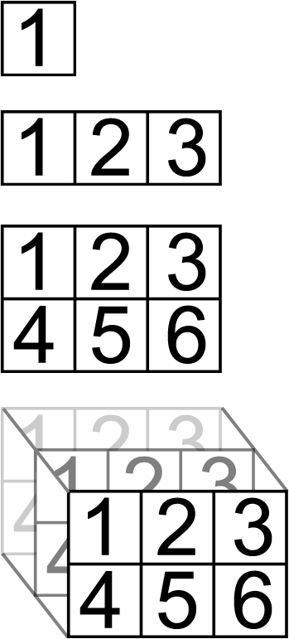
Tensors
Rank 0
Rank 1
Rank 2
Rank 3
N-dimensional arrays
Measured by “rank”
All elements same datatype
Basics

Slide 5
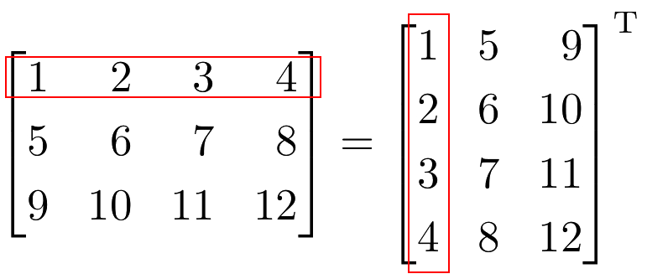
Tensor Operations
Matrix Multiplication
Addition & Subtraction
Multiplication & Division
Matrix Multiplication
Dot Product
Transpose
Common Ops
Tranpose

Slide 6
TesnorFlow Building Blocks
Tensors
Operations
Graphs & Sessions
Loss Functions
Lower Level
Higher Level
Optimizers
Layers
Estimators

Slide 7
Loss Functions
Differentiable functions that measure differences/error between true and predicted values.
Log Loss
MSE
Common types:
Cosine Distance
Cross Entropy

Slide 8
Optimizers
Built-in optimizers inherit from the Optimizer class.
Adam
RMSProp
Gradient Descent
Common types:
Adagrad
Momentum
Adadelta

Slide 9
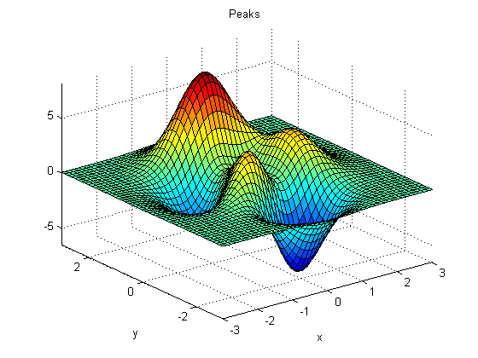
Optimizers
Optimizers are algorithms that minimize the loss (or error) of a model.
Local Minimum
Start
Global Minimum

Slide 10
Layers
Composed of tensors and operations forming the model
Generally connected in series
Pre-made functions for creating layers in a model
Input
Convolutional (1d, 2d, 3d)
What are they?
Common Types
Pooling
Dropout
Dense

Slide 11
Layers
Example of a neural network composed of 4 layers.
inputs (x)
a(wx+b)
activation
output
Input
Layer
Hidden Layers
Output
Layer

Slide 12
Estimators
Training
Evaluation
Prediction
Build Graph

Slide 13
Installation
check if pip[3] installed terminal: pip -V (install if not)
pip[3] install tensorflow
pip[3] install tensorflow-gpu
(linux only: requires NVIDIA GPU + CUDA + cuDNN)
check if pip[3] installed (if not use get-pip.py)
pip[3] install --upgrade tensorflow
pip[3] install --upgrade tensorflow-gpu
(requires NVIDIA GPU + CUDA + cuDNN)
Mac/Linux
Windows

