Slide 1
Predicting Cancer Relapse
Sombeet Sahu
DS-SF-25

Slide 2
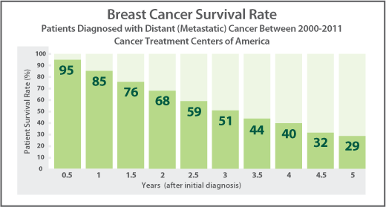
Breast Cancer: Most common disease in women
About 1 in 8 U.S. women (about 12%) will develop invasive breast cancer over the course of her lifetime. Very few survive after 5 years.
Breast cancer treatment may include surgery, radiation therapy, chemotherapy, hormone therapy, or biological therapy.
However, sometimes breast cancer can return after the initial treatment. This is called “recurrence” or “relapsing”.
*Cancer Treatment Canters of America

Slide 3

Problem:
Currently, physicians and clinicians are trying to predict who may or may not experience a recurrence of cancer based on a limited number of features or attributes.
Unfortunately, current evaluation of breast cancers does not adequately evaluate the malignant cell’s potential for spreading (called metastasis) and is an expensive process.
Can we solve this by Machine Learning Modelling.
Data Scientist to the rescue ➔

Slide 4
Hypothesis
1. Data generated by DNA Sequencing to be used.
2. DNA markers to be used as features.
3. Classify the patients into relapse categories

Slide 5
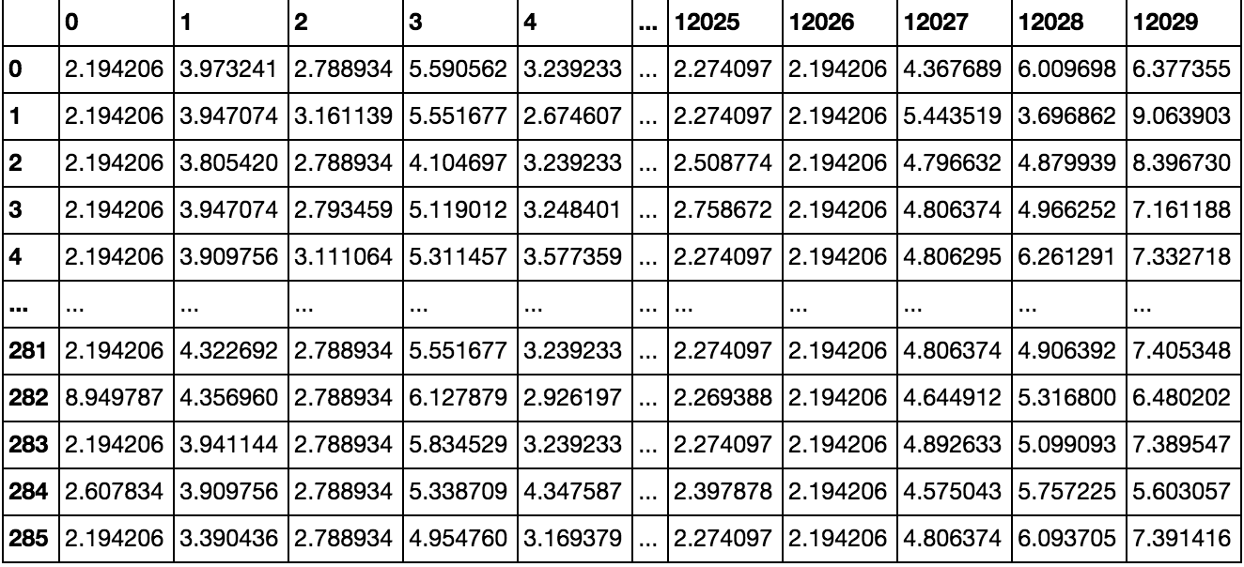
Data
Microarrays: > 10GB download size. Processing requires some serious CPU

Slide 6
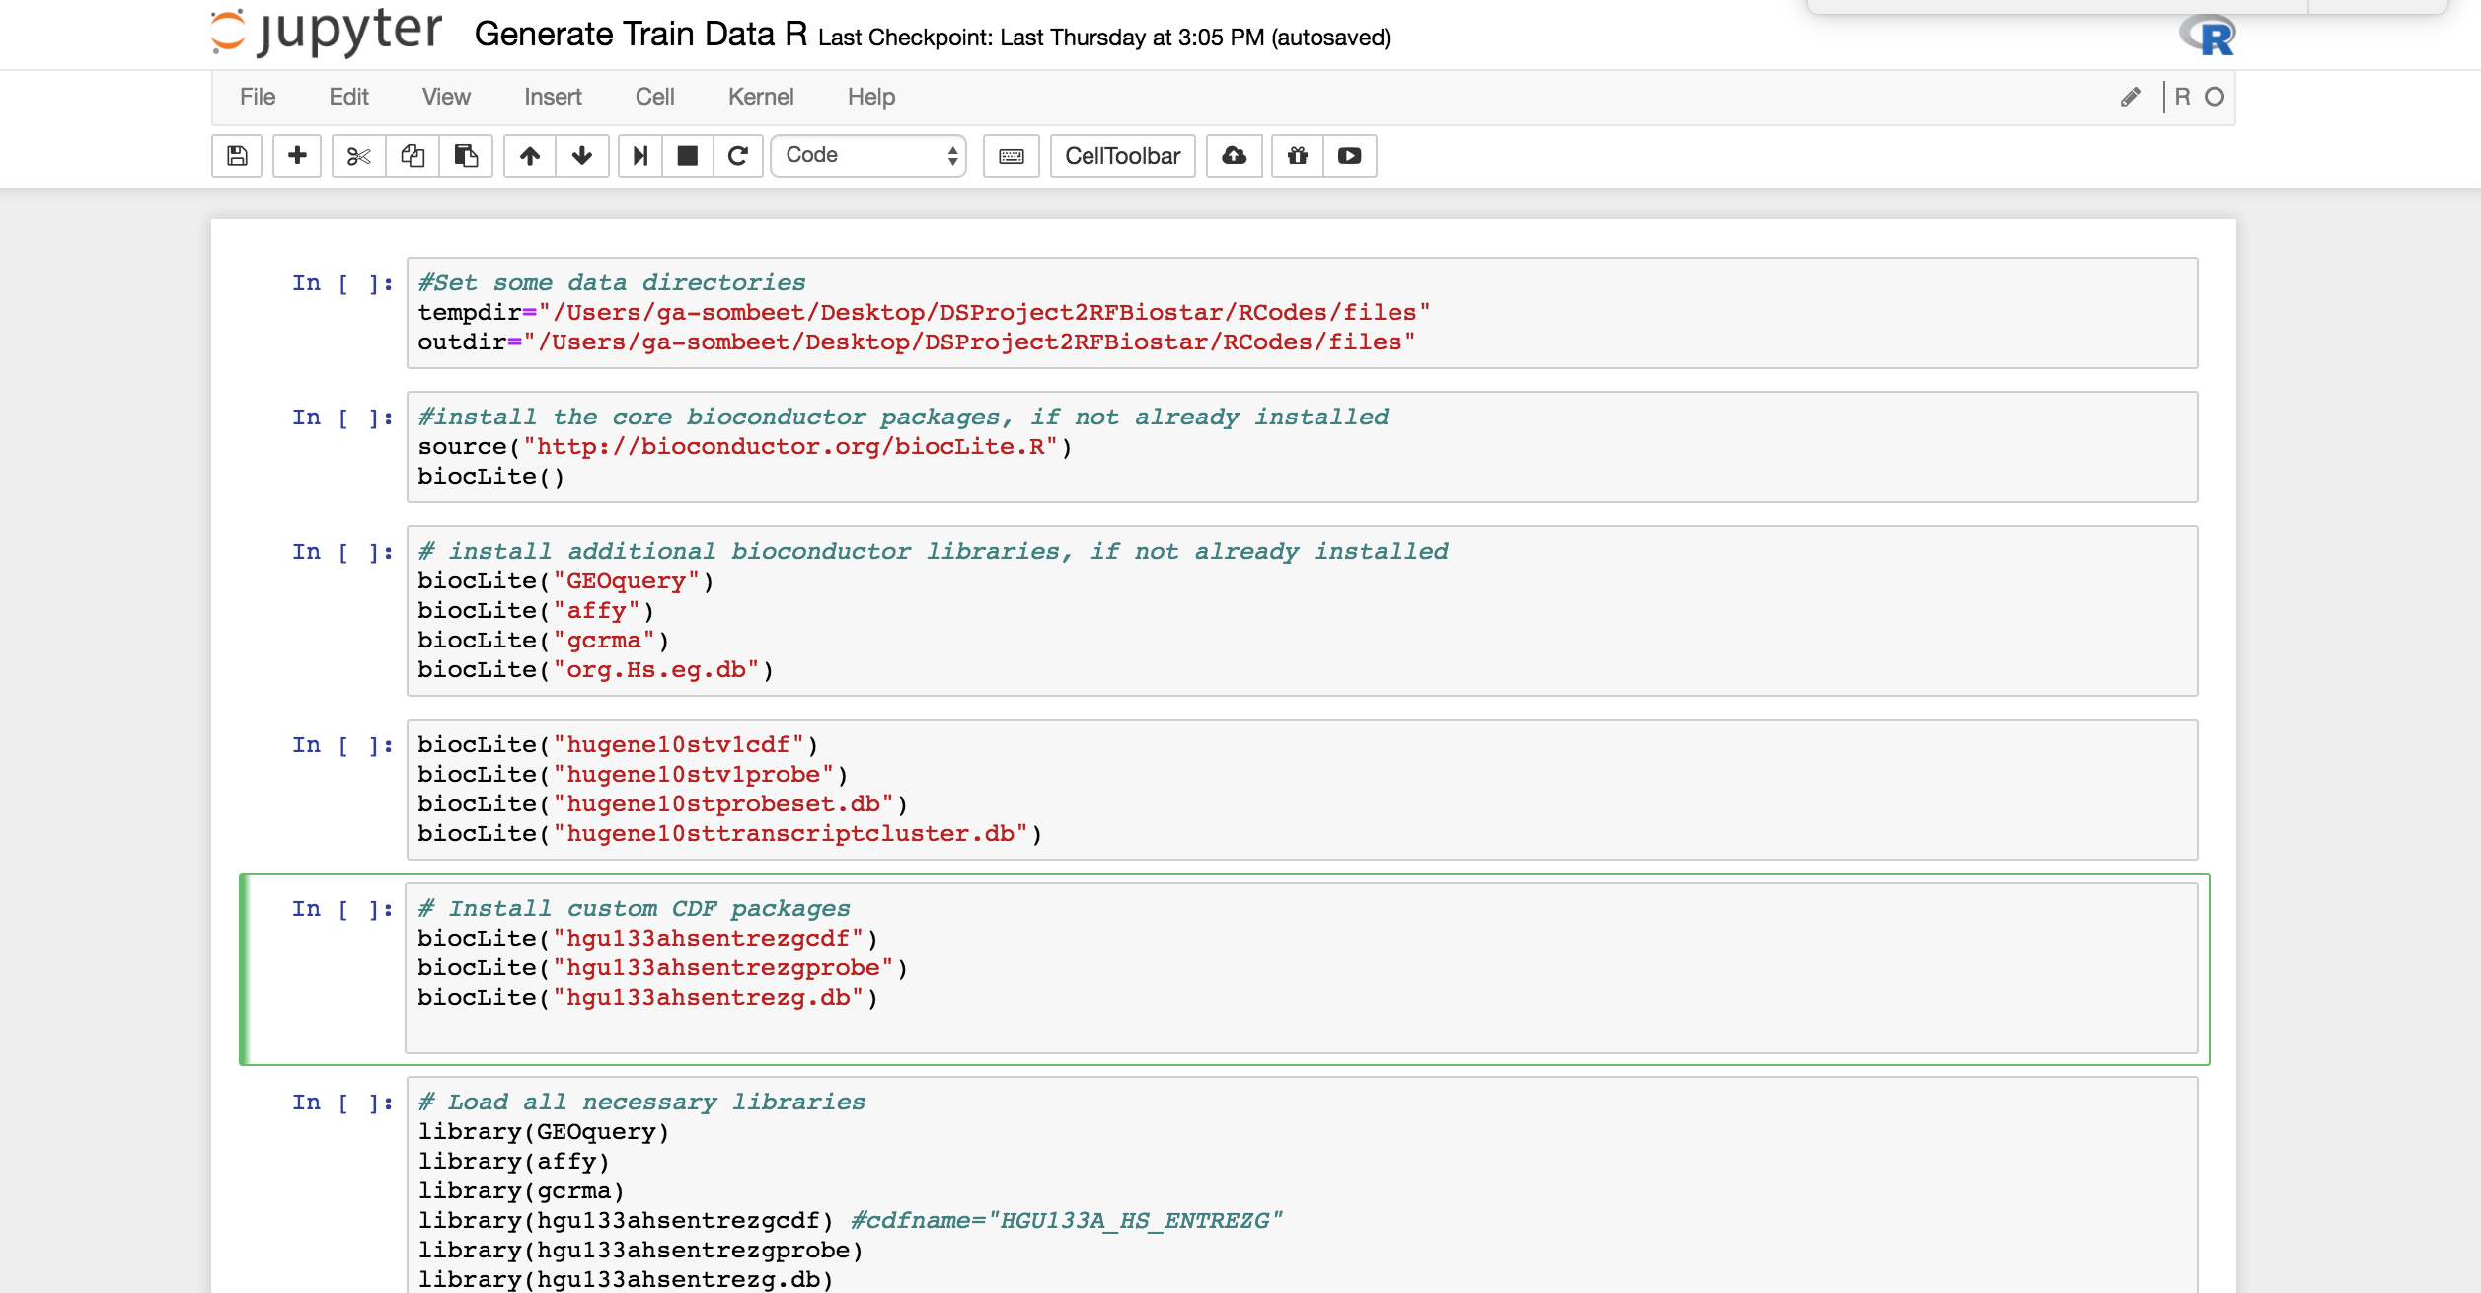
Preprocessing: In R

Slide 7
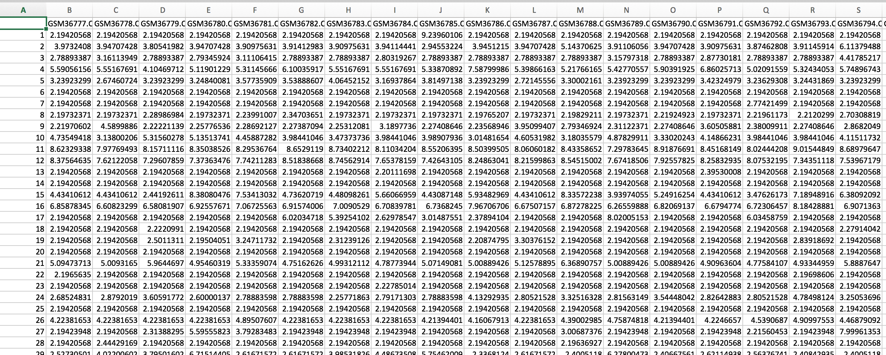
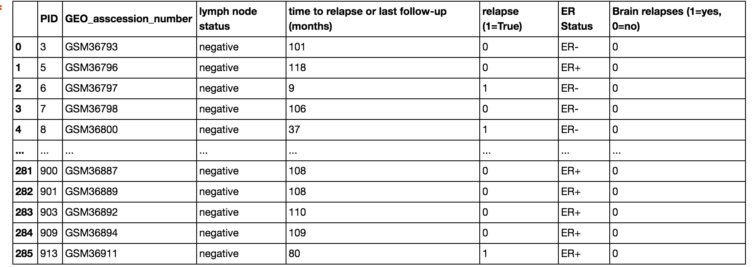
Dataset
rfinput.shape : (286, 12030)
Clindata.shape: (286, 7)
285 patients with 12029 genes/marker sequence data
The values indicate the expression level of a gene. (In other words it is the amount of a certain protein)

Slide 8
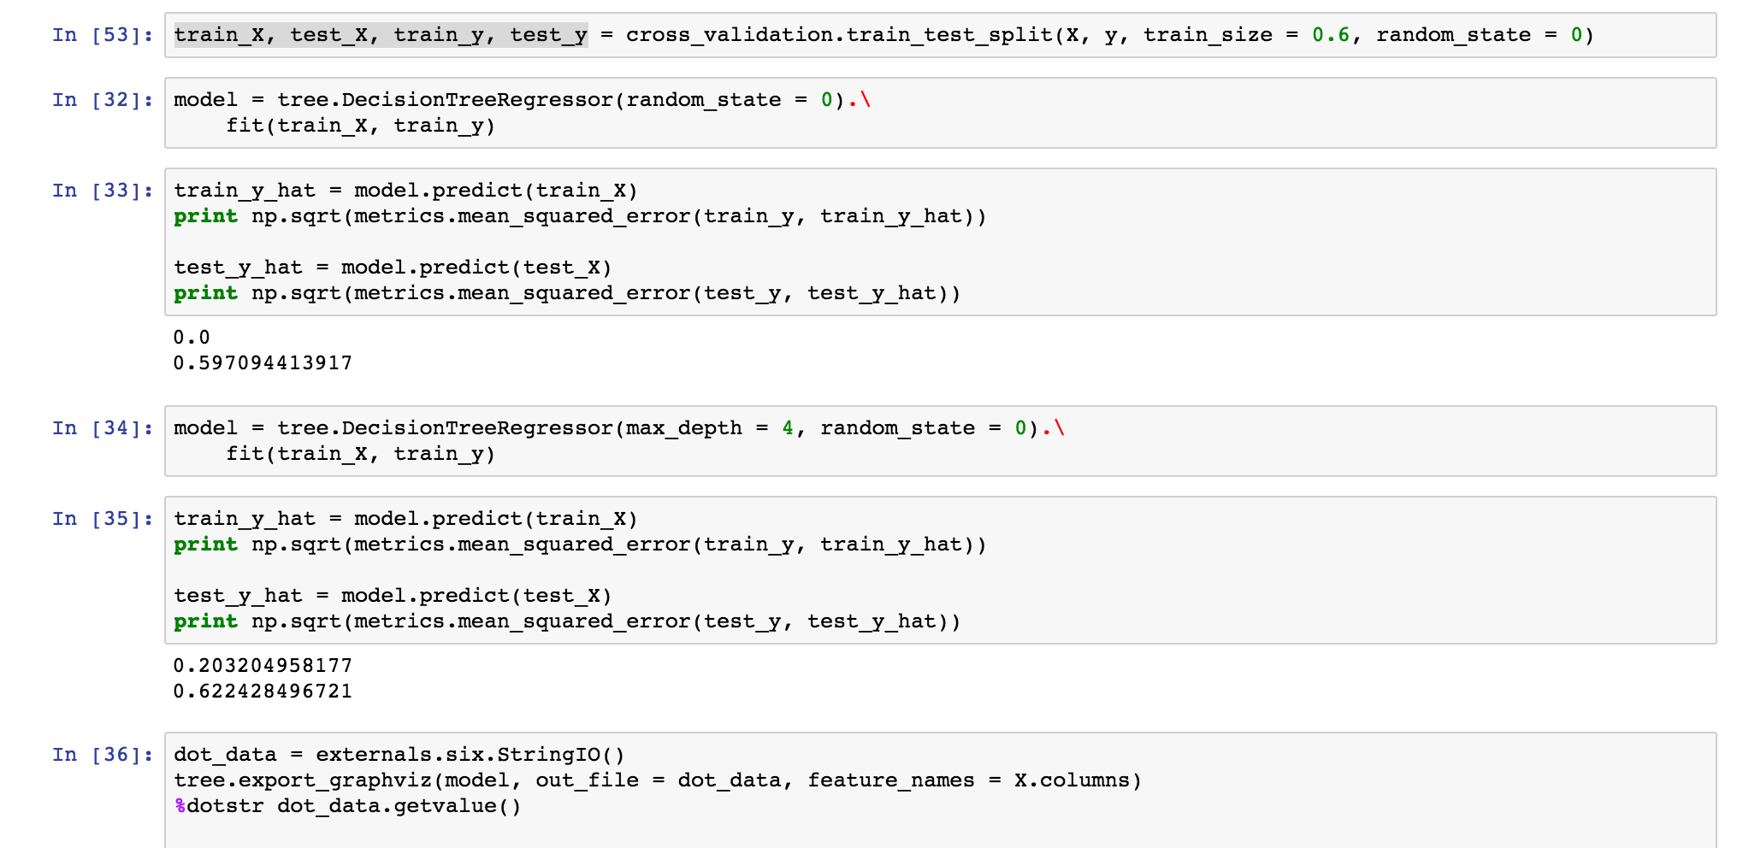
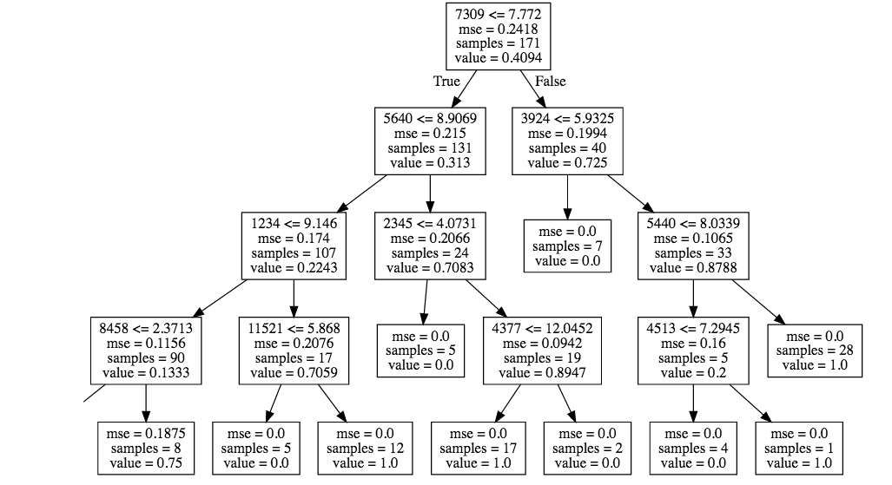
The customary Decision Tree
Maybe the most important Gene. Gene 7309

Slide 9
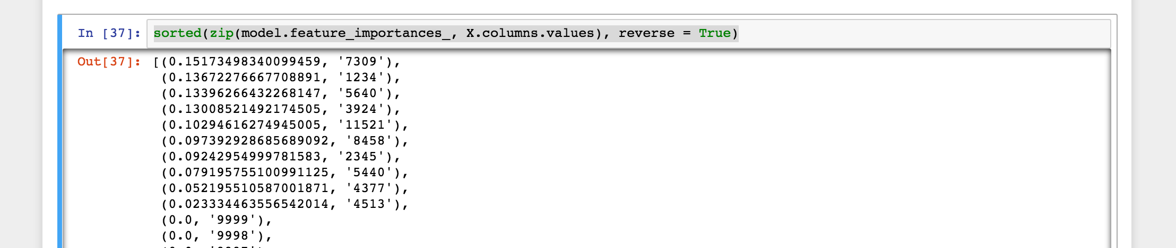
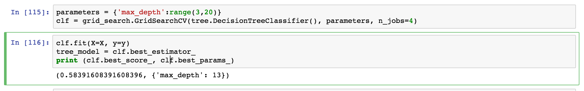
The customary Decision Tree: Scoring
Feature Importance
Cross Validation Score:
Grid Search: Best Score= 58%

Slide 10
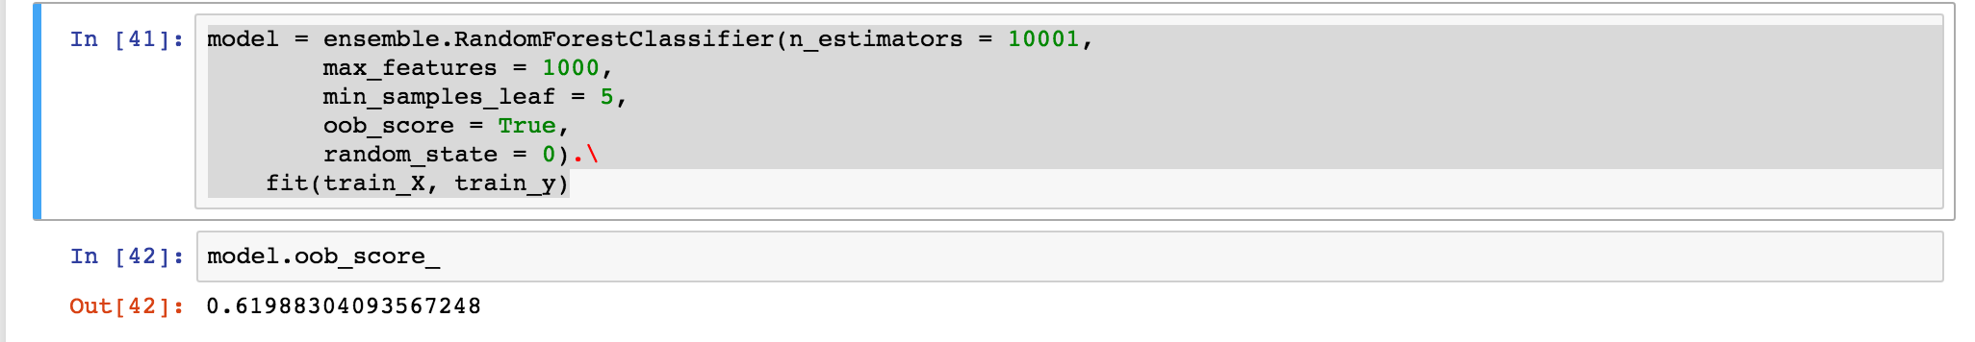
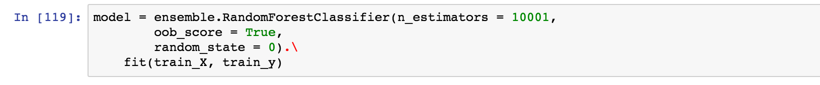
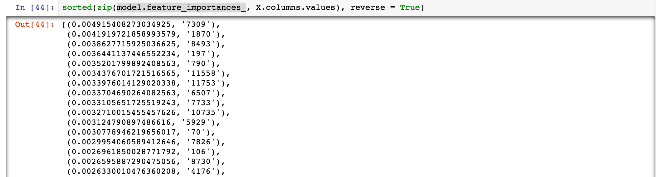
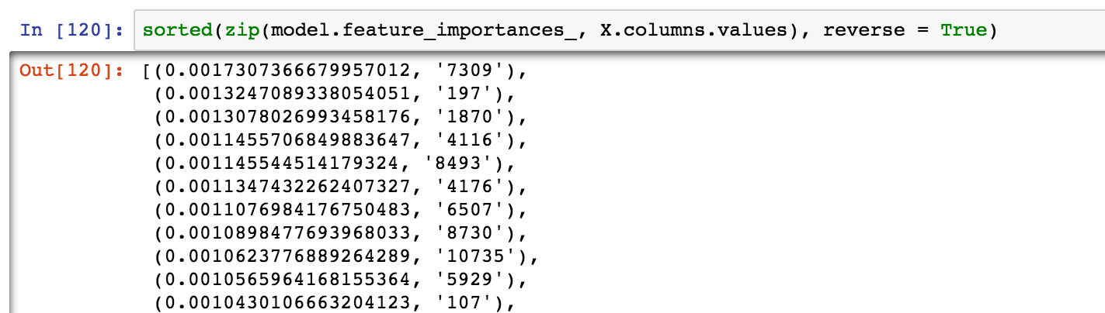
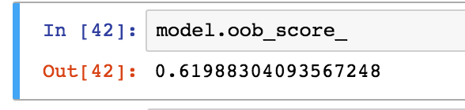
Random Forest
Try with 10001 estimators, max features : 1000
Try with 10001 estimators
Feature Importance:
Feature Importance:
Score
Score

Slide 11
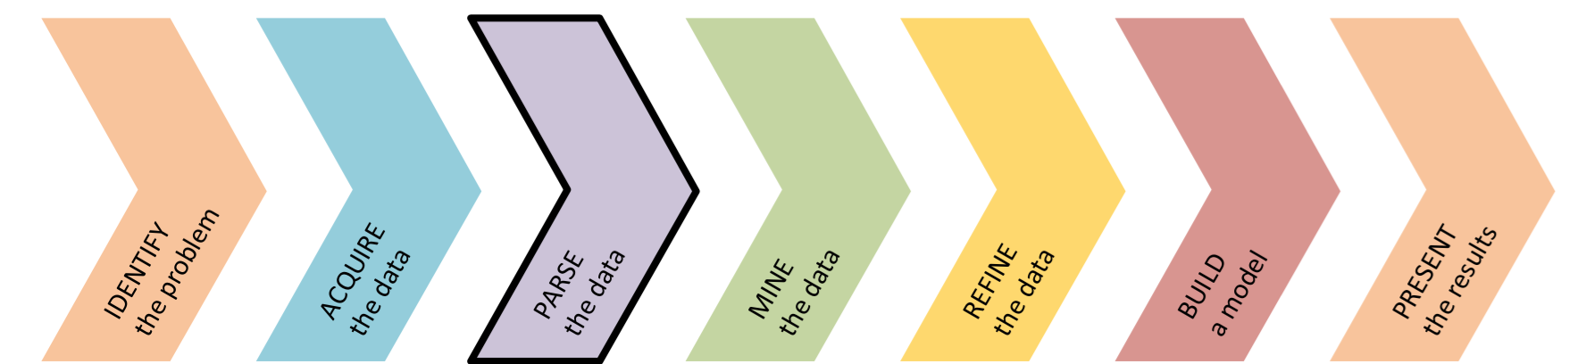
Approach

Slide 12
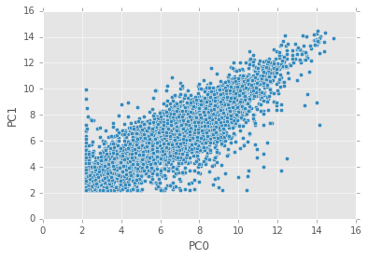
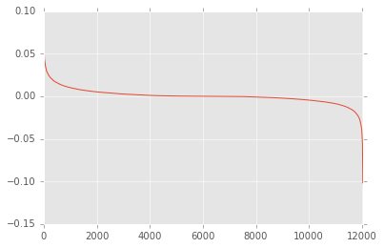
Principal Component Analysis
1st two principal components do not necessarily classify
Plot all 12000 principal components in ascending order of value

Slide 13
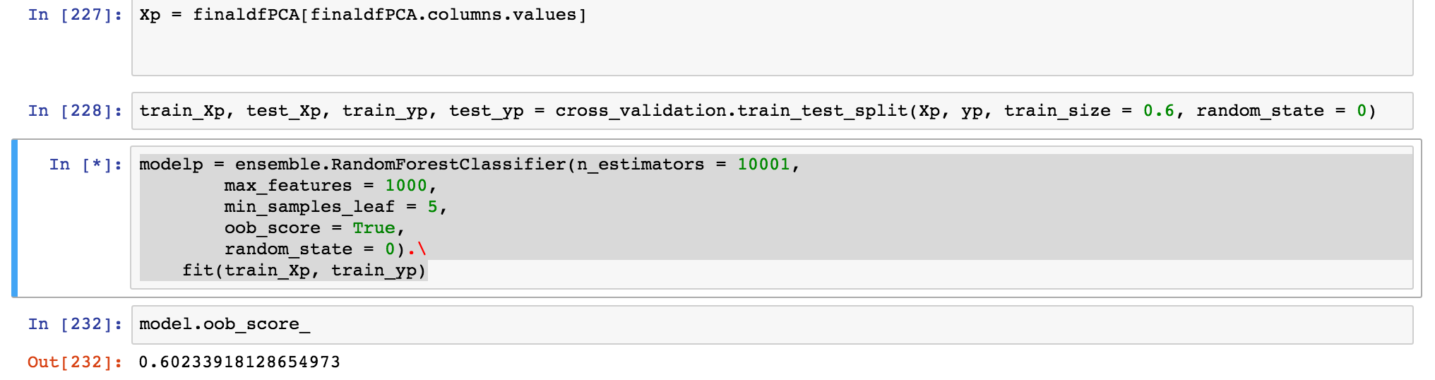
Feature Engineering
Select 1000 top features and 100 bottom features from PCA.
Filter the dataset to have only these features.
Random forest classifier oob score = ~60%

Slide 14
Further Improvements
I started grid search last week on random forest classifier with 10000 estimators and 1000 features. Is it finished?
Try classification in pca space itself. But I will loose feature meaning.
Correlation between features.

Slide 15
THanks

