Slide 1

Fully Connected Graph
Workshop: Pointers and Recursion

Slide 2

*
*
->POINTERS<-

Slide 3
Function calls -> Call-by-reference vs Call-by-value
Passing the address of a variable
Passing a variable

Slide 4

Memory on a computer

Slide 5
Memory on a computer
0x7fff550d209c

Slide 6
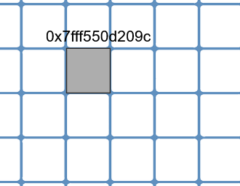
Officially…
The pointer variable contains an address and points to the data stored in that address.

Slide 7
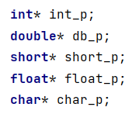
How to declare pointers
Type* pointer_var_name;

Slide 8
What is ‘&’?
Used to get the address of the variable
How to make the pointer point to something?
ptr = &point_to_me
ptr is pointing to where the variable ‘point_to_me’ is stored

Slide 9
Demo 1
Declare a pointer
Make it point to something
Print the address the pointer stores
Address
var_name

Slide 10
What is dereferencing?
Simply - get the value of the variable the pointer is pointing to
Address
var_name

Slide 11
Demo 2
Declare a pointer
Make it point to something
Change the value of the variable the pointer is pointing to
Change it so the pointer points to something else
Address
New_address
var_name = 42
to
var_name = 1
new_var_name
var_name

Slide 12
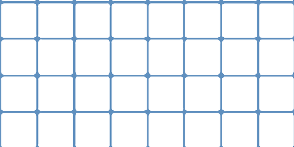
Allocating memory - malloc and calloc
Malloc - memory allocation
Takes 1 parameter
ptr = malloc(sz∗sizeof(int))
Uninitialised memory returned
Calloc - contiguous allocation
Takes 2 parameters
ptr = calloc(sz, sizeof(int))
Initialised memory - all bytes set to 0

Slide 13
Demo 3
Write a function to duplicate an array n times and return it as a matrix

Slide 14
Recursion

Slide 15
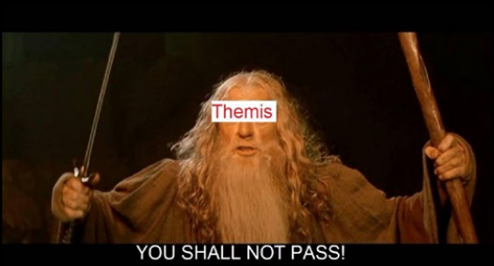
Tips and conclusions
Use pen and paper to understand the problem
Use the resources available on the Cover website and Themis
Solve exercices/labs

