Slide 1
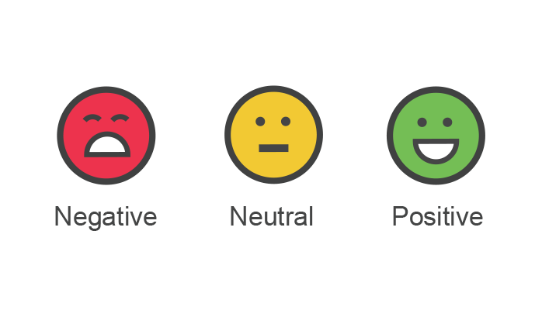
Sentiment Analysis
Technique & Application on TripAdvisor
Mai and Yvonne

Slide 2
Outline
Definition
Applications
Component
Case Study on United Airline Crisis Management
Sentiment Analysis on TripAdvisor Hotel Review

Slide 3
Definition of Sentiment Analysis
To determine emotional tone behind words
Positive, negative, or neutral
Use of natural language processing (NLP) to analyze online conversation

Slide 4
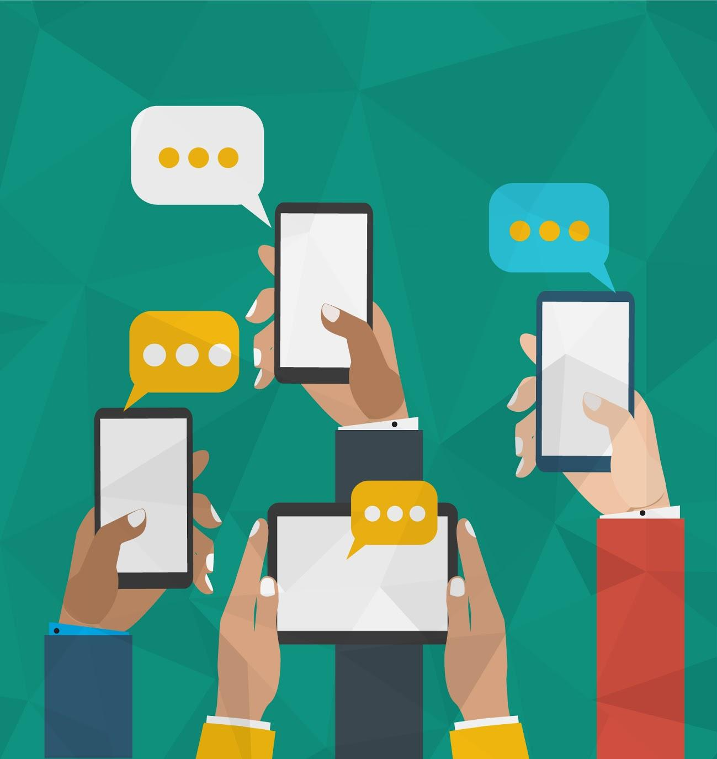
Definition of Sentiment Analysis
6,000 tweets every second
400 hours of YouTube videos every minute
500,000 Facebook comments every minute

Slide 5
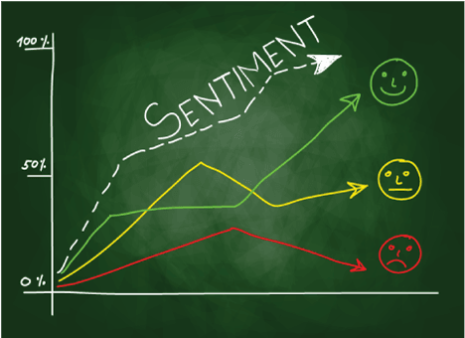
Advantages of Sentiment Analysis
Scalability
Real-time analysis
Consistency
Notes:
Scalability: Process vast amounts of data efficiently and at low-cost.
Real-time analysis: Immediately identify and assess potential crises, from PR to customer support.
Consistency: Apply the same criteria to all data, reducing variance.

Slide 6
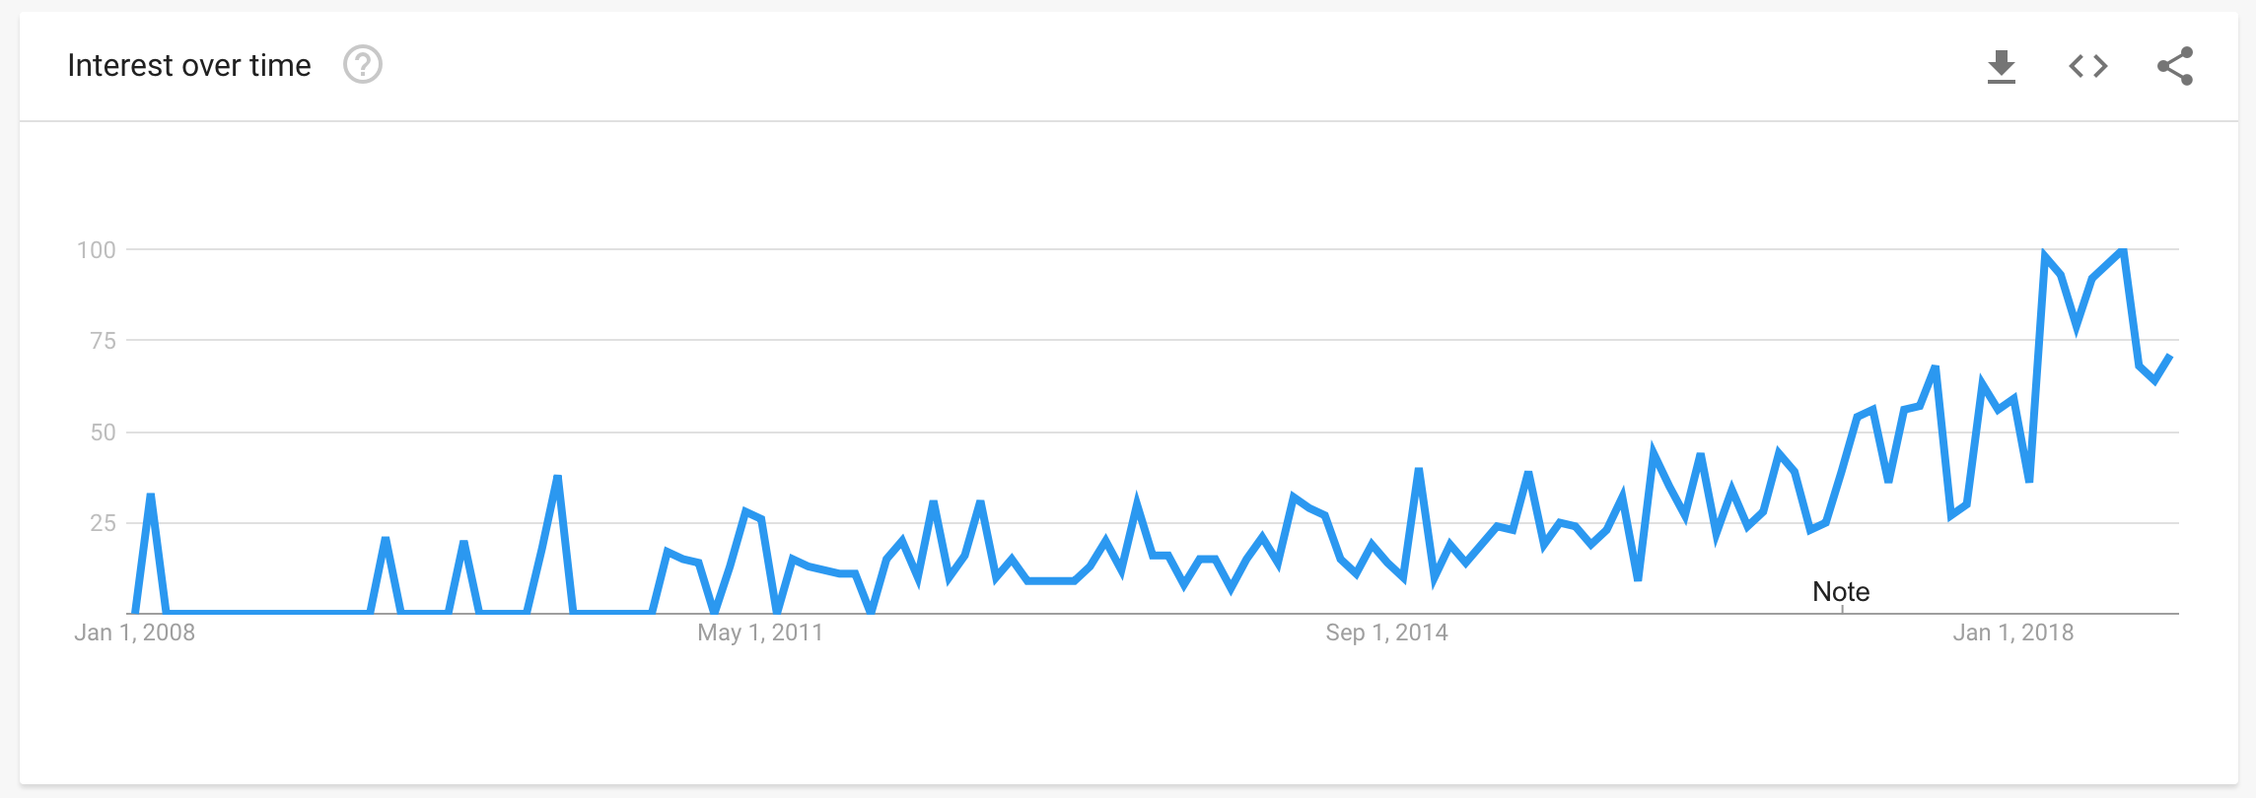
Interest on Sentiment Analysis Over Time
Notes:
https://www.google.com/trends/explore#q=sentiment%20analysis
In recent years there has been a steady increase in interest from companies and researchers in Sentiment Analysis. The rise of social media such as blogs and social networks has fueled interest in sentiment analysis.With the proliferation of reviews, ratings, recommendations and other forms of online expression, online opinion has turned into a kind of virtual currency for businesses looking to market their products, identify new opportunities and manage their reputations. As businesses look to automate the process of filtering out the noise, understanding the conversations, identifying the relevant content and actioning it appropriately, many are now looking to the field of sentiment analysis.

Slide 7
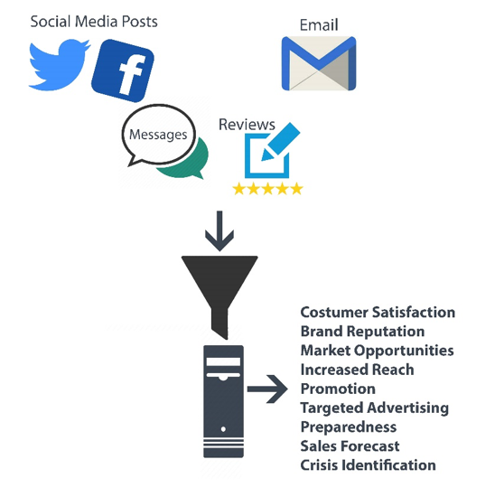
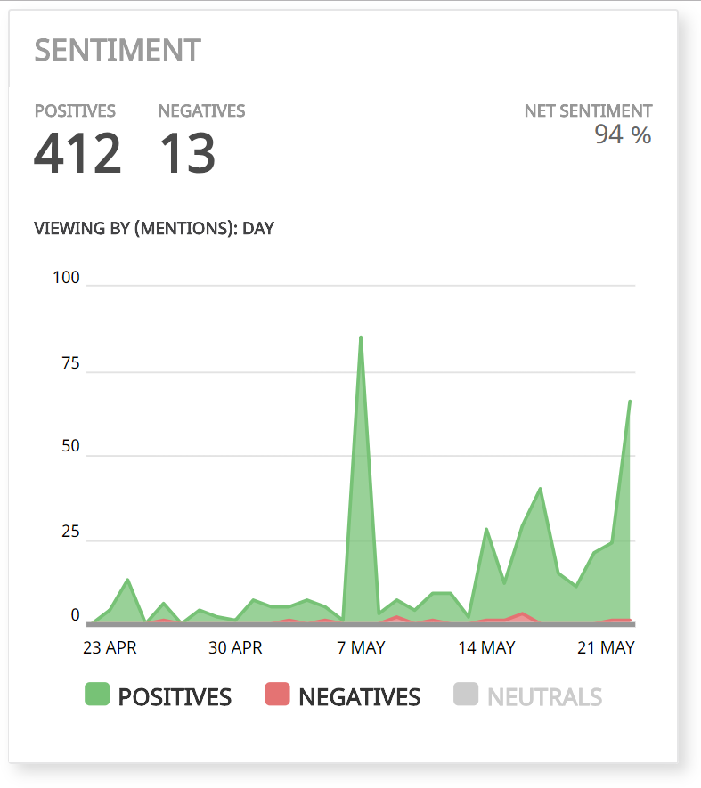
“Sentiments” Available from Social Media
Notes:
There are huge volume of available sentiments from social media platform: Twitter, Facebook, message boards, blogs, and user forums. When sentiment analysis is applied to social media channels, it can be used to identify spikes in sentiment, thereby allowing you to identify potential product advocates or social media influencers. By monitoring social media channels, companies and individuals can monitor their reputation and get timely feedback.

Slide 8
Applications of Sentiment Analysis
Businesses and organizations: give business valuable insights to how people feel about your product brand or service
Individuals: interested in other’s opinions when purchasing a product or using a service or finding opinions on political topics
Financial market: stock picking
Government intelligence: track how voters feel about issues and candidates.

Slide 9

Applications of Sentiment Analysis
It allows business to track:
Brand reputation & monitoring
New product development
Crisis management
Customer Services
Advertising

Slide 10
Component of Sentiment Analysis
Input:
I love iPhone X
Input:
I don’t like iPhone X
Output:
Sentiment Score: + 0.83332451000 Polarity: Positive
Subjectivity: Subjective Subjectivity Confidence: 1
Output:
Sentiment Score: -0.941234500001 Polarity: Negative
Subjectivity: Subjective Subjectivity Confidence: 1
Notes:
Using machine learning algorithms, we can train a model to associate particular inputs (texts) with corresponding outputs (tags). The more we train our model, the more accurate it becomes. The algorithm is designed and guided by human intelligence, but maximized by the automating power of computers.
The sentiment of a text is expressed using a sentiment score which can fall in the range -1 to +1. Where +1 represents completely positive, -1 represents completely negative and 0 represents neutral. For example if I wrote “Today is a beautiful day”, the sentiment score of this text would be +1.
The Subjective field is used to identify whether the text is objective or subjective. The Subjectivity Confidence field simply measures the confidence of the program that the Subjectivity is correct

Slide 11

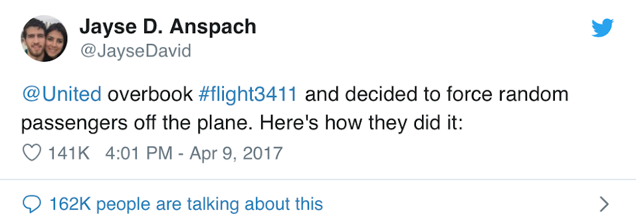
Sentiment Analysis Case Study - Crisis Management from United Airlines Incident
Notes:
The crisis started with a series of Tweets and Facebook posts from several passengers about the treatment of Kentucky Doctor David Dao while on United Express Flight 3411. Many of the posts included videos shot on mobile phones, which showed Dr Dao being violently removed from his seat and dragged from the plane.

Slide 12
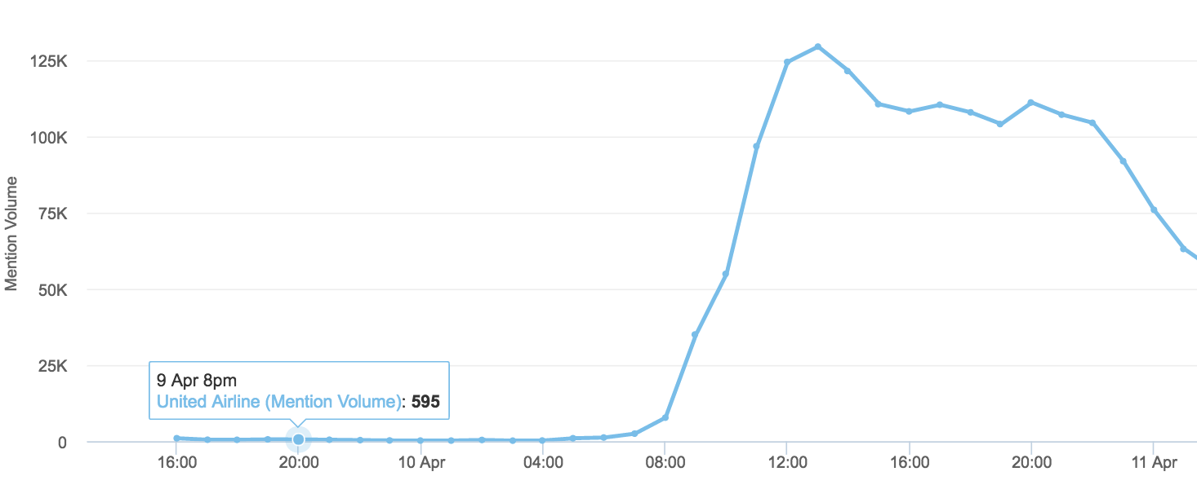
Sentiment Analysis Case Study - Crisis Management from United Incident
Notes:
The first Tweets about the incident starting appearing online between 7-8PM EST on Sunday, April 9

Slide 13
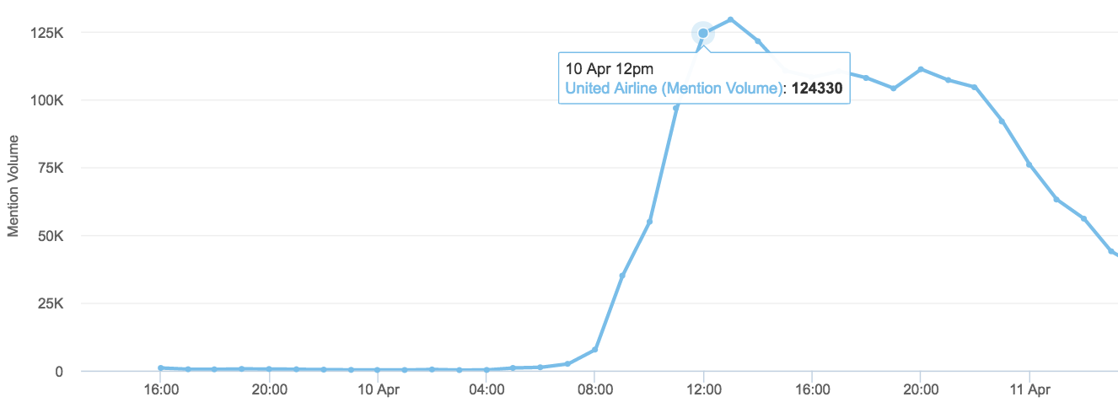
Sentiment Analysis Case Study - Crisis Management from United Incident
Notes:
In just a two hours United would go from under 1,000 mentions an hour to nearly a quarter of a million mentions between 12-1 pm EST.

Slide 14
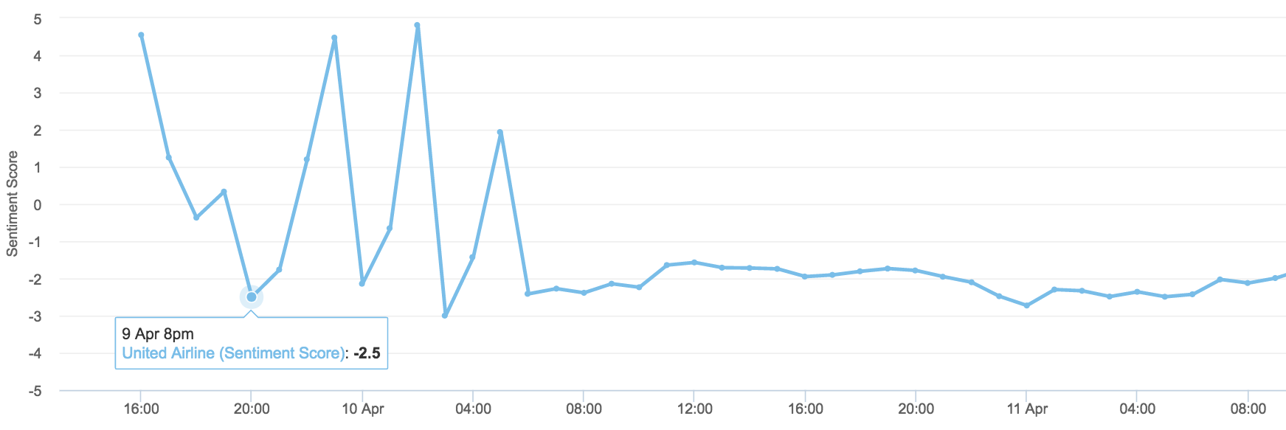
Sentiment Analysis Case Study - Crisis Management from United Incident
Notes:
there was a change in net sentiment following the first series of Tweets.

Slide 15
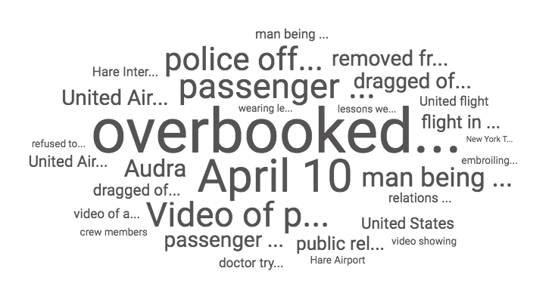
Sentiment Analysis Case Study - Crisis Management from United Incident

Slide 16
Analysis of TripAdvisor Hotel Review
Objective:
From hotel perspective: Extract customer insights from their reviews
From TripAdvisor: Potential value-added service that Trip Advisor can provide for Hotel owner
Steps:
Scraping Review Data from TripAdvisor
Text Mining
Sentiment Analysis
Compare Sentiment Analysis with the Rating
Notes:
Context & background information

Slide 17
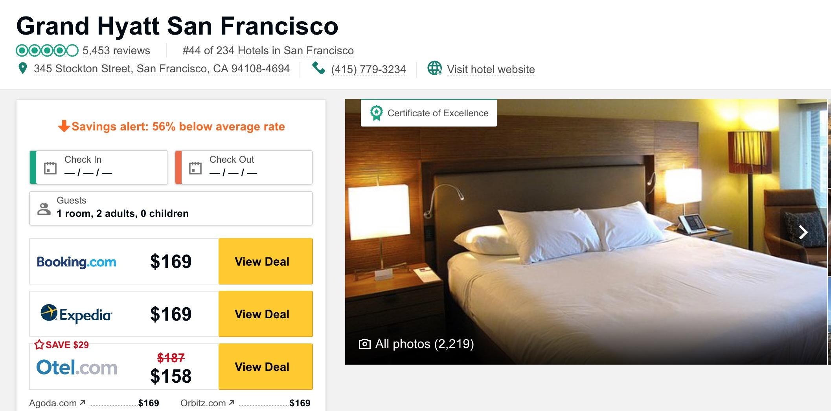
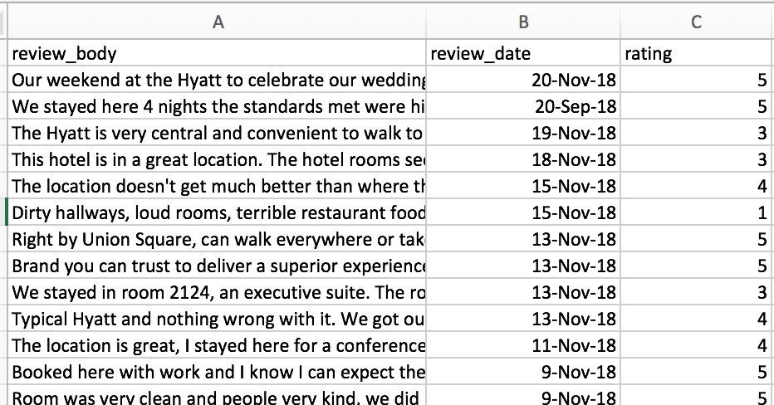
Step1: Getting Data from TripAdvisor
Using Python to scrape the Review data for Grand Hyatt San Francisco hotel.
4653 Reviews in English with review date and rating data.
Source: https://bit.ly/2EeXYc6

Slide 18
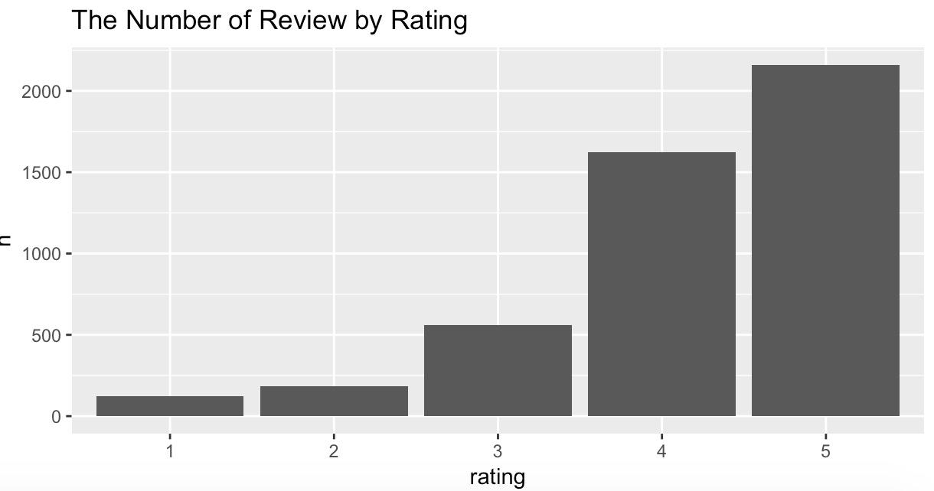
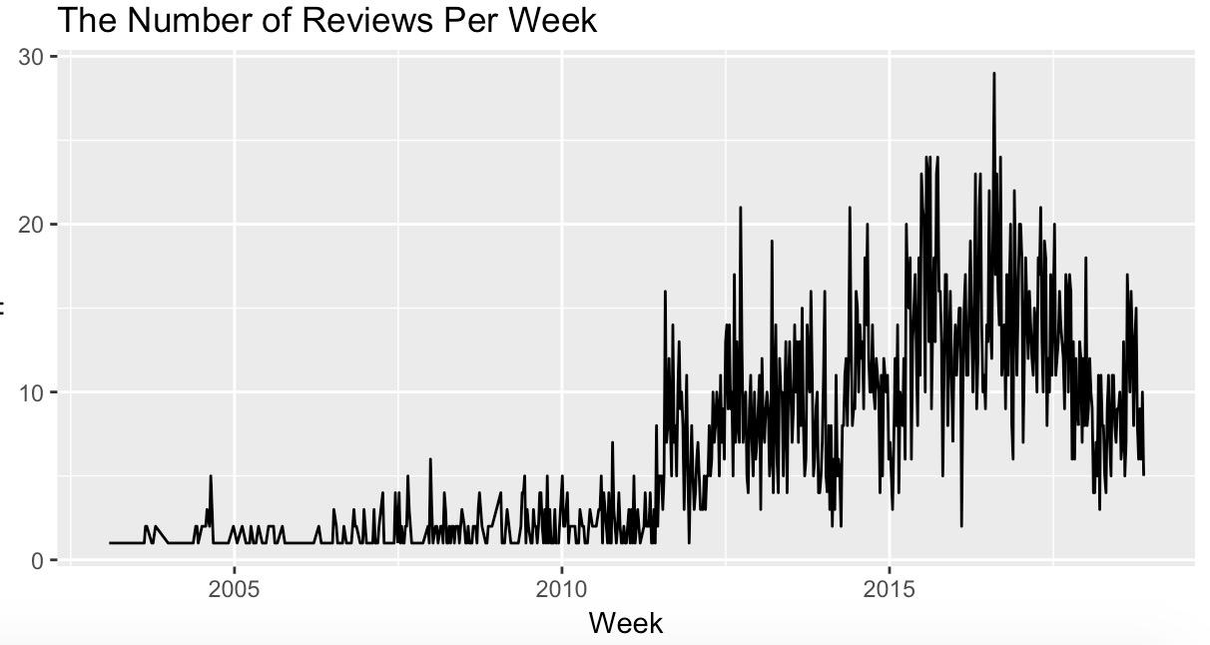
Step 2: Text Mining
With 4.0 average review, most of the reviews are 4 and 5 stars. Only 18.6% of the reviews have 1,2 and 3 ratings.
The number of reviews increase exponentially starting 2011-2016 and tend to decrease after that

Slide 19
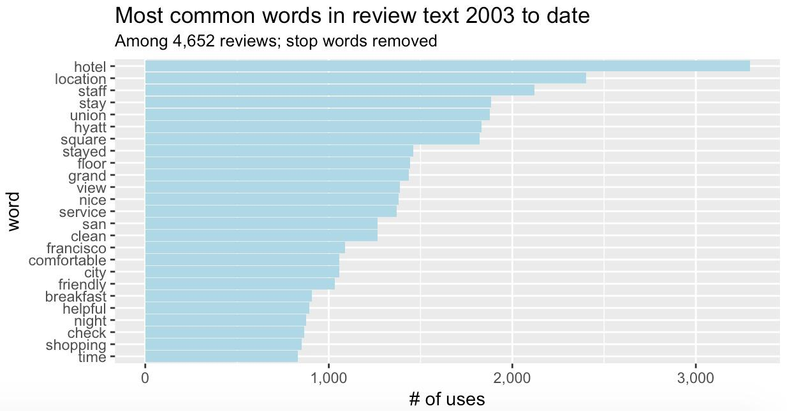
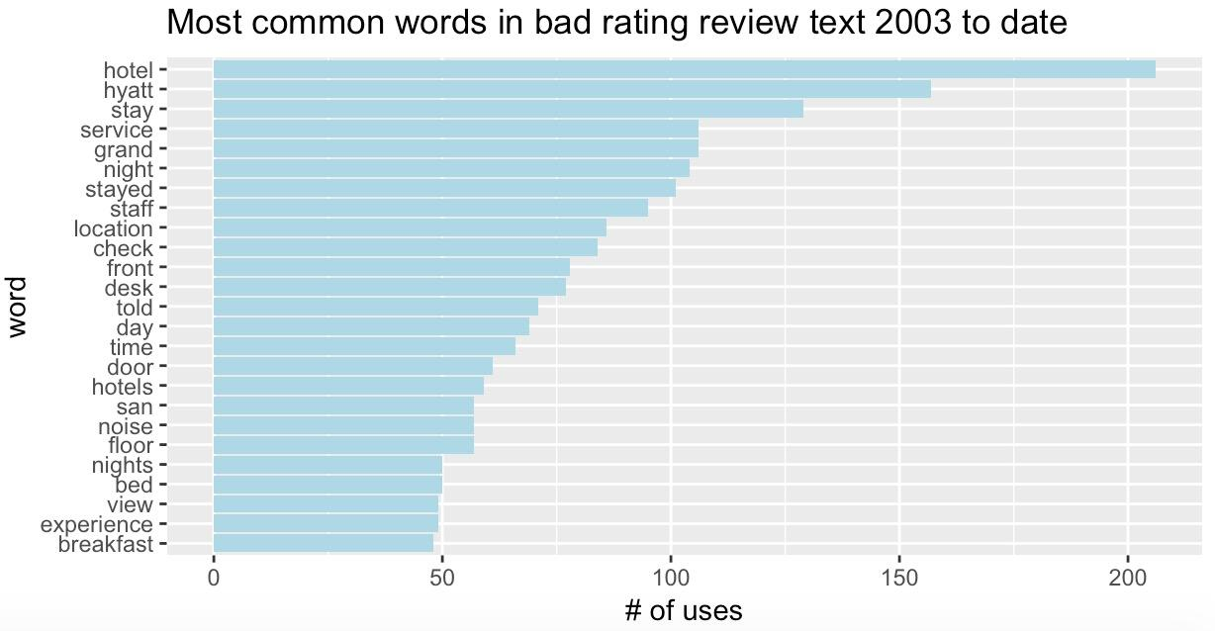
Step 2: Text Mining (cont.)
Customer usually care about:
Location
Staff
View
Breakfast
Shopping
Not a significant difference between bad reviews and good reviews, except that “noise" appear in bad reviews quite often.
This is a hint that “Noise" can be a problem of Grand Hyatt.
Notes:
biagram = 2 Consecutive words in the review text
Example about biagram

Slide 20
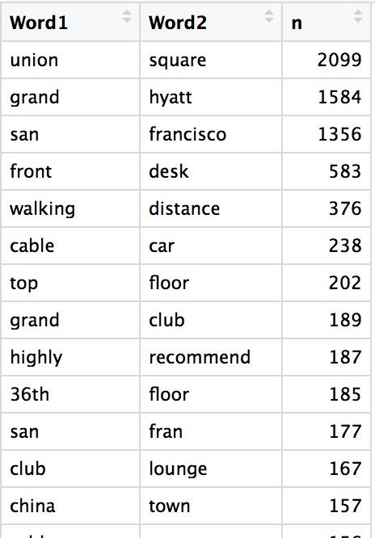
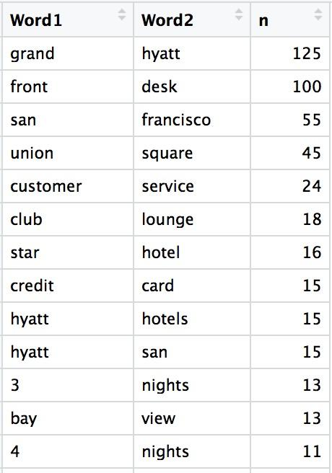
Step 2: Text Mining (cont.)
All Reviews
Bad Rating Reviews
Biagram: Each 2 consecutive words in a text will create a biagram
I don't like iPhone X
5 biagrams in this text: “I don't", “don't like", “like iPhone", “iPhone X"
A clearer picture of customer interest emerges when using biagram.
Overall Customers care about walking distance, cable car, 36th floor revenue, China Town, Club & Lounge, etc
Unhappy customers concern about “customer service", “credit card", “bay view", etc
Notes:
36th floor revenue where they can see the breathtaking view of Union Square

Slide 21
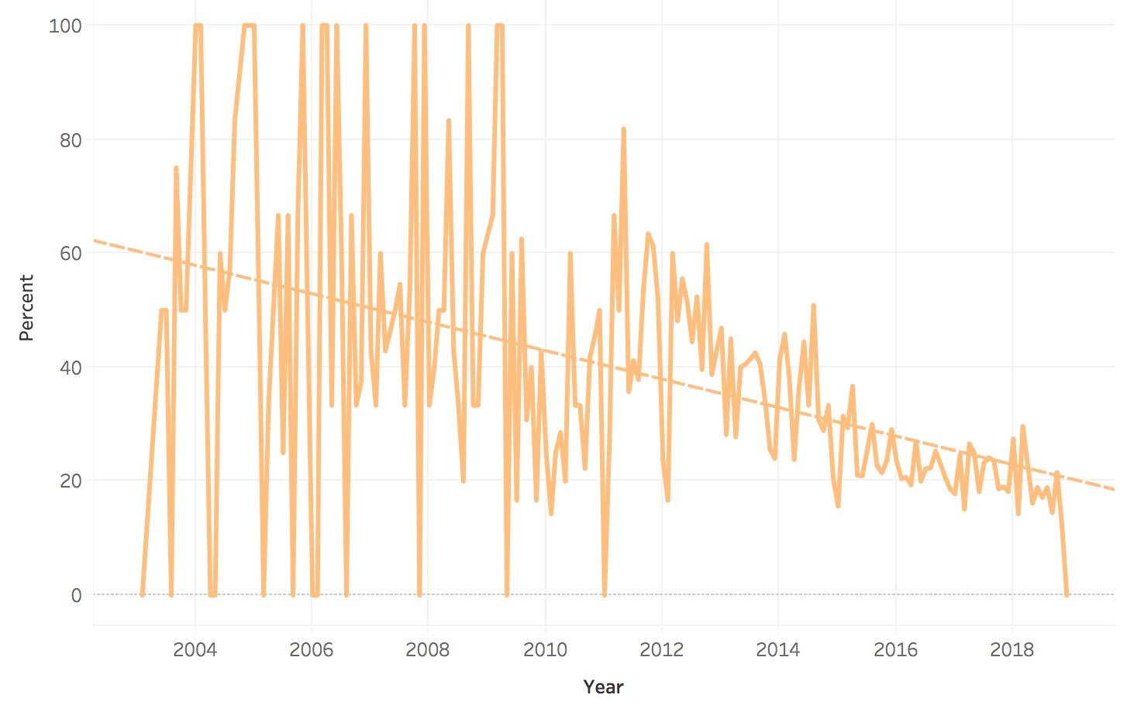
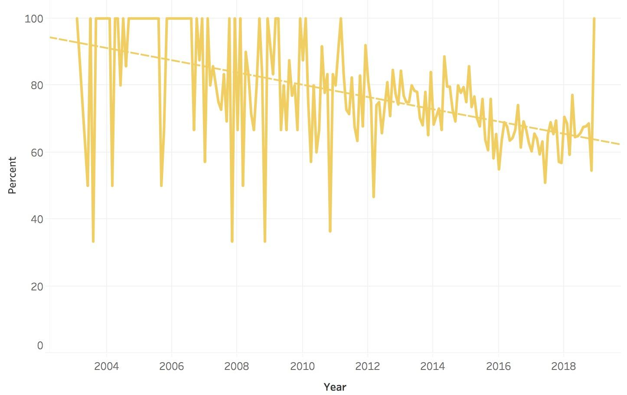
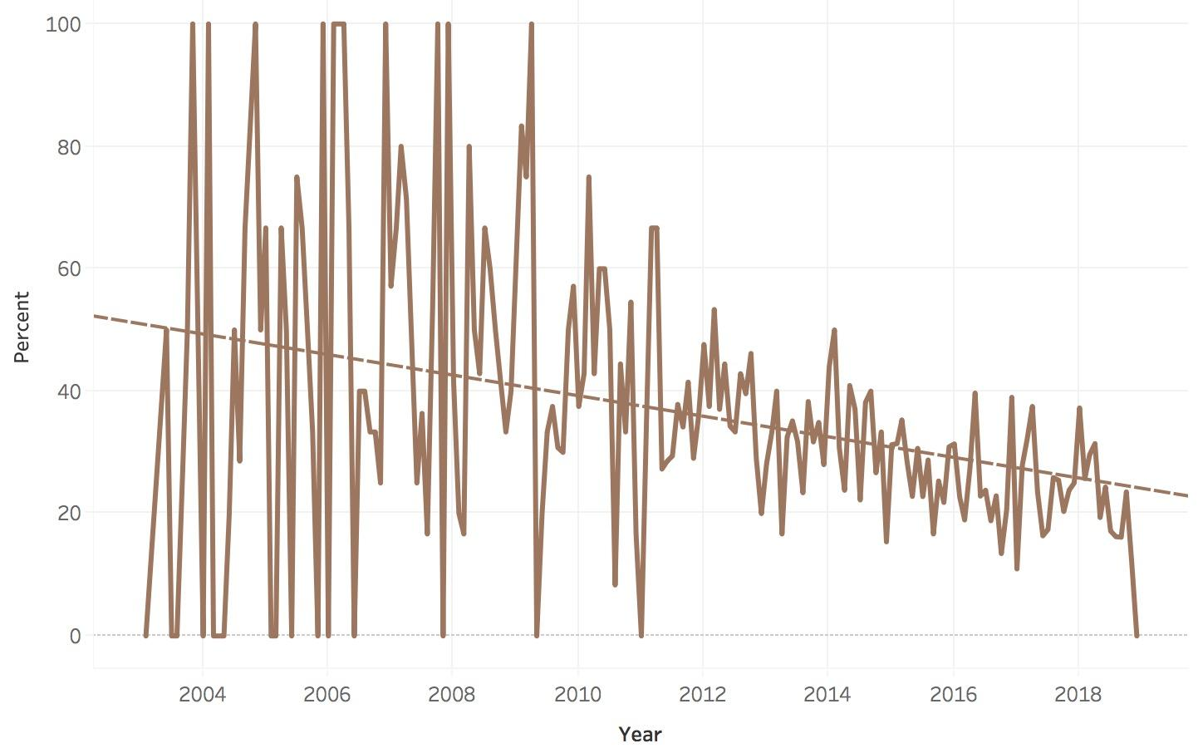
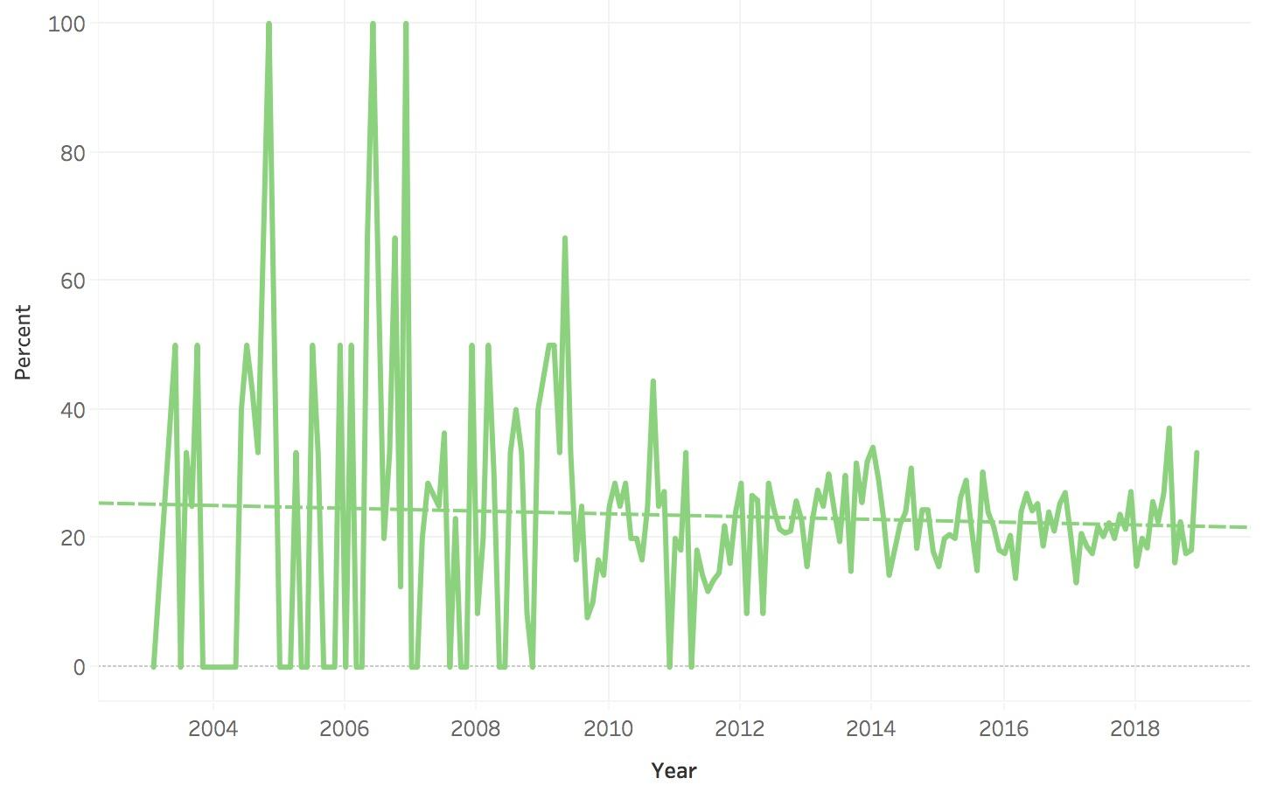
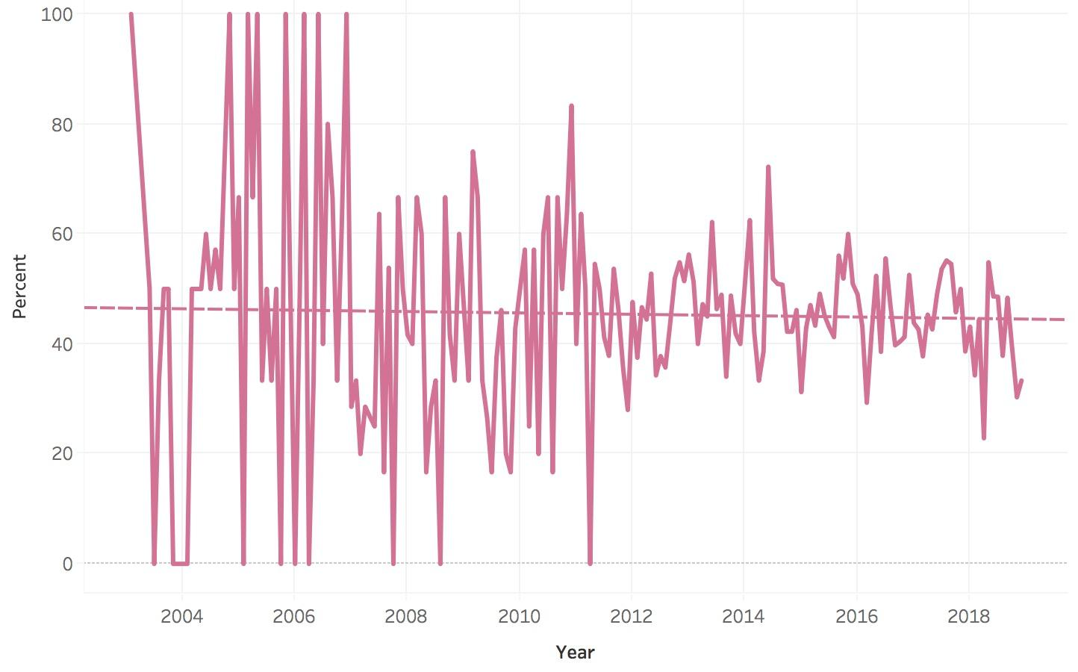
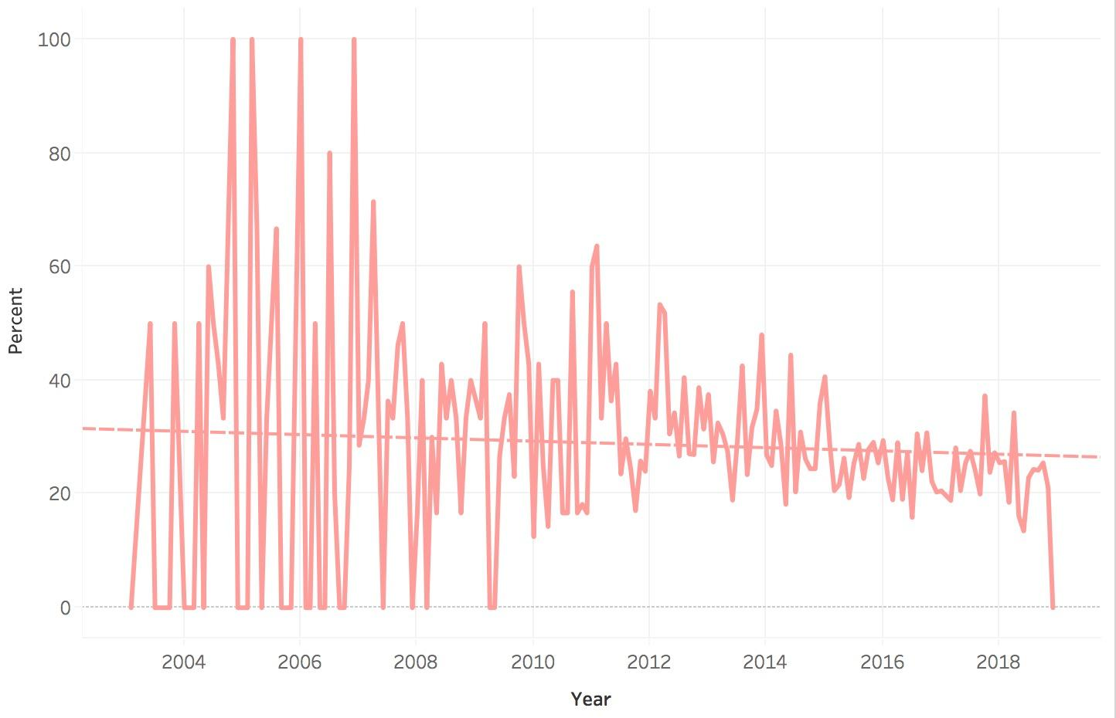
Step 2: Text Mining (cont.)
floor
Hotel
View
Staff
Friendly
San
Notes:
Above row: the words that have its frequency decreasing the most over the last 15 years
Below row: the words that have stable frequency over the last 15 years

Slide 22
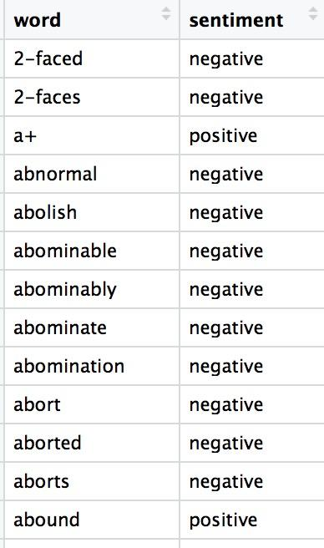
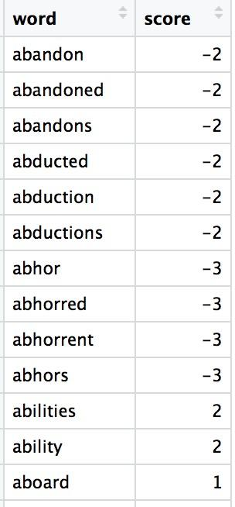
Step 3: Sentiment Analysis in R
Dictionaries of the words that are strongly associated to negative or positive sentiment
Sentiment Dictionary 1
Sentiment Dictionary 2

Slide 23
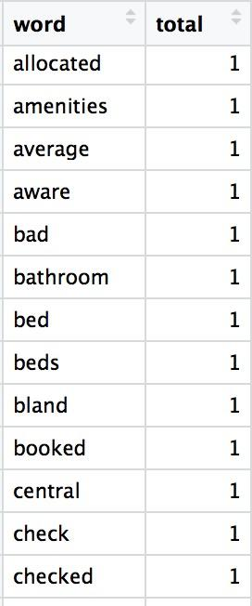
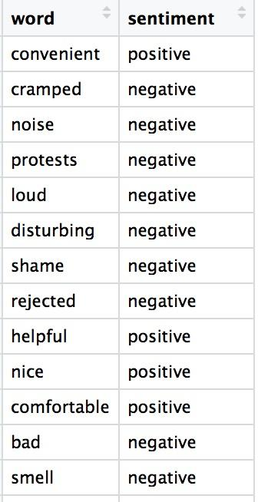
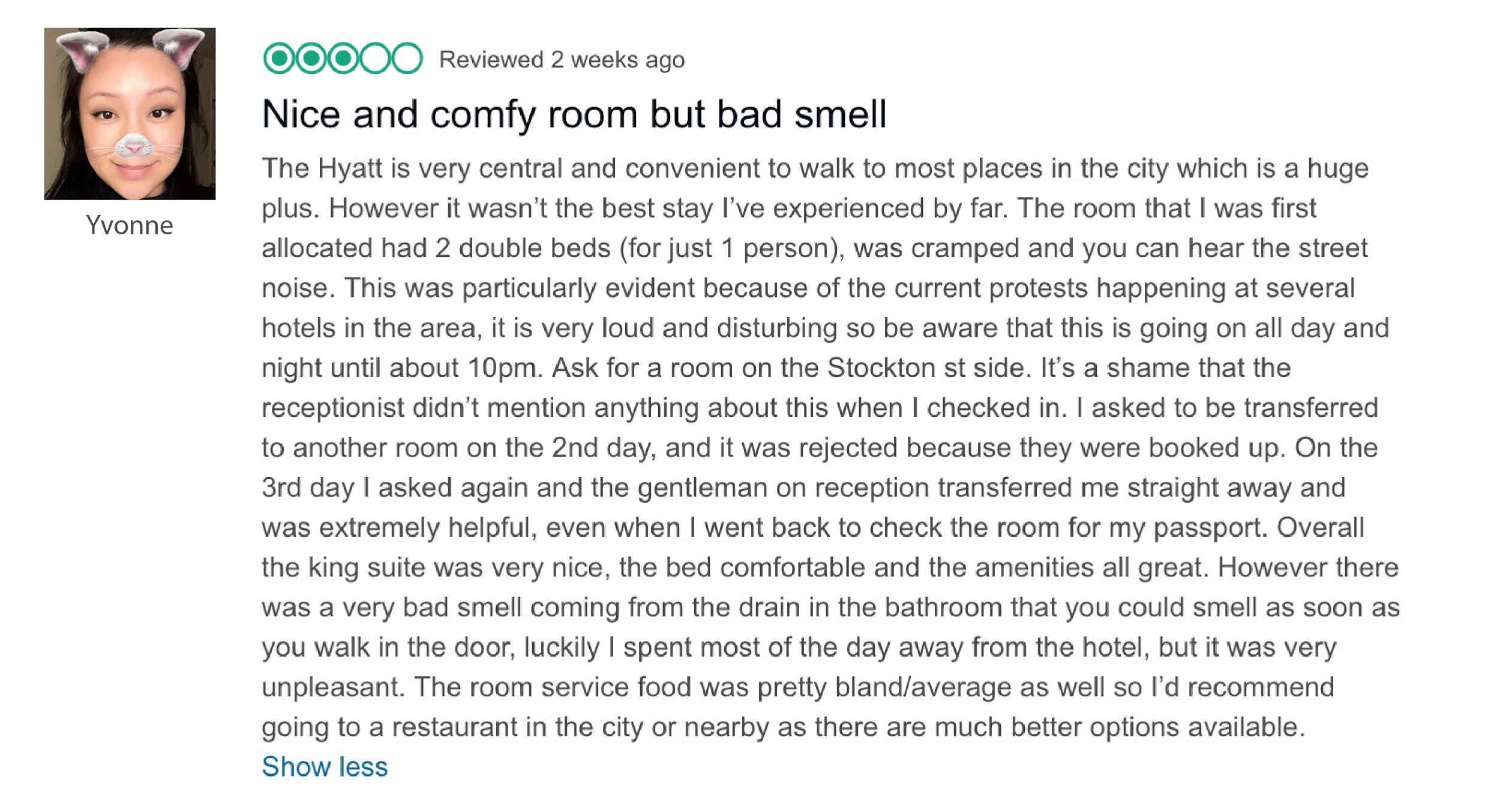
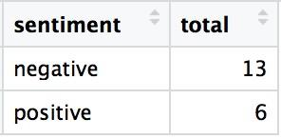
Step 3: Sentiment Analysis in R

Slide 24
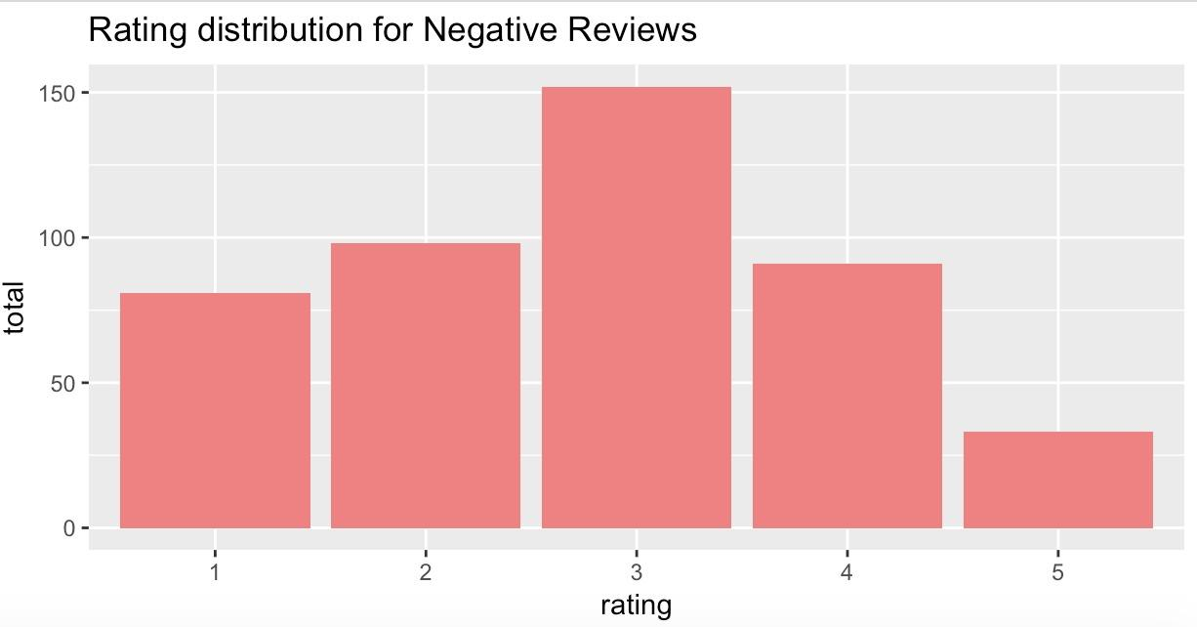
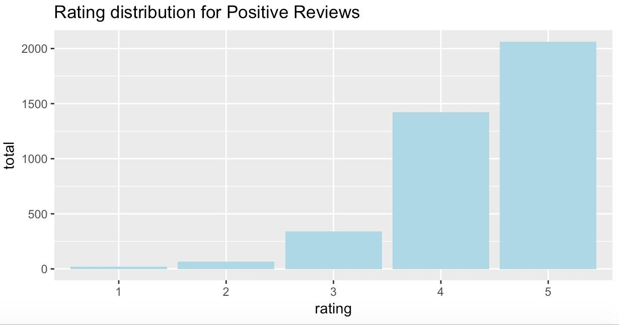
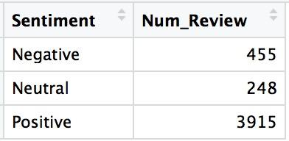
Step 3: Sentiment Analysis in R
This sentiment analysis have consistent result with rating data. The majority of 1,2,3 rating reviews lies in Negative sentiment and vice versa. However, some 4,5 rating reviews still belong to negative sentiment, which indicates that this approach has some limitations

Slide 25
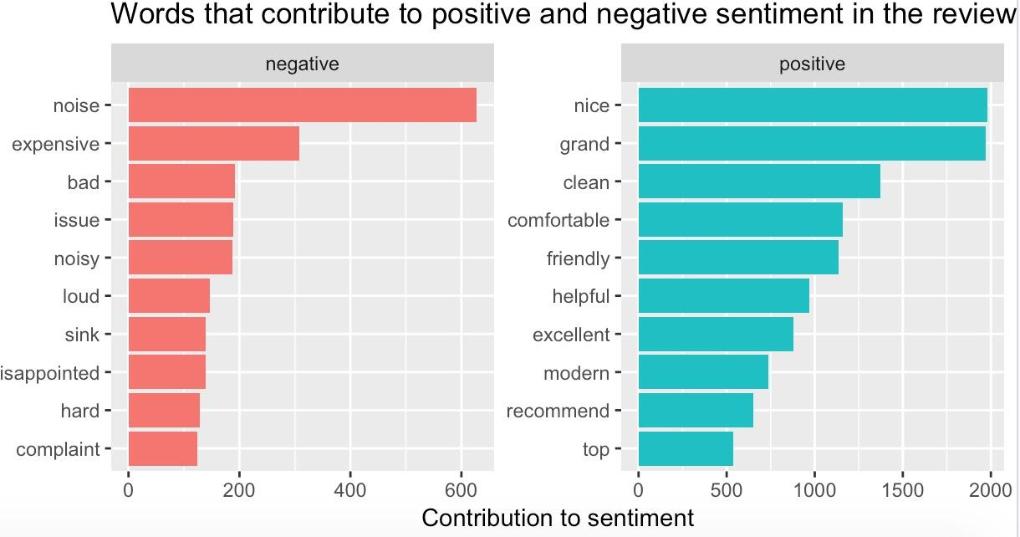
Step 3: Sentiment Analysis in R
People complain about the noise at Grand Hayatt
Pricing is also a problem with many customer
On the other side, positive comments tend to contain clean, comfortable, helpful, modern

Slide 26
Limitation
Unstructured text is complicated!
Negation words such as “Not", “No", “Without"
Ironic Language & Sarcasm
Conditional and question statements
Complex statements have different sentiments on different targets

