Slide 1

PROGRAMMING IN HASKELL
Topic 8.4
Function Composition

Slide 2
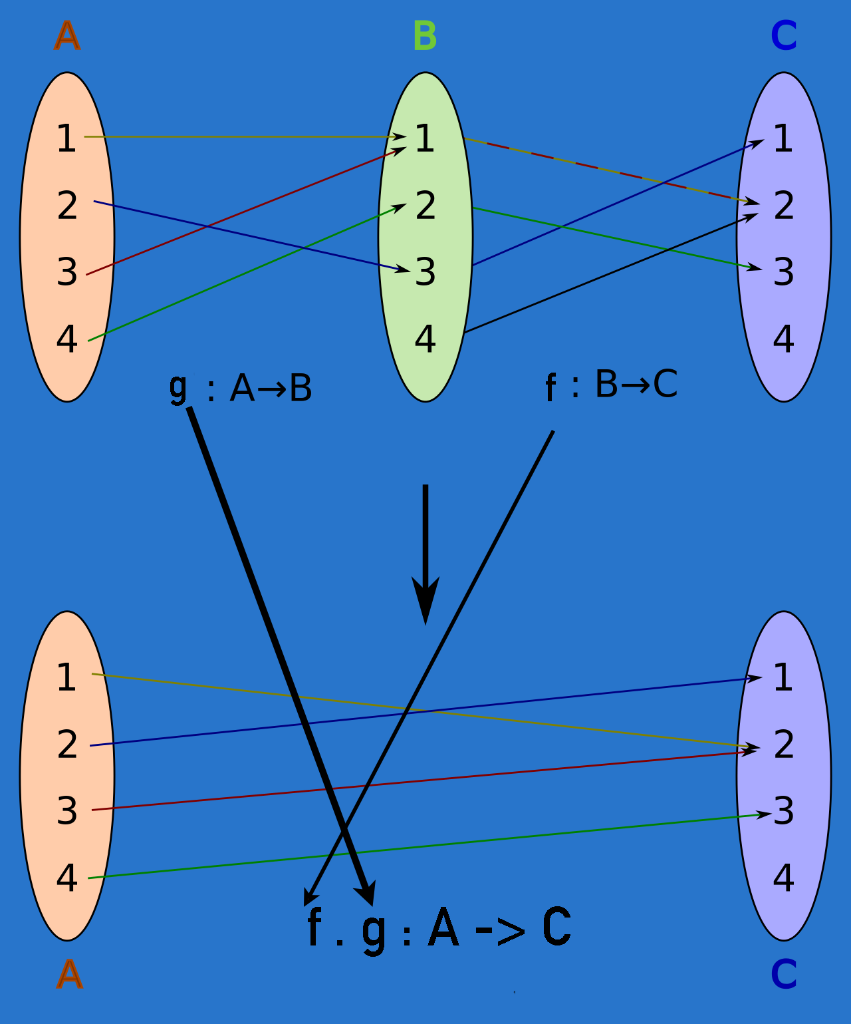
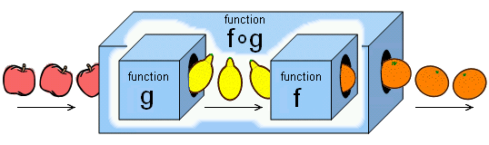
Function Composition
We sometimes use one function after another and we can see these functions as one, composed together:
(f . g) (x) = f (g (x) )

Slide 3
Function Composition
Call g with some value, call f with the result
(.) :: (b -> c) -> (a -> b) -> a -> c
f . g = \x -> f (g x)
Input parameter of f must be the same as the return type of g

Slide 4
Function Composition – why
Often convenient to create functions on the fly
Could use lambda, but composition may be more concise
[-5,-3,-2,-7]
[-5,-3,-2,-7]
*Main> map (\x -> negate (abs x)) [5,-3, -2, 7]
*Main> map (negate . abs) [5, -3, -2, 7]

Slide 5
Function Composition – why
*Main> map (\xs -> negate (sum (tail xs)))
Apply to
[[1..5],[3..6],[1..7]]
returns [-14,-15,-27]
Apply to
[[1..5],[3..6],[1..7]]
returns [-14,-15,-27]
*Main> map (negate . sum . tail)

Slide 6
Eta conversion with Function Composition
f ( g ( h (i (j (k x) ) ) ) )
can be rewritten as
(f . g . h . i . j . k ) x
myfunc :: a -> b
myfunc x = (f . g . h . i . j . k ) x
can be rewritten as
myfunc :: a -> b
myfunc = (f . g . h . i . j . k )

Slide 7
Eta Conversion
answer :: [Int] -> Int
answer xs = sum (map cube (filter by7 xs))
cube :: Int -> Int
cube x = x * x * x
by7 :: Int -> Bool
by7 x = x `mod` 7 == 0
can be rewritten using the eta reduction

Slide 8
Steps to introduce function composition
answer :: [Int] -> Int
answer xs = sum (map cube (filter by7 xs))
Each function operates on the output of the previous function:
filter by7 xs → Filters numbers divisible by 7.
map cube (filter by7 xs) → Cubes the filtered numbers.
sum (map cube (filter by7 xs)) → Sums the cubed numbers.
Our goal is to express the function using functional composition
and eliminate xs if possible.

Slide 9
Applying Function Composition
We use the composition operator (.) which allows us to rewrite:
f (g (h x)) ⟶ (f . g . h) x
Since xs is simply being passed through all the functions, we can remove it by introducing function composition:
answer = sum . map cube . filter by7

Slide 10
Break it down
filter by7 produces a list.
map cube transforms that list.
sum reduces the list to a single value.
As function composition applies functions from right to left:
answer = sum . map cube . filter by7
Is equivalent to
answer xs = sum (map cube (filter by7 xs))

Slide 11
Example Usage
If we run:
answer = sum . map cube . filter by7
answer [1, 7, 14, 21]
filter by7 [1, 7, 14, 21] → [7, 14, 21]
map cube [7, 14, 21] → [343, 2744, 9261]
sum [343, 2744, 9261] → 12348

Slide 12
More on Composition Operator
Object-level definition - xs still named
answer :: [Int] -> Int
answer xs = sum . map cube . filter by7 xs
can be rewritten , by removing xs when it is the rightmost term on each side of =
Function-level definition – xs argument is removed
answer :: [Int] -> Int
answer = sum . map cube . filter by7

Slide 13
Function Composition with multiple parameters
sumReplicatedMax :: Int -> Int -> Int
sumReplicatedMax x y = sum (replicate 5 (max x y))
To rewrite, note that :
max 6 9 → Finds the maximum of 6 and 9.
Since 9 is larger, this simplifies to 9.
replicate 5 9 → Creates a list with 5 copies of 9, producing [9,9,9,9,9].
sum [9,9,9,9,9] → Sums the elements, resulting in 45.

Slide 14
The process
To rewrite a function with lots of parentheses using function composition
first write out the innermost function and its parameters
then put a $ before it
compose all prior functions by omitting their last parameter (but not other parameters) and putting . between them

Slide 15
Function Composition with multiple parameters
sumReplicatedMax n x y = sum (replicate n (max x y))
Rewrite innermost function and put $ before it,
Then compose all prior functions
sumReplicatedMax n x y = sum . replicate n $ max x y
As x and y appear on the right of both sides of the equals (=) sign, we can reduce by dropping them
sumReplicatedMax n = sum . replicate n $ max

Slide 16
More on Composition Operator
fun xs = (filter odd . map square) xs
similarly can be rewritten
fun = filter odd . map square
Eta reduction
Eta abstraction
We try to eliminate the arguments as often as possible

Slide 17


