Slide 1

Functional Programming
Introduction to module
Ms. Mairead Meagher
Department of Computing and Mathematics
http://www.setu.ie/

Slide 2
Agenda
Why Functional Programming
Overview of course
Overview of Assessment

Slide 3
Why Functional Programming
A different way to think and think about programming and solving problems.
A great way to get good at recursion
A lot of companies are using it..

Slide 4
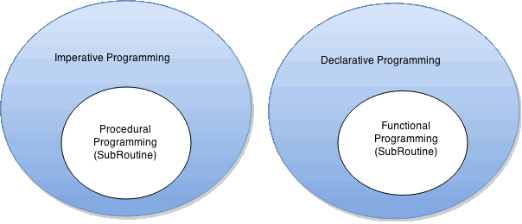
What’s different from what you’ve seen
How to do it, not what to do
What to do, not how to do it.

Slide 5
What’s different from what you’ve seen
Explain to your friend : What is an orange peanut?
(He only knows brown peanuts)
Imperative
Functional
How to do it, not what to do
What to do, not how to do it.
That brown peanut you have : Paint it orange.
That’s what an orange peanut is.
That brown peanut that you have:
If you had another peanut that’s just like it in every way except that it’s orange.
That’s what an orange peanut is.

Slide 6
Differences
Imperative
Functional
Loops
No loops !!!
Variables – use them for e.g. accumulating values
Variables cannot be changed
(immutability)
If [condition]
then [command]
else [command]
If [condition]
then [value]
else [value]
More later ….

Slide 7


So how will we approach this module?
14 weeks (12 weeks of tuition)
4 hours per week
Each topic will have associated with it:
  Lecture/s
  Labs
Each hour contact where we have either
    lecture OR
    Labs practising :
      Techniques we have seen in lectures
      Going through pre-defined sets of exercises online.

Slide 8
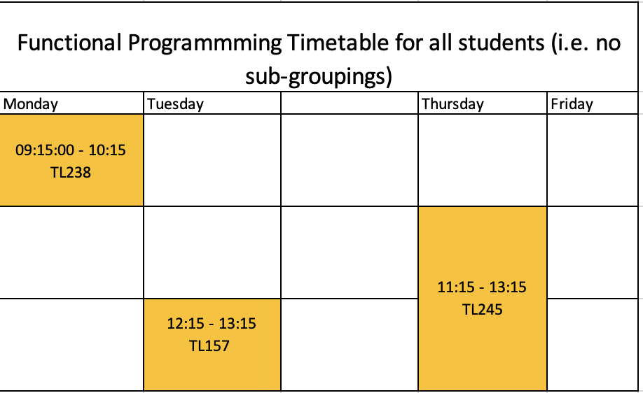
Timetable of Classes

Slide 9
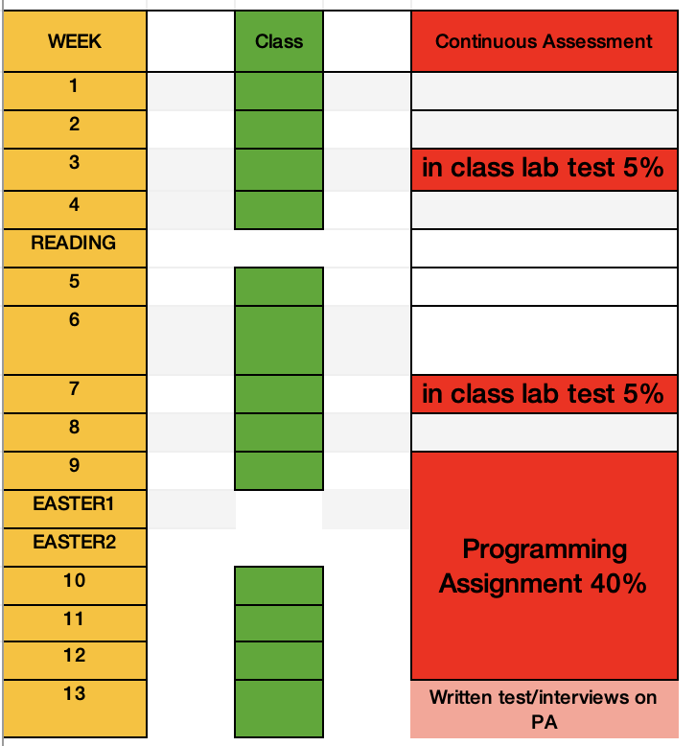
Breakdown of Assessment

Slide 10



Ethos of Module
Practice, practice, practice,
Engagement – ask questions,
Work submitted must be your fully understood by you,
Help me to help you.

Slide 11
Brief Overview of Course
We will use
Moodle – used for linking the current week’s content to the appropriate topic from the tutors course
Tutors (where course material is curated)
Slack for communication within the group and to me. This will be the main channel for communication.

Slide 12
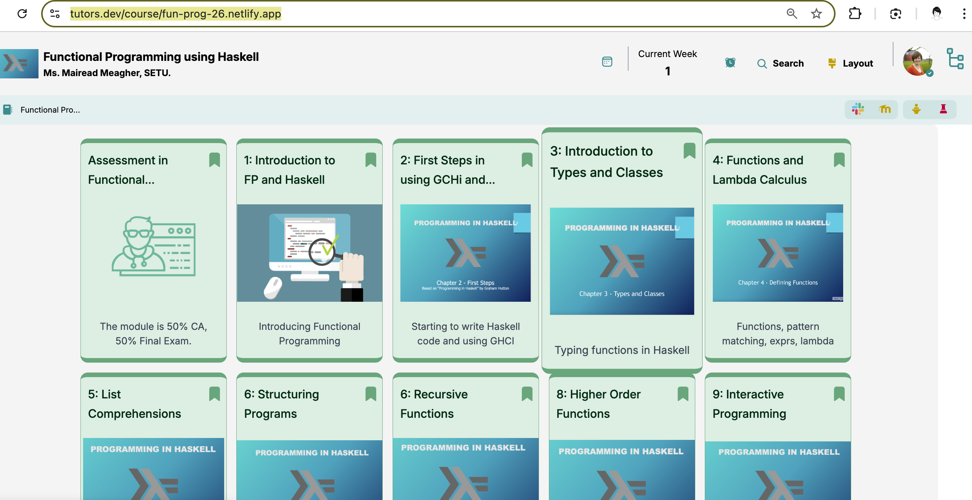
Brief Overview of Course - tutors
https://tutors.dev/course/fun-prog-26

Slide 13


Any questions?
Preferably the Slack channel
Or
mairead.meagher@setu.ie

