Slide 1

PROGRAMMING IN HASKELL
State Monads

Slide 2
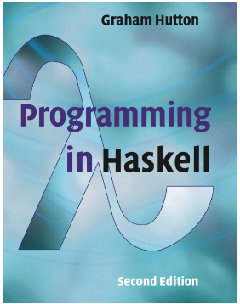

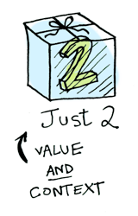
Based on lecture notes by Graham Hutton,
the book “Learn You a Haskell for Great Good”,
pictures from Aditya Bhargava, and https://wiki.haskell.org/State_Monad

Slide 3
Monads
We have seen how Monads work.
There is a nice introduction to Writer, Reader and State Monads here (Aditya Bhargava)
We will look at the State Monad most closely.

Slide 4
State Monad
There are a few things going on here
newtype is a lot like data, except for some details
what's "in" our data type? It's a function! And we're implicitly defining a function to extract our inner function from the data type: that function is called runState
It's type is s -> (a,s). Essentially, it's a type for any function that takes some initial state and then returns a tuple of (regular return value, new state).

Slide 5
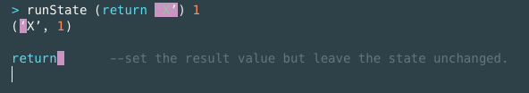


State Monad – primitives
return, runState

Slide 6
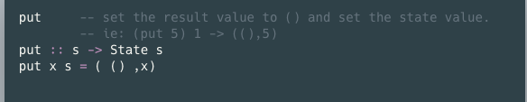
State Monad - put

Slide 7
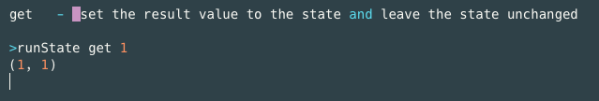
State Monad - get

Slide 8
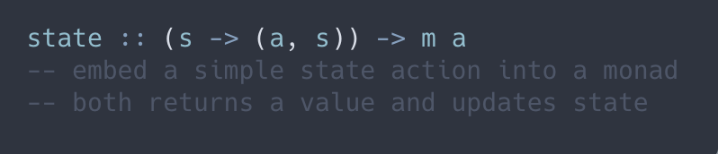
State Monad - state

Slide 9
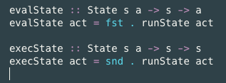
State Monad - helpers
evalState and execState just select one of the two values returned by runState.
EvalState returns the final result while execState returns the final state:

Slide 10
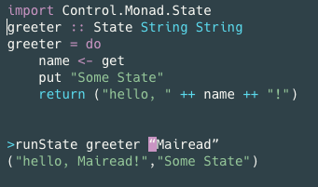
State Monad –simple example

Slide 11
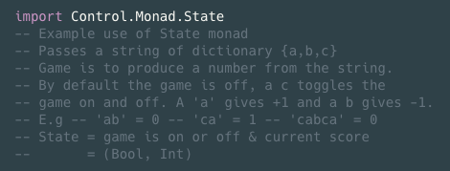
State Monad - parse example
*This code is from https://wiki.haskell.org/State_Monad

Slide 12
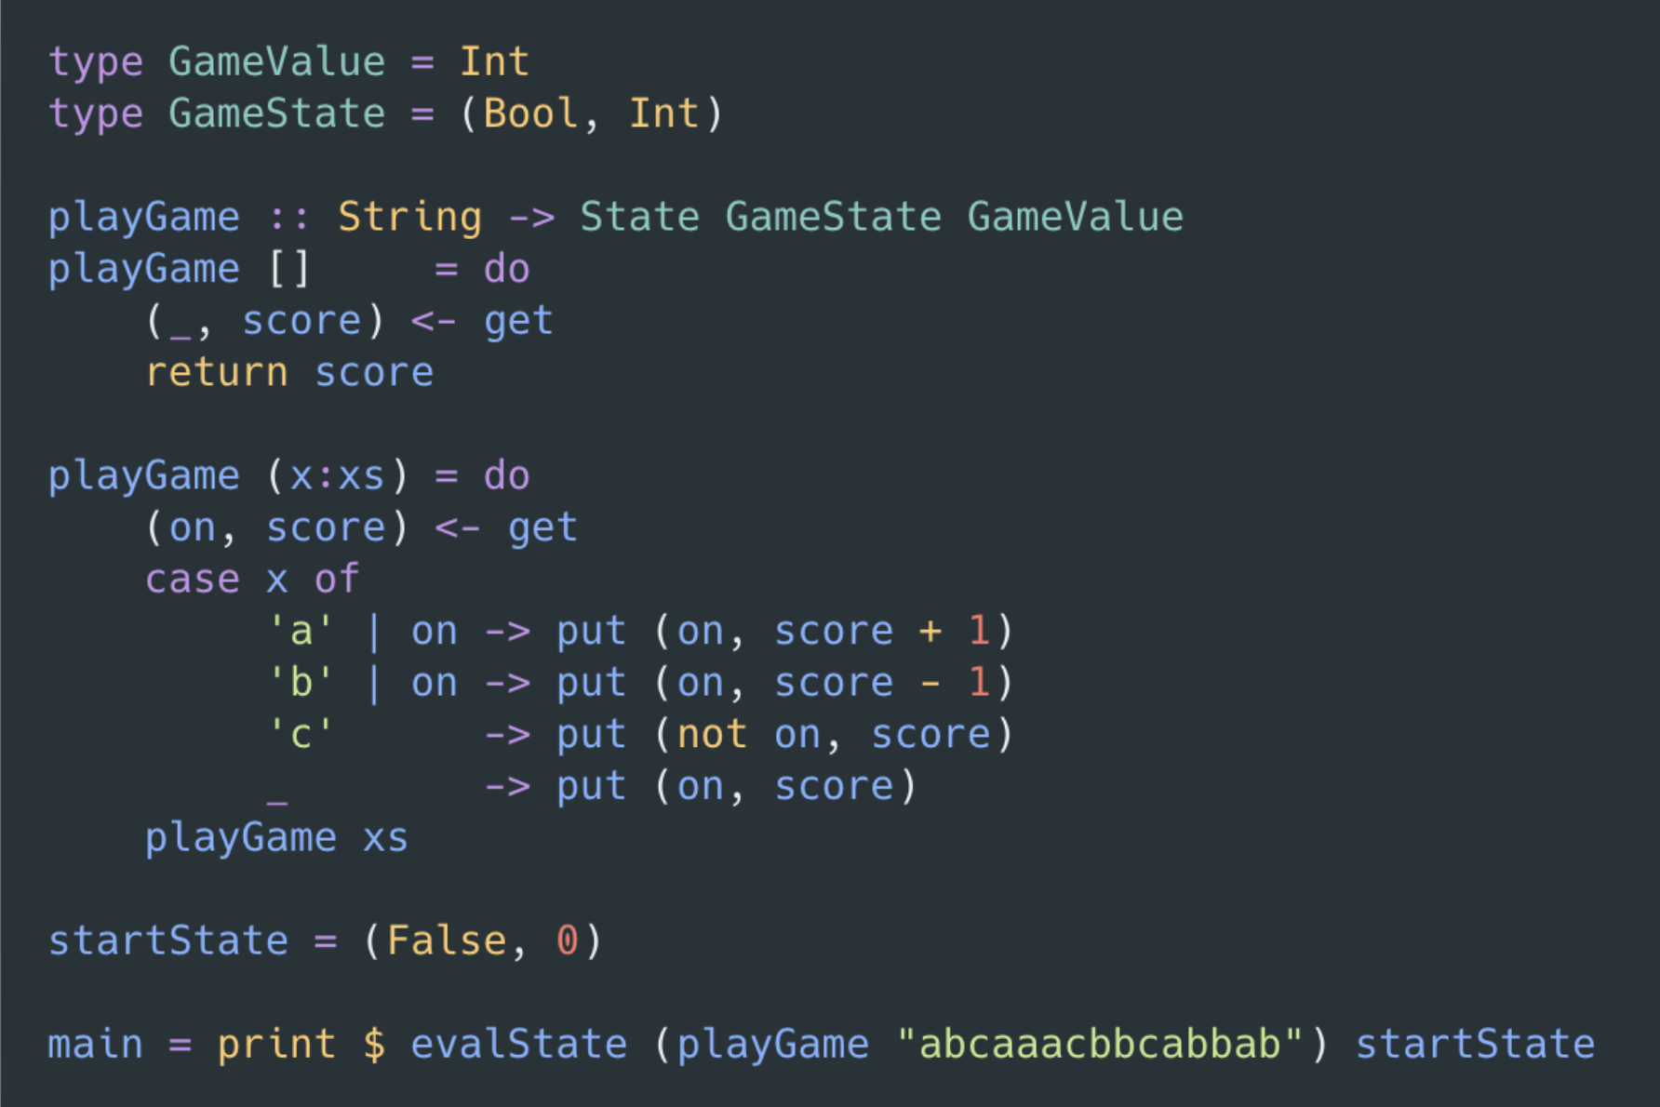
State Monad - parse example
Call by running main

Slide 13
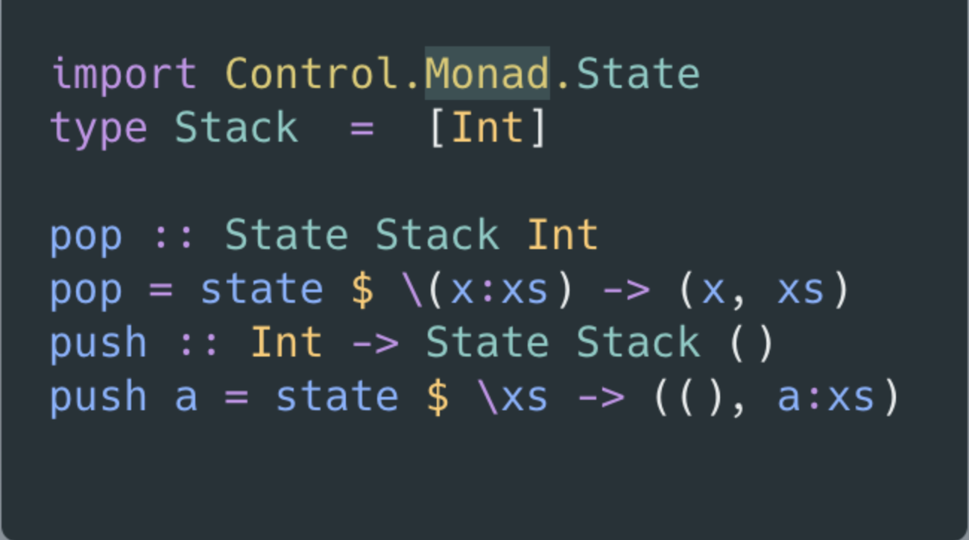
State Monad – stack example

Slide 14
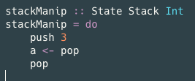

State Monad – stack example
Run as

Slide 15
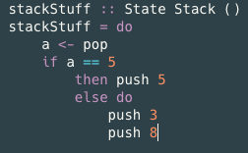

State Monad – stack example
Run as

Slide 16
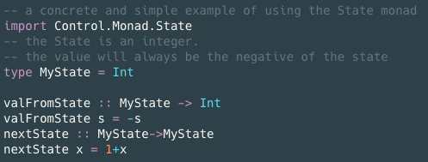
State Monad – simple state

Slide 17
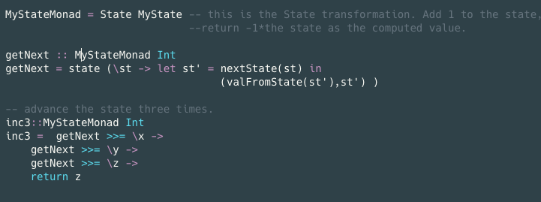
State Monad – simple state

Slide 18
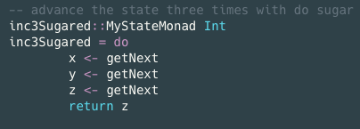
State Monad – simple state

Slide 19
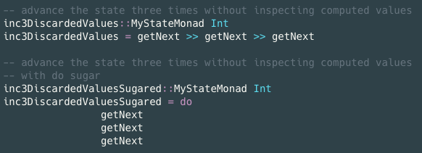
State Monad – simple state

Slide 20
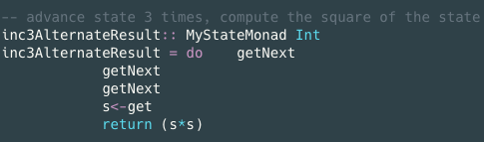
State Monad – simple state

Slide 21
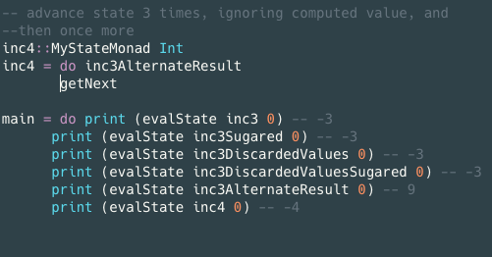
State Monad – simple state

Slide 22


