Slide 1

PROGRAMMING IN HASKELL
Topic 11.2 Functors, Applicatives

Slide 2
Before we start on Functors, remember our Maybe
data Maybe a = Nothing | Just a
we can define:
safediv :: Int → Int → Maybe Int
safediv _ 0 = Nothing
safediv m n = Just (m `div` n)
safehead :: [a] → Maybe a
safehead [] = Nothing
safehead xs = Just (head xs)

Slide 3

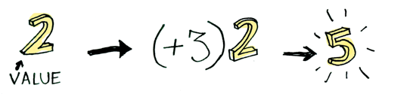
Applying a function to a simple value

Slide 4
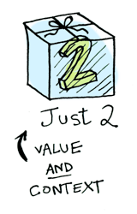
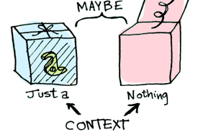
Any value can be in a context
when you apply a function to this value, you'll get different results depending on the context

Slide 5
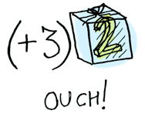
Functors
When a value is wrapped in a context, you can't apply a normal function to it
Enter fmap.
fmap knows how to apply functions to values that are wrapped in contexts.

Slide 6
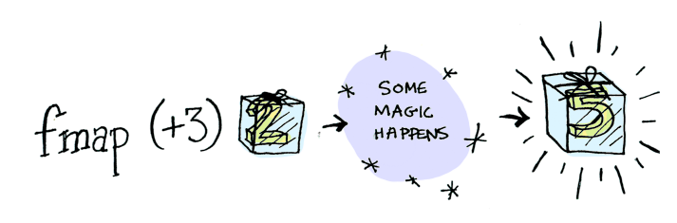
Functors
To apply (+3) to fmap

Slide 7
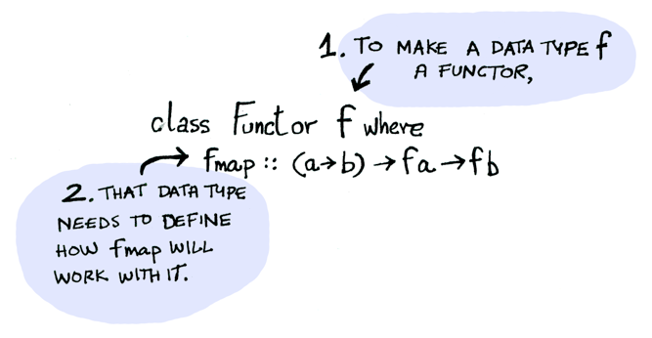
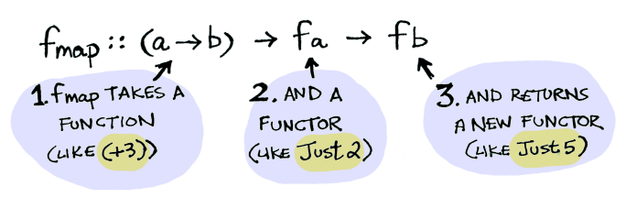
Functors

Slide 8
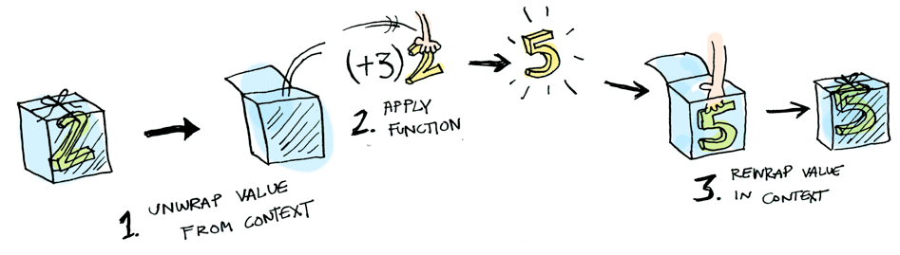
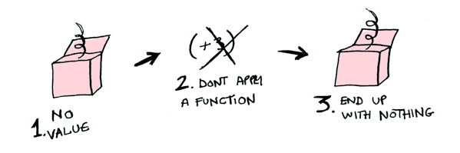
Functors

Slide 9
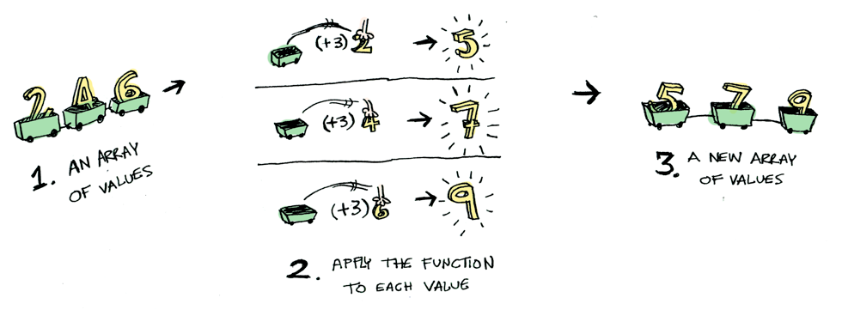
Functors
main > fmap (+3) [2,4,6]
[5,7,9]

Slide 10
Functors
Functors are a typeclass, just like Ord, Eq, Show, and all the others. This one is designed to hold things that can be mapped over; for example, lists are part of this typeclass.
class Functor f where
fmap :: (a -> b) -> f a -> f b
Essentially, fmap promotes an “ordinary” function, that takes a -> b, to a function that works over values in a context.

Slide 11
Map over Lists
map f xs applies f over all the elements of the list xs
map :: (a -> b) -> [a] -> [b]
map _ [] = []
map f (x:xs) = f x : map f xs
>map (+1) [1,2,3]
[2,3,4]
>map even [1,2,3]
[False,True,False]

Slide 12
Map over Binary Trees
Remember binary trees with data in the inner nodes:
data Tree a = Leaf
| Node (Tree a) a (Tree a)
deriving Show
They admit a similar map operation:
mapTree :: (a -> b) -> Tree a -> Tree b
mapTree _ Leaf = Leaf
mapTree f (Node l x r) =
Node (mapTree f l) (f x) (mapTree f r)

Slide 13
Map over optional values
Optional values are represented with Maybe data
Maybe a = Nothing | Just a
How does a map operation over optional values look like?

Slide 14
Map over optional values
How does a map operation over optional values look like?
mapMay :: (a -> b) -> Maybe a -> Maybe b
mapMay _ Nothing = Nothing
mapMay f (Just x) = Just (f x)

Slide 15
Map over optional values
mapMay applies a function over a value, only if it is present
>mapMay (+1) (Just 1)
Just 2
>mapMay (+1) Nothing
Nothing

Slide 16
Maps have similar types
map :: (a -> b) -> [a] -> [b]
mapTree :: (a -> b) -> Tree a -> Tree b
mapMay :: (a -> b) -> Maybe a -> Maybe b
mapT :: (a -> b) -> T a -> T b
The difference lies in the type constructor
▶ [] (list), Tree, or Maybe
▶ Those parts need to be applied to other types

Slide 17
Functors
A type constructor which has a “map” is called a functor
class Functor f where
fmap :: (a -> b) -> f a -> f b
instance Functor [] where
-- fmap :: (a -> b) -> [a] -> [b]
fmap = map
instance Functor Maybe where
-- fmap :: (a -> b) -> Maybe a -> Maybe b
fmap = mapMay

Slide 18
Higher Kinded Absraction
class Functor f where
fmap :: (a -> b) -> f a -> f b
In Functor the variable f stands for a type constructor
▶ A “type” which needs to be applied
▶ This is called higher-kinded abstraction
▶ Not generally available in a programming language
▶ Haskell, Scala and Rust have it
▶ Java, C# and Swift don’t

Slide 19
Functors generalize maps
Suppose you have a function operating over lists
inc :: [Int] -> [Int]
inc xs = map (+1) xs
You can easily generalize it by using fmap
inc :: Functor f => f Int -> f Int inc xs = fmap (+1) xs
Note that in this case the type of elements is fixed to Int, but the type of the structure may vary
You can easily generalize it by using fmap Note that in this case the type of elements is fixed to Int, but the type of the structure may vary

Slide 20
( <$> ) instead of fmap
Many Haskellers use an alias for fmap
(<$> ) = fmap
This allows writing maps in a more natural style, in which the function to apply appears before the arguments
inc xs = (+1) <$> xs

Slide 21
Back to trees
data Tree a = EmptyTree
| Node a (Tree a) (Tree a)
deriving (Show,Read,Eq)

Slide 22
An example run:
ghci> let nums = [8,6,4,1,7,3,5]
ghci> let numsTree =
foldr treeInsert EmptyTree nums
ghci> numsTree
Node 5 (Node 3 (Node 1 EmptyTree EmptyTree) (Node 4 EmptyTree EmptyTree)) (Node 7 (Node 6 EmptyTree EmptyTree) (Node 8 EmptyTree EmptyTree))

Slide 23
5
3
7
1
4
6
8
ET
ET
ET
ET
ET
ET
ET
ET

Slide 24
Back to functors:
If we looked at fmap as though it were only for trees, it would look something like:
(a -> b) -> Tree a -> Tree b
We can certainly phrase this as a functor, also:
instance Functor Tree where
fmap f EmptyTree = EmptyTree
fmap f (Node x leftsub rightsub) =
Node (f x) (fmap f leftsub)
(fmap f rightsub)

Slide 25
Using the tree functor:
ghci> fmap (*2) EmptyTree
EmptyTree
ghci> fmap (*4) (foldr treeInsert
EmptyTree [5,7,3,2,1,7])
Node 28 (Node 4 EmptyTree (Node 8 EmptyTree (Node 12 EmptyTree (Node 20 EmptyTree EmptyTree)))) EmptyTree

Slide 26
28
4
ET
ET
8
ET
12
ET
20

Slide 27
Another functor: IO actions
main = do line <- getLine
let line' = reverse line
putStrLn $ "You said " ++ line' ++ " backwards!"
putStrLn $ "Yes, you really said" ++ line' ++ " backwards!"
In the above code, we are getting a line as an IO action, then reversing it and printing it back out.
But – an IO is a functor, which means it is designed to be mapped over using fmap!

Slide 28
Another functor: IO actions
Old way:
main = do line <- getLine
let line' = reverse line
putStrLn $ "You said " ++ line' ++ " backwards!"
putStrLn $ "Yes, you really said " ++ line' ++ " backwards!"
Better way: use fmap! This getline has type IO String, so fmap with a string function will map the function over the result of getLine:
main = do line <- fmap reverse getLine
putStrLn $ "You said " ++ line ++ " backwards!"
putStrLn $ "Yes, you really said " ++ line ++ " backwards!"

Slide 29
Functors and IOs
In general, any time you are binding an IO action to a name, only to call functions on that name, use fmap instead!
import Data.Char
import Data.List
main = do line <- fmap (intersperse '-' . reverse . map toUpper) getLine
putStrLn line
> main
hello there
E-R-E-H-T- -O-L-L-E-H

Slide 30
How do these type?
ghci> :t fmap (*2)
fmap (*2) :: (Num a, Functor f) => f a -> f a
ghci> :t fmap (replicate 3)
fmap (replicate 3) :: (Functor f) => f a -> f [a]
The expression fmap (*2) is a function that takes a functor f over numbers and returns a functor over numbers.
  That functor can be a list, a Maybe , an Either String, whatever.
The expression fmap (replicate 3) will take a functor over any type and return a functor over a list of elements of that type.

Slide 31
What will one of these do?
ghci> fmap (replicate 3) [1,2,3,4]
[[1,1,1],[2,2,2],[3,3,3],[4,4,4]]
ghci> fmap (replicate 3) (Just 4)
Just [4,4,4]
ghci> fmap (replicate 3) Nothing
Nothing
The type fmap (replicate 3) :: (Functor f) => f a -> f [a] means that the function will work on any functor. What exactly it will do depends on which functor we use it on.
  If we use fmap (replicate 3) on a list, the list's implementation for fmap will be chosen, which is just map.
  If we use it on a Maybe a, it'll apply replicate 3 to the value inside the Just, or if it's Nothing, then it stays Nothing.

Slide 32
Functor laws
There are two laws any functor MUST follow if you define them:
fmap id = id
fmap (g . f) = fmap g . fmap f
If we can show that some type obeys both functor laws, we can rely on it having the same fundamental behaviors as other functors when it comes to mapping.
We can know that when we use fmap on it, there won't be anything other than mapping going on behind the scenes and that it will act like a thing that can be mapped over, i.e. a functor.
This leads to code that is more abstract and extensible, because we can use laws to reason about behaviors that any functor should have and make functions that operate reliably on any functor.

Slide 33
Takeaway: WHY?
The availability of the fmap method relieves us from having to recall, read, and write a plethora of differently named mapping methods (maybeMap, treeMap, weirdMap, ad infinitum). As a consequence, code becomes both cleaner and easier to understand. On spotting a use of fmap, we instantly have a general idea of what is going on. Thanks to the guarantees given by the functor laws, this general idea is surprisingly precise.
Using the type class system, we can write fmap-based algorithms which work out of the box with any functor - be it [], Maybe, Tree or whichever you need. Indeed, a number of useful classes in the core libraries inherit from Functor.

Slide 34
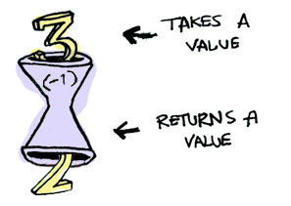
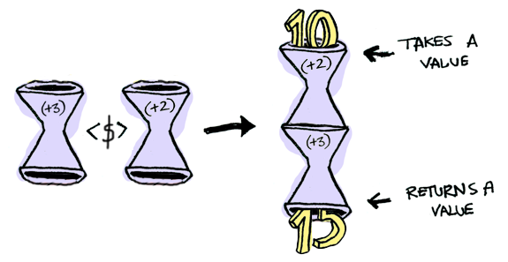
One last thing on functors
*Main> (-1) 3
2
What happens when you apply a function to another function?
*Main> fmap (+3) (+2) 10

Slide 35
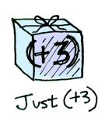
Applicatives
Applicatives take it to the next level. With an applicative, our values are wrapped in a context, just like Functors
But our functions are wrapped in a context too!

Slide 36
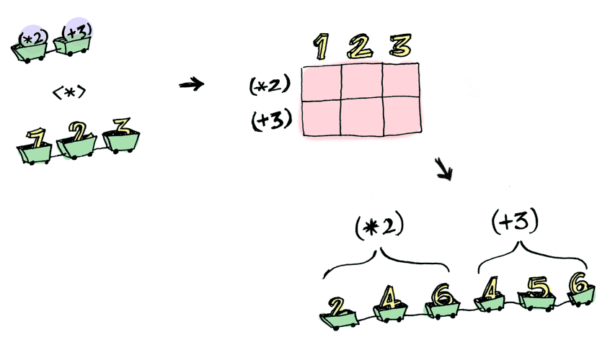
Applicatives

Slide 37

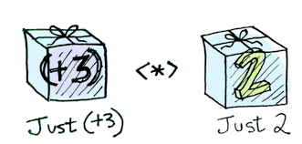
Functors apply a function to a wrapped value:
Applicatives apply a wrapped function to a wrapped value:

Slide 38
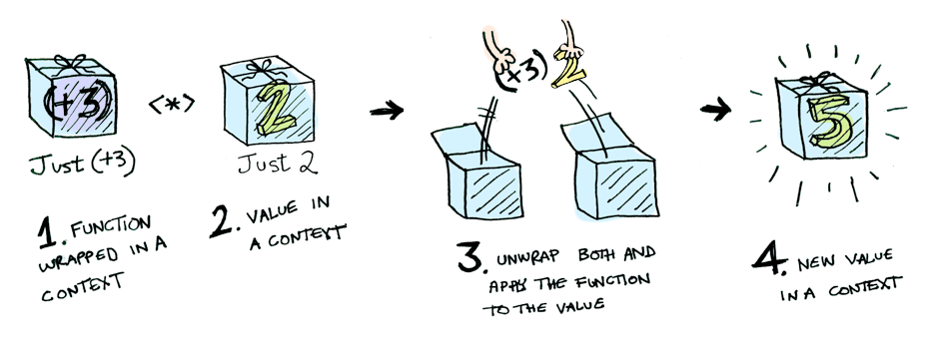
Applicatives

Slide 39
The Applicative TypeClass has two main
functions
pure :: a -> f a
(<*>) :: f (a -> b) -> f a -> f b
These need to be defined if we are writing an instance of Applicative, e.g.
instance Applicative Maybe where
pure x= Just x
Nothing <*> _ =Nothing
(Just f) <*> something = fmap f something

Slide 40


