Slide 1

PROGRAMMING IN HASKELL
Topic 12 – Monads

Slide 2
Recap on functor
class Functor f where
fmap :: (a-> b) -> f a -> f b
fmap (+2) [1,2,3]
[3,4,5]
fmap (+2) (Just 1)
Just 3
fmap (+2) Nothing
Nothing

Slide 3
Recap on Applicative
Generalise the idea of Functors to functions with more than one argument or parameter
This gives rise to an Applicative Functor
class Functor f => Applicative where
pure :: a -> f a
( <*> ) :: f (a-> b) -> f a -> f b
Data structure of functions
Data structure of arguments
Data structure of results

Slide 4
Examples
pure (+) <*> Just 1 <*> Just 2
Just 3
pure (+) <*> Nothing <*> Just 2
Nothing
Applicative handles Errors (Nothing) correctly.

Slide 5
Introduce Monads – Example a simple evaluator
data Expr = Val Int | Div Expr Expr
e.g.
e:: Expr
e = Div (Val 6) (Val 3)

Slide 6
eval :: Expr -> Maybe Int
eval (Val n) = n
eval (Div x y ) = eval x `div` eval y
Problem – how do we deal with division by zero (this would crash)

Slide 7
Need to refine program to deal with this
How to capture failure
safeDiv :: Int -> Int -> Maybe Int
safeDiv _ 0 = Nothing
safeDiv n m = Just (n `div` n)

Slide 8
Now, rewrite eval to use safeDiv
eval:: Expr -> Maybe Int
eval (Val n) = Just n
eval (Div x y) = case eval x of
Nothing -> Nothing
Just n -> case eval y of
Nothing -> Nothing
Just m -> safeDiv n m
Can we simplify?

Slide 9
Problem with Applicative
eval:: Expr -> Maybe Int
eval (Val n) = pure n
eval (Div x y) = pure safeDiv <*> eval x <*> eval y
Applicative needs Int -> Int -> Int
Maybe Int
Maybe Int
But we have Int -> Int -> Maybe Int

Slide 10
Monads – observe a common pattern and abstracting it out
eval:: Expr -> Maybe Int
eval (Val n) = Just n
eval (Div x y) = case eval x of
Nothing -> Nothing
Just n -> case eval y of
Nothing -> Nothing
Just m -> safeDiv n m

Slide 11
See pattern
Maybe (monadic) value
case of
Nothing -> Nothing
Just x ->
Some function on x

Slide 12
See pattern
case mx of
Nothing -> Nothing
Just x -> f x
We want to turn this into a definition.

Slide 13
See pattern
case mx of
Nothing -> Nothing
Just x -> f x
mx >>= f = case mx of
Nothing -> Nothing
Just x -> f x
We want to turn this into a definition.
“into” “bind”
(>>=) :: Maybe a -> (a-> Maybe b) -> Maybe b

Slide 14

>>=

Slide 15
New evaluation function using >>=
eval :: Expr -> Maybe Int
eval (Val n) = Just n
eval (Div x y) = eval x >>= (\n ->
eval y >>= (\m ->
safeDiv n m) )

Slide 16
General pattern
m₁ >>= \x₁ ->
m₂ >>= \x₂ ->
m₃ >>= \x₃ ->
:
:
m_{n} >>= \x_{n} ->
f x₁ x₂ .. x_{n}
“This is what we use”
do x₁ <- m₁
x₂ <- m₂
x₃ <- m₃
x_{n} <- m_{n}
f x₁ x₂ x₃ .. x_{n}
Syntactic sugar

Slide 17
New evaluation function using do (final version)
eval :: Expr -> Maybe Int
eval (Val n) = Just n
eval (Div x y) = do
n <- eval x
m <- eval y
safeDiv n m

Slide 18
So now we are ready for Monads
Now that we have bind (>>=) we now can define this kind of applicative that has bind.
class Applicative m => Monad m where
(>>= ) :: m a -> (a -> m b) -> m b
return :: a -> m a
return = pure

Slide 19
Example - Maybe – already have Functor, Applicative defs
data myMaybe a = Just a | Nothing deriving (Eq, Show)
instance Functor Maybe where
fmap f (Just x) = Just (f x)
fmap _ _ = Nothing
instance Applicative Maybe where
pure = Just
Nothing <*> _ = Nothing
(Just f ) <*> something = fmap f something
instance Monad Maybe where
-- (>>=) :: Maybe a -> (a -> Maybe b ) -> Maybe b
Nothing >>= f = Nothing
Just x >>= f = fx

Slide 20
Example - Maybe – already have Functor, Applicative defs
data myMaybe a = Just a | Nothing deriving (Eq, Show)
instance Functor Maybe where
fmap f (Just x) = Just (f x)
fmap _ _ = Nothing
instance Applicative Maybe where
pure = Just
Nothing <*> _ = Nothing
(Just f ) <*> something = fmap f something
instance Monad Maybe where
-- (>>=) :: Maybe a -> (a -> Maybe b ) -> Maybe b
Nothing >>= f = Nothing
Just x >>= f = fx

Slide 21
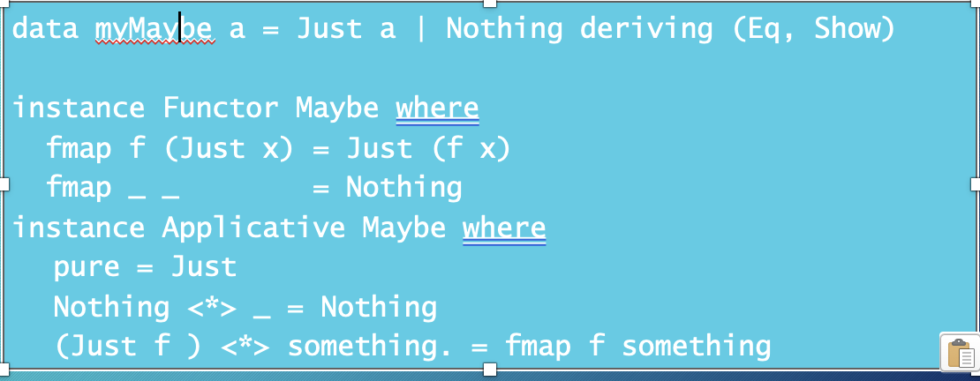
Example - Maybe – already have Functor, Applicative defs
instance Monad Maybe where
-- (>>=) :: Maybe a -> (a -> Maybe b) -> Maybe b)
Nothing >>= f = Nothing
Just x >>= f = Just (f x)
instance Monad Maybe where
-- (>>=) :: Maybe a -> (a -> Maybe b ) -> Maybe b
Nothing >>= f = Nothing
Just x >>= f = fx

Slide 22
Example - Lists
instance Monad [] where
-- (>>=) :: [a] -> (a -> [b] ) -> [b]
Nothing >>= f = Nothing
xs >>= f = concat map f xs
Note the concat
instance Monad [] where
-- (>>=) :: [a] -> (a -> [b] ) -> [b]
Nothing >>= f = Nothing
xs >>= f = [y| x <- xs, y <- f x]
or

Slide 23
Example - using List monads
pairs [1,2] [3,4] -- cartesian product
[(1,3), 1,4), (2,3), 2,4)]
pairs :: [a] -> [b] -> [(a,b)]
pairs xs ys = do x <- xs
y <- ys
return (x,y)

Slide 24
Monads
A monad is defined by 3 things:
A type constructor m
A function return
An operator (>>=) – read as “bind”
Originally, these were introduced for IO, but they can be much more powerful.
The function and operator are methods of the Monad typeclass and have types themselves, which are required to obey 3 laws (more later):
return :: a -> m a
(>>=) :: m a -> (a -> m b) -> m b

Slide 25
Monad laws
Monads are required to obey 3 laws:
m >>= return = m
return x >>= f = f x
(m >>= f) >>= g = m >>= (\x -> f x >>= g) -- associativity
Monads originally come from a branch of mathematics called Category Theory.
(Fortunately, it is entirely unnecessary to understand category theory in order to understand and use monads in Haskell.)

Slide 26
Monadic Programming
Having designed a Monad (i.e. ‘I need a Monad with this shape’), we define an instance of a Monad.
This involves essentially writing what
return and
>>= mean in this Monad
(this assumes you have written instances for Functor and Applicative)

Slide 27
Examples of monadic programming – 1 - fmap
--- fmap using IO
fmap :: (a -> b) -> IO a -> IO b
Given
a function f :: a -> b and
an IO interaction m :: IO a,
run the interaction,
then apply f to the result, and
wrap it back in IO.

Slide 28
fmap
fmap :: (a -> b) -> IO a -> IO b
Given
a function f :: a -> b and
an IO interaction m :: IO a,
We want to:
run the interaction,
then apply f to the result, and
wrap it back in IO.
fmap f m =
do
x <- m
return(f x)

Slide 29
Examples of monadic programming– 2 – using recursion - repeat
repeat :: IO Bool -> IO () -> IO ()
So that
repeat test oper
keeps running oper until test returns False.
Recursion
Base Case
Recursive case
do res <- test
if res
then return ()
-- done, stop here
else do m -- run the operation
repeat test oper -- recurse

Slide 30
Examples of monadic programming– 2 – using recursion - repeat
Full solution:
repeat :: IO Bool -> IO () -> IO ()
repeat test oper
= do res <- test
if res
then return ()
else do oper
repeat test m
run test, bind result to res
if True → done (base case)
if False → run oper then recurse

Slide 31
Some more useful monadic functions
sequence :: Monad m => [m a] -> m [a]
sequence [] = return []
sequence (m:ms) = do
x <- m
xs <- sequence ms
return (x:xs)
Example runs:
sequence [Just 1, Just 2, Just 3] -- Just [1, 2, 3]
sequence [Just 1, Nothing, Just 3] -- Nothing

Slide 32
Some more useful monadic functions
mapM :: Monad m => (a -> m b) -> [a] -> m [b]
mapM f xs = sequence (map f xs)
map f xs produces a list of monadic actions, and sequence runs them left to right, threading the monad through and collecting results.
Example runs:
mapM safeHead [[1,2], [3,4], [5,6]] -- Just [1,3,5]
mapM safeHead [[1,2], [], [5,6]] -- Nothing (one failure kills the whole thing)

Slide 33


