Slide 1

XML Structure Overview
Understanding the fundamentals of XML formatting
Notes:
AI-generated content may be incorrect. ---

Slide 2
XML Overview
XML Structure and Syntax
XML uses custom tags and nested elements to represent hierarchical data in a flexible, human-readable format.
Key Features of XML
XML is platform-agnostic, self-describing, supports comments, and enforces strict well-formedness rules.
Applications of XML
XML is widely used in configuration files, document formats, and data interchange standards like SOAP.
Understanding XML as a Tree
Visualizing XML as a recursive tree structure helps beginners grasp parsing, navigation, and transformation concepts.
Notes:
XML, or Extensible Markup Language, is a structured text format designed for storing and transporting data in a human-readable and machine-interpretable way. At its core, XML provides a simple, flexible syntax that uses custom tags to define data, making it distinct from fixed-schema formats like JSON or CSV. One of XML’s main characteristics is its ability to represent deeply structured or hierarchical information using nested tags, where each element can contain other elements, attributes, and text. This structure makes XML ideal for scenarios where relationships between pieces of information matter, such as configuration files, document formats like DOCX, and data interchange standards such as SOAP. Because XML is platform-agnostic and self-describing, systems of different types can exchange XML-based data reliably. Another key feature is its strictness about well-formedness rules, such as requiring one root element, properly nested tags, and closing tags, all of which help avoid parsing ambiguity. In addition, XML supports comments, processing instructions, and declarations, which can control how parsers read the document. While XML is more verbose than many modern formats, its combination of structure, extensibility, and cross-system compatibility ensures it remains widely used in enterprise systems, document standards, and academic domains. For beginners transitioning from using XML without understanding its structure, recognizing that it is fundamentally a tree of elements is the key to making sense of parsing behavior, tooling, and how programs navigate or transform XML documents by walking this tree. Because this structured approach resembles algebraic data types in Haskell, understanding XML becomes much easier when it is visualized as a recursive data structure that defines nested relationships in a predictable manner.

Slide 3
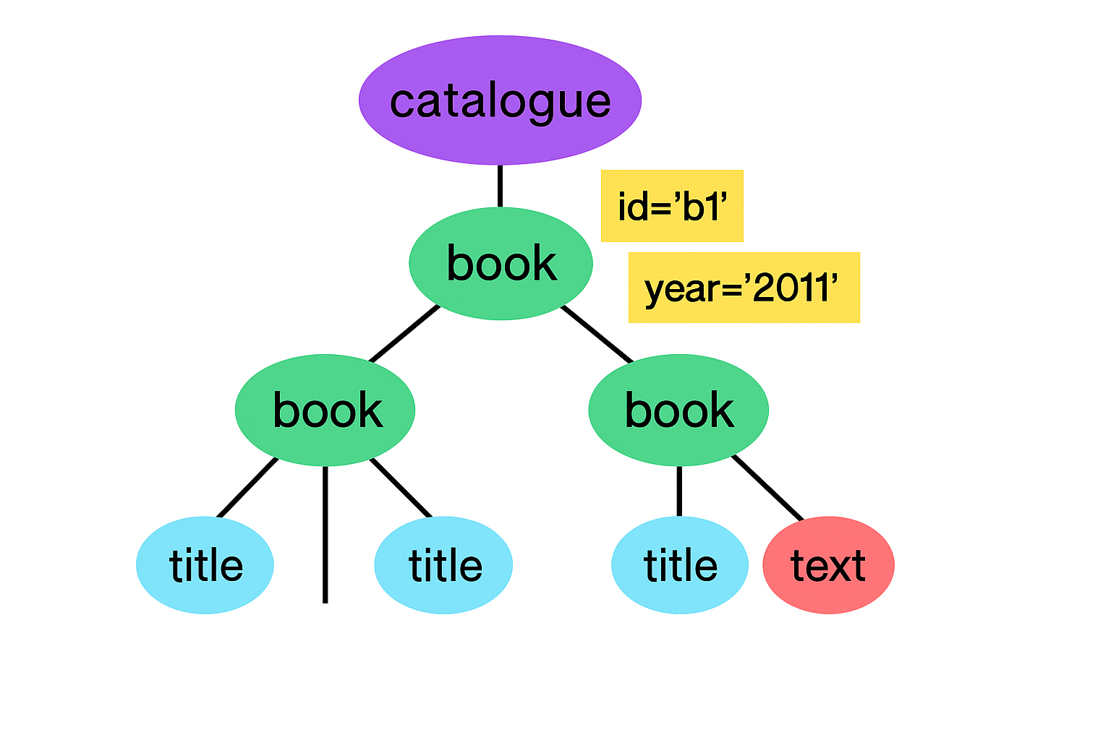
XML as a Tree
Hierarchical Structure
XML documents start with a single root element enclosing all nested child elements, forming a hierarchical tree.
Parent-Child Relationships
Each node represents an element with attributes, text, or nested elements, emphasizing parent-child tree relationships.
Parsing and Navigation
Parsing XML involves navigating nodes, similar to recursive structures, enabling extraction and traversal operations.
Tree in Memory and Transformations
Representing XML as a tree enables structural transformations and aligns with recursive programming concepts in Haskell.
Notes:
XML documents form a hierarchical tree structure, which means every document begins with exactly one root element that encloses all other content. This design emphasizes parent–child relationships, making it similar to data structures that Haskell programmers already know, such as recursive ADTs. Each node in this tree can represent an element, which may contain attributes, text, or additional nested elements. These nested elements create the branching structure that defines the data. Viewing XML as a tree helps clarify why parsing involves navigating nodes, and why certain operations, such as extracting a title or finding repeated sections, resemble walking through a recursive structure. The tree also reveals why whitespace often appears as text nodes—each indentation or newline is treated as content unless a parser is configured to trim it. This concept becomes especially important when dealing with pretty-printed XML, where extra whitespace may create unexpected child nodes. Understanding XML as a tree also helps explain the behavior of XPaths and DOM navigation, where each step refers explicitly to parent, child, or sibling relationships. Moreover, representing XML in memory as a tree allows transformations such as filtering, reshaping, or mapping nodes structurally, akin to manipulating deeply nested lists or custom recursive types. For Haskell programmers, this representation naturally aligns with pattern matching and recursion, making XML processing intuitive once the underlying structure is clear. The tree model also sets the stage for converting XML into strongly typed Haskell ADTs, where the programmer selects which portions of the structure are meaningful and enforces constraints such as the number or type of required subelements.

Slide 4
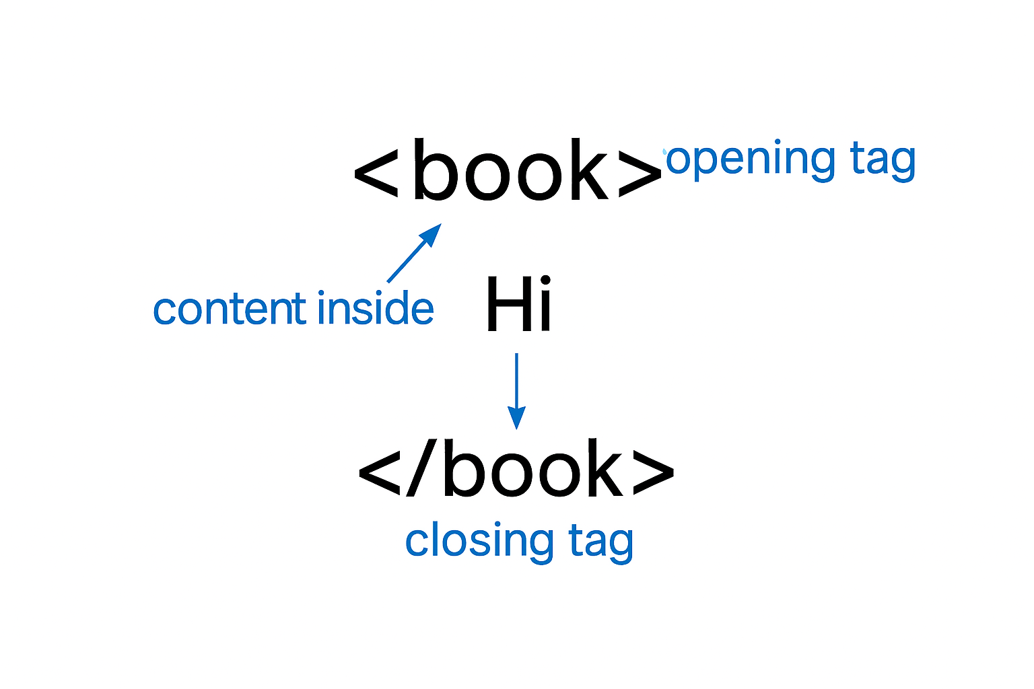
Elements (Tags)
Fundamental XML Structure
Elements are the basic building blocks of XML, defined by opening and closing tags enclosing text or nested elements.
Self-closing Elements
Some elements contain no child content and use a concise self-closing tag format for brevity and clarity.
Element Naming Rules
Element names are case-sensitive and must follow rules allowing letters, digits, and certain symbols but not start with digits or spaces.
Extensibility and Semantics
XML elements have flexible semantics defined by application domains, supporting schema-driven extensibility and interoperability.
Notes:
Elements—commonly known as tags—form the fundamental building blocks of XML documents. Each element begins with an opening tag and ends with a closing tag, creating a clearly delimited region that contains either text, nested elements, or both. For example, a <book> element may include child elements like <title> or <author>, illustrating how XML captures structured information. Tags can be deeply nested, allowing XML to represent highly detailed and hierarchical datasets. Some elements contain no child content, and these can be written in a concise self-closing form, such as <br/>, which reduces verbosity while maintaining well-formedness. Element names are case-sensitive and must follow naming rules that permit letters, digits, underscores, hyphens, and periods, though they may not begin with a digit or contain spaces. The use of elements to model structure aligns well with Haskell's conceptualization of data types, where tags act like constructors that can contain fields or additional value structures. Because XML does not prescribe meaning to element names, their semantics come entirely from the application domain, allowing developers to define schemas that match their requirements. This flexibility is central to XML’s extensibility, enabling different systems to produce or consume XML documents while preserving structure and meaning. Understanding elements is key to parsing and transformation, as most tools operate by locating elements by name, exploring their children, and working with associated attributes, which serve as additional metadata attached to the element’s opening tag.

Slide 5
Attributes
Definition and Structure
Attributes appear in an element’s opening tag as key="value" pairs providing metadata about the element.
Attributes vs Elements
Attributes store simple scalar values while child elements represent complex hierarchical content and sequences.
Usage and Limitations
Attributes cannot contain nested elements or other attributes, enforcing clear metadata boundaries.
Role in XML Processing
Attributes are vital for identification, classification, and rendering rules in XML-processing libraries.
Notes:
Attributes in XML provide metadata about an element and appear only within the element’s opening tag. Structured as key="value" pairs, attributes store information that is relevant to the element but not part of its hierarchical content. For instance, in <book id="b1" year="2011">, the id and year attributes describe properties of the book rather than forming part of the nested structure. This distinction allows attributes to be used for identifiers, format markers, or small scalar values, while elements capture more complex content or sequences. Attributes never contain nested elements and cannot themselves have attributes, which enforces a clear boundary between metadata and hierarchical structure. The choice between using attributes and child elements often depends on semantic relevance: attributes are suitable for simple, atomic values, whereas child elements are better for meaningful structured content. In many XML-processing libraries including Haskell-based ones, attributes are represented as maps or lists of key–value pairs attached directly to element nodes. They play a crucial role in identification and classification tasks, such as locating nodes with a specific id or determining rendering rules. While attributes make XML more expressive, their presence must align with the document’s schema or conventions to maintain clarity. Beginners should understand attributes not as subnodes but as supplemental information that travels with an element, ensuring that the primary structure remains represented by the nested element tree.

Slide 7

Text Nodes
Definition of Text Nodes
Text nodes store actual textual content inside XML elements as distinct nodes in the XML tree structure.
Whitespace as Text Nodes
Whitespace like indentation and newlines often becomes separate text nodes, which can confuse beginners.
Handling in XML Libraries
Libraries differ in whitespace handling; some preserve, normalize, or ignore whitespace text nodes.
Significance in Parsing
Recognizing text nodes helps manage content extraction and avoid treating whitespace as meaningful data.
Notes:
Text nodes represent actual textual content within XML elements and are treated as distinct nodes in the XML tree structure. For example, in <title>Learn You a Haskell</title>, the text Learn You a Haskell is stored in a text node that is a child of the <title> element. One important nuance is that whitespace—such as indentation, newlines, and spaces between elements—often becomes its own text node, which can surprise beginners. Pretty-printed XML frequently includes such whitespace nodes, making it appear as though there is unexpected text in the document. Different libraries handle whitespace differently; some preserve it strictly, while others can normalize or ignore it. Understanding text nodes is essential for extraction tasks, because tools may return a mixture of text and element nodes, requiring programmers to filter or combine content. In Haskell, text nodes are commonly represented as constructors distinct from element constructors in XML libraries, reinforcing the fact that text is not merely a property of an element but a real node with its own identity. This model allows accurate representation of mixed content documents where text and elements interleave, such as XHTML or richly formatted content. Learning to handle text nodes effectively helps clarify how parsing libraries behave when retrieving or navigating content and makes it easier to avoid issues such as treating whitespace as meaningful data.

Slide 8
Advanced XML Features
Notes:
Namespaces, XML Declaration

Slide 9

Namespaces
Purpose of Namespaces
Namespaces prevent name collisions by qualifying element and attribute names with unique URI prefixes in XML documents.
Namespace Declaration
Namespaces are declared using the xmlns attribute with or without prefixes to define element scope in XML.
Complexities for Beginners
Beginners find namespaces confusing due to expanded names pairing tags with URIs, complicating XML parsing.
Benefits of Namespaces
Namespaces enable extensibility and interoperability, allowing multiple XML standards to coexist without conflicts.
Notes:
Namespaces in XML address the problem of name collisions by qualifying element and attribute names with a prefix tied to a unique URI. This becomes particularly important when combining XML vocabularies from different domains, such as embedding SVG within XHTML or parsing Moodle quiz XML that uses prefixes like m:. A namespace declaration uses the xmlns attribute, either with a prefix (e.g., xmlns:m="http://moodle.org/question") or as a default namespace for unprefixed tags. Once declared, the prefix acts as a shorthand within the XML document, but the true identity of each element derives from the URI rather than the prefix spelling. Beginners often find namespaces confusing because XML parsers typically expose elements using expanded names that pair the local tag name with its namespace URI, making it necessary to match both when navigating nodes. While namespaces increase interoperability and correctness, they add a layer of complexity during parsing, particularly in strongly typed languages like Haskell. Many beginners benefit from initially ignoring namespaces—treating documents without prefixes to focus on core structure—before learning the expanded-name model required for correct matching. Namespaces ensure robust extensibility, avoid name collisions, and allow different XML-based standards to coexist cleanly within the same document, making them a critical but advanced feature of XML.

Slide 10

XML Declaration
Purpose of XML Declaration
The XML declaration provides metadata about version and encoding for the XML parser.
Not Part of Element Tree
The declaration is not part of the XML element tree and is excluded from document structure searches.
Automatic Parsing Usage
XML parsers use the declaration automatically to configure decoding and rarely expose it to programmers.
Specialized Programmer Access
Programmers access the declaration mainly for low-level byte handling or strict validation tasks.
Notes:
The XML declaration appears at the top of an XML document and typically looks like <?xml version="1.0" encoding="utf-8"?>. Although it resembles a tag, it is not part of the document’s element tree but instead serves as metadata that instructs the XML parser how to read the document. The version attribute identifies the XML specification being followed, while the encoding attribute specifies how bytes in the file are interpreted as characters. Many XML parsers automatically process this declaration when loading the file, using it to configure internal decoding logic. In languages like Haskell, high-level XML libraries often do not expose the declaration through the parsed structure, because once the document is decoded, the declaration has served its purpose. Programmers rarely need to access the declaration directly unless performing low-level byte handling, building XML serializers, or validating documents against strict standards. Understanding that the declaration is not part of the tree helps clarify why it cannot be found by searching for elements and why typical workflows begin with the documentRoot rather than including any representation of the declaration itself. Overall, the XML declaration provides essential file-level metadata but does not participate in the document’s structural content.

Slide 11
Special Content Forms
Notes:
CDATA Sections

Slide 12

CDATA Sections
Purpose of CDATA
CDATA sections allow inclusion of raw text with reserved characters without escaping in XML documents.
Usage in Markup Embedding
CDATA is useful for embedding HTML or code samples within XML, preserving complex markup content.
Parsing Behavior
XML parsers treat CDATA content as plain text, simplifying processing but hiding escaped content differences.
Limitations and Workarounds
CDATA cannot contain the sequence ]]>, requiring splitting blocks as a workaround to avoid errors.
Notes:
CDATA sections in XML allow raw text to appear without being treated as markup, providing a way to include reserved characters such as < and & without escaping them. CDATA is introduced with <![CDATA[ and closed with ]]>, and everything inside is treated as literal text except for the forbidden end sequence. This mechanism is especially useful when embedding HTML, code samples, or other markup-heavy content within XML documents, as seen in Moodle quiz files where question text often contains HTML wrapped in CDATA. Although CDATA affects how XML is written, most XML parsers—including those in Haskell—return CDATA content as plain text, making it functionally equivalent to normal text nodes from the consumer’s perspective. This simplifies parsing but can obscure the distinction between escaped and unescaped content in the original document. CDATA cannot itself contain the sequence ]]>, requiring workarounds such as splitting CDATA blocks when necessary. Its purpose is convenience rather than structural complexity, allowing authors to avoid excessive escaping of characters that would otherwise be misinterpreted as markup. For beginners, understanding CDATA clarifies why some XML text sections appear differently formatted and why certain documents embed HTML or special symbols without escape sequences. Recognizing CDATA helps ensure correct handling of these text-heavy regions when writing transformations or serializers.

Slide 13
Haskell-Oriented XML Interpretation
Notes:
Haskell Perspective on Parsing XML

Slide 14

Haskell Perspective on Parsing XML
Two-Stage XML Parsing
Haskell parses XML in two stages: building a generic tree, then converting it into strongly typed ADTs.
Library Support and Tree Navigation
Libraries like xml-conduit facilitate parsing and navigating XML trees via tag filtering and attribute retrieval.
Strong Typing and Constraints
Mapping XML to ADTs enforces domain rules and ensures correctness through Haskell’s strong typing system.
Notes:
From a Haskell programmer’s perspective, XML parsing typically involves two conceptual stages: reading the document into a generic tree structure and transforming that structure into strongly typed Haskell ADTs. XML libraries in Haskell, such as xml-conduit or HXT, provide parsers that automatically process the XML declaration, construct element nodes, preserve attributes, and represent text nodes explicitly. Once parsed, developers navigate the tree by selecting children with specific tag names, retrieving attribute values, and extracting text content. This process resembles traversing custom recursive data types, making XML manipulation intuitive once the programmer internalizes XML’s tree-based model. A common pattern is to parse XML into a Document and then walk from the root using helper functions like filtering children or folding through nodes. The second stage—mapping XML into ADTs—enforces domain-specific constraints, such as requiring a <title> element or interpreting an attribute as a specific type. This separation of parsing and decoding helps maintain clarity, correctness, and composability. Because XML is flexible and often allows missing or repeated fields, Haskell’s strong typing provides a way to assert expectations explicitly, turning loosely structured XML into predictable, well-formed data structures. Understanding these two stages empowers Haskell developers to build reliable, maintainable XML-processing pipelines.

