Slide 1

PROGRAMMING IN HASKELL
Chapter 4.2 The Lambda Calculus

Slide 2

PROGRAMMING IN HASKELL
Chapter 4.2 The Lambda Calculus

Slide 3
Lambda Calculus
lambda calculus is a model of computation
devised in the 1930s by Alonzo Church.
Functional programming languages are all
based on the lambda calculus.
Haskell is a pure functional language because
all its features are translatable into lambda
expressions.
Allows a higher degree of abstraction and
composability.

Slide 4
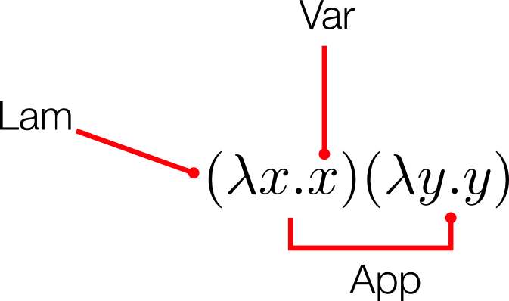
The structure of lambda terms

Slide 5
Alpha Equivalence
We have seen the function:
λ x. x
The variable x here is not semantically meaningful
except in its role in that single expression.
Because of this, there’s a form of equivalence
between lambda terms called alpha equivalence.

Slide 6
Alpha Equivalence
In other words:
λ x. x
λ apple. apple
λ orange. orange
all mean the same thing.

Slide 7
Beta Reduction
When we apply a function to an argument,
we substitute the input expression for all
instances of bound variables within the body
of the abstraction.
Then we eliminate the head of the
abstraction (its only purpose was to bind a
variable).
This process is called beta reduction.

Slide 8
Beta Reduction – Example 1
λ x. x
We apply the function above to 2
substitute 2 for each bound variable in the body of the function, and then
eliminate the head:
(λ x. x) 2
2
The only bound variable is the single x, so applying this function to 2 returns 2.
This function is the identity function.

Slide 9
Beta Reduction – Example 2
(λ x. x+1)
What happens if we apply this to 2 (try this yourself

Slide 10
Encoding Booleans in λ Calculus
We can encode booleans as functions. For example:
TRUE = λ x. λ y. x
FALSE = λ x. λ y. y
Using these, we define NOT as:
NOT = λ b. b FALSE TRUE
Testing:
NOT TRUE => FALSE
NOT FALSE => TRUE

