Slide 1

PROGRAMMING IN HASKELL
Chapter 4.2 The Lambda Calculus

Slide 2
Lambda Calculus
lambda calculus is a model of computation devised in the 1930s by Alonzo Church.
Functional programming languages are all
based on the lambda calculus.
Haskell is a pure functional language because all its features are translatable into lambda expressions.
Allows a higher degree of abstraction and
composability.

Slide 3
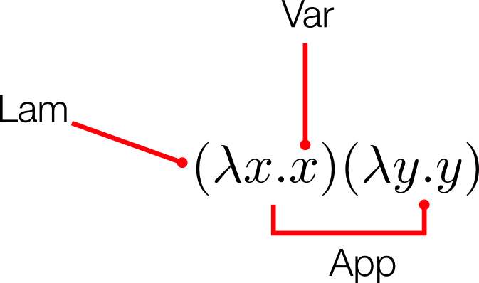
The structure of lambda terms

Slide 4
Alpha Equivalence
We have seen the function
λx.x
The variable x here is not semantically meaningful except in its role in that single expression. Because of this, there’s a form of equivalence between lambda terms called alpha equivalence. In other words,
λx.x λapple.apple λorange.orange
all mean the same thing.

Slide 5
Beta Reduction
When we apply a function to an argument, we
substitute the input expression for all instances of bound variables within the body of the abstraction
eliminate the head of the abstraction (its only purpose was to bind a variable)
This process is called beta reduction.

Slide 6
Beta Reduction – Example 1
λ x. x
We apply the function above to 2
substitute 2 for each bound variable in the body of the function, and then
eliminate the head:
(λ x. x) 2
2
The only bound variable is the single x, so applying this function to 2 returns 2.
This function is the identity function.

Slide 7
Beta Reduction – Example 2
(λ x. x+1)
What happens if we apply this to 2
(try this yourself)

Slide 8
Beta Reduction-Example 1
λx.x
We apply the function above to 2
substitute 2 for each bound variable in the body of the function, and
eliminate the head:
(λx.x ) 2
2
The only bound variable is the single x , so applying this function to 2 returns 2. This function is the identity function.

Slide 9
Beta Reduction – Example 2
(λ x. x+1)
What happens if we apply this to 2 (try this yourself)

Slide 10
Beta Reduction- Example 3
We can also apply our identity function to another lambda abstraction:
(λx.x )(λy.y )
In this case, we substitute the entire abstraction in for x .
We use a new syntax here, [x := z ], to indicate that z will be substituted for all occurrences of x
(here z is the function (λy.y ))
We reduce this application like this:
(λx.x )(λy.y )
[x := (λy.y )]
(λy.y )

Slide 11
Beta Reduction- Example 4
Once more, but this time we’ll add another argument:
(λx.x )(λy.y )z
Applications in the lambda calculus are left associative. That is, unless specific parentheses suggest otherwise, they associate, or group, to the left. So, it can be rewritten as:
((λx.x )(λy.y ))z The β-reduction is as follows:
((λx.x )(λy.))z
[x := (λy.y )]
(λy.y )z
[y := z ]
z
We can’t reduce this any further as there is nothing left to apply, and we know nothing about z .

Slide 12
Variables
Variables can be
  bound or
  free
as the λ-calculus assumes an infinite universe of free variables. They are bound to functions in an environment, then they become bound by usage in an abstraction.
For example, in the λ-expression:
(λx.x∗ y )
x is bound by λ over the body x∗ y , but y is a free variable.When we apply this function to an argument, nothing can be done with the y . It remains irreducible.

Slide 13
Variables contd.
Look at the following when we apply such a function to an argument:
(λx.x ∗ y )z We apply the lambda to the argument z .
(λx.x ∗ y )z
[x := z ]
zy
The head has been applied away, and there are no more heads or bound variables. Since we know nothing about z or y , we can reduce this no further.

Slide 14
Multiple Arguments
Each lambda can only bind one parameter and can only accept one argument. Functions that require multiple arguments have multiple, nested heads. When you apply it once and eliminate the first (leftmost) head, the next one is applied and so on. This means that the following
λxy.xy

Slide 15
Multiple Arguments
Each lambda can only bind one parameter and can only accept one argument. Functions that require multiple arguments have multiple, nested heads. When you apply it once and eliminate the first (leftmost) head, the next one is applied and so on. This means that the following
λxy.xy
is simply syntactic sugar for
λx (λy.xy )

Slide 16
Lambda Caculus in Haskell
How do we write lambda expressions in Haskell?
Named Function | Lambda Calculus (maths) | Lambda Calculus (Haskell) | Result
f x = x + 1 | ( λx.x + 1) 2 | (\x → x + 1) 2 | 3
f x y = x ∗ y | ( λx y.x ∗ y ) 2 3 | (\x y → x ∗ y ) 2 3 | 6
f xs = ‘c‘ : xs | ( λxs.‘c‘ : xs) ”at” | (\xs → ‘c‘ : xs) ”at” | ”cat”
Lambda functions are used extensively in Haskell, notably with Higher Order Functions.

Slide 17
Encoding Lambda Calculus
Alonzo Church is probably most well known for inventing lambda calculus,
Church encodings were developed by Alonzo Church
Church encodings are a very interesting development arising from lambda calculus,
Church found out that every concept in programming languages can be represented using functions!

Slide 18
Encoding Lambda Calculus
▶ Alonzo Church is probably most well known for inventing lambda calculus,
▶ Church encodings were developed by Alonzo Church
▶ Church encodings are a very interesting development arising from lambda calculus,
▶ Church found out that every concept in programming languages can be represented using functions!
▶ Everything from boolean logic, conditional statements, numbers (natural, integer, real, complex, imaginary), and even loops (infinite loops also)!

Slide 19
Encoding Lambda Calculus.. contd.
So how do we encode all these constructs using only functions?
Idea: Encode the behavior of values and not their structure

Slide 20
Encoding Booleans in λ Calculus - IF
What can we do with a boolean?
We can make a binary choice (if expression)
A boolean is a function that, given two choices, selects one of them:
TRUE = λx.λy.x
FALSE = λx.λy.y

Slide 21
Encoding Booleans in λ Calculus NOT
So how do we encode NOT
if we think of the structure :
if b then FALSE ;
else TRUE
NOT = λb.b FALSE TRUE

Slide 22
Encoding Booleans in λ Calculus - NOT
NOT = λb.b FALSE TRUE
Let’s test this on NOT TRUE :
NOT = λb.b FALSE TRUE
NOT TRUE (λb.b FALSE TRUE ) TRUE (TRUE ) FALSE TRUE
= FALSE

Slide 23
Encoding Booleans in λ Calculus - NOT
Next, let’s test this on NOT FALSE :
NOT FALSE
(λb.b FALSE TRUE ) FALSE
(FALSE ) FALSE TRUE
= TRUE

Slide 24
Encoding Lambda Calculus.. Exercise
Using the techniques above, encode the following using lambda calculus:
AND
OR

Slide 25
Encoding Lambda Calculus..video
For a very good introduction to lambda calculus and encoding boolean logic using lambdas, see link to Graham Hutton’s video (Computerphile) here
(You’ll need to view this pdf through Adobe Reader to use the link. Otherwise Google ’youtube Lambda Calculus Computerphile Graham Hutton’)

Slide 26


