Slide 1

PROGRAMMING IN HASKELL
Chapter 1 - Introduction

Slide 2
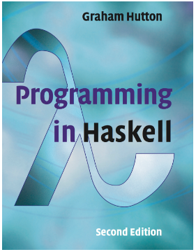
Book Title
This course(including slides) is largely based on the book:
Programming in Haskell,
Graham Hutton, 2nd Ed,
Cambridge University Press,
ISBN 978-1-316-62622-1.

Slide 3
What is a Functional Programming?
A programming style using functions to compute results.
Emphasizes immutability, pure functions, and recursion.

Slide 4
Why Functional Programming
A different way to think and think about programming and solving problems.
A great way to get good at recursion
A lot of companies are using it..

Slide 5
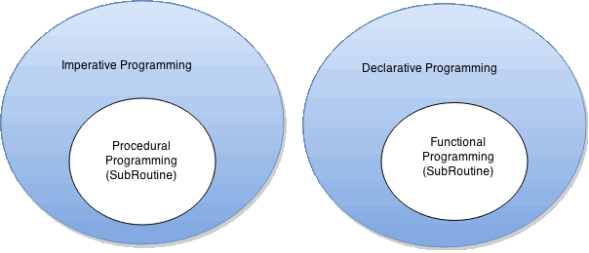
What’s different from what you’ve seen
How to do it, not what to do
What to do, not how to do it.

Slide 6
What’s different from what you’ve seen
Explain to your friend : What is an orange peanut?
(He only knows brown peanuts)
Imperative
Functional
How to do it, not what to do
What to do, not how to do it.
That brown peanut you have : Paint it orange.
That’s what an orange peanut is.
That brown peanut that you have:
If you had another peanut that’s just like it in every way except that it’s orange.
That’s what an orange peanut is.

Slide 7
Differences
Imperative
Functional
Loops
No loops !!!
Variables – use them for e.g. accumulating values
Variables cannot be changed
(immutability)
If [condition]
then [command]
else [command]
If [condition]
then [value]
else [value]
More later ….

Slide 8
Comparison
Java
Haskell
int total = 0;
for (int i = 1; i ≤ 10; i++)
total = total + i;
sum [1..10]
The computation method is variable assignment.
The computation method is function application.

Slide 9
Key Characteristics of Functional Programming
- Immutability: Variables don't change once set.
- Higher-order functions: Functions as arguments or return values.
- Pure functions: No side effects.
- Lazy evaluation: Values computed only when needed.
- Recursion: Functions calling themselves

Slide 10
Historical Evolution of Functional Programming
1930’s : Lambda calculus by Alonzo Church.
1950’s: Lisp by John McCarthy.
1960’s : ISWIM by Peter Landin.
1970’s : FP (Backus) and ML (Milner).
1980’s : Miranda (Turner).
1987 : Haskell development begins.
2003 : Haskell Report published.
2010+ : Modern Haskell advancements.

Slide 11
Why Haskell?
Strong type system with type inference.
Lazy evaluation for efficiency.
Expressive syntax for clean code.
Extensive library and tooling support.
Promotes reasoning about programs.

Slide 12
Basic Syntax in Haskell
Strong type system with type inference.
Lazy evaluation for efficiency.
Expressive syntax for clean code.
Extensive library and tooling support.
Promotes reasoning about programs.

Slide 13
Real world applications of Haskell
Data analysis and processing.
Blockchain (e.g., Cardano).
Compilers and language tooling.
Web development frameworks.

