Slide 1

PROGRAMMING IN HASKELL
Topic 10.2 - Syntax and Use of Records

Slide 2
First try
We wish to construct a data type that describes a Student. We want to record the following
- First Name
- Second Name
- Age
- Course
- email address
We could try :
data Student = Student String String Int String String
deriving (Show)

Slide 3
First try.. Contd.
data Student = Student String String Int String String
deriving (Show)
Then write functions to return back the various elements, e.g.
firstName :: Student -> String
firstName (Student firstname _ _ _ _ ) = firstname
age :: Student -> Int
age (Student _ _ age _ _ ) = age
etc..

Slide 4
Then use..
ghci> let student1 =
Student ”Adam" ”Ant" 21 ”Computer Science”
”stud1@wit.ie"
ghci> firstName student1
ghci> ” Adam”

Slide 5
There is a better way
data Student = Student { firstName :: String
, lastName :: String
, age :: Int
, course :: String
, email :: String
} deriving (Show)

Slide 6
There is a better way
Main benefit – we now have created lookup functions so
ghci> :t firstName
ghci> Student -> String
And using the student1 from before
ghci> firstName student1
ghci> ”Adam”

Slide 7
To construct a student:
student1 = Student { firstName = "Adam",
lastName="Ant",
age=21,
course="Applied",
email="mm"}

Slide 8
lookup functions
So, given:
student1 = Student { firstName = "Adam",
lastName="Ant",
age=21,
course="Applied",
email="mm”
}
We can access the elements:
ghci> lastName student1
ghci> ”Ant"
etc.

Slide 9
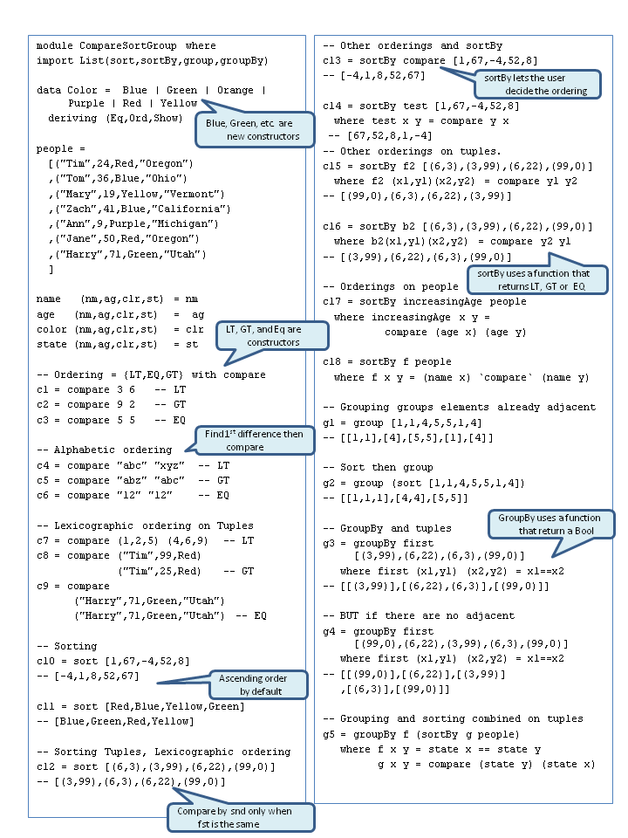
http://web.cecs.pdx.edu/~sheard/course/Cs163/Haskell/Crib07.hs
Sorting and grouping on lists of tuples
See lab 07 for full example

Slide 10


