Slide 1

PROGRAMMING IN HASKELL
Topic 4.3 – First Class Functions

Slide 2
Lambdas, let and where
1
We wish to write a function that takes two numbers, and returns the greater of the sum of the squares of the numbers (x² + y²) or the square of the sums of the numbers (x+y)²
We will call it sumSquareOrSquareSum we will write this using :
where
lambda functions, and finally
let

Slide 3
Starting point
Repetition of terms
2
sumSquareOrSquareSum :: Int -> Int -> Int
sumSquareOrSquareSum x y =
if x^2 + y^2 > (x + y)^2
then x^2 + y^2
else (x + y)^2
We can do better….

Slide 4
Using where
3
sumSquareOrSquareSum’ :: Int -> Int -> Int
sumSquareOrSquareSum’ x y =
if sumSquare > squareSum
then sumSquare
else squareSum
where sumSquare = x^2 + y^2
squareSum = (x + y)^2
Cleaner
Easier to read

Slide 5
Towards lambda functions
4
body :: Int -> Int -> Int
body sumSquare squareSum =
if sumSquare > squareSum
then sumSquare
else squareSum
sumSquareOrSquareSum'' :: Int -> Int -> Int
sumSquareOrSquareSum'' x y =
body (x^2 + y^2) ((x + y)^2)
Next, we will rewrite body as a lambda function.

Slide 6
Using lambda functions
Rewrite ‘body as lambda
5
sumSquareOrSquareSum''' :: Int -> Int -> Int
sumSquareOrSquareSum''' x y =
(\sumSquare squareSum ->
if sumSquare > squareSum
then sumSquare
else squareSum )
(x^2 + y^2) ((x + y)^2)

Slide 7
Using let
Readability of the where clause
6
sumSquareOrSquareSum'''' :: Int -> Int -> Int
sumSquareOrSquareSum'''' x y =
let sumSquare = (x^2 + y^2)
squareSum = (x + y)^2
in
if sumSquare > squareSum
then sumSquare
else squareSum
With the power of the lambda function

Slide 8
First Class Functions
7
First class functions are functions that can be passed around like any other values, including as arguments to functions.

Slide 9
First Class Functions - Example
8
ifEvenInc :: Int -> Int
ifEvenInc n =
if even n
then n + 1
else n
ifEvenDouble :: Int -> Int
ifEvenDouble n =
if even n
then n*2
else n
ifEvenSquare :: Int -> Int
ifEvenSquare n =
if even n
then n^2
else n
Only differences

Slide 10
First Class Functions - Introduce a function as an argument
9
inc :: Num a => a -> a
inc n = n + 1
double :: Num a => a -> a
double n = n * 2
square :: Num a => a -> a
square n = n ^ 2
ifEven :: Integral a => (a->a) -> a -> a
ifEven f n =
if even n
then f n
else n
even only works on integers

Slide 11
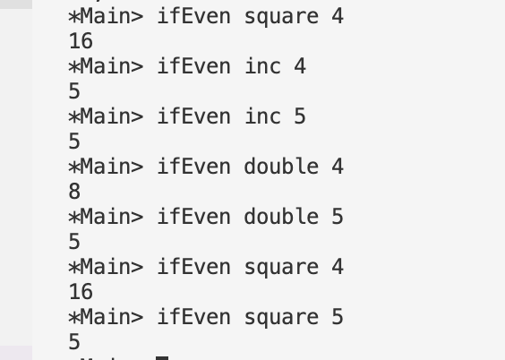
First Class Functions
10
We can call these functions thus:

Slide 12
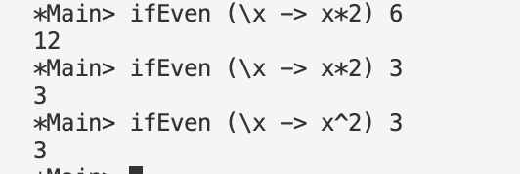
Using lambdas
11
etc.

Slide 13
The map Function
The higher-order library function called map applies a function to every element of a list.
map :: (a → b) → [a] → [b]
For example:
> map (+1) [1,3,5,7]
[2,4,6,8]

Slide 14
The map Function
We will examine more higher-order functions later
map :: (a → b) → [a] → [b]
For example:
> map toUpper ”cat”
>”CAT”

Slide 15
Example – sorting 1/3
14
In this sorting example we use:
built in functions and also
pass functions into other (sortBy) functions
We use:
Pairs/Tuples (fst and snd return the first and second element of the tuples respectively)
Form (“firstname”, “lastname”)

Slide 16
15
Example – sorting 2/3
names :: [(String, String)]
names = [ ("Hugo", "Keenan"),
("Mack", "Hansen"),
("James", "Lowe"),
("Bundee", "Aki"),
("Robbie", "Henshaw"),
("Sam", "Prendergast"),
("Dan", "Sheehan"),
("Jack ", "Crowley") ,
("Caelan", "Doris"). ]
Default sort is on first element
Called as

Slide 17
16
Example – sorting 3/3
import Data.List ( sort, sortBy )
names :: [(String, String)]
names = “as before”
compareLastNames :: Ord a => (a, a) -> (a, a) -> Ordering compareLastNames name1 name2
| lastName1 > lastName2 = GT
| lastName1 < lastName2 = LT
| otherwise = EQ
where lastName1 = snd name1
lastName2 = snd name2
Called as

Slide 18


