Slide 1

PROGRAMMING IN HASKELL
Chapter 4.2 The Lambda Calculus

Slide 2
Lambda Calculus
lambda calculus is a model of computation devised in the 1930s by Alonzo Church.
Functional programming languages are all based on the lambda calculus.
Haskell is a *pure* functional language because all its features are translatable into lambda expressions.
Allows a higher degree of abstraction and composability.

Slide 3
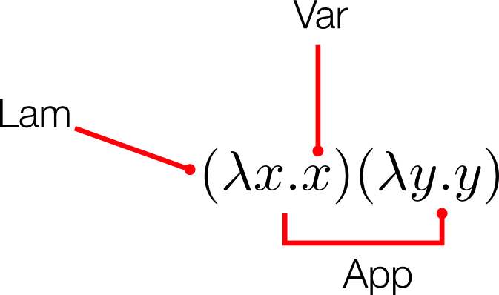
The structure of lambda terms
Structure of lambda terms

Slide 4
Alpha Equivalence
We have seen the function:
λ x. x
The variable x here is not semantically meaningful except in its role in that single expression. Because of this, there’s a form of equivalence between lambda terms called alpha equivalence. In other words:
λ x. x
λ apple. apple
λ orange. orange
all mean the same thing.

Slide 5
Beta Reduction
When we apply a function to an argument, we substitute the input expression for all instances of bound variables within the body of the abstraction.
Then we eliminate the head of the abstraction (its only purpose was to bind a variable).
This process is called beta reduction.

Slide 6
Example of Beta Reduction
Encoding Booleans in λ Calculus
We apply the function above to 2 λ x. x
substitute 2 for each bound variable in the body of the function, and then eliminate the head:
(λ x. x) 2
The only bound variable is the single x, so applying this function to 2 returns 2.
This function is the *identity* function.

Slide 7
We can encode booleans as functions. For example:
TRUE = λ x. λ y. x
FALSE = λ x. λ y. y
Using these, we define NOT as:
NOT = λ b. b FALSE TRUE
Testing:
NOT TRUE => FALSE
NOT FALSE => TRUE

