Slide 1

PROGRAMMING IN HASKELL
Topic 12.1 – Monads

Slide 2
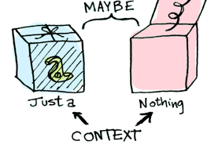
Monads
We look at Maybe to illustrate

Slide 3
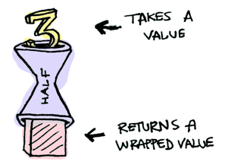

Monads
Suppose half is a function that only works on even numbers:

Slide 4

Monads
What if we feed it a wrapped value?
We need to use >>= to shove our wrapped value into the function. Here's a photo of >>=:

Slide 5

>>=

Slide 6

Monads
How does it work?

Slide 7

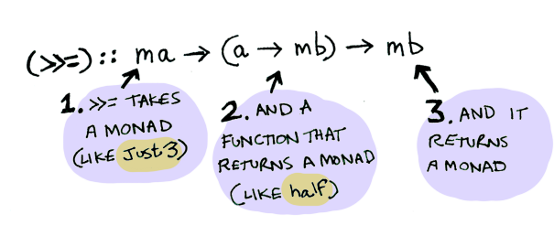
Monads
What's happening inside? Monad is another typeclass. Here's a partial definition:
Where
>>=
is:

Slide 8

Monads
So Maybe is a Monad:

Slide 9
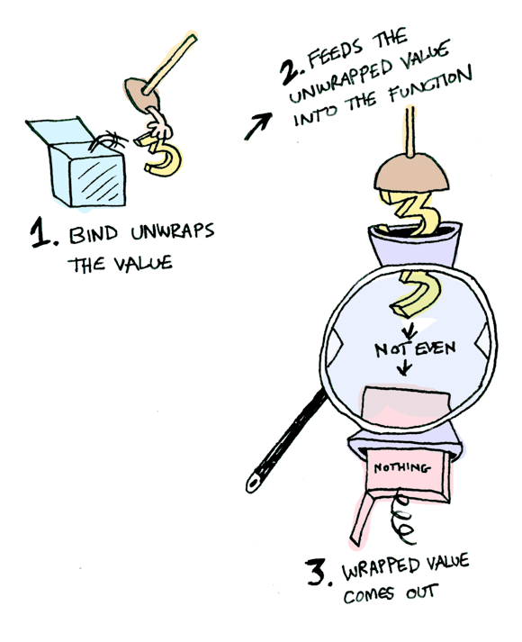
Monads
Here it is in action with a Just 3!

Slide 10
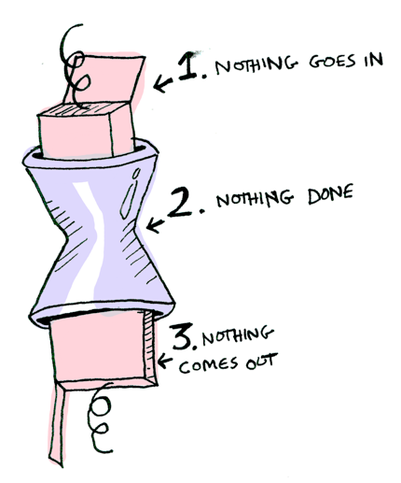
Monads
And if you pass in a Nothing it's even simpler:

Slide 11
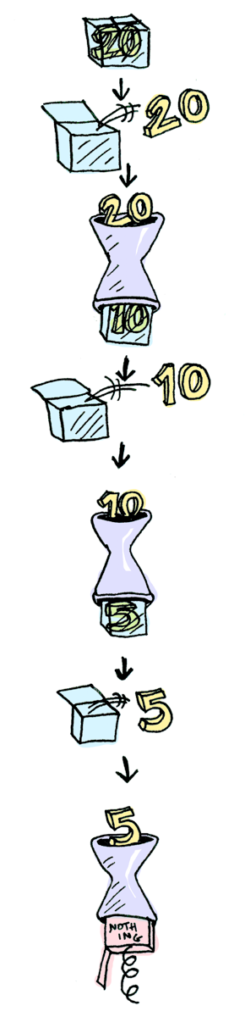

Monads
You can also chain calls:

Slide 12

What is a Monad?
Computerphile
Graham Hutton
Computer Science at the University of Nottingham

Slide 13

Monads
A monad is defined by 3 things:
  A type constructor m
  A function return
  An operator (>>=) – read as “bind”
Originally, these were introduced for IO, but they can be much more powerful (and difficult to understand).
The function and operator are methods of the Monad typeclass and have types themselves, which are required to obey 3 laws (more later):

Slide 14
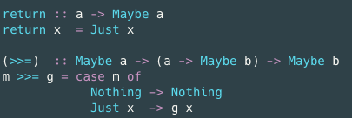
Monads example: Maybe
Maybe is the monad, and return brings a value into it by wrapping it with Just.
As for (>>=), it takes a m :: Maybe a value and a g :: a -> Maybe b function. If m is Nothing, there is nothing to do and the result is Nothing. Otherwise, in the Just x case, g is applied to x, the underlying value wrapped in Just, to give a Maybe b result.
To sum it all up, if there is an underlying value of type a in m, we apply g to it, which brings the underlying value back into the Maybe monad.

Slide 15

Monads: motivation
Continuing this example:
Imagine a family database with two functions, which look up the parents of a person:
The Maybe is there in case our database is missing some information.
We then might want to build other functions, to look up grandparents, etc (next slide)

Slide 16

Monads: motivation
Now, let’s find grandparents:
But there’s a better way! Maybe is a monad, so can do:

Slide 17
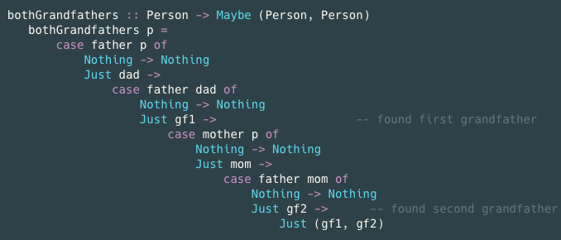
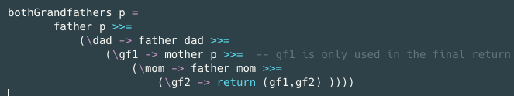
Monads
Even more drastic:
Becomes:

Slide 18
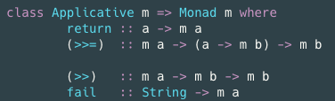
Monads: nuts and bolts
Monad the typeclass lives in Control.Monad, and has the following methods:
Aside from return and bind, there are two additional methods, (>>) and fail.
  Both of them have default implementations, and so you don't need to provide them when writing an instance.

Slide 19

Monads: nuts and bolts
Monad is a subclass of Applicative, which is a subclass of Functor. So these are also functors!
Note: (>>) and fail both have default implementations, and so you don't need to provide them when writing an instance.
(>>) sequences two monadic actions when the second action does not involve the result of the first, which is a common scenario for monads such as IO. Simple example:

Slide 20
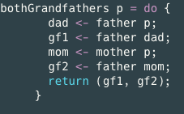
Monads: back to that example
In fact, that grandfather example can be made even better if we use the do notation with braces and semi-colons.
This will look more like imperative code that we’re used to! (Like IOs.)
Here, father and mother are functions that might fail to produce results, i.e. raise an exception, and when that happens, the whole do-block will fail, i.e. terminate with an exception.

Slide 21

Monad laws
Monads are required to obey 3 laws:
Monads originally come from a branch of mathematics called Category Theory.
(Fortunately, it is entirely unnecessary to understand category theory in order to understand and use monads in Haskell.)

Slide 22
Monadic Programming
Having designed a Monad (i.e. ‘I need a Monad with this shape), we define an instance of a Monad. This involves essentially writing what
  return and
  >>= mean in this Monad
For the purposes of this module, we concentrate on the instance of Monad. However, in order to write the full code, we need to remember that
  Monad is an Applicative
  Applicative is a Functor
So we need to write the instances down the chain
We look at MyMaybe (you may remember this from Maybe!)

Slide 23
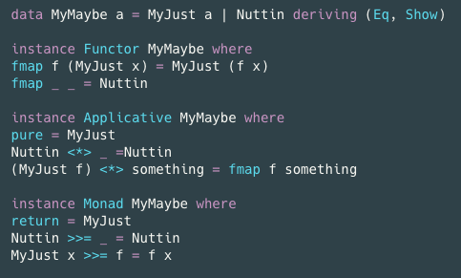
MyMaybe from scratch

Slide 24


Using MyMaybe
Call as :

Slide 25
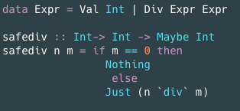
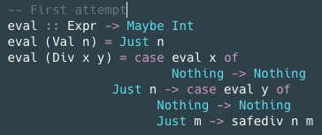
Desugaring do blocks from Graham Hutton’s Computerphile video.

Slide 26
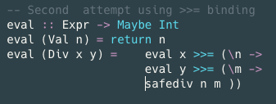
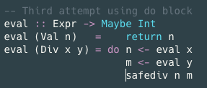
Desugaring do blocks

Slide 27






Desugaring do blocks
Bind Operator
Sequence Operator

Slide 28


