Slide 1

PROGRAMMING IN HASKELL
Topic 9- Interactive Programming

Slide 2
Introduction
To date, we have seen how Haskell can be used to write batch programs that take all their inputs at the start and give all their outputs at the end.
inputs
outputs
batch program

Slide 3
Introduction
However, we would also like to use Haskell to write interactive programs that read from the keyboard and write to the screen, as they are running.
keyboard
inputs
outputs
interactive
program
screen

Slide 4
mystery’s in Java ..
public static int mystery1(int val1, int val2) { int val3 = 3; return (val1+val2+val3)^2; }
Both have the same signature
mystery2 depends on the outside world.
Specifically, if I call mystery2(4,5) today and tomorrow, I may get different results.
public static int mystery2(int val1, int val2) { int val3 = 3; Scanner in = new Scanner(System.in); System.out.println("Enter a number: "); try { val3 = in.nextInt(); } catch (Exception e) { e.printStackTrace(); } return (val1+val2+val3)^2; }

Slide 5
The Problem
Haskell programs are pure mathematical functions:
Haskell programs have no side effects.
However, reading from the keyboard and writing to the screen are side effects:
Interactive programs have side effects.

Slide 6
The Solution
Interactive programs can be written in Haskell by using types to distinguish pure expressions from impure actions that may involve side effects.
IO a
The type of actions that return a value of type a.

Slide 7
IO Types
For example:
The type of actions that return a character.
IO Char
IO ()
The type of purely side effecting actions that return no result value.
Note:
() is the type of tuples with no components.

Slide 8
What is an Action?
Actions:
Have the type IO t
Are first-class values in Haskell – fit in seamlessly
Produce an effect when they are performed, but not when evaluated. i.e. they produce an effect only when called by something else in an I/O context.

Slide 9
What is an Action?
Actions:
Any expression may produce an action as its value, but the action will not perform I/O until it is executed inside another I/O action (or it is main)
Performing (executing) an action of type
IO t
may perform I/O and will ultimately deliver a result of type t.

Slide 10
The IO Type
Actions:
Values of type
IO a
are
descriptions of effectful computations,
which, if executed would (possibly) perform some effectful I/O operations and (eventually) produce a value of type a.

Slide 11
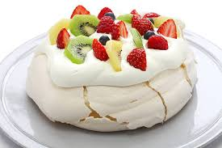
The IO Type
c :: Cake

Slide 12
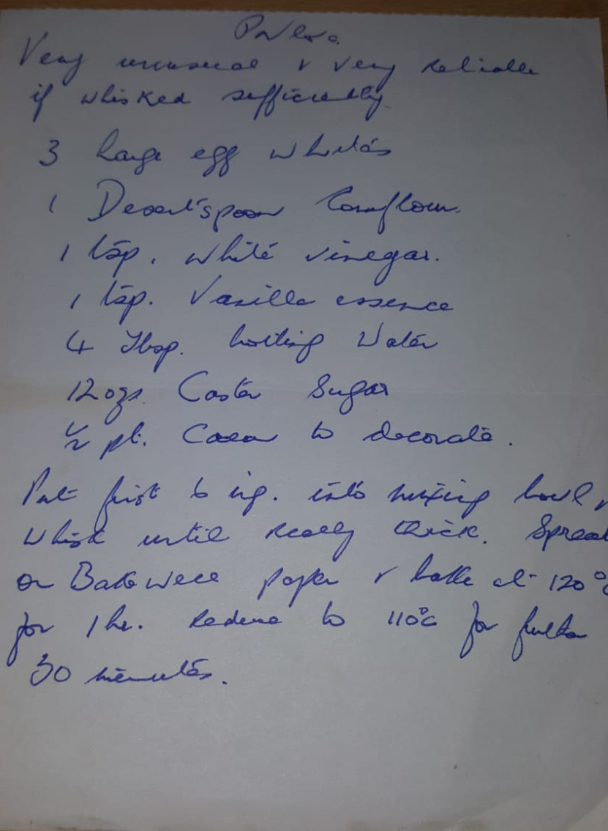
The IO Type
Alternatively we can have
c :: Recipe Cake
What do you have? A cake?
No, you have some instructions for how to make a cake, just a sheet of paper with some writing on it.

Slide 13
The IO Type
c :: Recipe Cake
Not only do you not actually have a cake, just having the recipe has no effect on anything else whatsoever. Simply holding the recipe in your hand does not, for instance:
Cause your oven to get hot or
Put all ingredients in the bowl or
Mix the ingredients
To actually produce a cake, the recipe must be followed (ingredients bought, causing flour to be spilled, ingredients mixed, the oven to get hot, etc.).

Slide 14
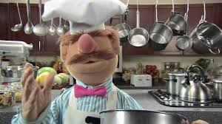
The IO Type
In the same way, a value of type IO a is just a “recipe” for producing a value of type a (and possibly having some effects along the way). Like any other value, it can be passed as an argument, returned as the output of a function, stored in a data structure, or (as we will see shortly) combined with other IO values into more complex recipes.
Click to see video

Slide 15
main
So, how do values of type IO a actually ever get executed? (Apart from when we use the interactive GHCI)
There is only one way: the Haskell compiler looks for a special value
which will actually get handed to the runtime system and executed. That’s it!
main :: IO ()

Slide 16
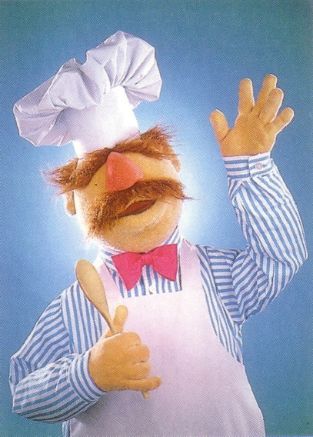
main
Think of the Haskell runtime system as a master chef who is the only one allowed to do any cooking.

Slide 17
Basic Actions
The standard library provides a number of actions, including the following three primitives:
The action getChar reads a character from the keyboard, echoes it to the screen, and returns the character as its result value:
getChar :: IO Char

Slide 18
Basic Actions
getChar :: IO Char
Look at it’s type – it looks like a value rather than a function – actually, getChar stores an I/O action. When it’s performed you get a Char.
The <- operator is used to “pull out” the result from performing the I/O action and store it in the variable.

Slide 19
Basic Actions
The action putChar c writes the character c to the screen, and returns no result value:
putChar :: Char → IO ()
The action return v simply returns the value v, without performing any interaction:
return :: a → IO a

Slide 20
Sequencing
A sequence of actions can be combined as a single composite action using the keyword do.
For example:
act :: IO (Char,Char)
act = do x ← getChar
getChar
y ← getChar
return (x,y)

Slide 21
do notation
The do notation give us a way of building IO programs from the components that we have seen. It does two things :
It is used to sequence I/O programs
It is used to name the values returned by the IO actions – this means that the later actions can depend on values captured earlier in the program

Slide 22
Derived Primitives
Reading a string from the keyboard:
if .. then .. else
getLine :: IO String
getLine = do x ← getChar
if x == '\n' then
return []
else
do xs ← getLine
return (x:xs)

Slide 23
Writing a string to the screen:
putStr :: String → IO ()
putStr [] = return ()
putStr (x:xs) = do putChar x
putStr xs
Writing a string and moving to a new line:
putStrLn :: String → IO ()
putStrLn xs = do putStr xs
putChar '\n'

Slide 24
Other examples
Writing a string four times:
put4times :: String → IO ()
put4times str
= do putStr str
putStr str
putStr str
putStr str
Spaces not tabs!

Slide 25
Other examples
Reading input
read2lines :: IO ()
read2lines
= do getLine
getLine
putStrLn “two lines read”
read2lines is applied to 2 arguments (the two lines that are typed in)

Slide 26
Other examples
Using the input
getNput :: IO ()
getNput = do line <- getLine
putStrLn line
Note that in Haskell, each
var <-
creates a new variable – so, this ‘single assignment’ is allowed (rather than ‘updatable assignment’)
line <- getLine acts as a local definition

Slide 27
Other examples
We can’t change line but we can use it differently:
reverse2lines :: IO ()
reverse2lines =
do line1 <- getLine
line2 <- getLine
putStrLn(reverse line1)
putStrLn(reverse line2)

Slide 28
Other examples
We can also use local definitions:
Only used to name IO actions
reverse2lines2 :: IO ()
reverse2lines2 =
do line1 <- getLine
line2 <- getLine
let rev1 = reverse line1
let rev2 = reverse line2
putStrLn(rev1)
putStrLn(rev2)
Local definitions

Slide 29
Pure Versus I/O
Pure code ensures that Haskell functions return the same result when given the same input and have no side effects. We use the execution of I/O actions to avoid these rules
Pure | Impure
Always produces the same result when given the same parameters | May produce different results for the same parameters
Never has side effects | May have side effects
Never alters state | May alter the global state of the program , system or world

Slide 30
Why purity matters
In other languages (e.g. C, Java) cannot be sure of no side effects (need to read documentation, hope it’s accurate).
Many bugs are caused by unanticipated side effects.
This can cause cascading effects when using multi-threading, other forms of parallelisms.
In Haskell, isolating side effects into I/O actions provides a clear boundary between no side effects and potential side effects.

Slide 31
Back to mystery’s in Java .. recap
public static int mystery2(int val1, int val2) { int val3 = 3; Scanner in = new Scanner(System.in); System.out.println("Enter a number: "); try { val3 = in.nextInt(); } catch (Exception e) { e.printStackTrace(); } return (val1+val2+val3)^2; }
public static int mystery1(int val1, int val2) { int val3 = 3; return (val1+val2+val3)^2; }

Slide 32
mystery’s in Haskell ..
mystery1:: Int -> Int -> Int
mystery1 val1 val2 = (val1 + val2 + val3)^2
where val3 = 3
No IO involved here
It is clear where IO is involved
mystery2 :: Int -> Int-> IO Int
mystery2 val1 val2 = do
putStrLn "Enter a number"
val3Input <- getLine
let val3 = read val3Input::Int
return ((val1 + val2 + val3)^2)
IO involved here

Slide 33
More Examples
We can now define an action that prompts for a string to be entered and displays its length:
strlen :: IO ()
strlen = do putStr "Enter a string: "
xs ← getLine
putStr "The string has "
putStr (show (length xs))
putStrLn " characters"

Slide 34
More Examples
> strlen
Enter a string: Haskell
The string has 7 characters
Note:
Evaluating an action executes its side effects, with the final result value being discarded.

Slide 35
Hangman
Consider the following version of hangman:
One player secretly types in a word.
The other player tries to deduce the word, by entering a sequence of guesses.
For each guess, the computer indicates which letters in the secret word occur in the guess.

Slide 36
Hangman
The game ends when the guess is correct.
We adopt a top down approach to implementing hangman in Haskell, starting as follows:
hangman :: IO ()
hangman = do putStrLn "Think of a word: "
word ← sgetLine
putStrLn "Try to guess it:"
play word

Slide 37
Hangman
The action sgetLine reads a line of text from the keyboard, echoing each character as a dash:
sgetLine :: IO String
sgetLine = do x ← getCh
if x == '\n' then
do putChar x
return []
else
do putChar '-'
xs ← sgetLine
return (x:xs)

Slide 38
Hangman
The action getCh reads a single character from the keyboard, without echoing it to the screen:
import System.IO
getCh :: IO Char
getCh = do hSetEcho stdin False
x ← getChar
hSetEcho stdin True
return x

Slide 39
Hangman
The function play is the main loop, which requests and processes guesses until the game ends.
play :: String → IO ()
play word =
do putStr "? "
guess ← getLine
if guess == word then
putStrLn "You got it!"
else
do putStrLn (match word guess)
play word

Slide 40
Hangman
The function match indicates which characters in one string occur in a second string:
match :: String → String → String
match xs ys =
[if elem x ys then x else '-' | x ← xs]
For example:
> match "haskell" "pascal"
"-as--ll"

Slide 41
Reading values in general
Haskell contains the class Read with the function
read :: Read a => String -> a
This can be used to parse a string representing a value of a particular type into that value

Slide 42
Example using read
Suppose that we want to read an I/O program to read in an integer value.
To read an integer from a line of input, we start by
do line <- getLine
Then we need to sequence this with an I/O action to return the line interpreted as an Integer.
We can convert the line to an integer by the expression
read line

Slide 43
Example using read
What we need is the IO Integer action which returns this value – this is the purpose of return.
Our program to read an integer is
The compiler can figure out it’s an Integer from this
getInt :: IO Integer
getInt =
do line <- getLine
return (read line)
Compiler is expecting an Integer to be returned so needs return

Slide 44
Being more specific
More generally, remember that
Read a => String -> a
So we can specify directly into which type we wish to cast:
Or.. E.g. Inside a do block ..
..
st1 <- getLine
let int1 = read st1 :: Int
..
read "1" :: Int

Slide 45
Add two numbers using show
Recall that to use a non-string type as a string, we use show
Add two numbers and print result
add :: IO ()
add = do putStrLn "Enter two numbers"
numstr1 <- getLine
numstr2 <- getLine
let num1 = read numstr1 :: Int
let num2 = read numstr2 :: Int
putStrLn ("Sum is "++ show (num1 + num2))

Slide 46
Alternative using getInt
Using getInt (which already uses read to make into Integer)
add :: IO ()
add = do putStrLn ”Enter two numbers"
num1 <- getInt
num2 <- getInt
putStrLn ("Sum is "++show (num1+num2))

Slide 47
References
Programming in Haskell, Graham Hutton
https://www.seas.upenn.edu/~cis194/fall16/index.html
Get Programming with Haskell, Will Kurt, Mannning, ISBN 9781617293764.

Slide 48

47

