Slide 1
Procedure、Function、Package and
Trigger
9134015 莊易霖

Slide 2
Procedure、Function
和Microsoft SQL server很類似
Oracle的stored procedure主要結構如下
設定: 說明本PL/SQL是Procedure或Function
宣告: 變數宣告
SQL執行: 在處理過程還可以依狀況進行流程控制
例外處理: PL/SQL發生錯誤時的處理狀況
Procedure to Trigger - <number>

Slide 3
Package
一群相關的Procedure、Function、Variable、Date type 所組成作為特殊用途
當用戶第一次使用系統會將之載入到記憶體，隨後可讓多人存取
Oracle提供內建package包括
DBMS_LOB
DBMS_SESSION
DBMS_UTILITY
DBMS_SPACE
Procedure to Trigger - <number>

Slide 4
Package (cont.)
DBMS_LOB: 提供關於大型物件運算的subroutine
DBMS_SESSION: 產生如SET_ROLE、SET_ROLE_TRACE等package procedure
DBMS_UTILITY: 提供各種SQL*Plus、PL/SQL可以使用的subroutine
DBMS_SPACE: 提供尚有多少space segment可用的資訊
Procedure to Trigger - <number>

Slide 5
Trigger
針對table: Row trigger、statement trigger
以時間來分: BEFORE、AFTER
BEFORE: 先讓trigger去確認DML可以被執行，如果不行就駁回
AFTER: 事後被激發，通常用於輔助DML進行特定的紀錄工作
Procedure to Trigger - <number>

Slide 6
Trigger Caution
必要時才用triggers，過度使用會造成互相依
賴，會使得很難去維持一個大的應用程式。舉例來
說，當一個trigger被執行時，他的trigger action
裡面包含SQL敘述可能會執行其它triggers。當在一
個trigger裡面的敘述造成其它trigger被執行，這
種trigger被叫做cascading。
Procedure to Trigger - <number>

Slide 7
Trigger
DML: insert、update、delete
DDL: create、alter、drop
System event: startup、shutdown
User event: logon、logoff
Oracle 可針對table、view、schema、database做trigger
Procedure to Trigger - <number>

Slide 8
Trigger syntax
CREATE [OR REPLACE] TRIGGER <trigger_name>
{BEFORE|AFTER} {INSERT|DELETE|UPDATE} ON <table_name>
[REFERENCING [NEW AS <new_name>] [OLD AS <old_name>]]
[FOR EACH ROW [WHEN (<trigger_condition>)]]
<trigger_body>
Procedure to Trigger - <number>

Slide 9
Trigger notes
May specify up to three triggering events using the keyword OR
Furthermore, UPDATE can be optionally followed by the keyword OF and a list of attribute(s) in <table_name>
... INSERT ON R ...
... INSERT OR DELETE OR UPDATE ON R ...
... UPDATE OF A, B OR INSERT ON R ...
For row-level trigger: NEW and OLD must be preceded by a colon(“:”) , but in WHEN clause , they do not have a preceding colon.
A trigger restriction can be specified in the WHEN clause, enclosed by parentheses. This trigger restriction may not contain subqueries.
Procedure to Trigger - <number>

Slide 10
Trigger example
CREATE TABLE T4 (a INTEGER, b CHAR(10));
CREATE TABLE T5 (c CHAR(10), d INTEGER);
CREATE TRIGGER trig1
AFTER INSERT ON T4
REFERENCING NEW AS newRow
FOR EACH ROW
WHEN (newRow.a <= 10)
BEGIN
INSERT INTO T5 VALUES(:newRow.b, :newRow.a);
END trig1;
.
run;
Procedure to Trigger - <number>

Slide 11
About trigger
Displaying Trigger Definition Errors | show errors trigger <trigger_name>;
Viewing Defined Triggers | select trigger_name from user_triggers;
Dropping Triggers | drop trigger <trigger_name>;
Disabling Triggers | alter trigger <trigger_name> {disable|enable};
Procedure to Trigger - <number>

Slide 12
提供的 trigger 屬性
Attribute | Type
ora_client_ip_address | VARCHAR2
ora_is_alter_column | Boolean
ora_login_user | VARCHAR2
ora_server_error | Number (1 for top of stack), it returns the error number at the position on error stack
ora_sysevent | VARCHAR2
Procedure to Trigger - <number>

Slide 13
Oracle 支援的event trigger
User event
System event
Procedure to Trigger - <number>

Slide 14
和SQL server不同處
特定table的DML指令，如insert、update、delete
特定的object、schema或database進行特定的DDL指令
特定的database事件，如startup、shutdown、server error
特定的user event，如log on/off
Procedure to Trigger - <number>

Slide 15
在 Oracle下輕鬆建立
Oracle 網頁管理介面十分好用
功能十分強大，甚至可直接調實體儲存方式
簡單易懂
可透過form-based表單系統自動完成SQL 語法
在撰寫程式時可直接顯示語法有無錯誤
網頁畫面很有質感
缺點: 吃太多記憶體，開其他程式會很慢
Procedure to Trigger - <number>

Slide 16
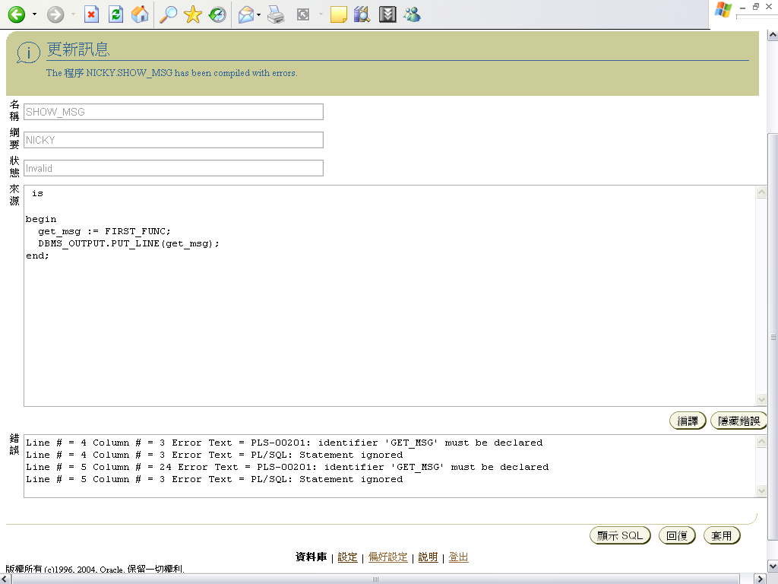
Procedure to Trigger - <number>

Slide 17
How to execute a procedure under oracle
使用前端VB工具或類似Power/TCP之類工具呼叫
使用Oracle的SQL*Plus執行
Set serveroutput on;
Execute [yourproc] ;
Procedure to Trigger - <number>

Slide 18
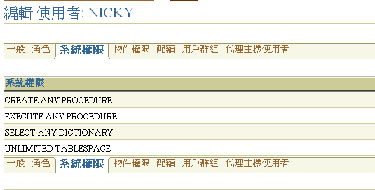
建立 procedure
最重要的事: 建立者要有足夠權限
Procedure to Trigger - <number>

Slide 19
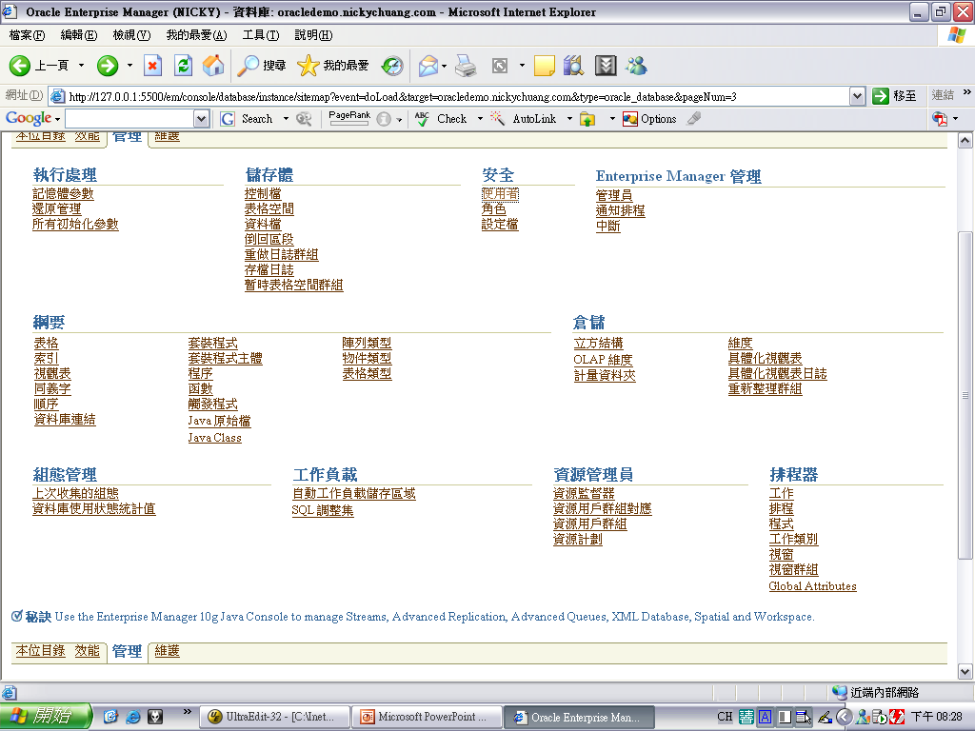
建立 procedure
Procedure to Trigger - <number>

Slide 20
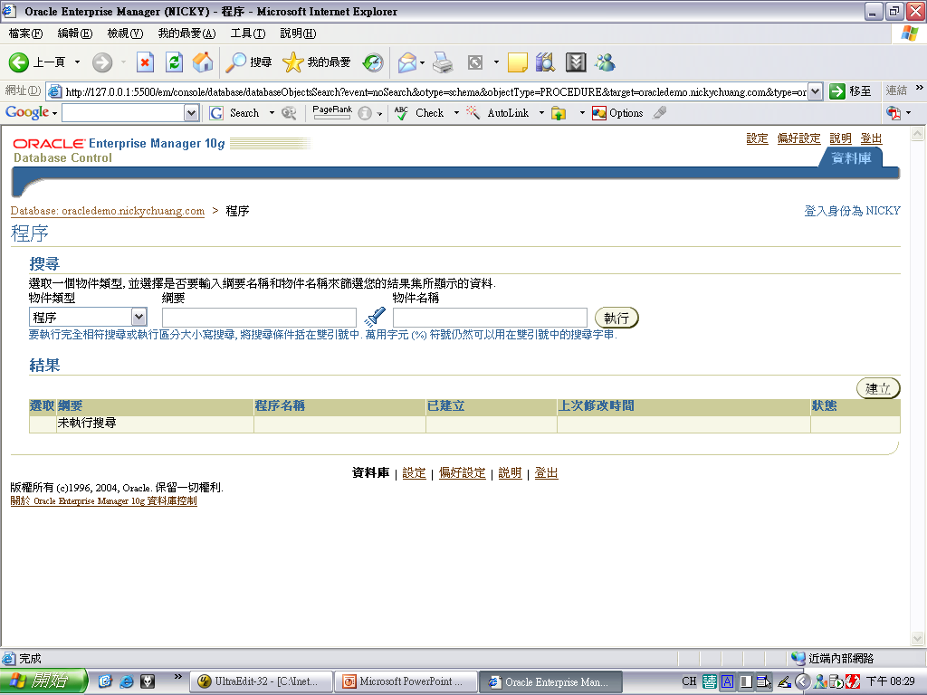
建立 procedure
Procedure to Trigger - <number>

Slide 21
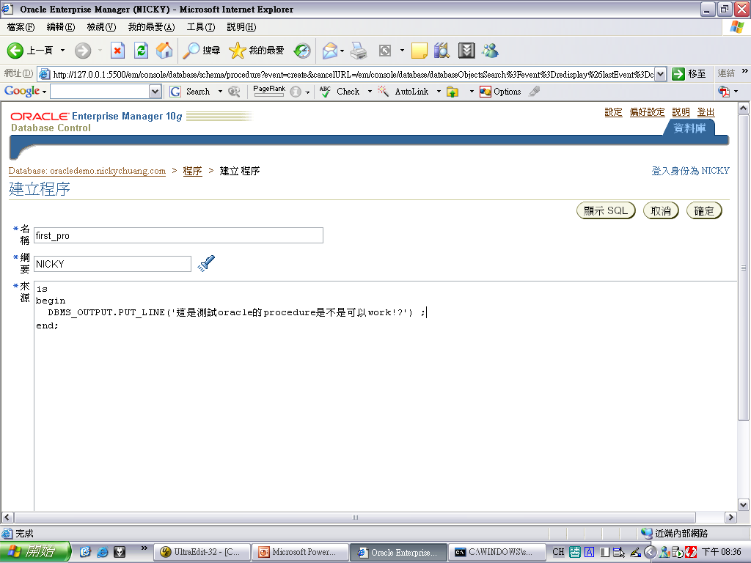
建立 procedure
Procedure to Trigger - <number>

Slide 22
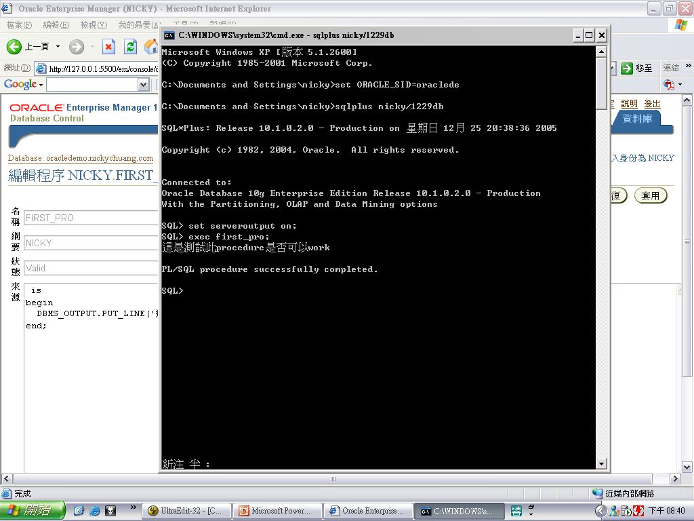
建立 procedure
Procedure to Trigger - <number>

Slide 23
建立 procedure
CREATE OR REPLACE PROCEDURE "NICKY"."FIRST_PRO" is
begin
DBMS_OUTPUT.PUT_LINE('這是測試此procedure是否可以work');
end;
Procedure to Trigger - <number>

Slide 24
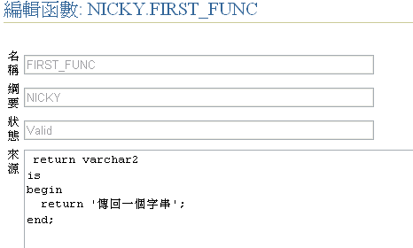
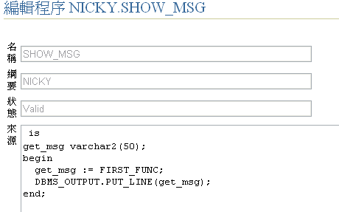
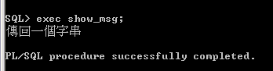
建立一個呼叫function的procedure
Procedure to Trigger - <number>

Slide 25
SQL syntax
CREATE OR REPLACE FUNCTION "NICKY"."FIRST_FUNC"
return varchar2
is
begin
return '傳回一個字串';
end;
Procedure to Trigger - <number>

Slide 26
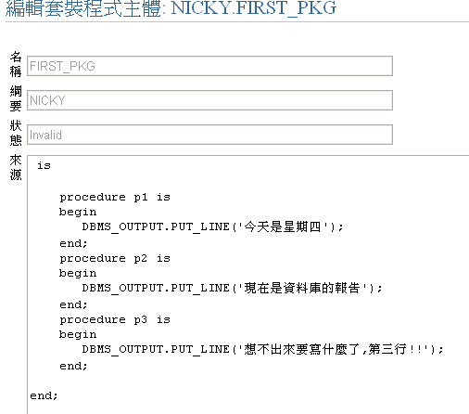
Package 主體
Procedure to Trigger - <number>

Slide 27
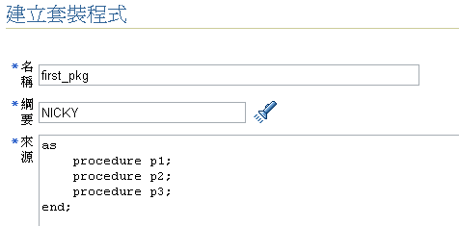
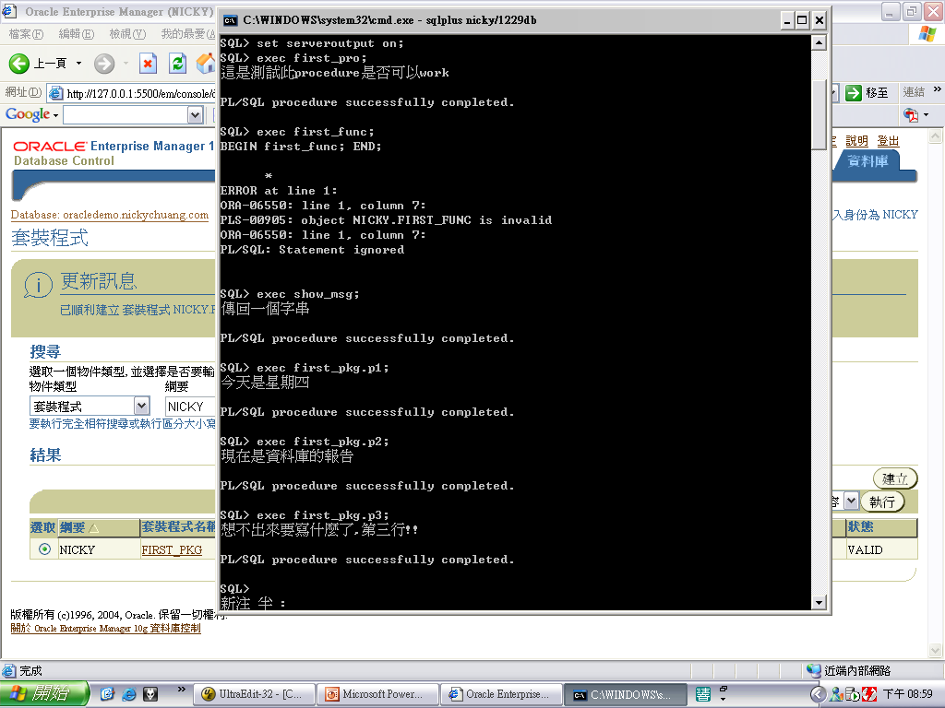
Package body
Procedure to Trigger - <number>

Slide 28
Package 主體
CREATE OR REPLACE PACKAGE BODY "NICKY"."FIRST_PKG" is
procedure p1 is
begin
DBMS_OUTPUT.PUT_LINE('今天是星期四');
end;
procedure p2 is
begin
DBMS_OUTPUT.PUT_LINE('現在是資料庫的報告');
end;
procedure p3 is
begin
DBMS_OUTPUT.PUT_LINE('想不出來要寫什麼了,第三行!!');
end;
end;
Procedure to Trigger - <number>

Slide 29
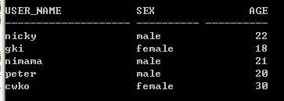
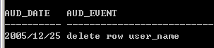
建立 trigger
假設目前DB有存在一table “FIRST_TBL”
希望每次一刪除一個row便記錄到另一table
Procedure to Trigger - <number>

Slide 30
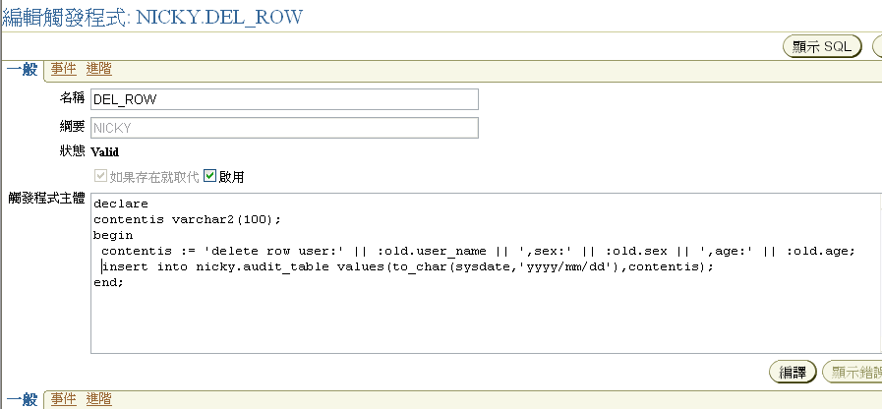
建立 trigger (cont.)
Procedure to Trigger - <number>

Slide 31
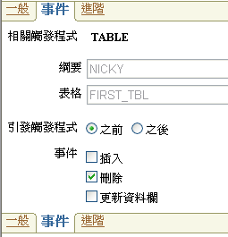
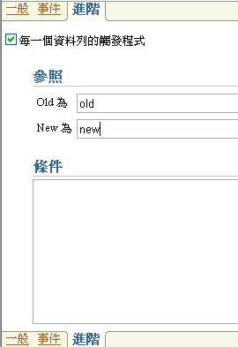
建立 trigger (cont.)
Procedure to Trigger - <number>

Slide 32
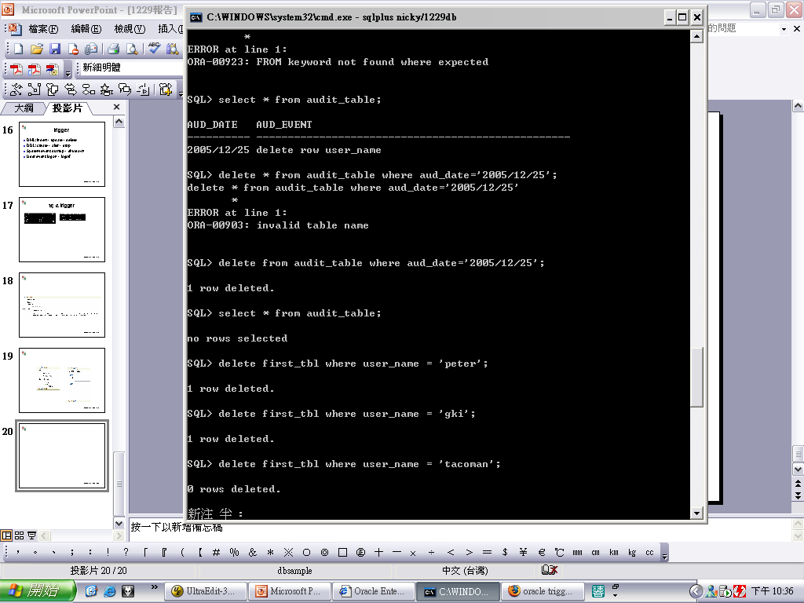
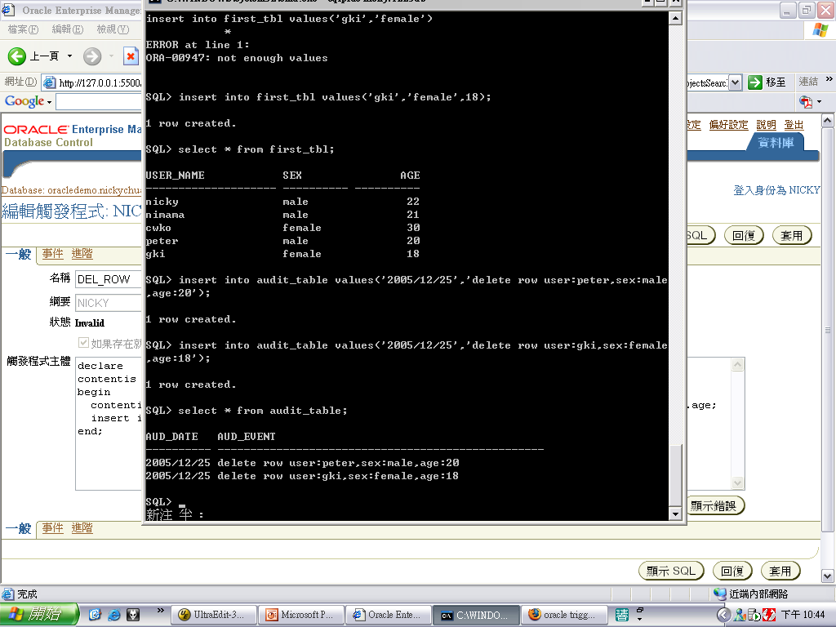
result
Procedure to Trigger - <number>

Slide 33
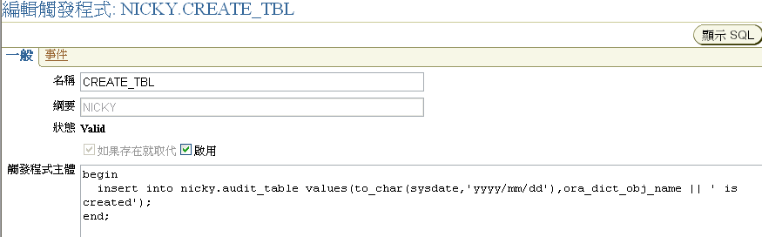
DDL trigger
Procedure to Trigger - <number>

Slide 34
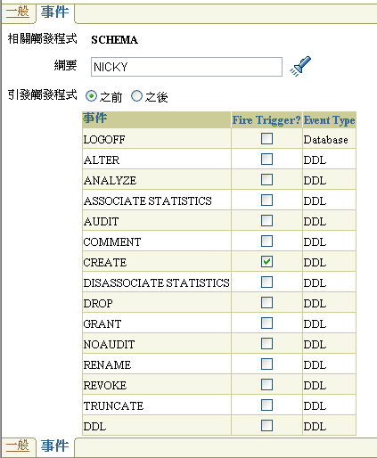
DDL trigger
Procedure to Trigger - <number>

Slide 35
SQL syntax
CREATE OR REPLACE TRIGGER "NICKY".CREATE_TBL
BEFORE
CREATE ON "NICKY".SCHEMA begin
insert into nicky.audit_table
values(to_char(sysdate,'yyyy/mm/dd'),ora_dict_obj_name ||
‘ is created');
end;
Procedure to Trigger - <number>

Slide 36
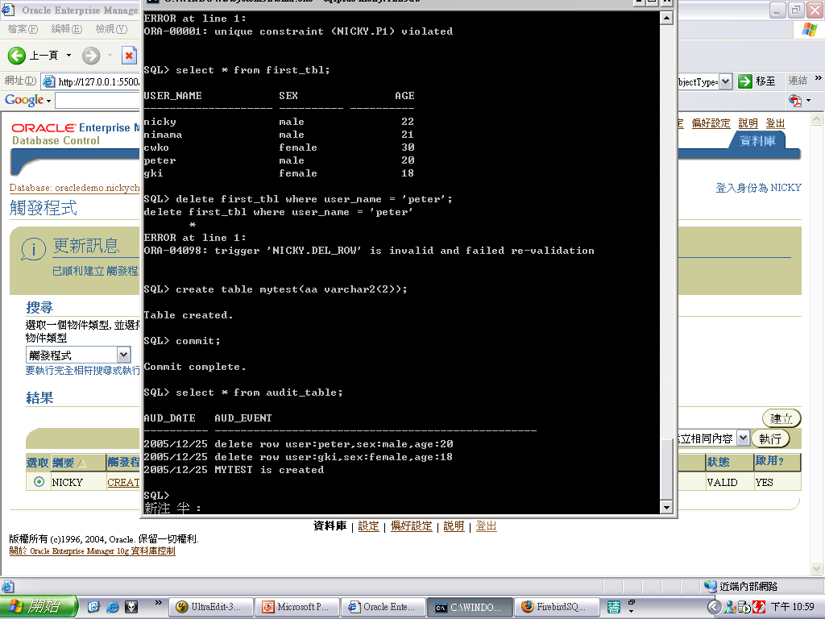
result
Procedure to Trigger - <number>

Slide 37
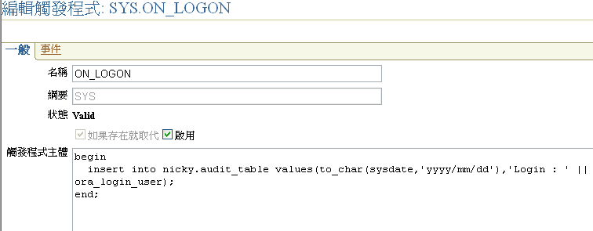
User event trigger
Procedure to Trigger - <number>

Slide 38
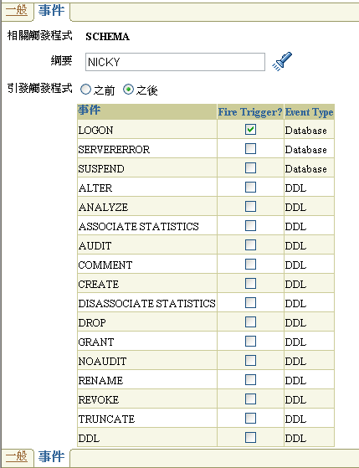
User event trigger
Procedure to Trigger - <number>

Slide 39
SQL syntax
CREATE OR REPLACE TRIGGER "SYS".ON_LOGON AFTER
LOGON ON "NICKY".SCHEMA begin
insert into nicky.audit_table values(to_char(sysdate,'yyyy/mm/dd'),'Login : ' || ora_login_user);
end;
Procedure to Trigger - <number>

Slide 40
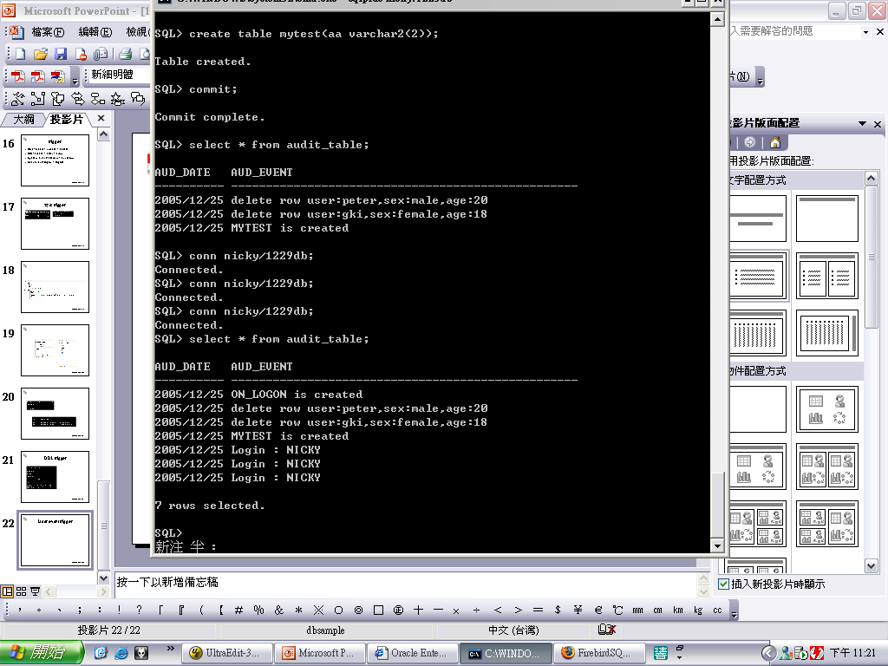
User event trigger result
Procedure to Trigger - <number>

Slide 41
Question!?
Procedure to Trigger - <number>

