Slide 1
Poisonous Mushrooms OR NOT Poisonous Mushrooms
IMAGE CLASSIFICATION
By Sophie Ngo @ BRAINSTATION 2020

Slide 2
Data Collection
The plan was to collect data using a library on Github called Flickr Scraper
Collect top five most deadly poisonous mushrooms combined with edibles mushrooms
Use Pillow to alter the images on my computer
Fortunately, I came across a mushroom image data set on Kaggle
Came from 9 common families of mushrooms

Slide 3
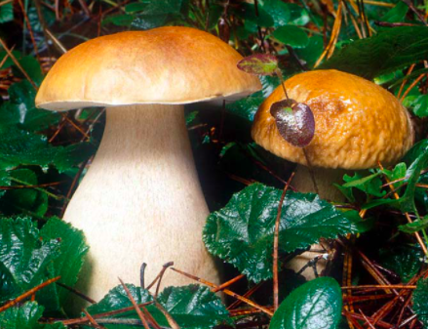
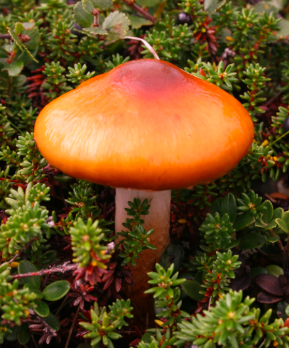
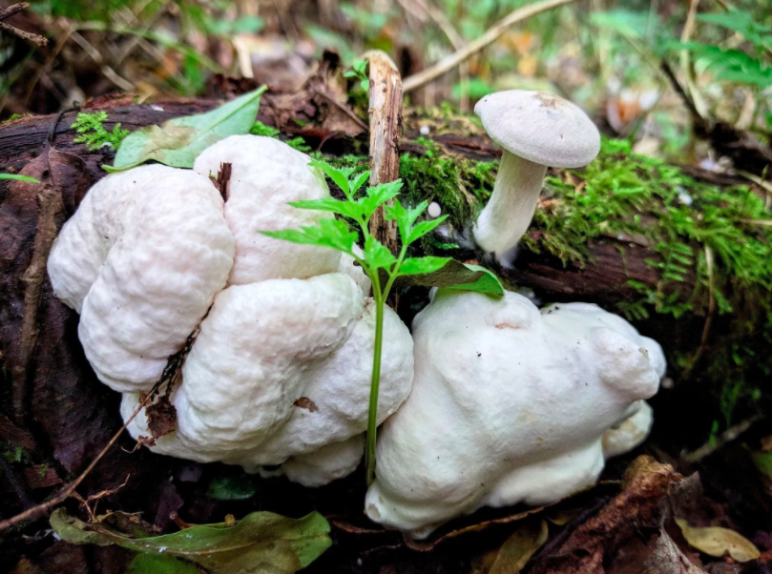
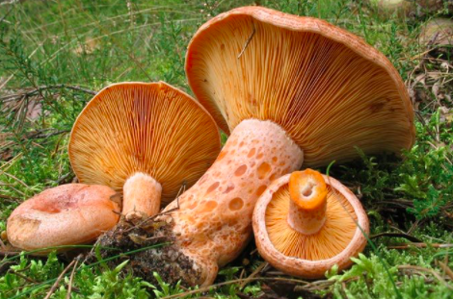
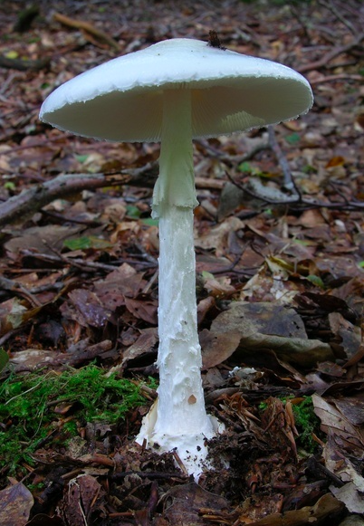
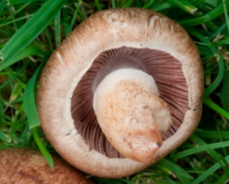
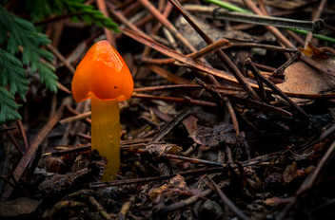
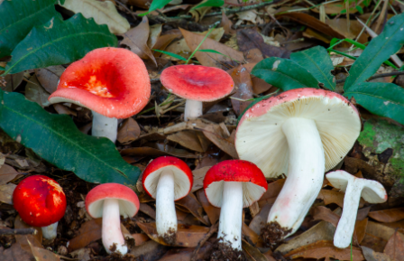
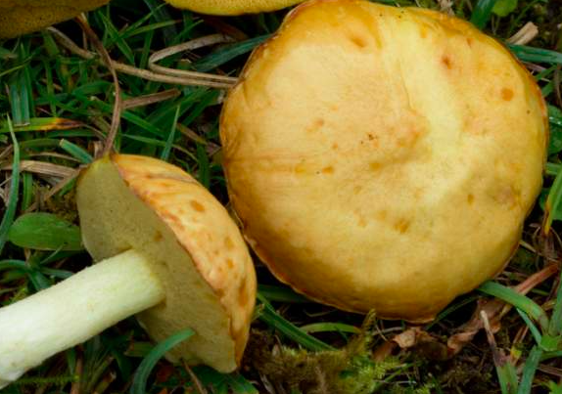
Data Description
Before it was uploaded for Modeling, the data was divided into training, test, validation
Boletus
Cortinarius
Entoloma
Lactarius
Amanita
Hygrocybe
Agaricus
Russula
Suillus

Slide 4
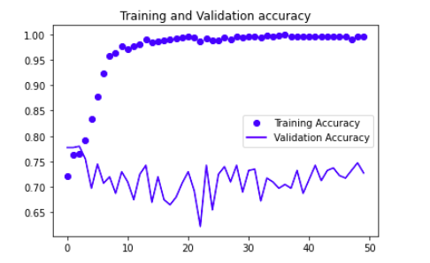
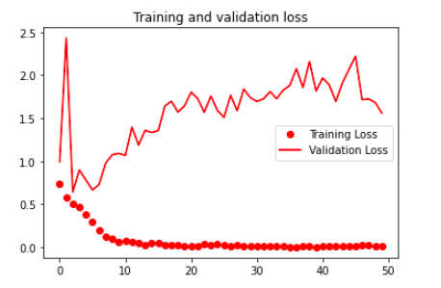
Modelling
Only focused on Poisonous or Not Poisonous Mushrooms. The Test Accuracy Score was only 70%.

Slide 5
Plan of Action
Improve the validation accuracy and loss for my model
Run my model on AWS for efficiency
Trading off precision and recall
Create my own data set and compare
Improving the model with data augmentation
Comparing the binary model to a categorical model

