Slide 1
Detecting Poisonous Mushrooms
By Sophie @ BrainStation 2020

Slide 2
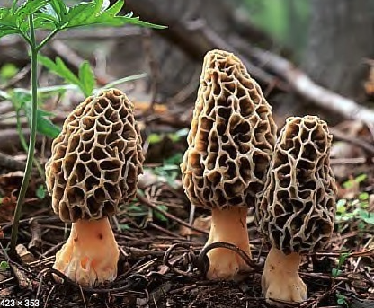
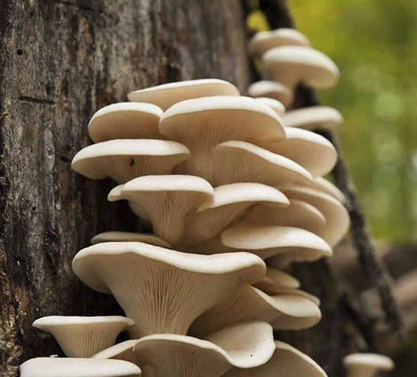
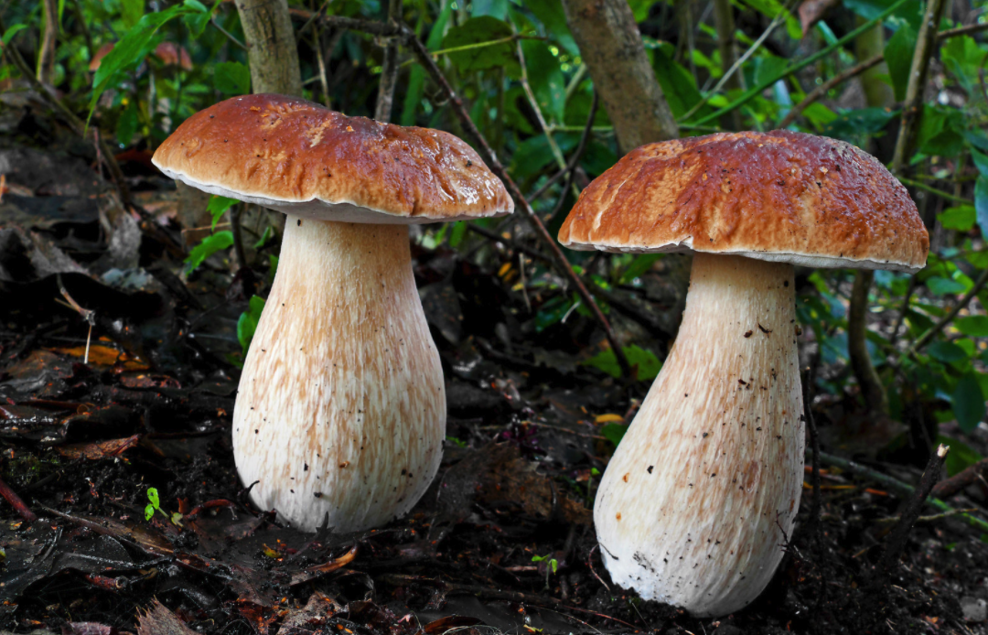
Provide additional food or income
Restaurants, Grocery Stores or Farmer’s Markets
For restaurants, generally more to an upscale restaurant
Free samples, restaurants are generally interested in finding fresh local food to add to their menu
Upscale grocers are likely to have the shoppers that will pay a premium price for gourmet mushrooms
If nothing works out, the farmer’s market is a great place

Slide 3
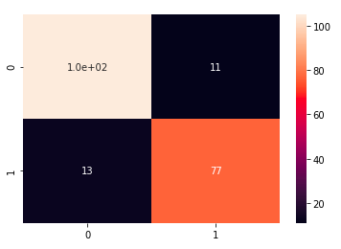
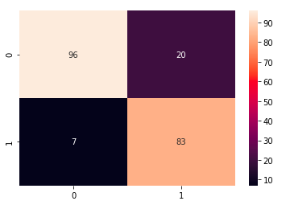


CNN and changing the threshold
Before Changing the Threshold
After Changing the Threshold
Predicted Not Poisonous
Predicted Poisonous
Predicted Not Poisonous
Predicted Poisonous
Actually Not Poisonous
Actually Not Poisonous
Actually Poisonous
Actually Poisonous

Slide 4
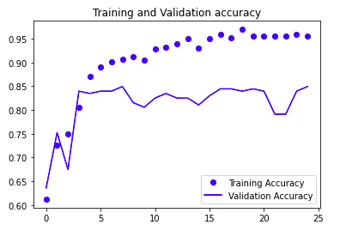
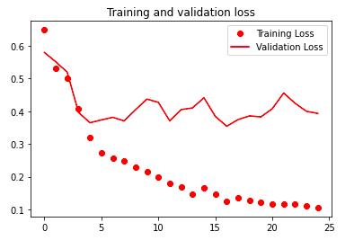
TWo type of Mushrooms Evaluation

Slide 5
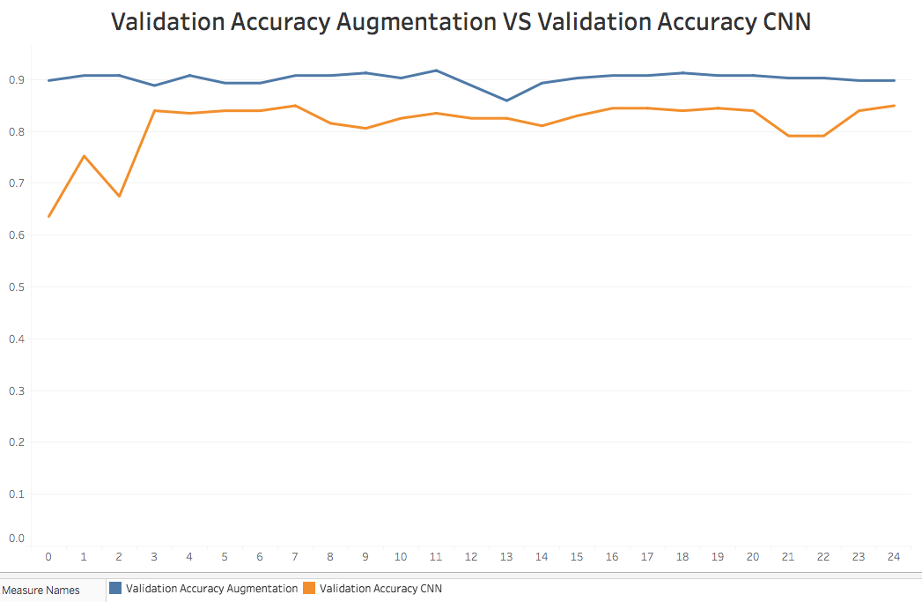
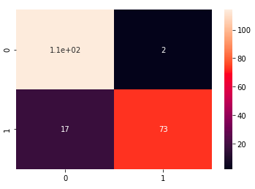

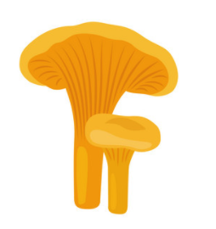

Augmented Images
Predicted Not Poisonous
Predicted Poisonous
Actually Not Poisonous
Actually Poisonous
Test Accuracy : 0.90776
Epochs

Slide 6
Vgg16
VGG16 is a CNN model
Pulled and used in the Keras pre-trained library
Altered to your liking such as changing the amount of outputs

Slide 7

Plan of action
Add more images of the same type mushrooms
Correctly match the mushroom to the family it belongs to

