Slide 1
Detecting Poisonous & Edible Mushrooms
By Sophie Ngo @ BrainStation 2020

Slide 2
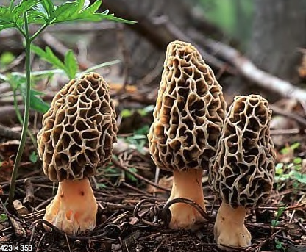
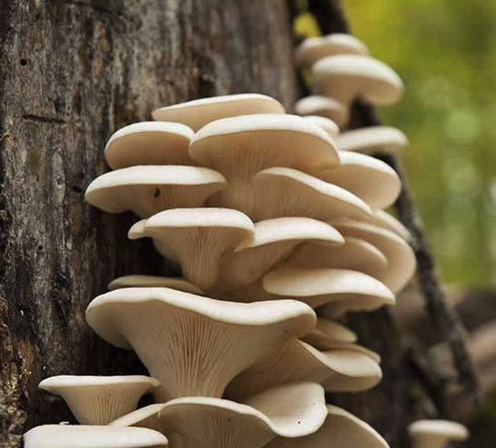
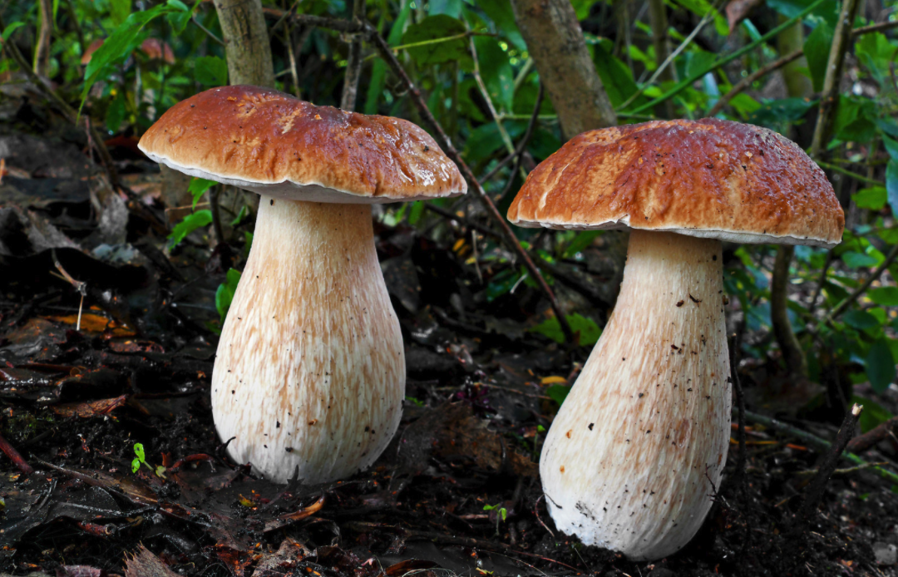
Provide additional food or income
Restaurants, Grocery Stores or Farmer’s Markets
For restaurants, generally more to an upscale restaurant
Free samples, restaurants are generally interested in finding fresh local food to add to their menu
Upscale grocers are likely to have the shoppers that will pay a premium price for gourmet mushrooms
If nothing works out, the farmer’s market is a great place

Slide 3
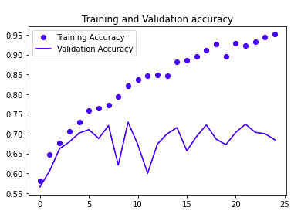
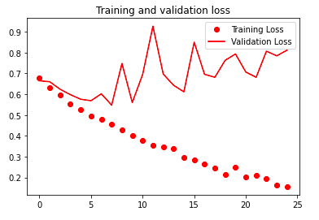
A few Different Family of Mushrooms

Slide 4
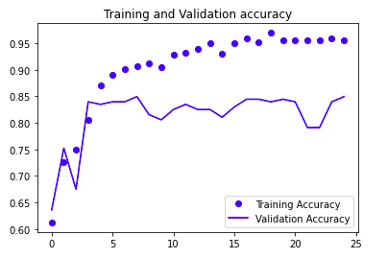
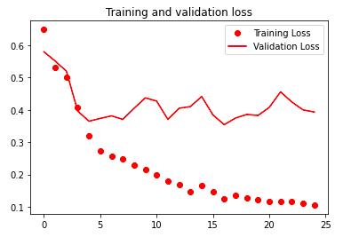
TWo type of Mushrooms

Slide 5
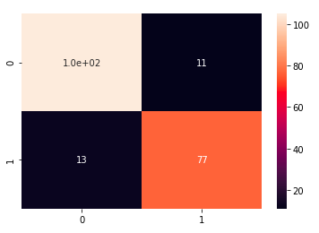
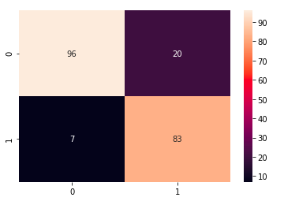


CNN and changing the threshold
Before Changing the Threshold
After Changing the Threshold
Predicted Not Poisonous
Predicted Poisonous
Predicted Not Poisonous
Predicted Poisonous
Actually Not Poisonous
Actually Not Poisonous
Actually Poisonous
Actually Poisonous

Slide 6
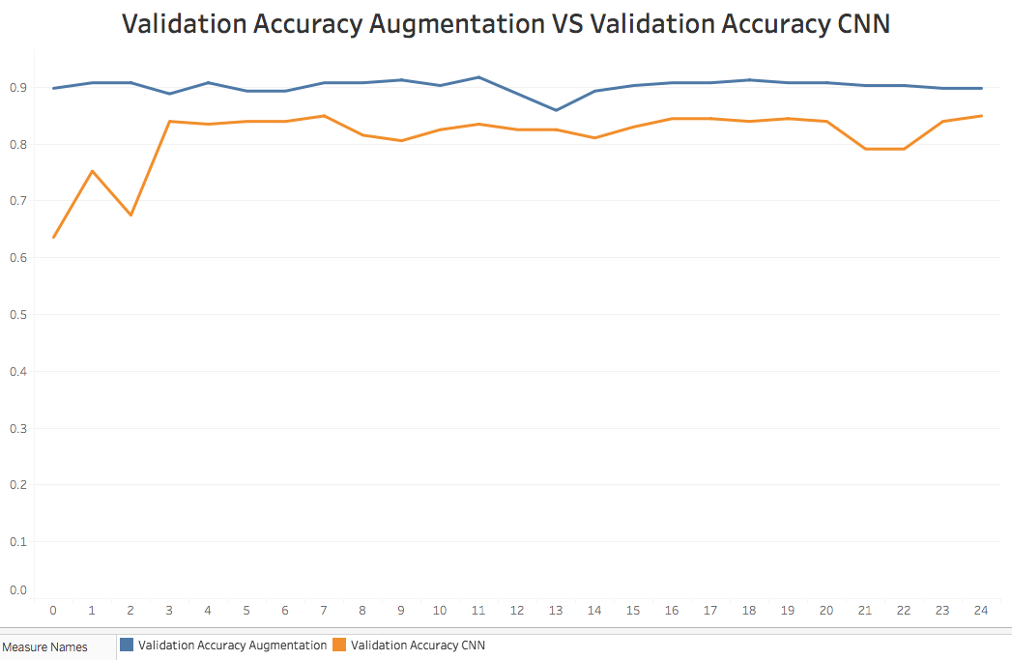
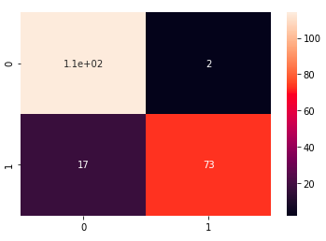



Augmented Images
Predicted Not Poisonous
Predicted Poisonous
Actually Not Poisonous
Actually Poisonous
Test Accuracy : 0.90776
Epochs

Slide 7
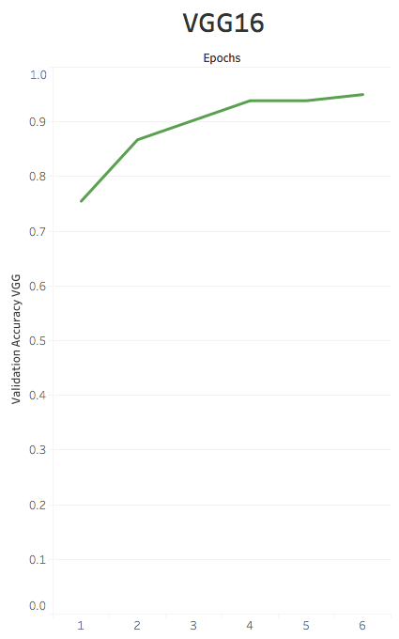

Vgg16
VGG16 is a CNN model
Pulled and used in the Keras pre-trained library
Altered the the amount of my outputs to 2
The validation loss also showed improvement, with a validation accuracy of 95% with a validation loss of 0.04 by the 6 epochs
For the original CNN, the accuracy only got up to 84% for validation accuracy with a validation loss of 0.38 by the 6 epochs
Was able to reduce false negative to 0.9%

Slide 8


Goals
Gradually add more images of the same type of mushrooms
Add more family of mushrooms and more images per mushroom
Correctly match the mushroom to the family it belongs to
Possibly look into the VGG 19 model with 19 layers deep compared to 16 layers
http://sophiengo.com/
https://github.com/funcodingPanda

