Slide 1

Project : a text-based adventure game
- maitrehenry nathanael
- vessella emilie
- Dartigues Mathieu
08/12/2023

Slide 2
Organisation
In group :
Search our game’s story
Think about it in Java : identify the different classes, methods…
Create the UML on paper then on computer (Visual Paradigm)
Write the report
Individually :
Create project’s structure, write classes, methods, tests…

Slide 3
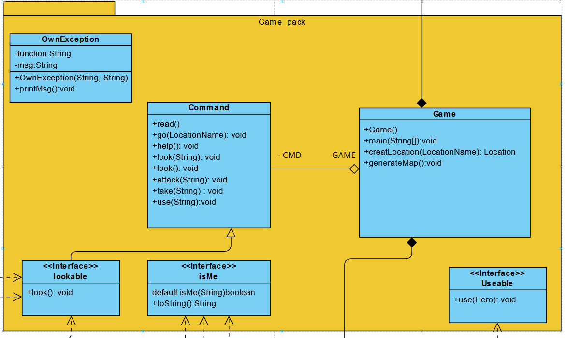
Game pack :
Game :
Core of the game
Generate map, initialize characters, handle commands
Command :
Perfom actions : aggregation to access Game functionality

Slide 4
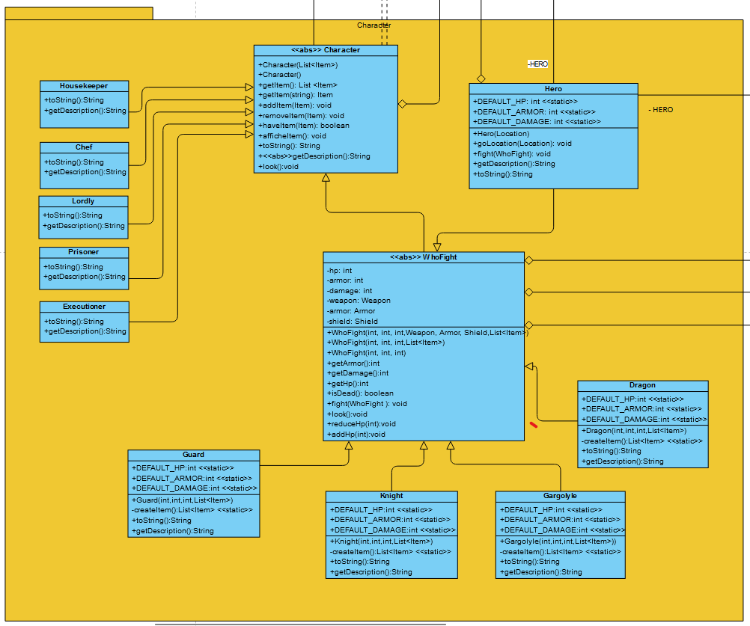
Characters
Character :
- Describe a character : add/remove/list items
- Abstract class : don’t instance a Character, must override getDescription() method
WhoFight :
- A character that can fight characters properties (heritage) + attacks methods
- Abstract class : same reasons

Slide 5
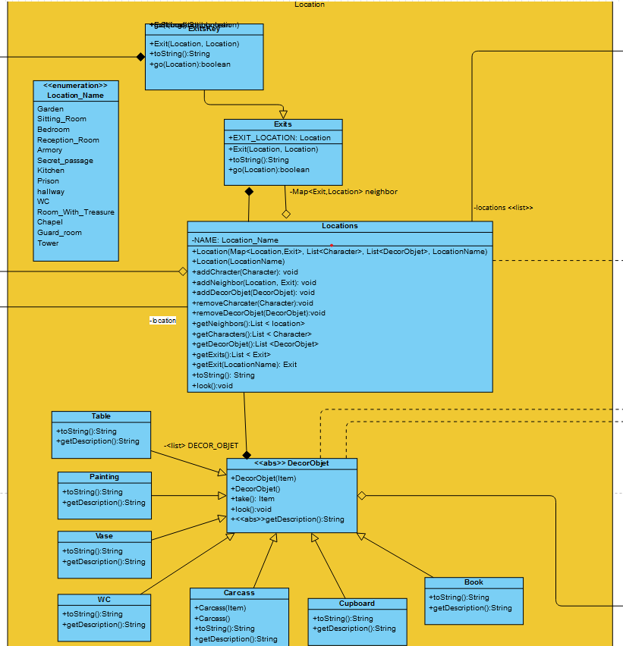
Locations
Enumeration to save all possibles locations.
A DecorObject exist only in a location : composition
Exits are locations

Slide 6
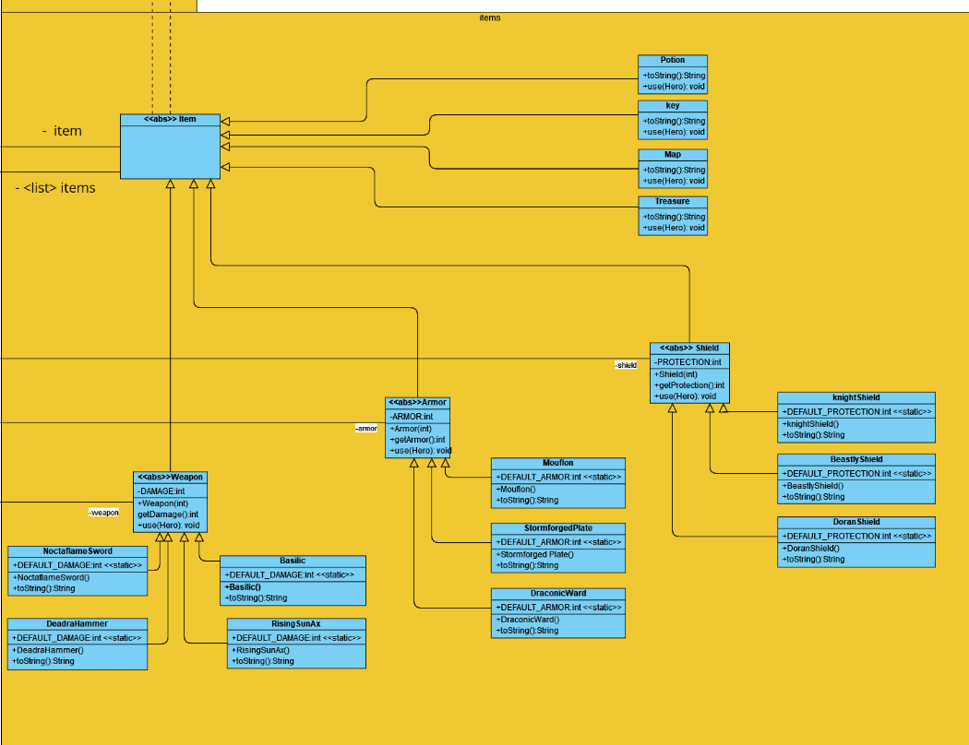
Items
Implements useable’s interface : each item has different functionality when used
Example : a potion add heal
Abstract class : describe property of a large type of items (Shield -> DoranShield, KnightShield…)

Slide 7
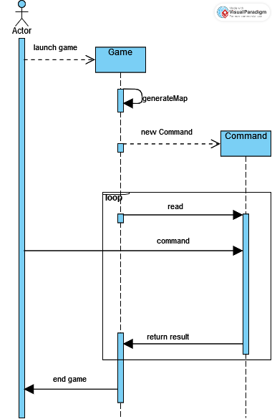
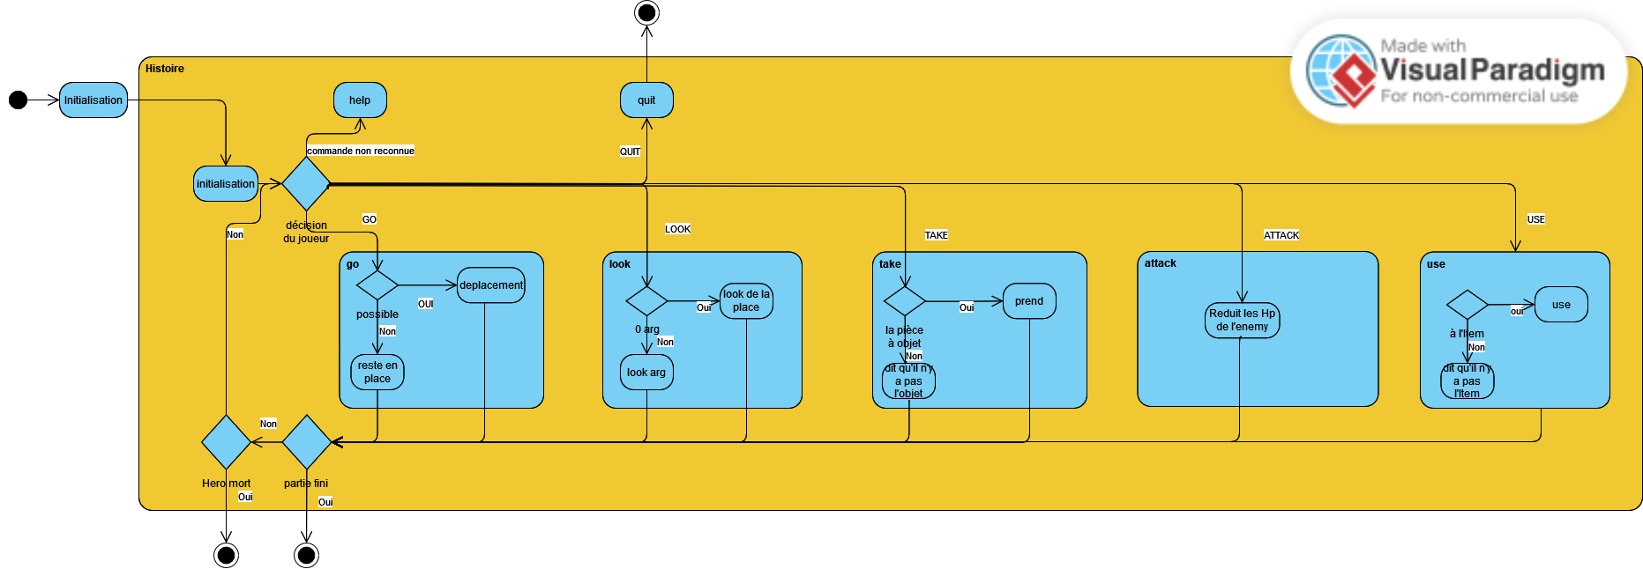
Other diagrams
Sequence diagram
State diagram

Slide 8
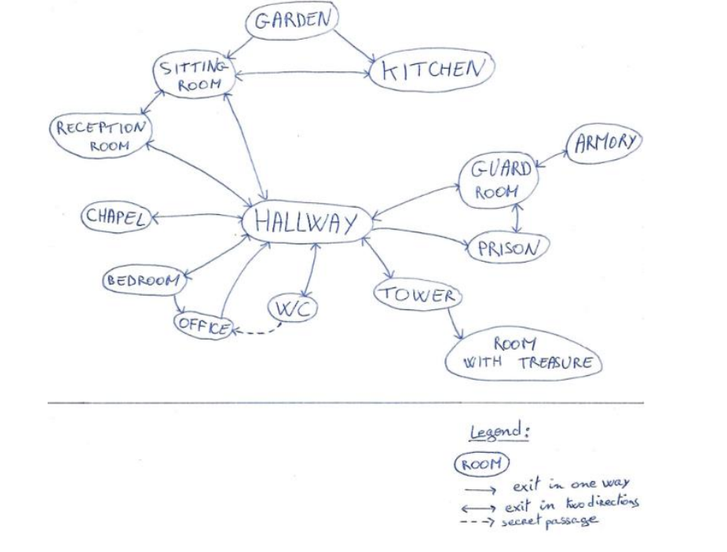
Conclusion

