Slide 1

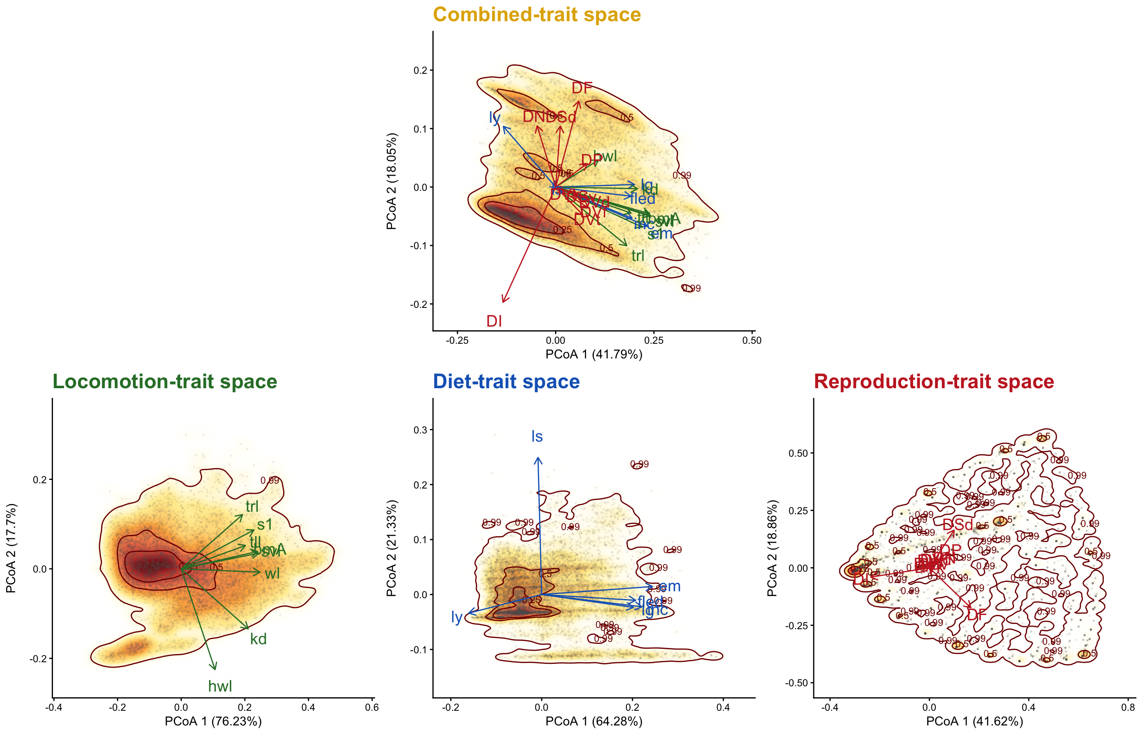
Morphological
Life-history
Diet
Traits
Traits
Traits
Original
trait databases
AVONET
(8 traits)
AMNIOTE
(6 traits)
EltonTraits
(11 traits)
Species
Quantitative
Species
Quantitative
Species
Categorical
Taxonomic homogenization + Missing traits imputation
Combined
trait databases
Morphological
Life-history
Diet
Species
PCoA with selected type of traits
Trait spaces

