Slide 1
I am listing some of my comments in the slides. Hope this can help us to improve the automatic analysis.

Slide 2
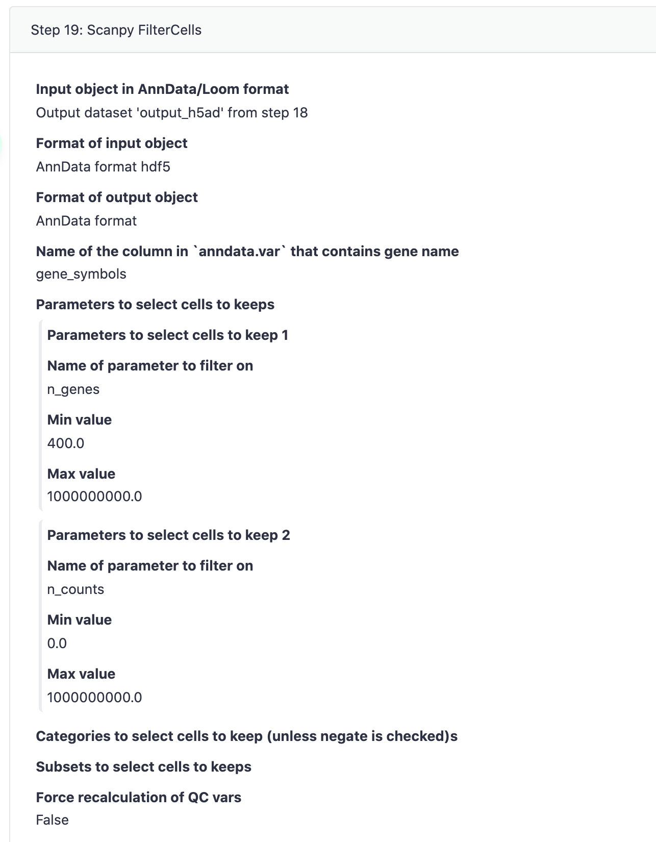
For the QC (of 10x), I normally set:
N_genes > 200
N_counts > 500 (I think sequencing depth is important!)
Of course, these cutoffs are very loose. Most of the datasets should exclude more cells.
For SS2, I normally set:
N_genes > 500
N_counts > 1500
We MUST have different parameters for 10x and SS2.
It is also very safe to add (for 10x):
N_genes < 10000
N_counts < 30000
* As discussed, it is necessary to add percent_mito cutoff.
To exclude cells based on the distribution, please refer to the paper: https://f1000research.com/articles/5-2122.

Slide 3
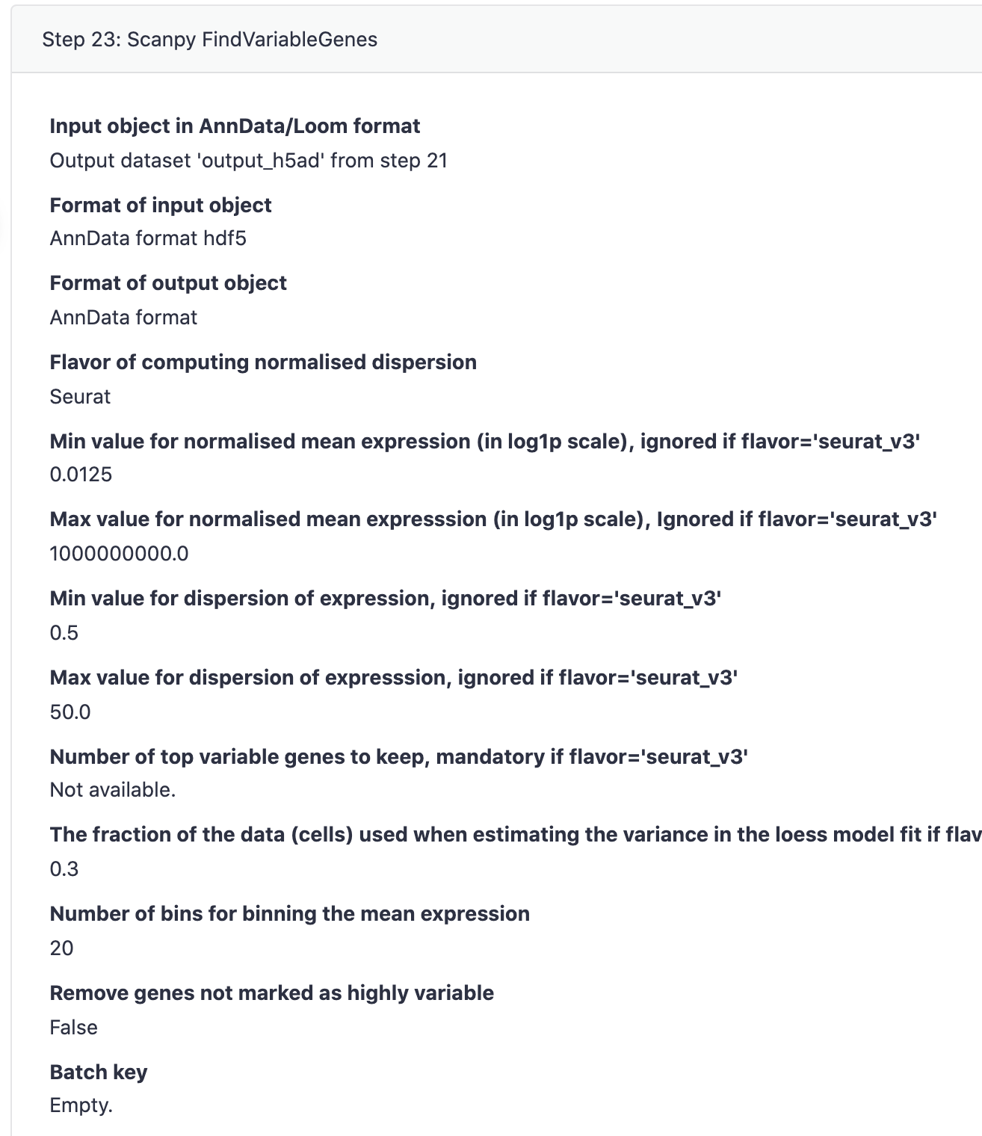
I am using flavor=‘Seurat_v3’ and select the top 2000 genes. I find it is pretty effective. 2000 genes normally cover the variances for most of the datasets. I cannot guarantee this works for all the datasets.
In the Seurat flavor, I would put the ‘Max value for normalized mean expression’ as 10.
* Most important (As I mentioned), we should input the ‘batch key’. This will help us to select the HVGs balancing the batch effect.
This automatic workflow may not cover all the situations. Sometimes, we may need to exclude ribosomal genes or cell cycle genes or MT genes.

Slide 4
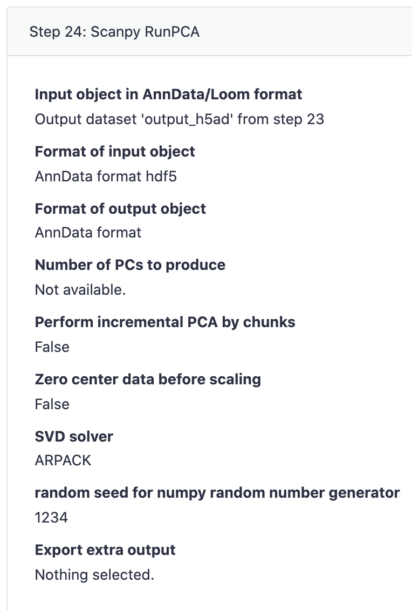
In both SCANPY and Seurat, there is a PC selection step after RunPCA.
We may calculate 50 or 100 PCs. But we only use the top PCs in later calculation.
Normally, we can select the top PCs if the cumulative explained variances is up to 85%. See Palantir for example: https://github.com/dpeerlab/Palantir/blob/master/notebooks/Palantir_sample_notebook.ipynb

Slide 5
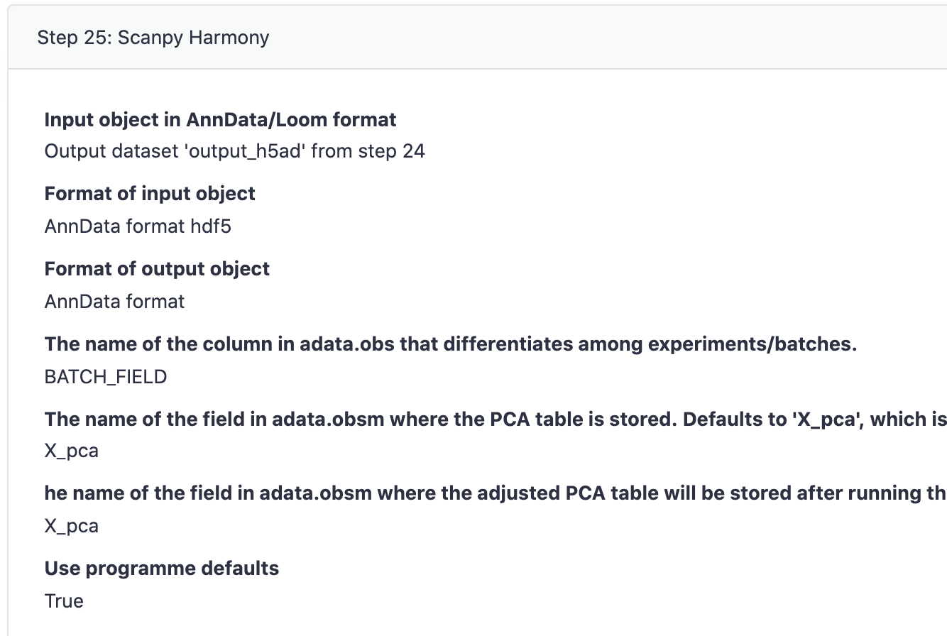
I am using Harmonypy. I am not sure how this step is performed. I can help to check the details if the command is available.
* It is best to save the harmony latent space in a different slot than X_pca. So we can keep both pca results and harmony results.

Slide 6
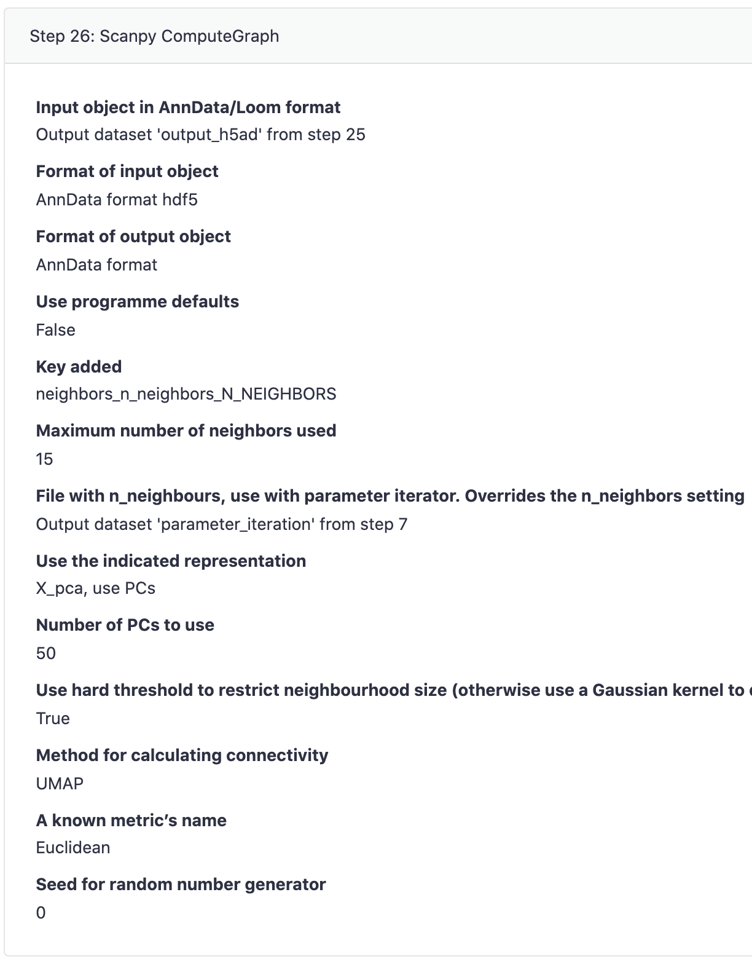
Using 50 PCs by default may include extra noise in some cases.

Slide 7
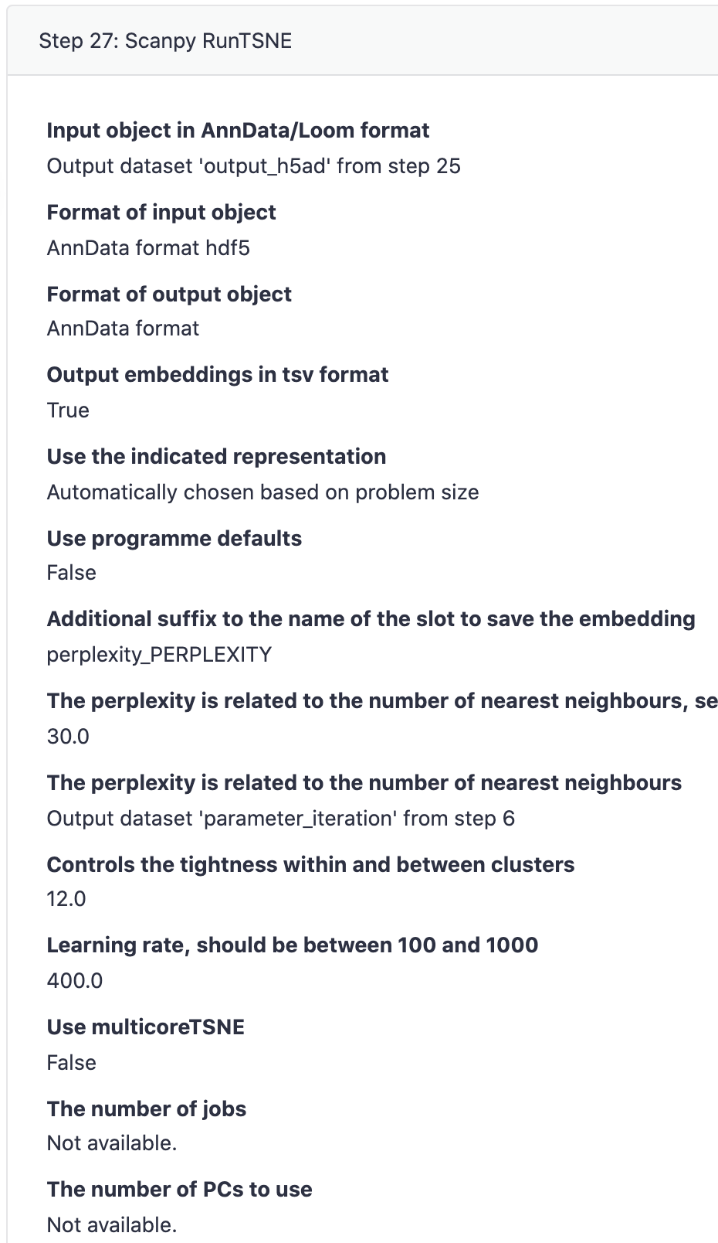
We should allow to run tSNE on the harmony latent space.

Slide 8
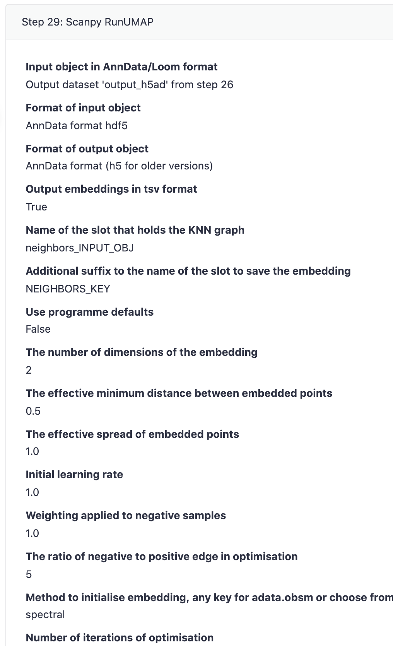
Normally, we need to adjust the ‘min_dist’ parameter for UMAP. ‘min_dist’ decides the tightness of the plot, it is the first and most important parameter for UMAP.

Slide 9
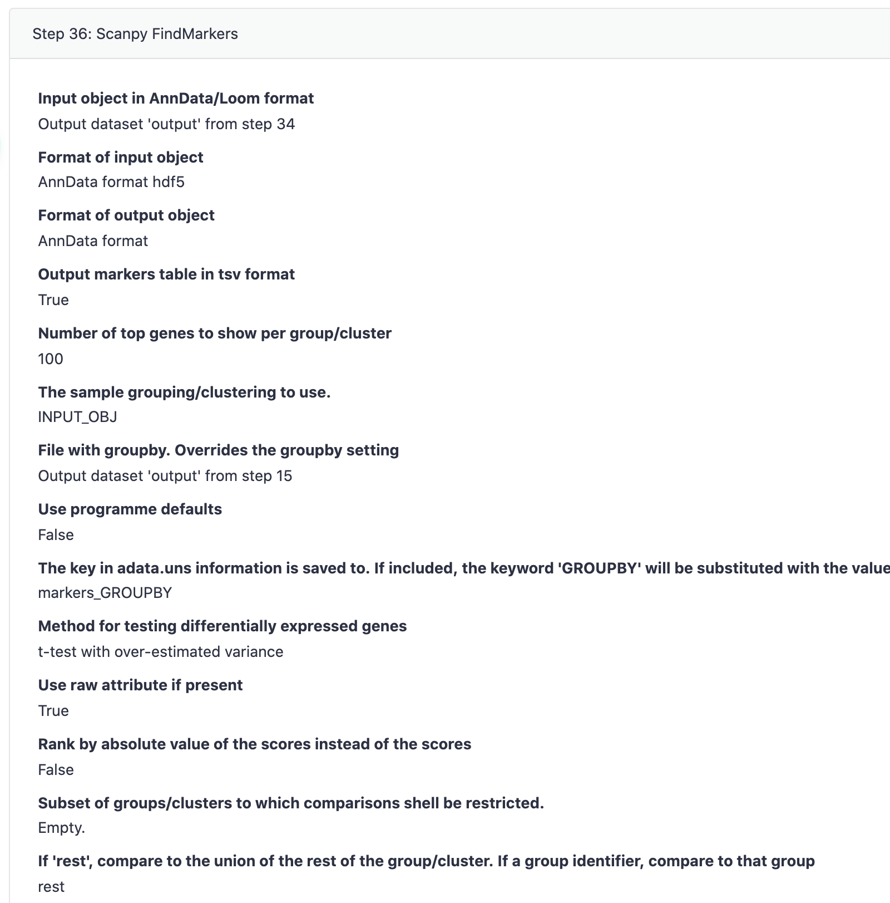
We are not allowed to perform differential expression analysis on batch-uncorrected data! Harmony corrects batch effect on the latent space rather than in the expression profile. So we should model the batch effect in DE. The best model is the ‘hurdle model’ in MAST. DE in SCANPY normally only works on datasets with little batch effect.
T-test model in SCANPY DE does not work well. If we have to use SCANPY for DE, we should use Wilcoxon test.

Slide 10
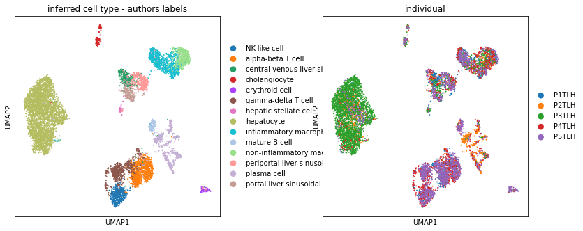
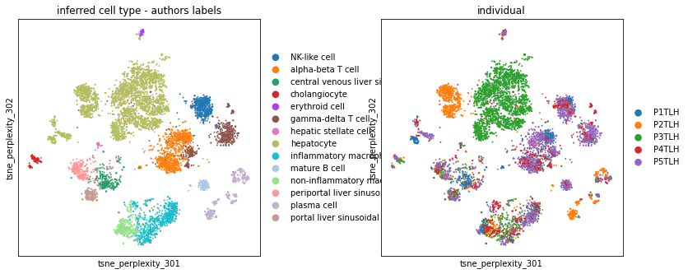
How to know if our analysis is correct or not?
According to the visualization of UMAP, each `cluster` (a blob) should be a cell population. A cell population should not be split into several different `clusters` (or blobs). It is better to see the left result than the right result. There should not be many `unclear` cells as in the blue circles.

Slide 11
How to know if batch effect is corrected?
The best way is to use kBET (https://github.com/theislab/kBET) or silhouette.
Otherwise, 1. the cells from different batches but of the same cell type should be well-mixed. 2. there should not be a cell cluster only includes cells from one single batch. (red circles)

