Slide 1






UNIC-CASS - Fulgor Design Example Run Current Steering DAC 24.08.2025 ─

Slide 2
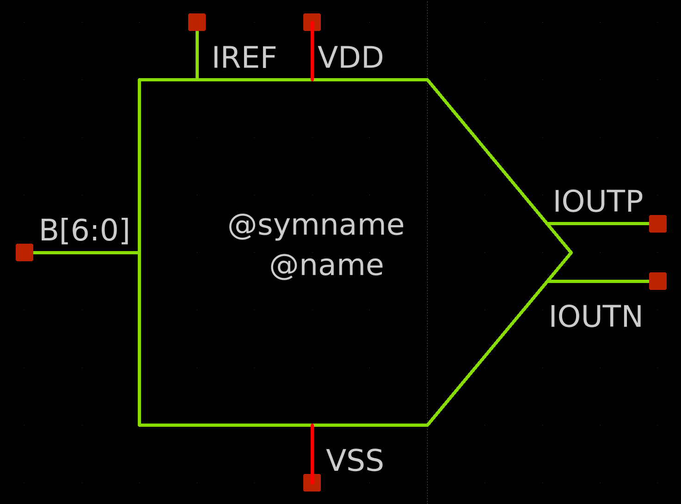
Current Steering DAC symbol

Slide 3
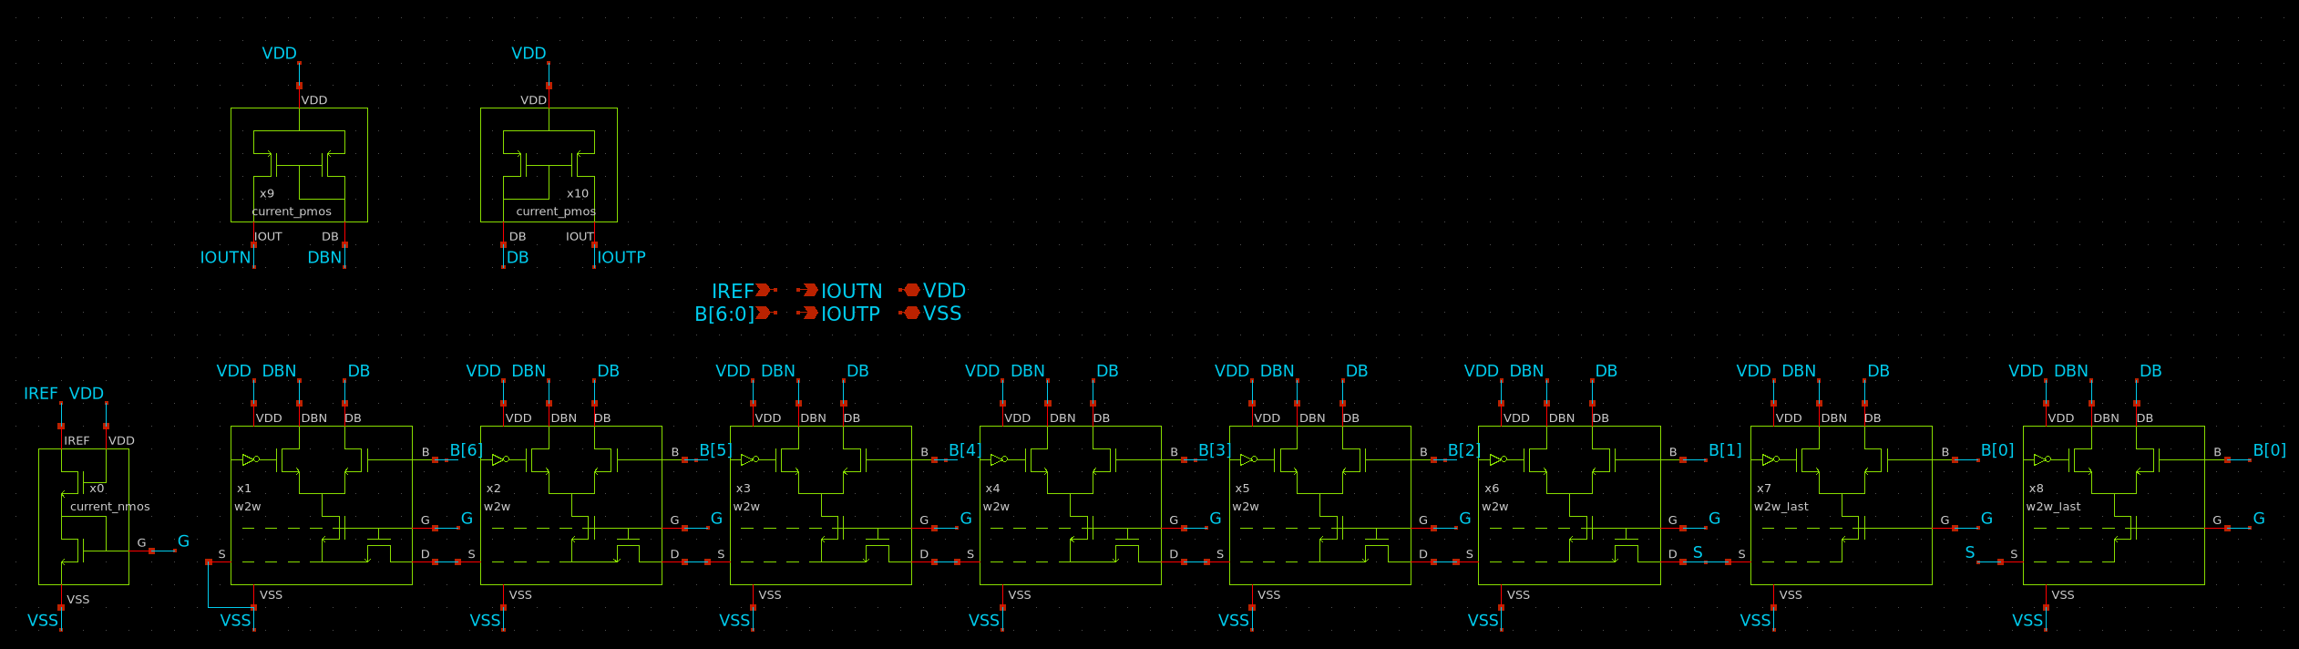
Current Steering DAC Schematic View

Slide 4
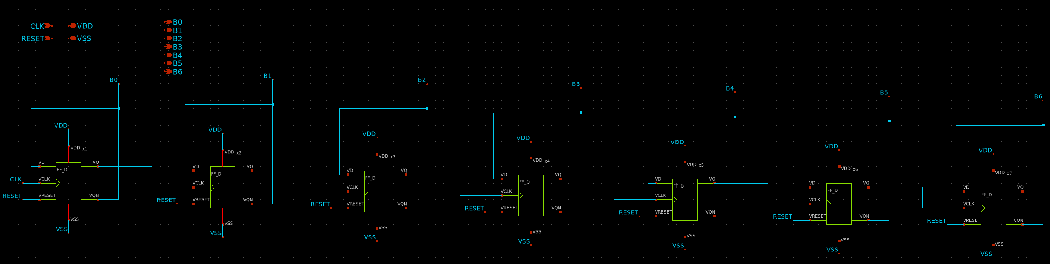
7-bit stimulous counter schematic

Slide 5
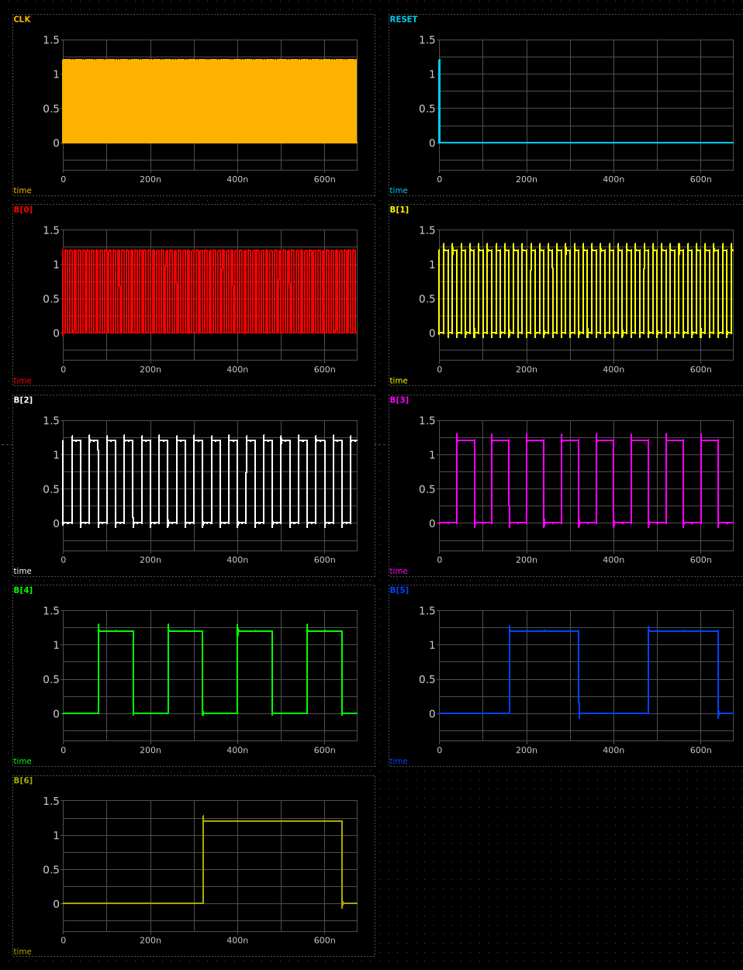
7-bit counter output signals

Slide 6
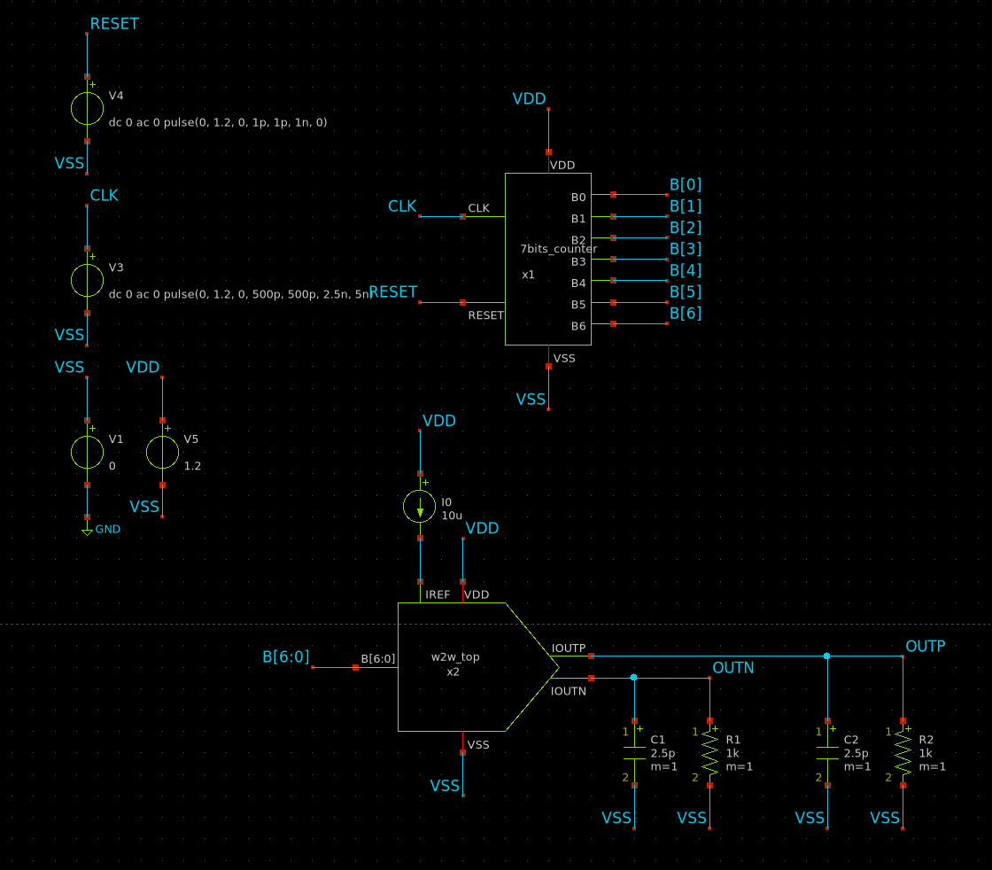
Test bench to validate the DAC performance

Slide 7
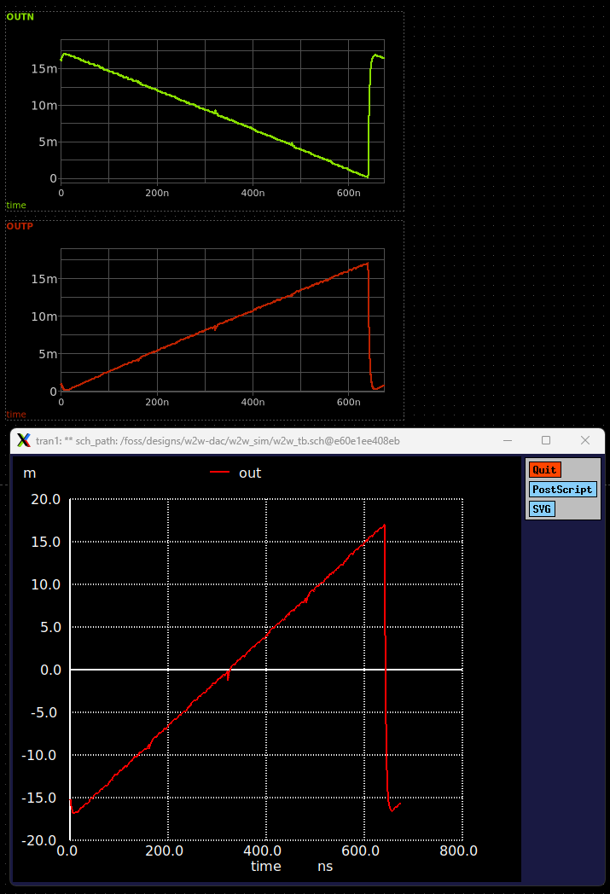
Measurement of DAC Static transfer curve

