Slide 1






UNIC-CASS - Fulgor
Block Diagram
Phase Interpolator
24.08.2025
─

Slide 2
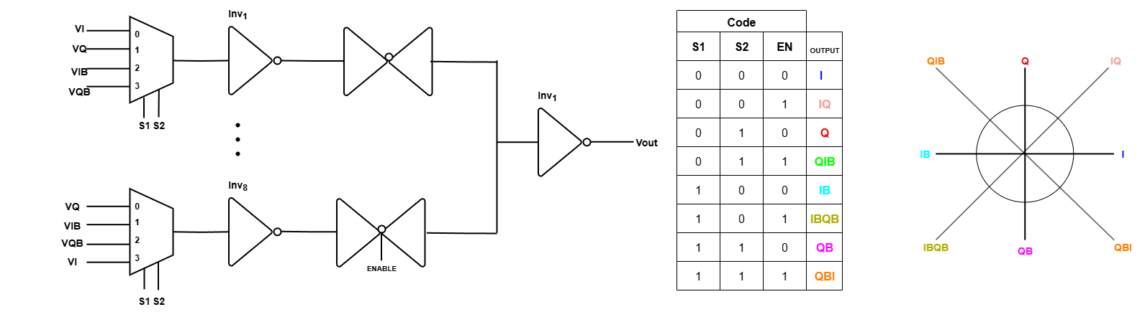
Block Diagram of a Phase Interpolator
Truth Table
Expected output

