Slide 1






UNIC-CASS - Fulgor Block Diagram 2-2W Current Steering DAC 24.08.2025 ─

Slide 2
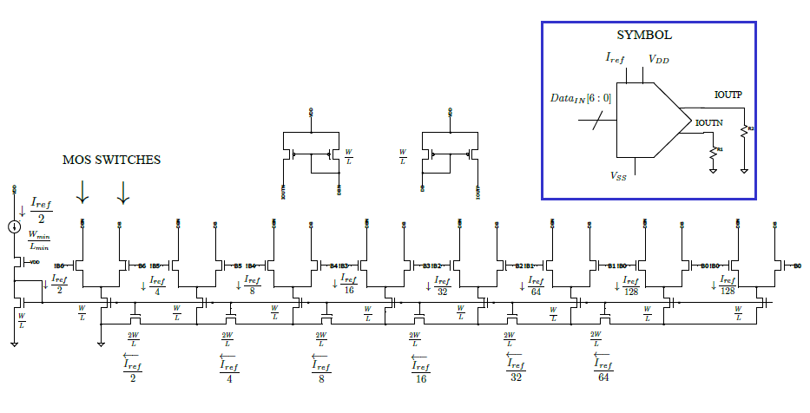
7-bit W-2W Current Steering DAC schematic and symbol

