Slide 1








UNIC-CASS - Fulgor Design Example Run W-2W Current Steering DAC 24.08.2025 ─

Slide 2
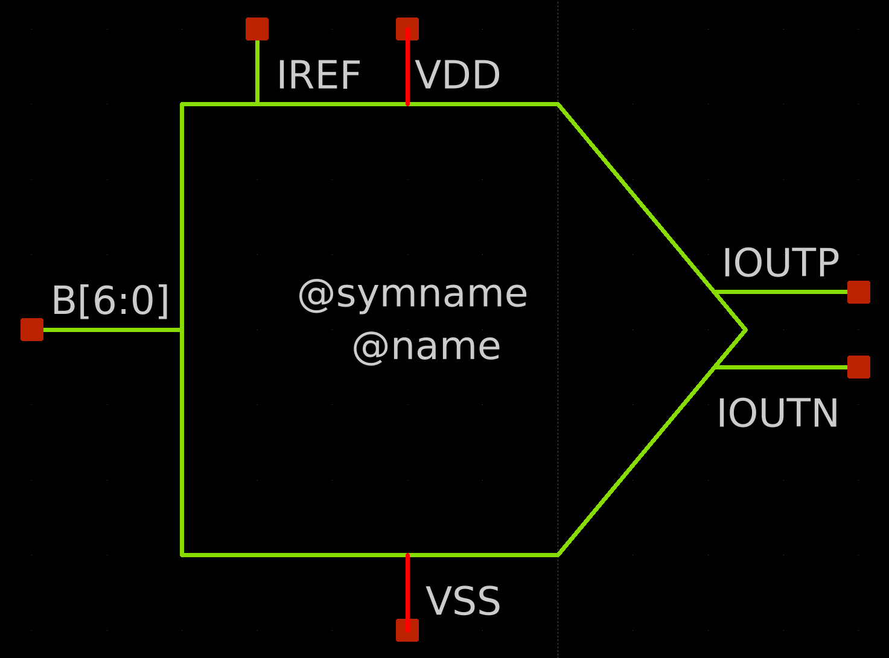
W-2W Current Steering DAC symbol

Slide 3
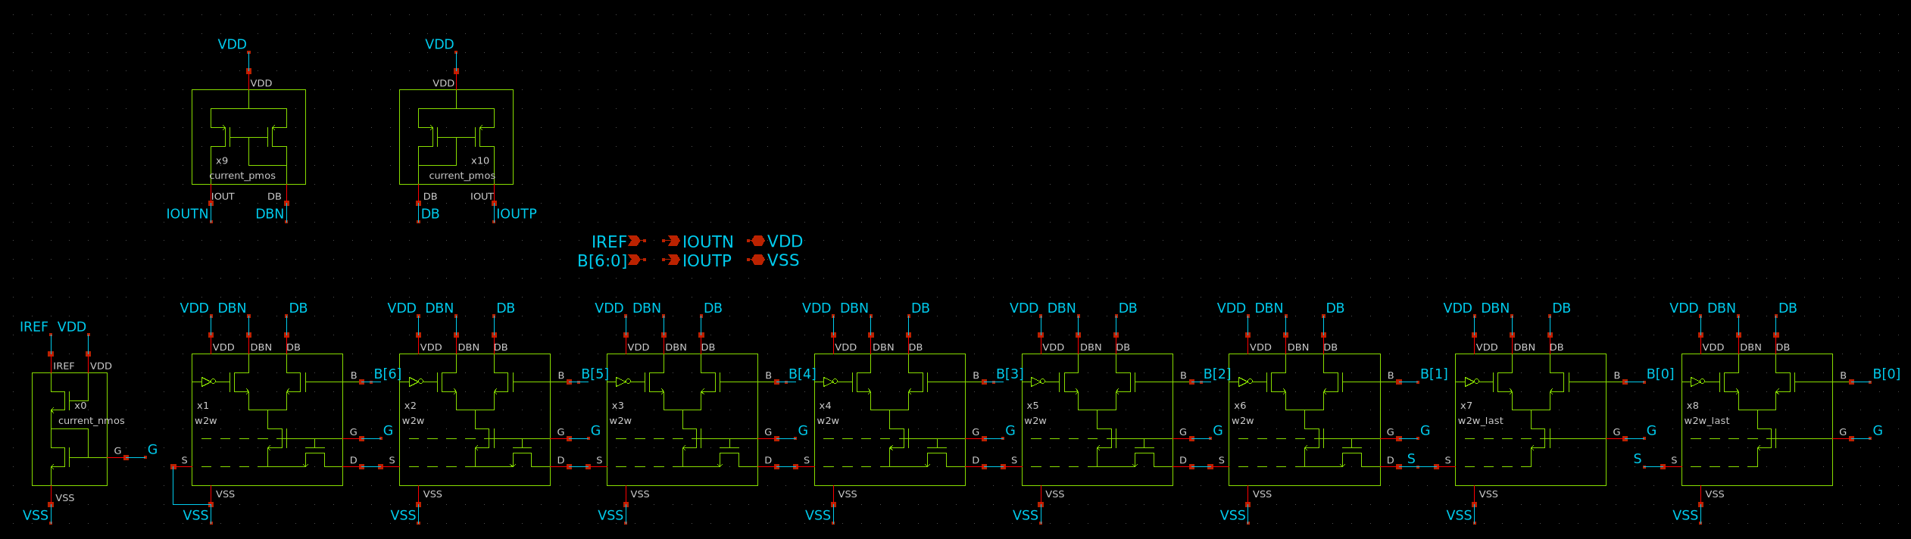
W-2W DAC Schematic View

Slide 4
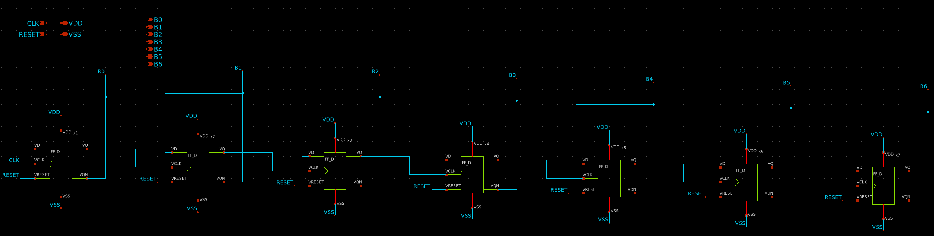
7-bit stimulous counter schematic

Slide 5
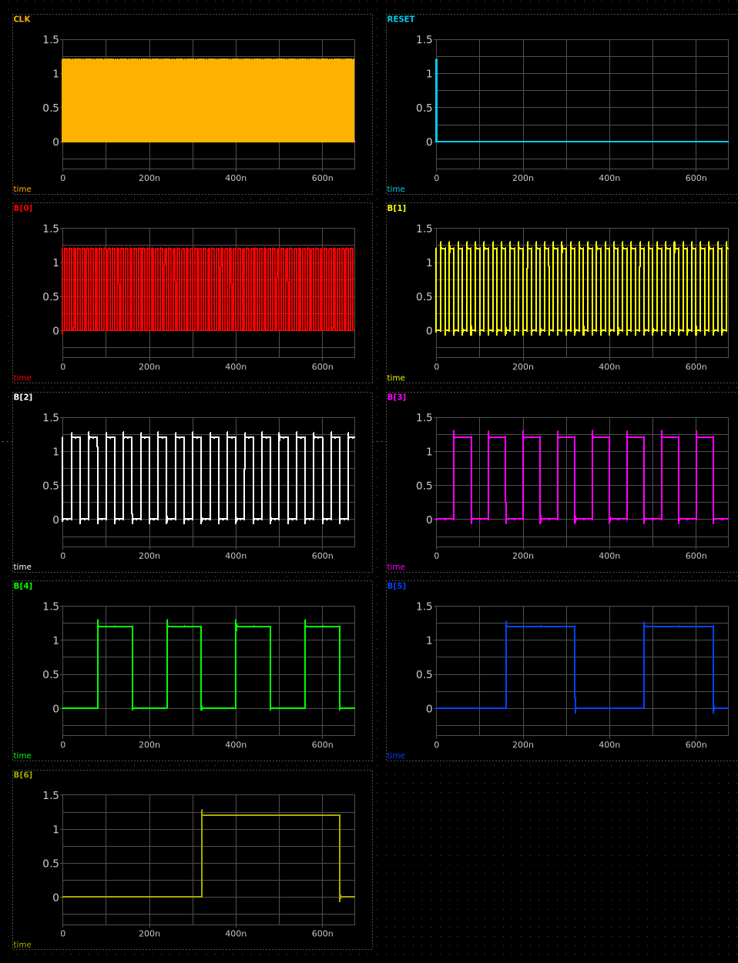
7-bit counter output signals

Slide 6
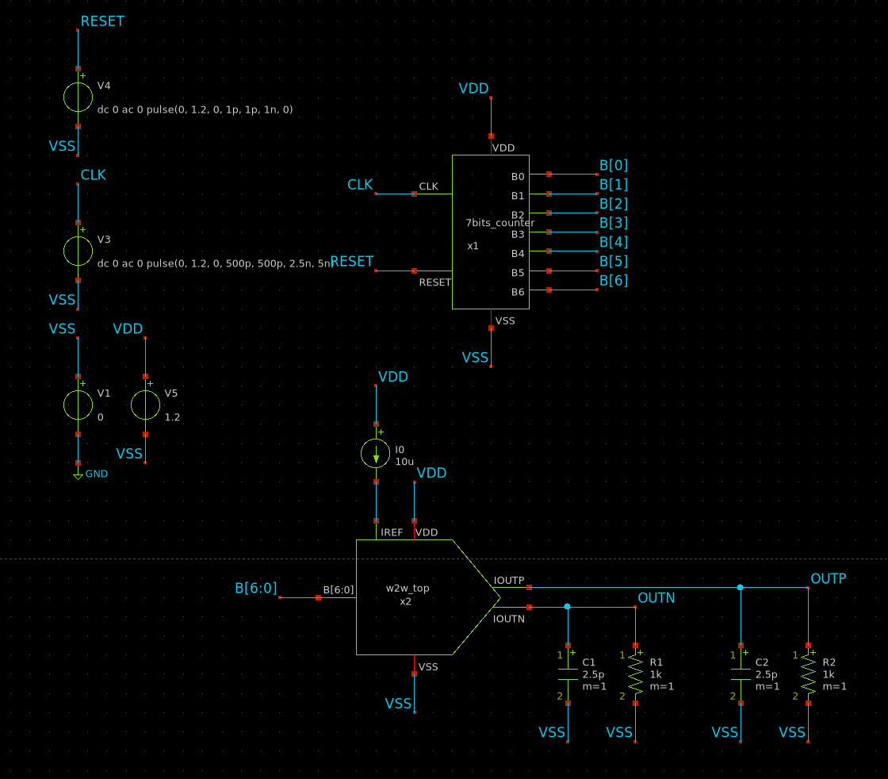
Test bench to validate the DAC performance

Slide 7
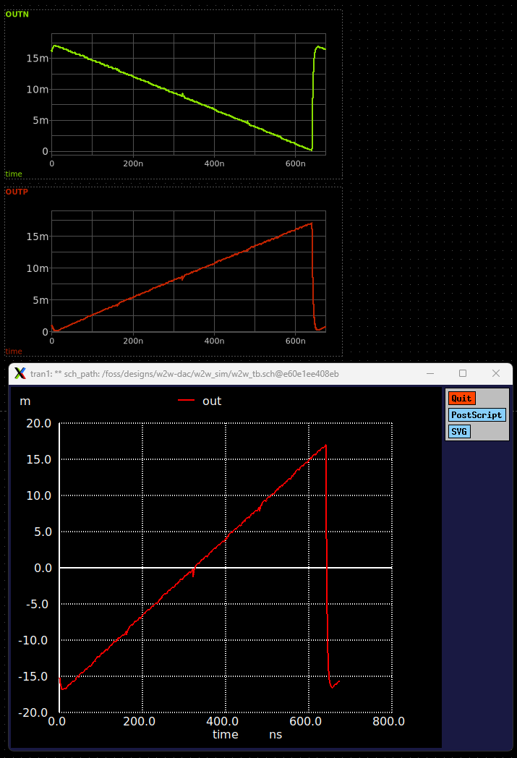
Measurement of DAC Static transfer curve

Slide 8
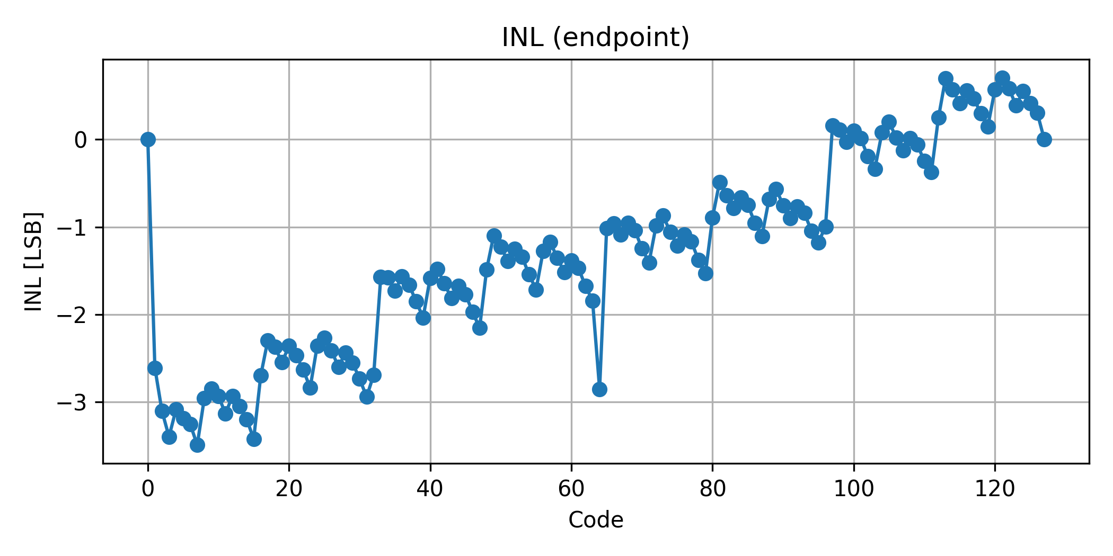
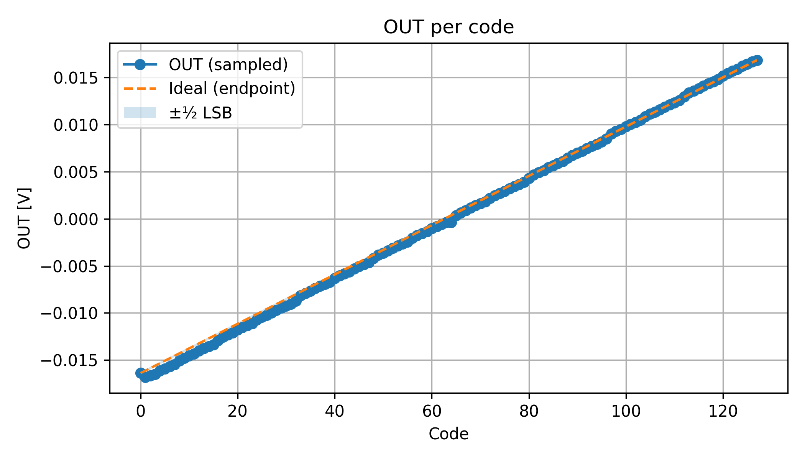
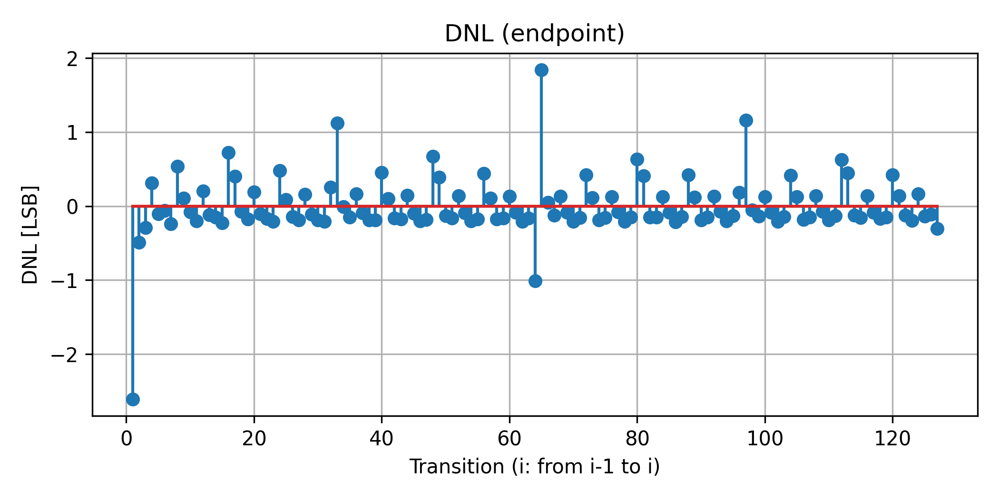
Linearity measurement curves
These results are preliminary and
are planned to be improved through
a more robust design.

