Slide 1

UNIC-CASS - Fulgor Block Diagram Phase Interpolator 24.08.2025 ─

Slide 2
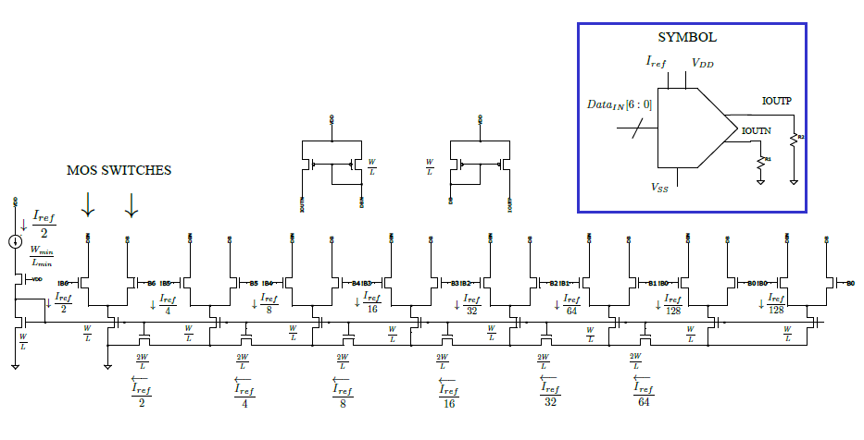
7-bit Current Steering DAC schematic and symbol

