Slide 1

UNIC-CASS - Fulgor Design Example Run Phase Interpolator 24.08.2025 ─

Slide 2
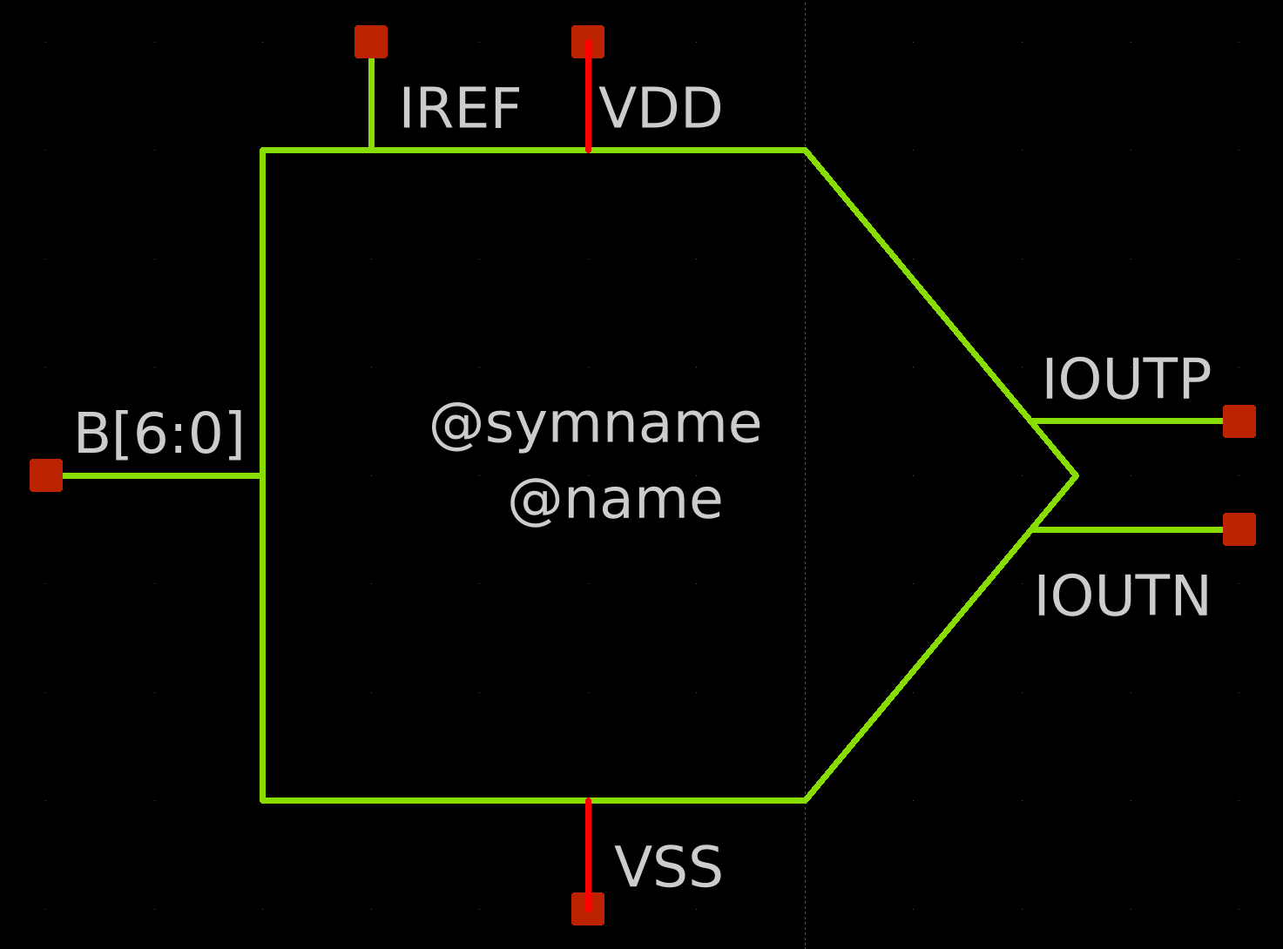
Phase Interpolator Symbol View

Slide 3
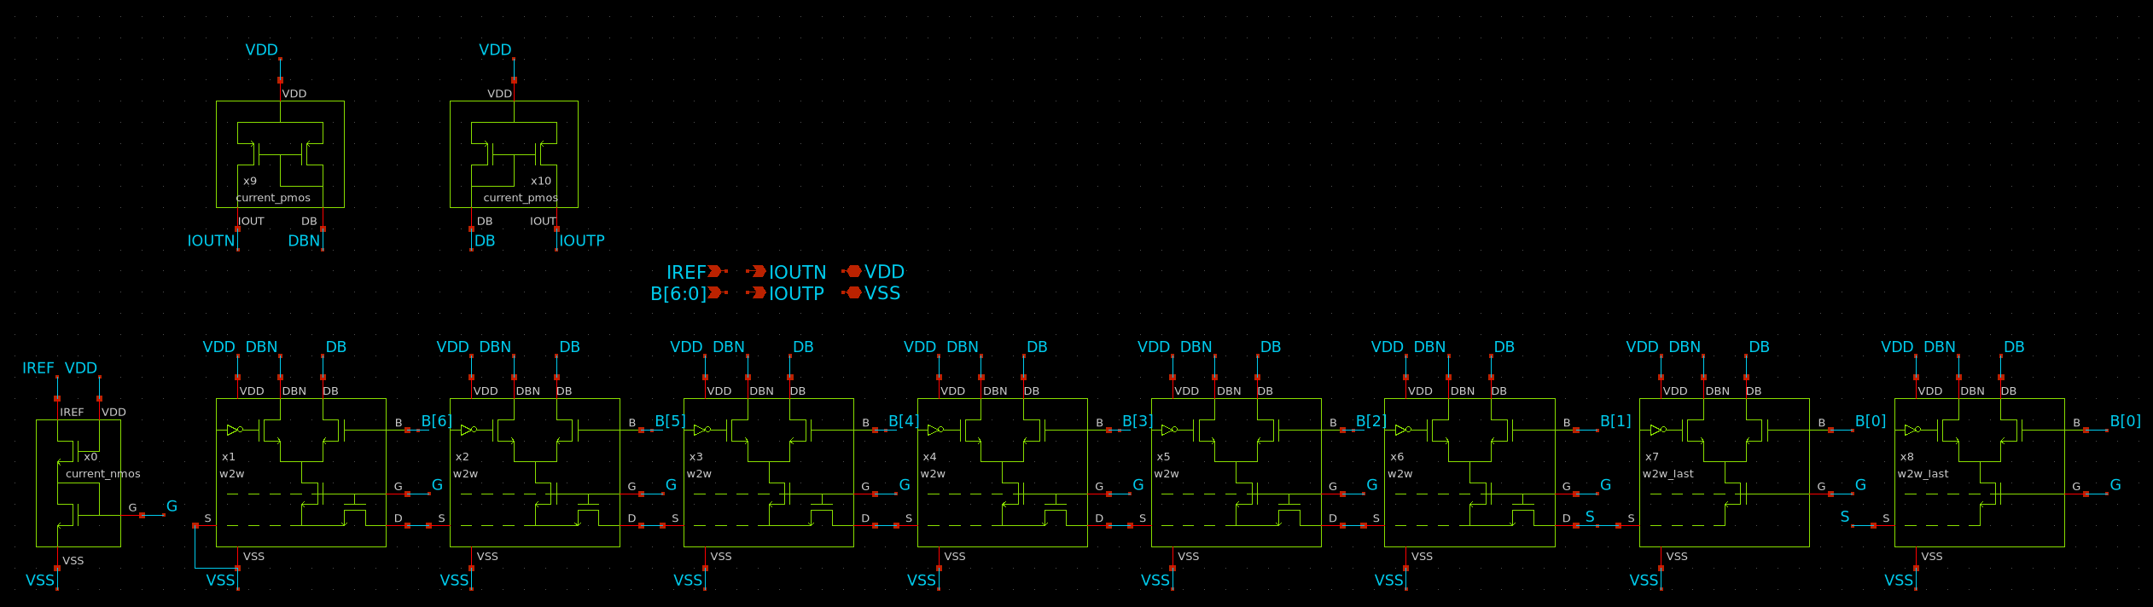
Phase Interpolator Schematic View

Slide 4
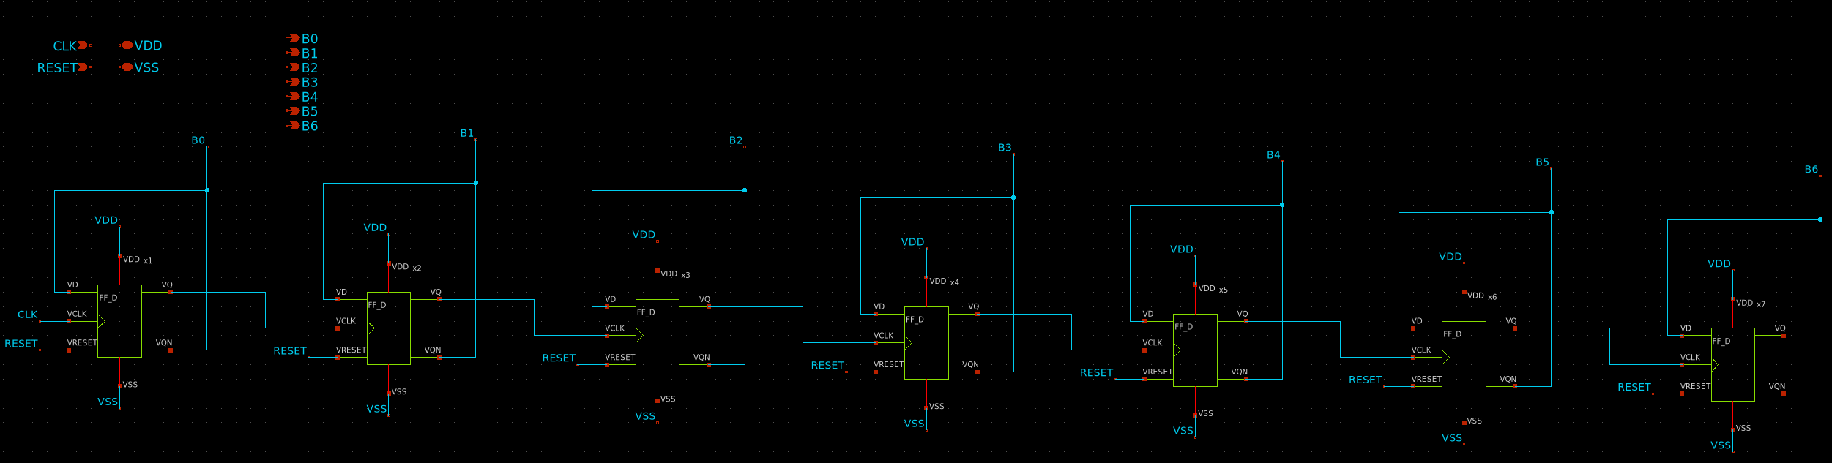
7-bit stimulous counter schematic

Slide 5
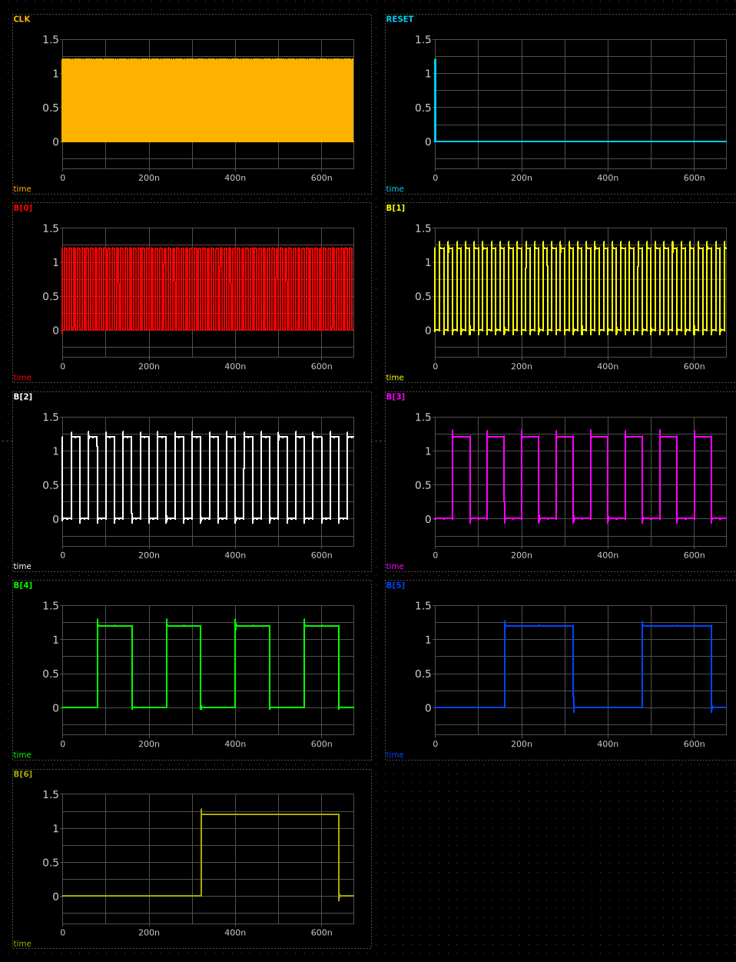
7-bit counter output signals

Slide 6
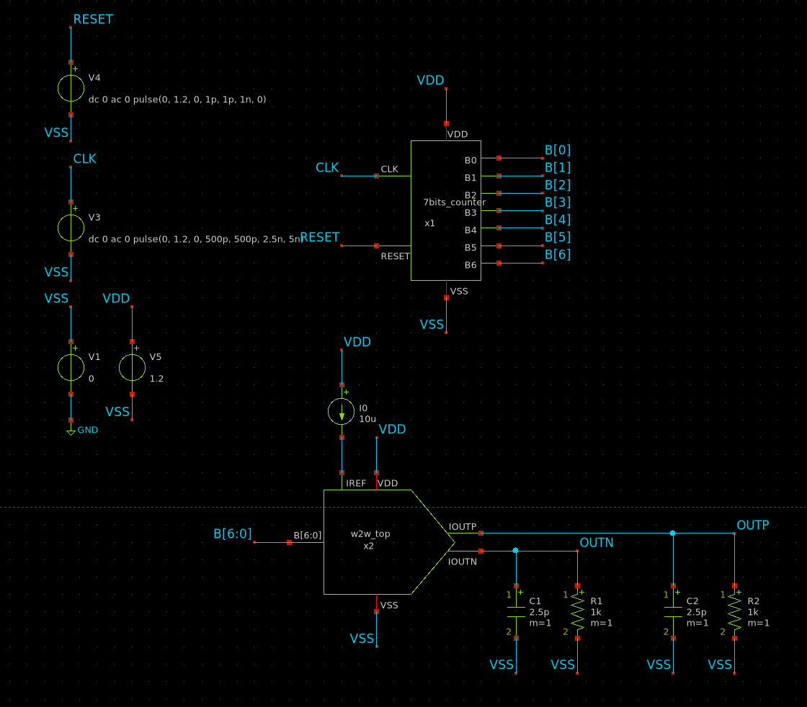
Test bench to validate the Current Steering DAC performance

Slide 7
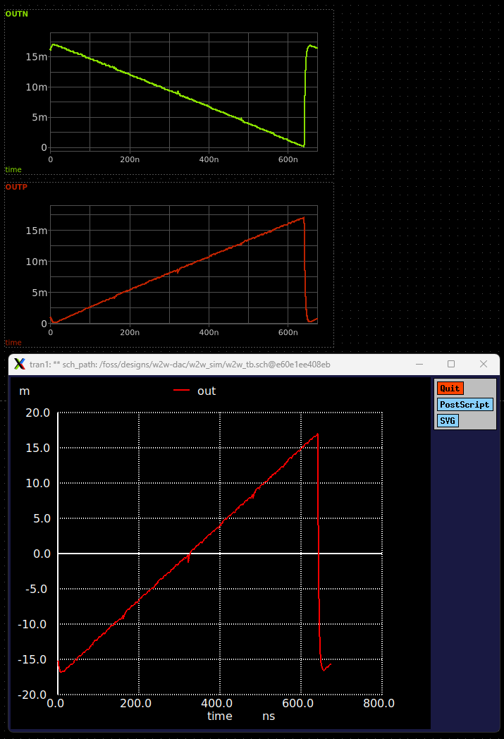
Measurement of DAC Static transfer curve

