Slide 1


The Test Machine
Patterns for testing asynchronous systems

Slide 2
Overview
Event Backbone at Funding Circle
Lessons Learned
The Test Machine
Questions?

Slide 3
“Turning the database inside out”
-- Martin Kleppmann (https://www.confluent.io/blog/turning-the-database-inside-out-with-apache-samza/)
Notes:
At the time I started at Funding Circle, this article by Martin Kleppman was doing the rounds
and

Slide 4
“Capture all the changes as a sequence of events”
--Martin Fowler (https://martinfowler.com/eaaDev/EventSourcing.html)
Notes:
There's lots of talks, articles, and even books now that talk about the properties
of systems built this this way

Slide 5
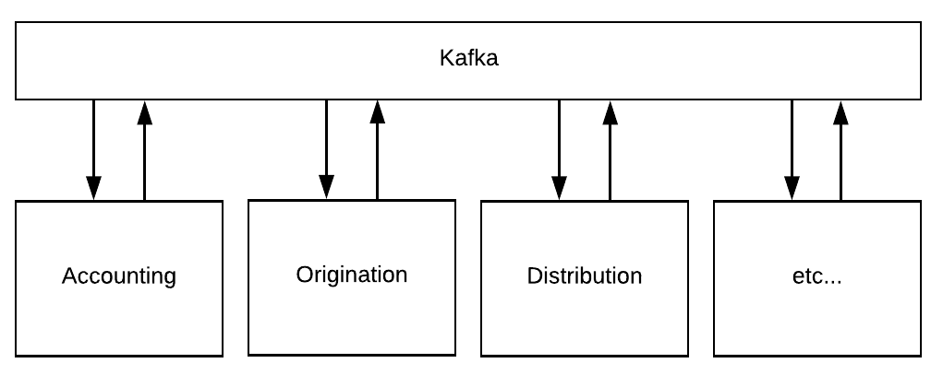
Event Backbone

Slide 6
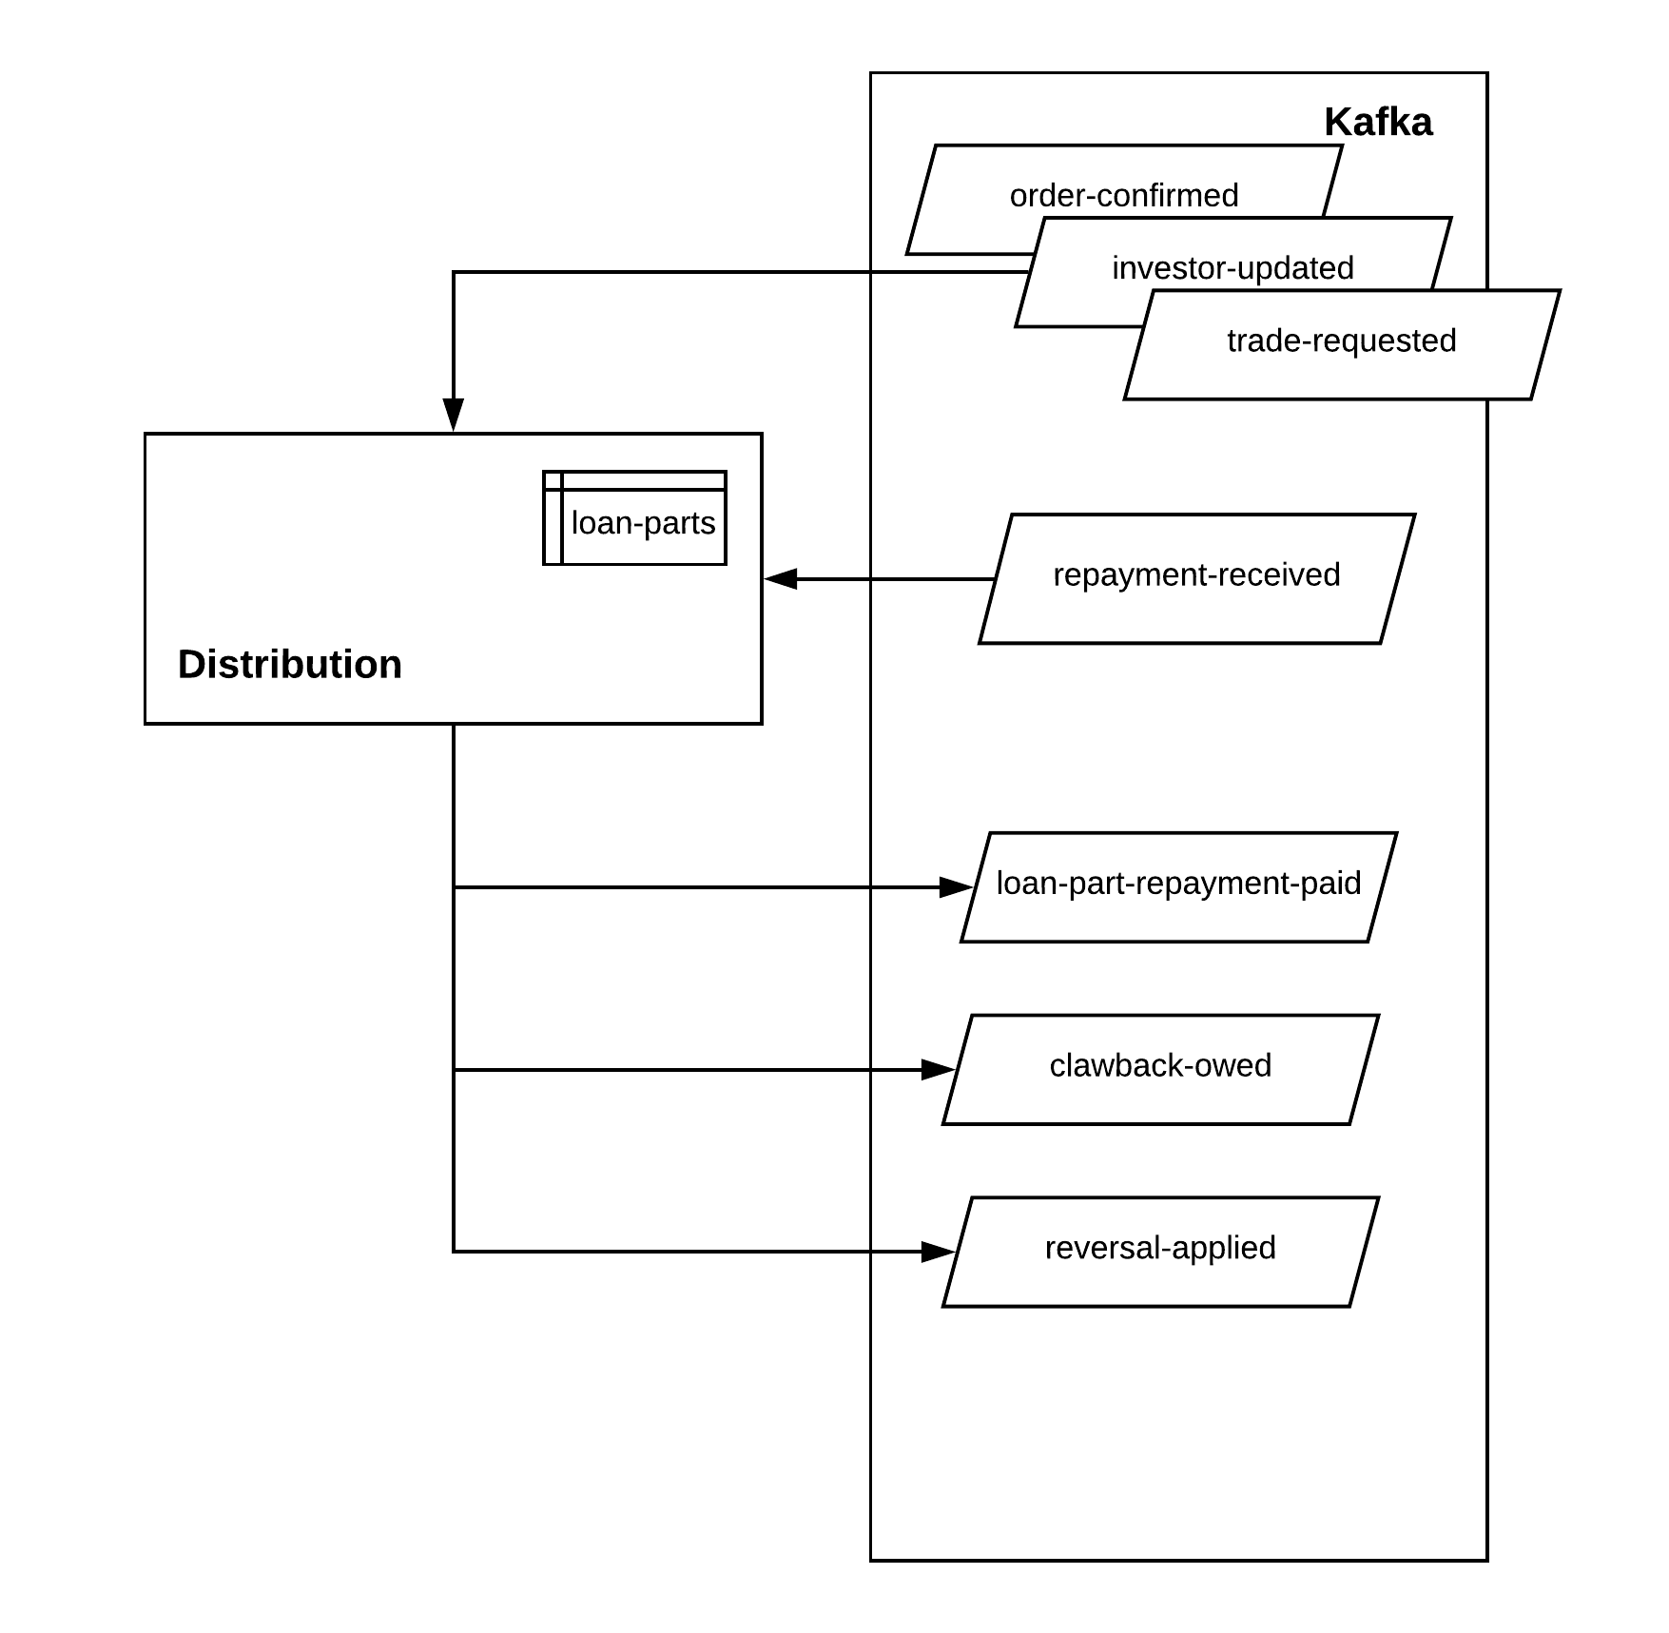
Distribution

Slide 7
Lessons Learned
Notes from the trenches

Slide 8

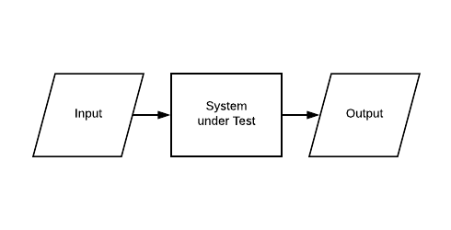
Simple testing primitives

Slide 9
Test Fixtures?

Slide 10
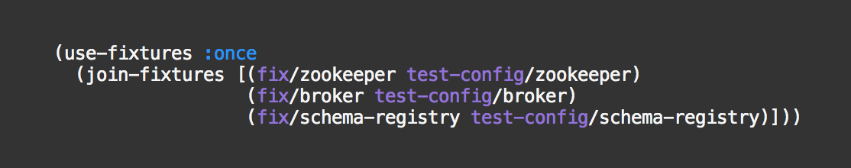
In-Memory Test Services

Slide 11
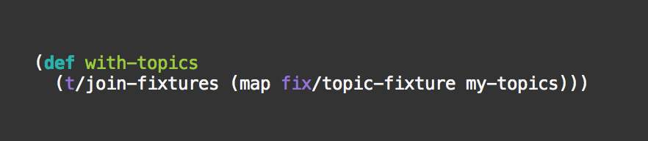
Topics, Tables

Slide 12
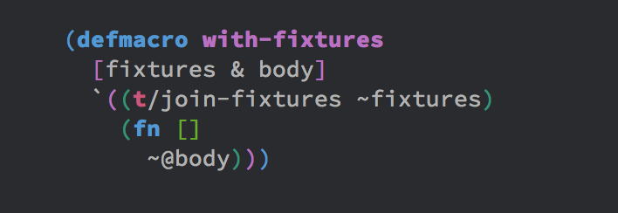
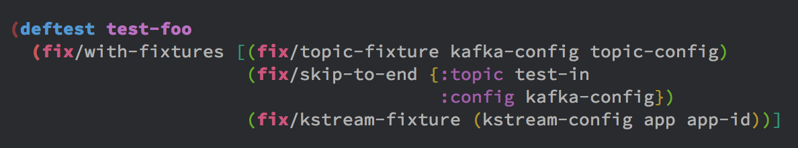
with-fixtures

Slide 13
TopologyTestDriver

Slide 14
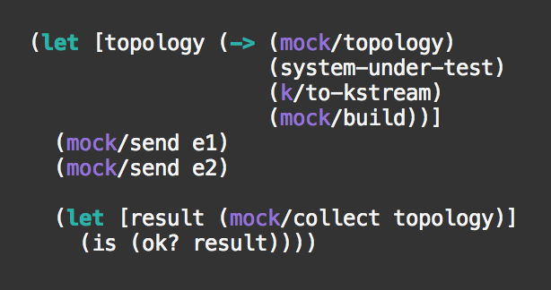
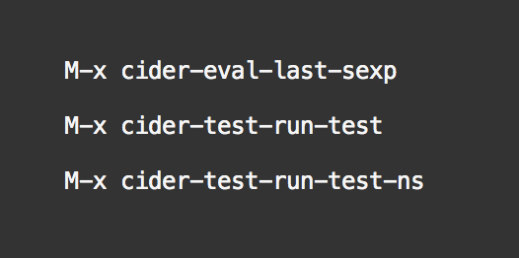
Unit Tests
Example Test
Test Runner

Slide 15
Scenario Definitions

Slide 16
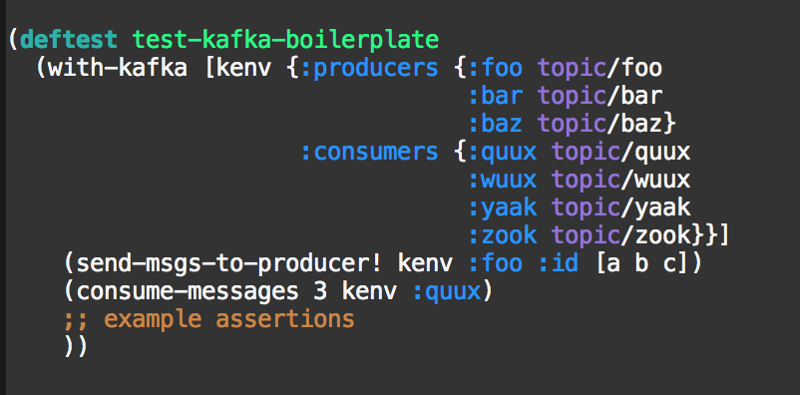
Iteration #1 (imperative)

Slide 17
Asynchronous System?
Asynchronous Tests!

Slide 18
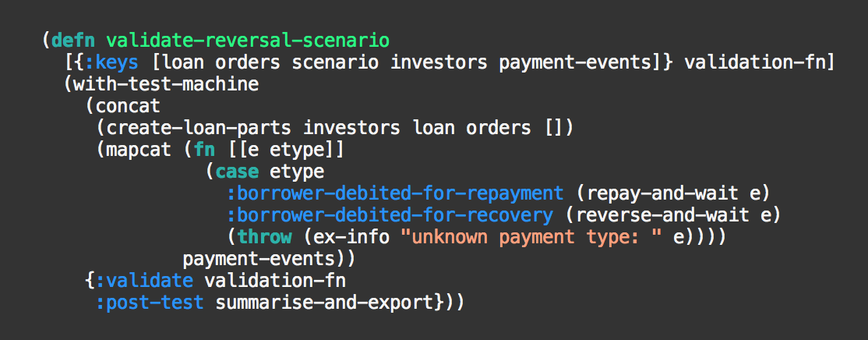
Iteration #2 (declarative)

Slide 19
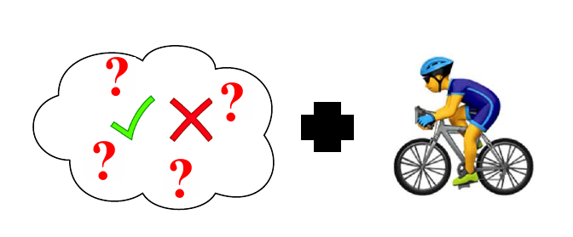
Questions + Hammock Time

Slide 20
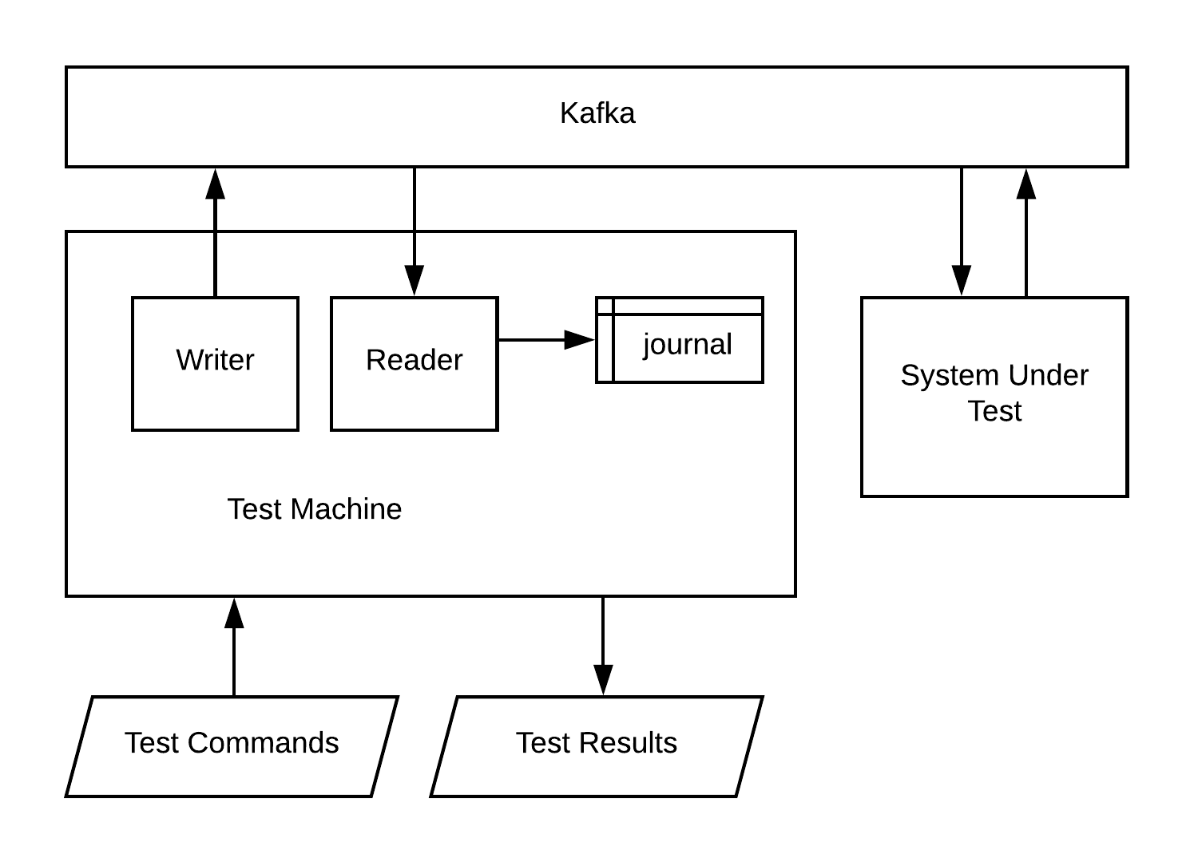
The Test Machine

Slide 21
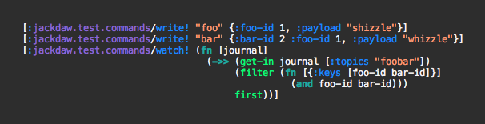
Test Commands

Slide 22
Test code is data too!

Slide 23
It’s all data!

Slide 24
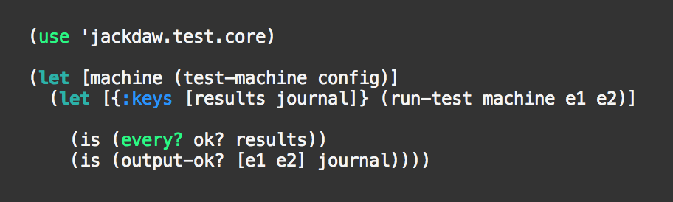
“Full-Stack Test” Distilled

Slide 25
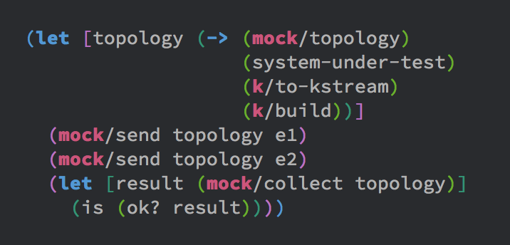
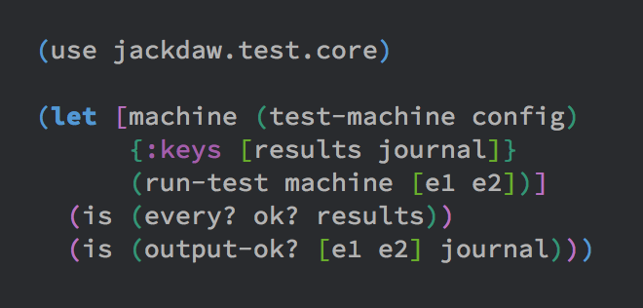
Look familiar?
Unit Test
Full-Stack Test

Slide 26
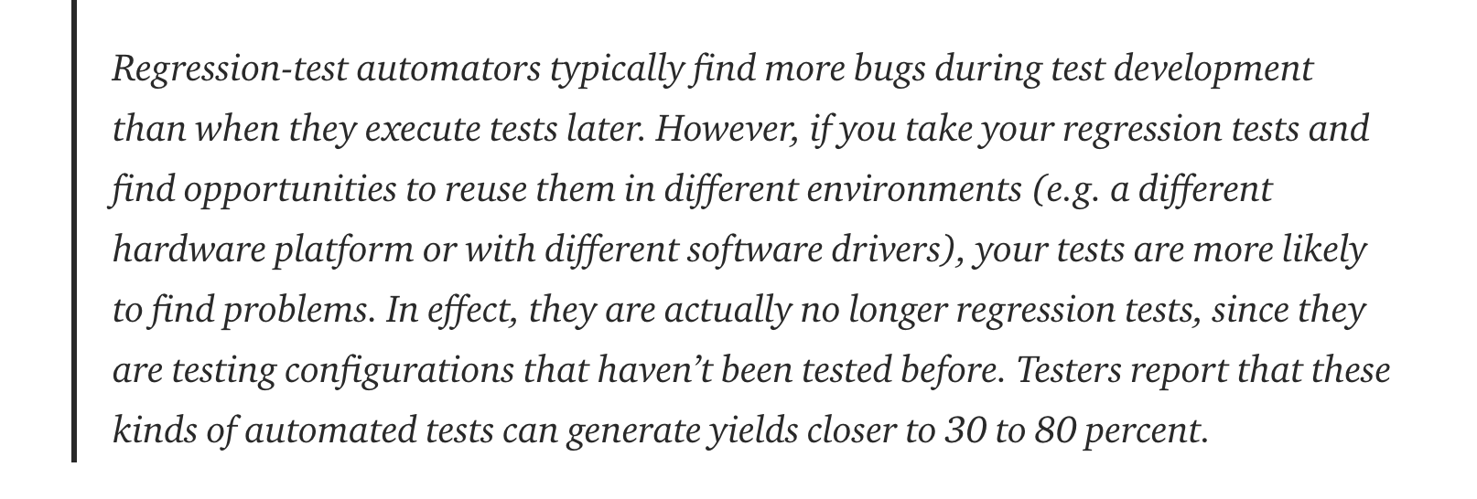
Lessons Learned in Software Testing
--Kaner & Bach (Lessons Learned in Software Testing, Wiley, 2001)
via https://medium.com/@copyconstruct/testing-microservices-the-sane-way-9bb31d158c16

Slide 27
Transports
Identity
TopologyTestDriver
Kafka (direct)
Kafka (remote via rest proxy)

Slide 28
“Don’t hope that events will turn out the way you want, welcome events in whichever way they happen: this is the path to peace reliable tests”
(with apologies to)
-- Epictetus (https://twitter.com/dailystoic/status/1041346154435207168)

Slide 29
Thank you
Andy Chambers
Software Engineer
achambers@fundingcircle.com
71 Queen Victoria Street, London. EC4V 4AY

