Slide 1

A Workload-oriented Programming Model for Temporal Isolation with VBS
Ana Sokolova
Department of Computer Sciences
University of Salzburg
joint work with
Silviu Craciunas and Christoph Kirsch
Notes:
I will present a particular scheduling problem and both our theoretical and experimental results
We start with the simplest definition of our process model

Slide 2
It is about
  Scheduling processes in temporal isolation
  Using variable bandwidth servers for predictability
  Server design for performance
the time it takes to execute a piece of code is bounded,
independently of concurrently running code

Slide 3
Process model
action α1
action α2
load
process
time
arrival
termination
response time
speed
action is a piece of code
process is a sequence of actions
Notes:
Consider a process that executes in time
Suppose that at a certain point in time we are at a certain point in the code of the process (we denote this as arrival)
At another point in time we want to arrive at a different location in the code
We call this an action, each action has a load that represents the time it takes for the action to finish if it were running alone on the cpu.
We are interested in the response time of an action.
In order to quantify the response time an action must execute its load with a certain speed. We will see later what this speed really is.

Slide 4

Problem
process 1
Solvable with variable
bandwidth servers (VBS)
process 2
uniprocessor
.
.
.
Results:
a constant-time scheduling algorithm
a constant-time admission test
process n
schedule the processes so that each of their
actions maintains its response time
Notes:
Now suppose we ave multiple processes, each with sequential actions running on the same processor.
The problem is how to schedule the processes such that the response time of each of their actions is maintained

Slide 5
Resources and VBS
virtual periodic resources
period π limit λ utilization λ/π
λ1
λ2
time
π1
π2
VBS is determined by a bandwidth cap (u)
VBS processes dynamically adjust speed (resource)
λ1/π1 ≤ u and λ2/π2 ≤ u
generalization of constant bandwidth servers (CBS)
[Abeni and Buttazzo 2004]
Notes:
We control the speed of action through the use of virtual periodic resources
A vpr is a pair of lambda, pi that allows a process to execute not more than lambda tiem units in pi time units. The utilization of a vpr is lambda/pi.
A VBS is a number that represents an upper utilization bound usually given in percentage of cpu time that a process can use.
Processes can dynamically adjust speed as long as .. holds
VBS can be seen as a generalization of CBS (Abeni and Buttazzo). CBS offer temporal isolation but processes cannot change the execution speed.

Slide 6
One process on a VBS
action α1
action α2
load
load
process
time
response time
response time
λ1
λ2
process
running on a VBS
time
π1
π2
response time under VBS
response time
under VBS
Notes:
Suppose that we have a process with action alpha like in the model, the action is mapped onto a vpr, etc
The reponse time of an action on a vbs approximates the desired reponse time due to the sampling into periods.

Slide 7
VBS
process
running on a VBS
time
arrival
termination
response time under VBS
new action
release
dispatch
next action
blocked
ready
running
completion
preemption due
to limit λ
preemption due
to release
Notes:
Scheduling of an action from arrival to completion

Slide 8
VBS
multiple processes are EDF-scheduled
process 1
(2,4)
0
4
8
12
16
20
process 2
(2,8)
0
8
16
process 3
(1,6)
0
6
12
18
blocked
ready
running
Notes:
Multiple vbs processes on a cpu in EDF fashion, where the deadline is the at the end of the current period of an action.
Suppose we have 3 processes with corrsponding actions running on the following vpr
At time 0 ...

Slide 9
Scheduling result and bounds
Processes P1,P2, … ,Pn on VBSs u1,u2, … ,un, are schedulable
if ∑ui ≤ 1
For any action α on a resource (λ,π) we have
upper response time bound
⎡load / λ⎤π + π - 1
jitter
π - 1
lower response time bound
⎡load / λ⎤π
Notes:
Our scheduling result is as follows:
Given n processes P1 to Pn running on respective VBSs with caps u1 to un, the processes are schedulable under Vbs if the sum of caps is smaller than or equal to 1
This is a sufficient but not necessary test.
For any action alpha with the vpr lambda,pi, we have that
Upper response time bound is …
Lower response time bound is ...
Jitter is …

Slide 10
Implementation
constant-time scheduling algorithm
different queue management plugins
trade-off time and space
 | list | array | matrix/tree
time
space
n – number of processes t – number of time instants
Notes:
We have implemented a constant time scheduling algorithm and 4 different queue management plugins. The processes in a VBS system are placed in ready and blocked queues and the complexity of the scheduling algorithm is dominated by the complexity of the queue operations.
Using different queues results in different time and space complexities.
For example with less time overhead the space overhead grows quadratically in period resolution for both plugins.
This allows us to trade-off space and time complexity.
We will further show the complexity results in different experiments.

Slide 11
Programming model
loop {
int number_of_frames=determine_rate();
allocate_memory(number_of_frames);
read_from_network(number_of_frames);
compress_data(number_of_frames);
write_to_disk(number_of_frames);
deallocate_memory(number_of_frames);
} until (done);
action 1
action 2
loop period
different throughput and latency requirements
for different portions of code

Slide 12
How do we get VBS parameters for an action?
“server design problem”

Slide 13
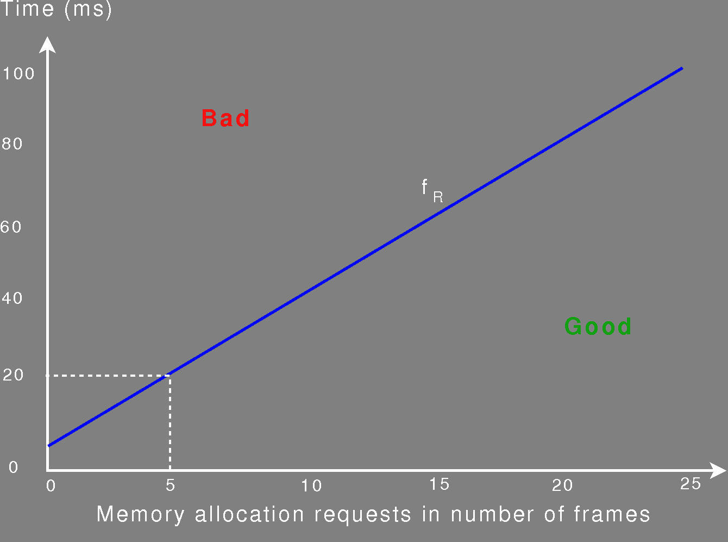
Response-time function

Slide 14
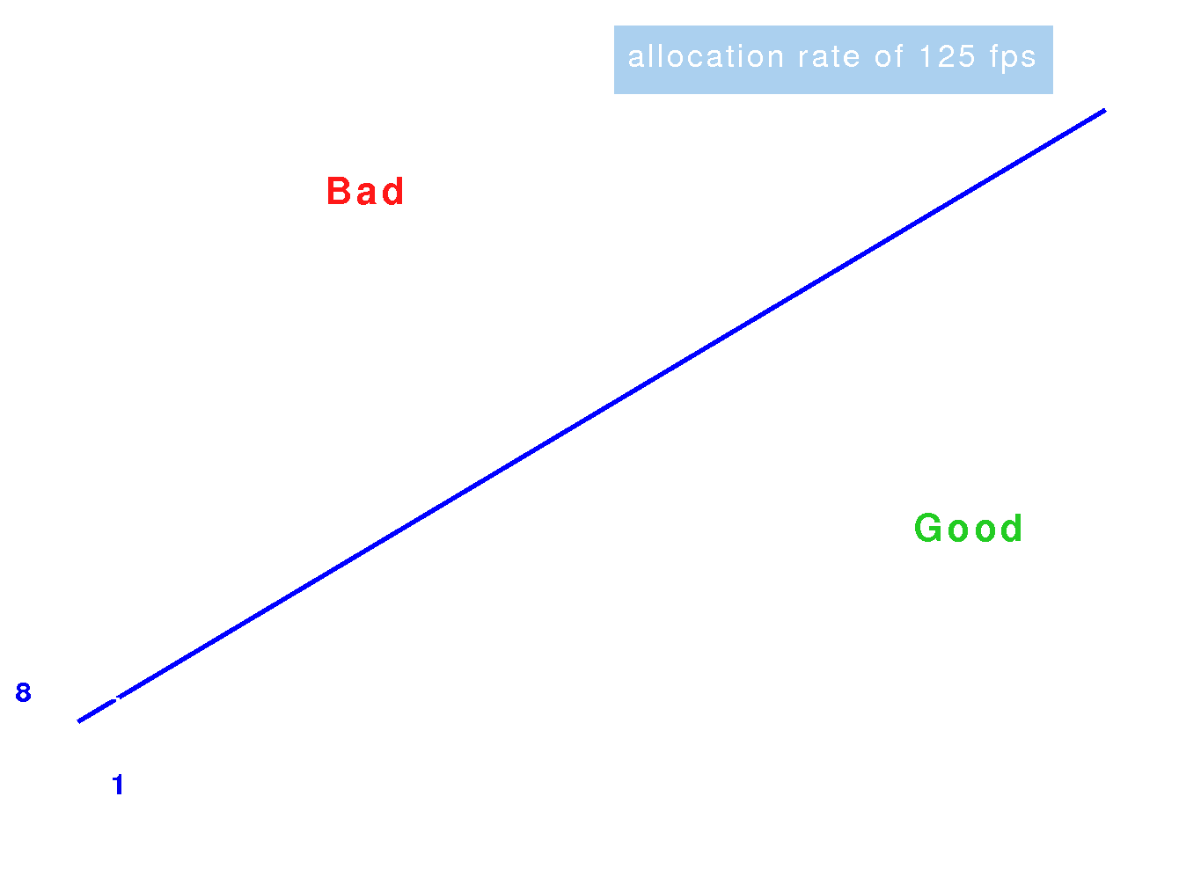
Response-time function

Slide 15
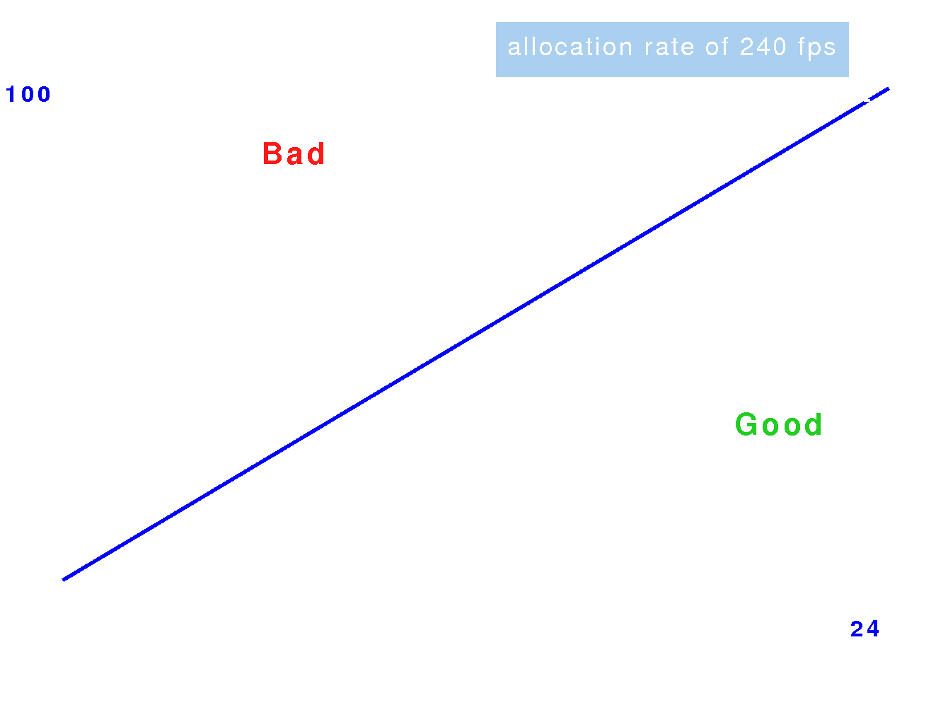
Response-time function
fR : RD → Q+

Slide 16
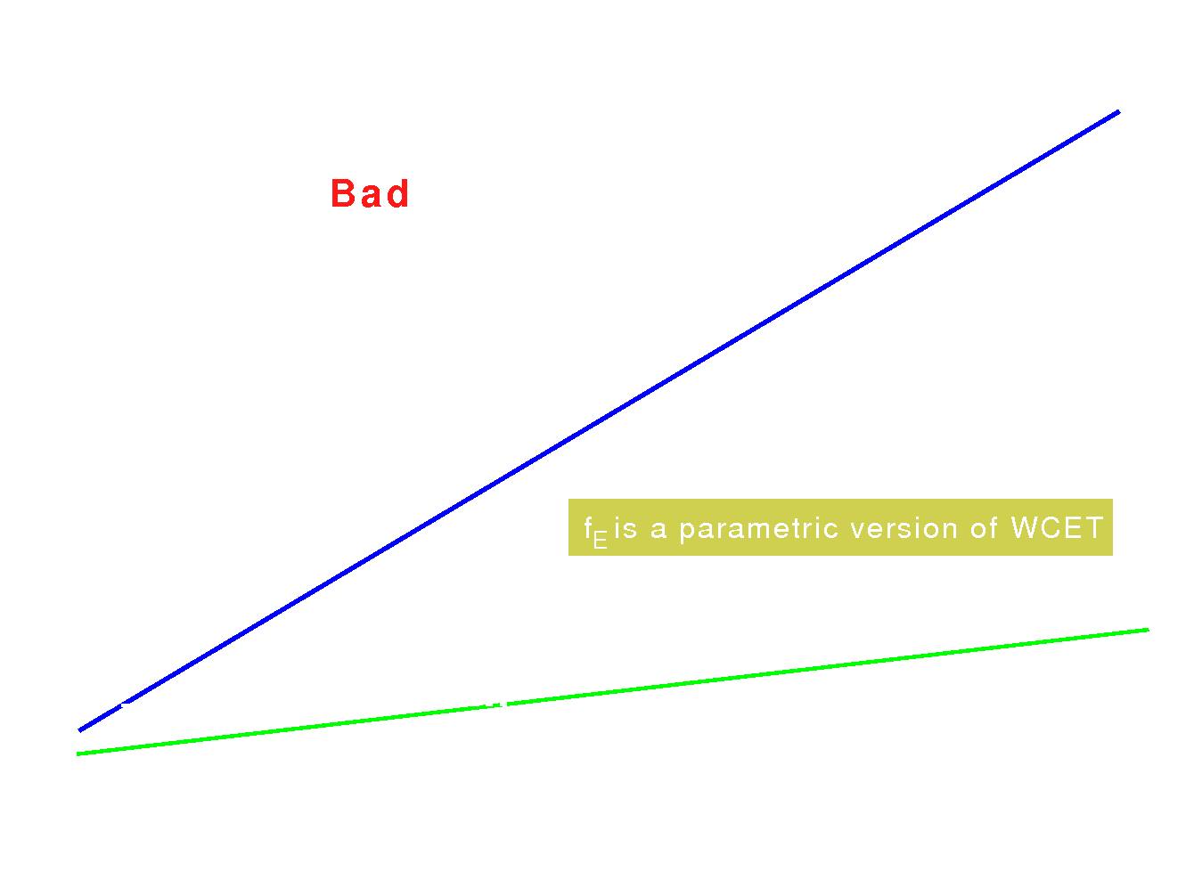
Execution-time function
fE : ED → Q+
load

Slide 17
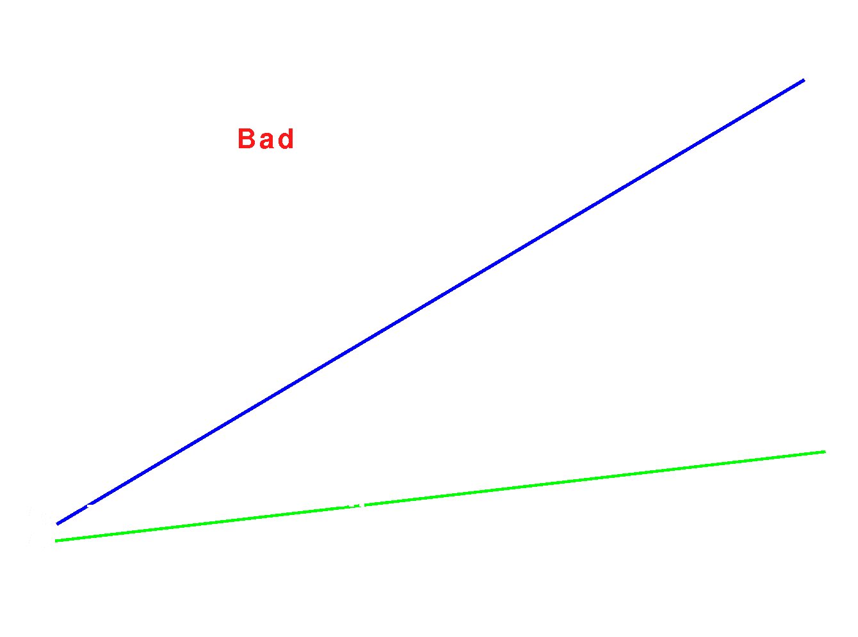
Utilization
fU(w) = (fE(w) – dE) / (fR(w) – dR)
fU(w) < cU

Slide 18
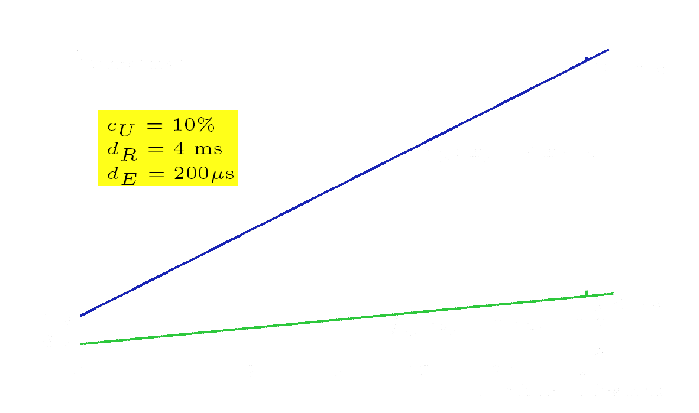
Timing of the allocate_memory action

Slide 19
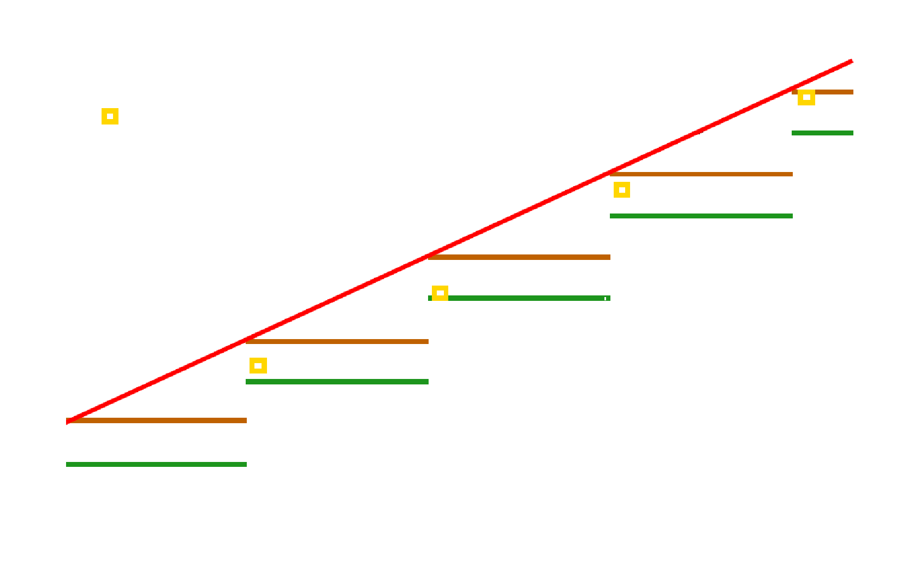
Response-time sampling
Scheduled response time
(under VBS)

Slide 20
Server Design Problem
Finding the right λ,π is difficult.
For fS(w) ≤ fR(w) one can choose π as follows:
  0 < π < dR – dE / cU
  π divides dR evenly
  π divides fR(w) – dR evenly or
  λ divides fE(w) – dE evenly
λ = π * cU

Slide 21
Server Design Problem
Smallest π possible:
  fS approximates fR best
  less response-time jitter
  increased scheduler overhead
Scheduler overhead accounting:
  utilization accounting
  response-time accounting
  combined accounting
Higher-level scheduler:
  small period for the first part of an action
  large period for the remaining part

Slide 22
Conclusion
For scheduling processes in temporal isolation:
  Programming model as a link to VBS
  VBS provide predictability
  Server design for better performance
http://tiptoe.cs.uni-salzburg.at/

