Slide 1
Air Pollution Patterns in Wisconsin
County-level PM2.5 spatial analysis for 2024
Legacy replication plus portfolio-grade rebuild
Yifang Qiu contribution highlighted
Sources: EPA Air Trends, EPA AirData, GeoData@Wisconsin, U.S. Census. Rebuild date: 2026-07-13.

Slide 2
Motivation and Research Questions
Which monitored counties had the highest descriptive annual mean PM2.5?
How sparse was Wisconsin's county monitor coverage?
Do monitored counties show robust spatial clustering?
Sources: EPA Air Trends, EPA AirData, GeoData@Wisconsin, U.S. Census. Rebuild date: 2026-07-13.

Slide 3
Data Sources and Processing
EPA Air Trends / AirData references provide pollutant context.
GeoData@Wisconsin supplies the archived Wisconsin county boundary layer.
Population context uses supplied tables tied to the 2020 Census.
Sources: EPA Air Trends, EPA AirData, GeoData@Wisconsin, U.S. Census. Rebuild date: 2026-07-13.

Slide 4
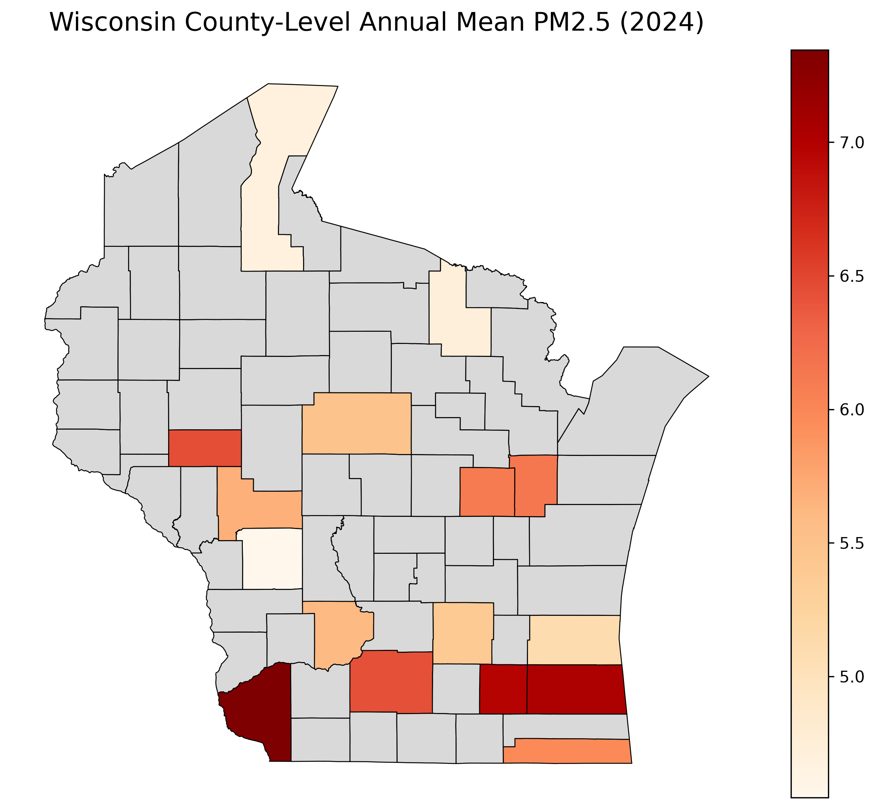
Data Quality and Monitor Coverage
72 total counties in the shapefile.
16 counties with PM2.5 benchmark values.
Unmonitored counties are kept as missing in statewide mapping.
Sources: EPA Air Trends, EPA AirData, GeoData@Wisconsin, U.S. Census. Rebuild date: 2026-07-13.

Slide 5
Methods
Legacy estimator: mean daily PM2.5 by site, then unweighted mean across sites by county.
Legacy spatial model: Queen contiguity among monitored counties only.
Robustness model: KNN weights using projected county representative points.
Sources: EPA Air Trends, EPA AirData, GeoData@Wisconsin, U.S. Census. Rebuild date: 2026-07-13.

Slide 6
Statewide Choropleth
Statewide map preserves all counties.
Gray fill marks no monitoring data.
County means are descriptive monitoring summaries, not regulatory design values.
Sources: EPA Air Trends, EPA AirData, GeoData@Wisconsin, U.S. Census. Rebuild date: 2026-07-13.

Slide 7
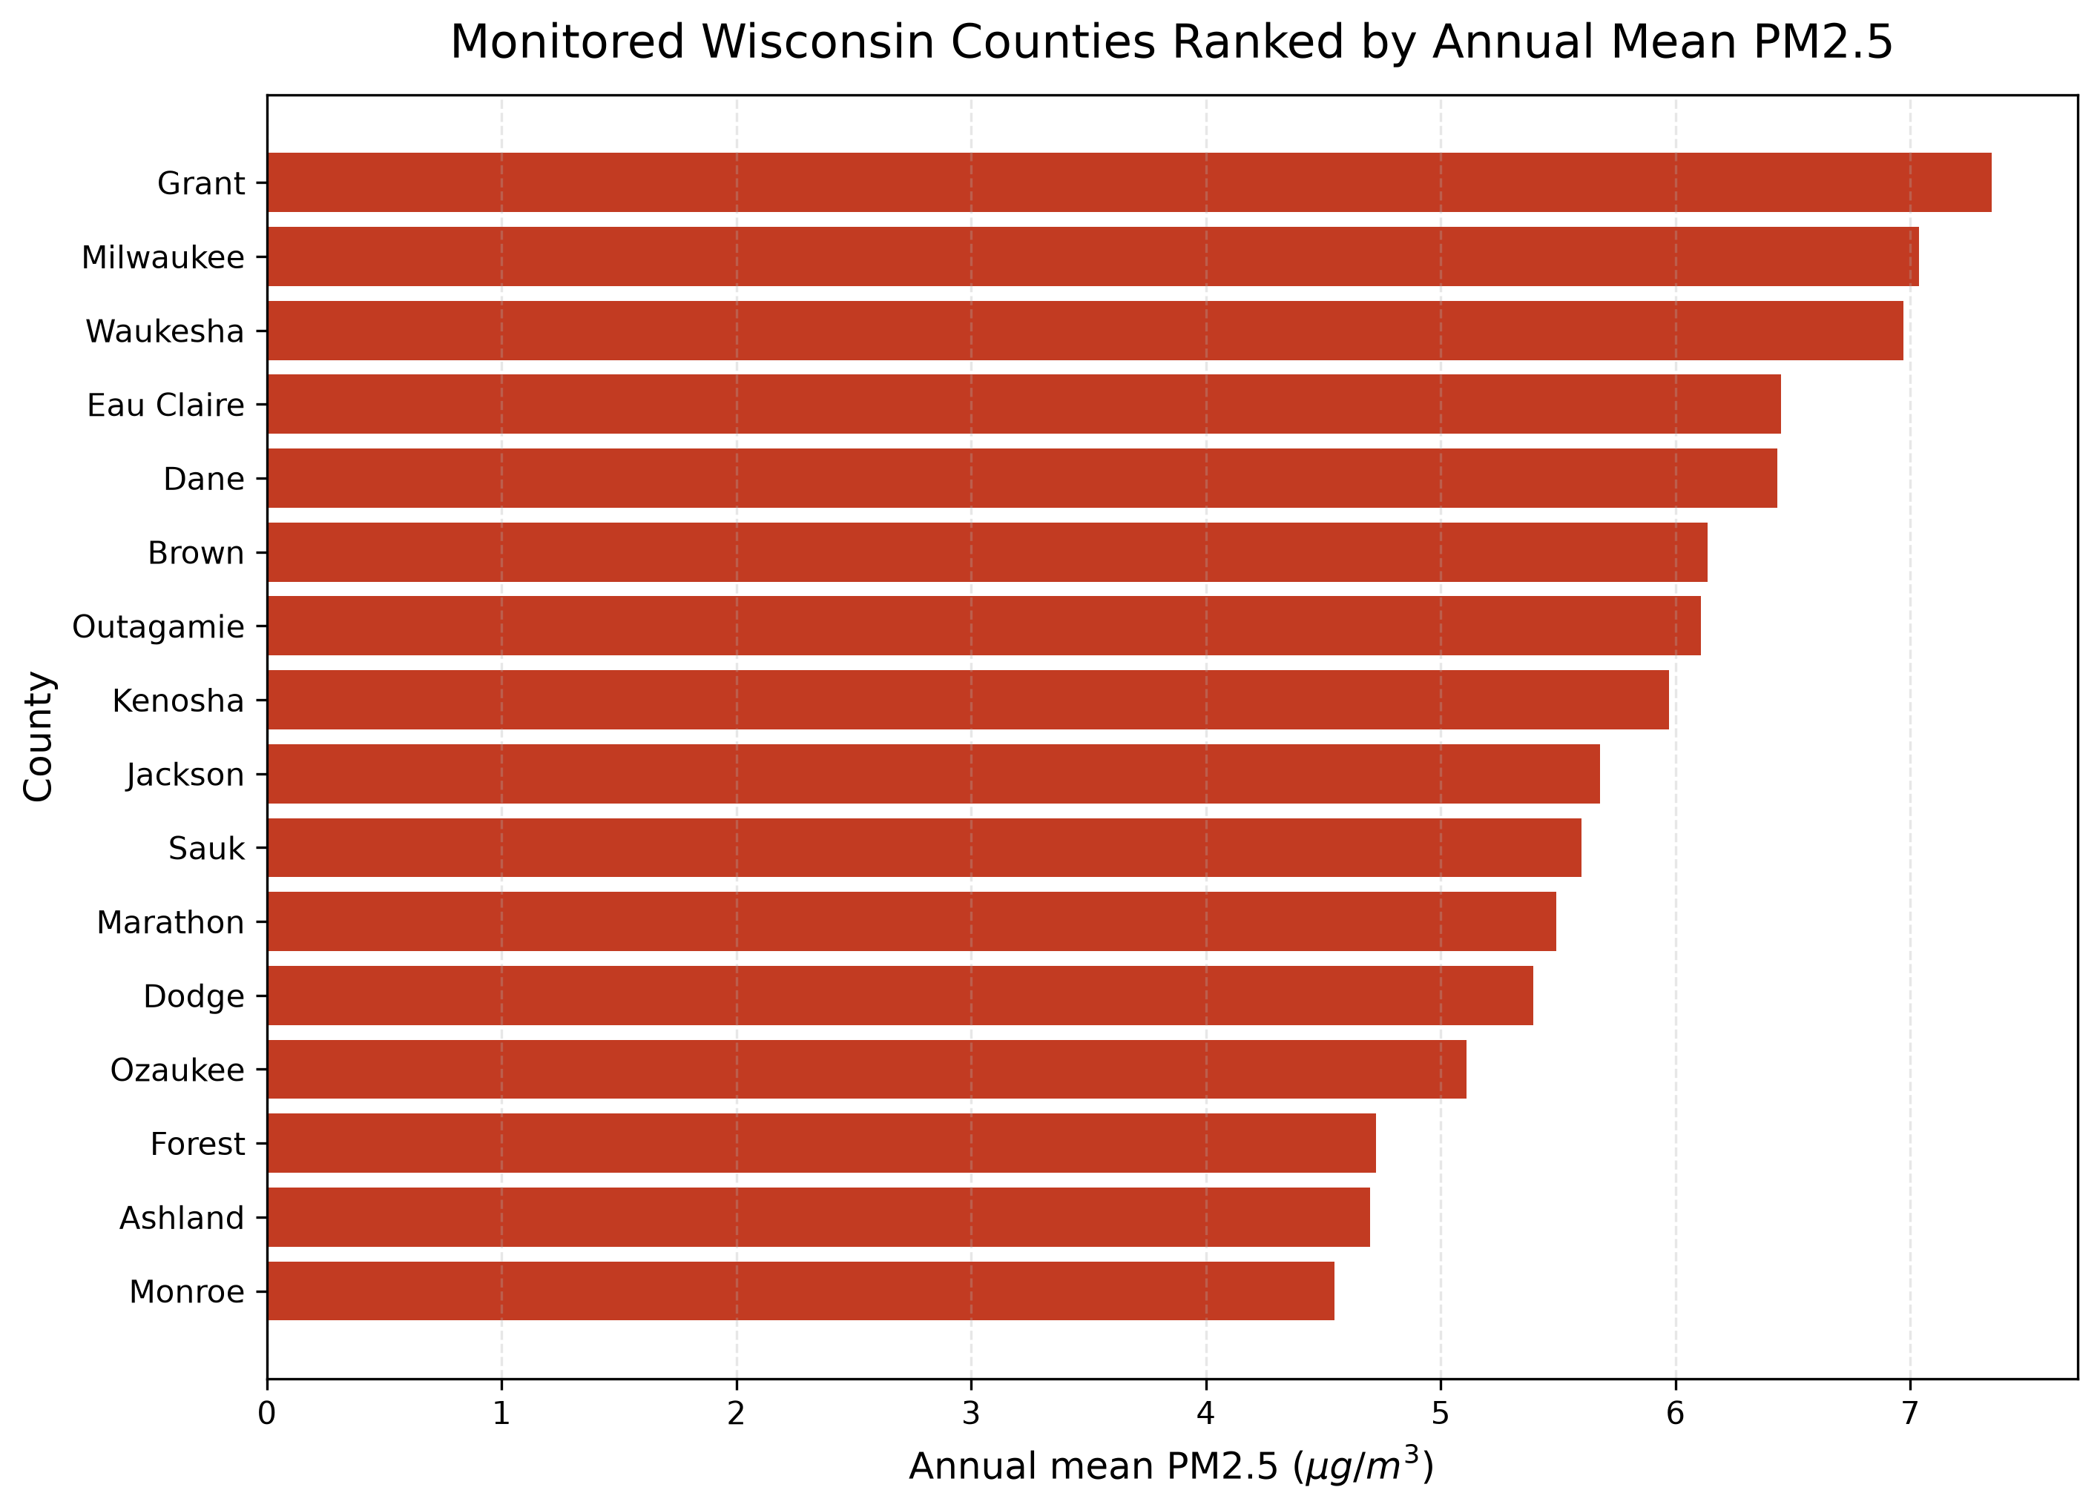
County Ranking
Highest monitored county: Grant.
Lowest monitored county: Monroe.
Milwaukee and Dane each have two monitoring sites in the legacy benchmark table.
Sources: EPA Air Trends, EPA AirData, GeoData@Wisconsin, U.S. Census. Rebuild date: 2026-07-13.

Slide 8
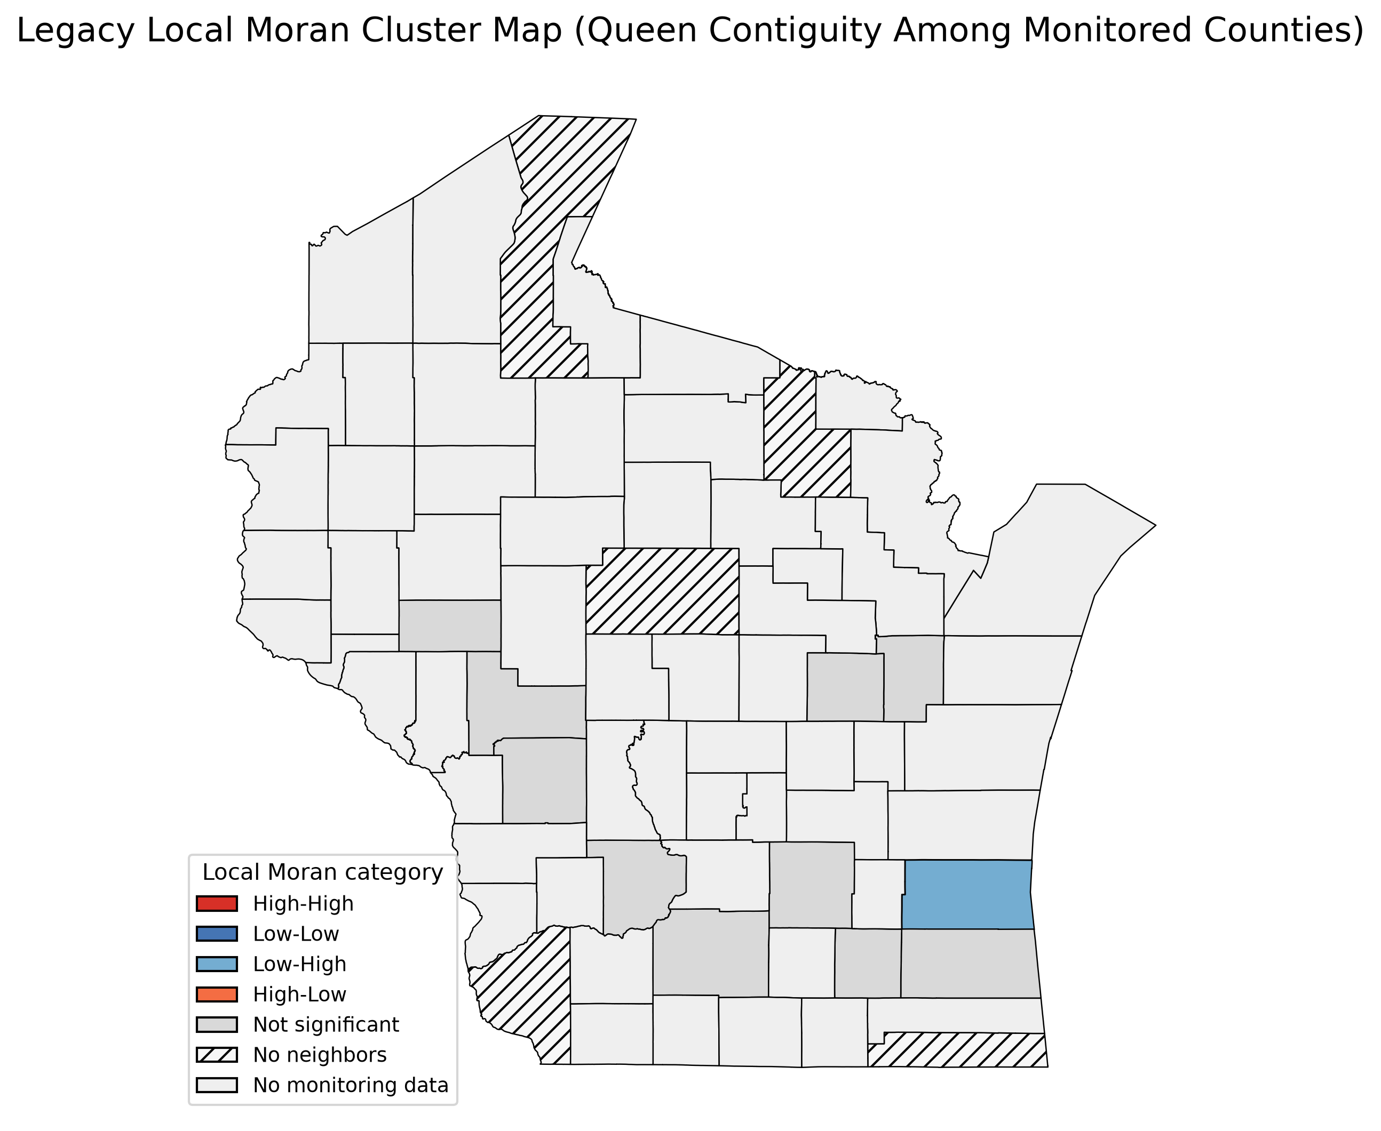
Global and Local Spatial Results
Legacy Moran's I = -0.140.
Legacy Queen weights contain disconnected components and island counties.
Local Moran categories should not be described as robust clusters under the legacy graph.
Sources: EPA Air Trends, EPA AirData, GeoData@Wisconsin, U.S. Census. Rebuild date: 2026-07-13.

Slide 9
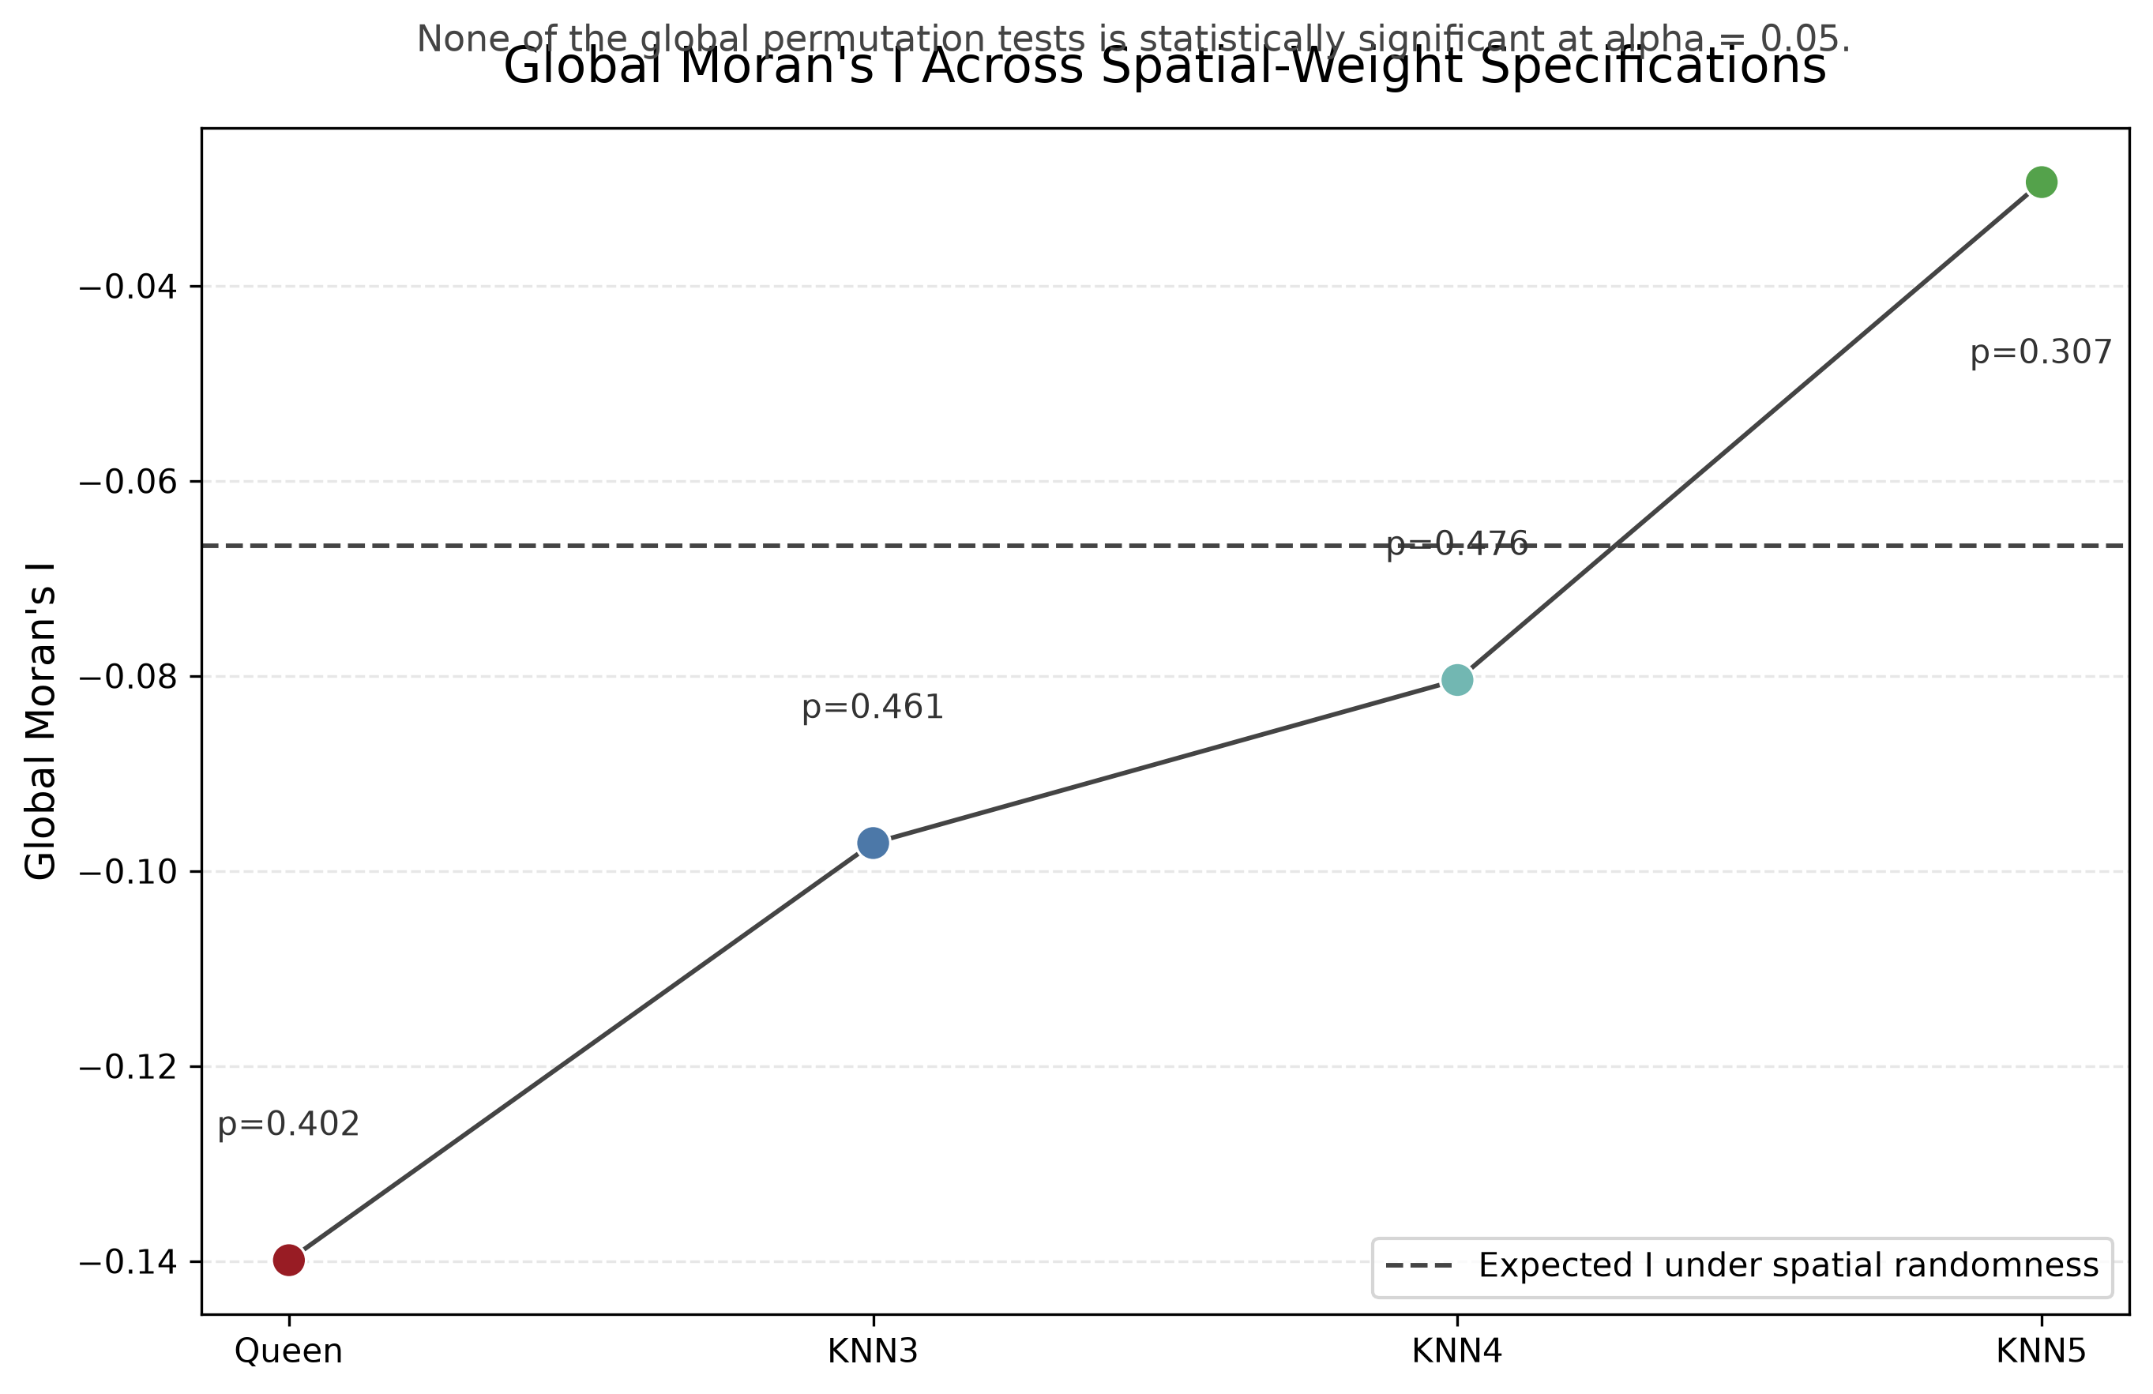
Are the Spatial Results Robust?
Spec I p comps islands
Queen -0.140 0.402 8 5
KNN3 -0.097 0.461 1 0
KNN4 -0.080 0.476 1 0
KNN5 -0.029 0.307 1 0
No significant global clustering under any tested spatial-weight definition; local cluster labels are sensitive to the neighborhood specification.
Sources: EPA Air Trends, EPA AirData, GeoData@Wisconsin, U.S. Census. Rebuild date: 2026-07-13.

Slide 10
References and Team Contributions
EPA Air Trends and AirData
GeoData@Wisconsin / U.S. Census TIGER/Line
Yifang Qiu: analysis, spatial joining, choropleth mapping, county ranking, Global Moran's I, Local Moran's I, and visualization
Sources: EPA Air Trends, EPA AirData, GeoData@Wisconsin, U.S. Census. Rebuild date: 2026-07-13.

